Slide 1

Database

Slide 2
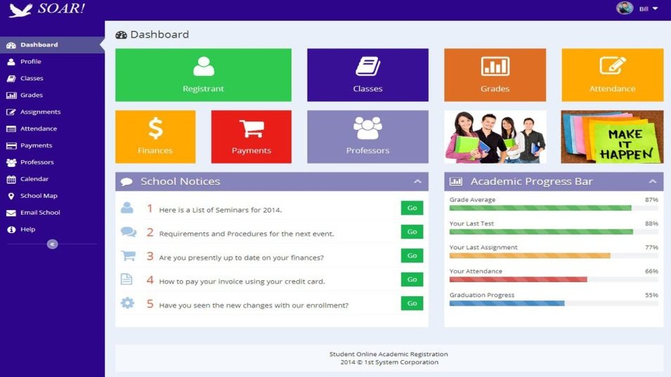



Data everywhere !!!

Slide 3
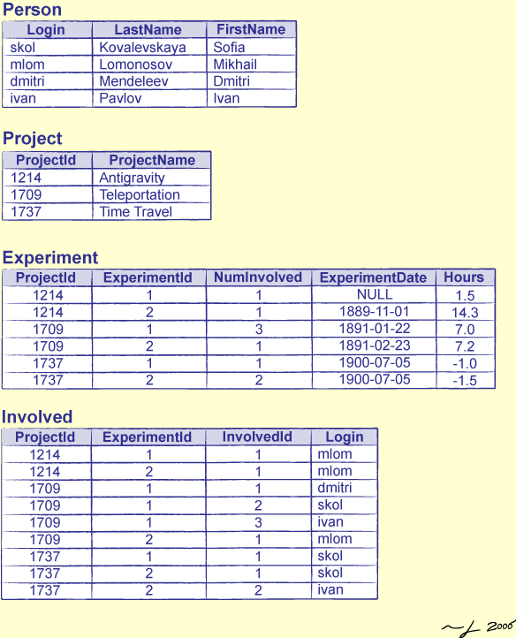
What is database ??

Slide 4


What about files ???

Slide 5
Files
Asma, 20179000, asm2017@std.psut.edu.jo, 0777888888
Amal, 20155000, ama2015@std.psut.edu.jo, 0777999998
Anas, 20199000, ana2019@std.psut.edu.jo, 0799888888
Alaa, 20119000, ala2011@std.psut.edu.jo, 0788888888
Ali, 20149000, ali2014@std.psut.edu.jo, 0787777778
…
…
…

Slide 6
Database features
Self-describing nature of a database system
Insulation between programs and data, and data abstraction
Support of multiple views of the data
Sharing of data and multiuser transaction processing

Slide 7
The complete process
Requirements specification and analysis
Conceptual design
Logical design
Physical design

Slide 8
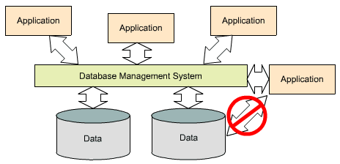
How to access the database

Slide 9

DBMS

Slide 10
In this course
Oracle DBMS
SQL*Plus

Slide 11
Why should we study DB?????

Slide 12

Why should we study DB?????

Slide 13
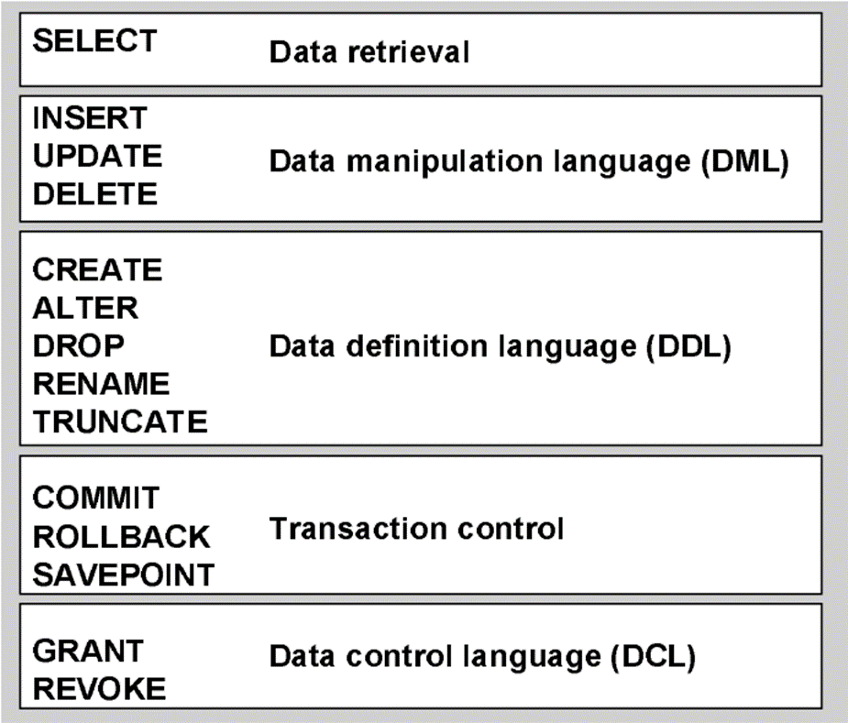
Structured query language (SQL)

Slide 14
Data Retrieval
Doctors
Doctors
ID | Name | Sal | address | …. | …
Departments
Appointments
Query: retrieve the id and salary for the doctors who lives in Amman
Patient

Slide 15
Data Retrieval
Doctors
Doctors
ID | Name | Sal | address | …. | …
 |  |  | Amman
 |  |  | Amman
Departments
Appointments
Determine the following:
1)Which table?
2) Which columns?
3)Which rows?(condition)
4)How to order the result?
Patient

Slide 16
Select Statement
Select cols
From Table-Name
Where Condition
Order by cols

Slide 17
Data Retrieval
Doctors
id | fname | Lname | bdate | address | sal | Dno
1255 | Ahmad | sami | 9-May-1979 | Amman | 2000 | 20
1314 | Sara | ali | 1-jan-1996 | Irbid | 1550 | 20
1772 | Sana | khalil | 5-mar-1960 | Ajloun | 3000 | 1
5988 | mohammad | qais | 10-aug-1988 | Karak | 5700 | 5
3421 | leen | wesam | 10-feb-1987 | Amman | 2500 | 3

Slide 18
Basic Data Retrieval
Select fname, bdate, sal from doctors
fname | bdate | sal
Ahmad | 9-May-1979 | 2000
Sara | 1-jan-1996 | 1550
Sana | 5-mar-1960 | 3000
mohammad | 10-aug-1988 | 5700
leen | 10-feb-1987 | 2500

Slide 19
Basic Data Retrieval
Select * from doctors
id | fname | Lname | bdate | address | sal | Dno
1255 | Ahmad | sami | 9-May-1979 | Amman | 2000 | 20
1314 | Sara | ali | 1-jan-1996 | Irbid | 1550 | 20
1772 | Sana | khalil | 5-mar-1960 | Ajloun | 3000 | 1
5988 | mohammad | qais | 10-aug-1988 | Karak | 5700 | 5
3421 | leen | wesam | 10-feb-1987 | Amman | 2500 | 3

Slide 20
Data Retrieval (operations)
Select fname, sal * 12 from doctors
fname | sal * 12
Ahmad | 24000
Sara | 1860
Sana | 36000
mohammad | 68400
leen | 30000

Slide 21
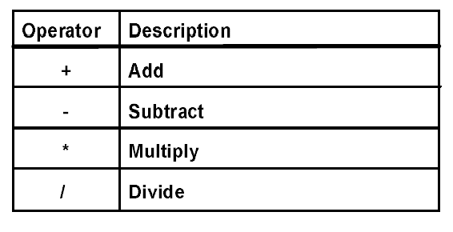
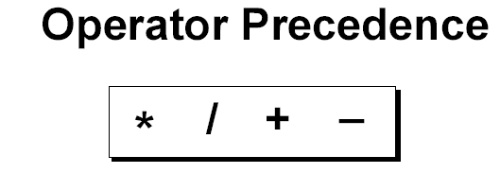
Data Retrieval (operations)

Slide 22
Data Retrieval (Alias)
Select fname as “First Name”, sal * 12 as “Annual Salary” from doctors
First Name | Annual Salary
Ahmad | 24000
Sara | 1860
Sana | 36000
mohammad | 68400
leen | 30000

Slide 23
Data Retrieval (Alias)
Select fname “First Name”, sal * 12 “Annual Salary” from doctors
As is optional
First Name | Annual Salary
Ahmad | 24000
Sara | 1860
Sana | 36000
mohammad | 68400
leen | 30000

Slide 24
Data Retrieval (Alias)
Select fname FirstName, sal * 12 “Annual Salary” from doctors
“” is optional
FIRSTNAME | Annual Salary
Ahmad | 24000
Sara | 1860
Sana | 36000
mohammad | 68400
leen | 30000

Slide 25
Data Retrieval
Select address from doctors
address
Amman
Irbid
Ajloun
Karak
Amman

Slide 26
Data Retrieval (distinct)
Select distinct address from doctors
Two columns
address
Amman
Irbid
Ajloun
Karak
ID | Name
1 | Ali
2 | Sama
3 | Ali
2 | Sama

Slide 27
Concatenation
Select id, fname || lname as “Name” from doctors
id | Name
1255 | Ahmadsami
1314 | Saraali
1772 | Sanakhalil
5988 | mohammadqais
3421 | leenwesam

Slide 28
Concatenation
Select id, fname ||’ ’|| lname as “Name” from doctors
id | Name
1255 | Ahmad sami
1314 | Sara ali
1772 | Sana khalil
5988 | Mohammad qais
3421 | Leen wesam

Slide 29
Concatenation
Select fname ||’ lives in ’|| address details from doctors
DETAILS
Ahmad lives in Amman
Sara lives in Irbid
Sana lives in Ajloun
Mohammad lives in Karak
Leen lives in Amman

Slide 30
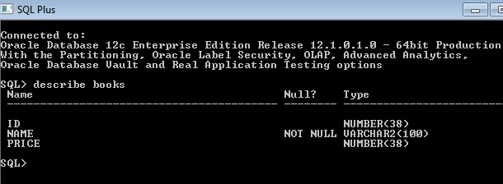
Describe
To view the structure of the table use describe keyword:
describe TableName
Example:
describe books

