Slide 1

Physics Laboratory
(20147)
Physics Laboratory Syllabus for first semester 2021 /2022
Exp. No. | Name of experiment | Week no. | Date-week starts on
- | Lab instructions | 1 | 10/10/2021
1 | Introduction to errors and graphs | 2 | 17/10/2021
2 | Basic Measurements I | 3 | 24/10/2021
3 | Basic Measurement II | 4 | 31/10/2021
4 | Static Equilibrium | 5 | 07/11/2021
 | عطلة المختبر اسبوع الامتحان الاول للجامعة | 6 | 14/11/2021
5 | Newton second law Acceleration due to gravity. | 7 | 21/11/2021
 | Midterm Exam | 8 | 28/11/2021
6 | Simple Harmonic Motion I. | 9 | 05/12/2021
7 | Simple Harmonic Motion II. | 10 | 12/12/2021
 | عطلة المختبر اسبوع الامتحان الثاني للجامعة | 11 | 19/12/2021
8 | Moment of Inertia. | 12 | 26/05/2021
 |  | 13 | 02/01/2022
 |  | 14 | 09/01/2022
 | Final Exam | 15 | 16/01/2022
 | الامتحانات النهائية | 16 | 23/1/2022

Slide 3
Grades
Reports. 40%
Mid Term Exam. 20%
Final Exam. 40%
Total Grades 100%

Slide 4
لا
PHYSICS LAB.
( 20147)
Experiment No. 1
Introduction to Errors and Graphs

Slide 5

Lab. 1 Introduction to Errors and Graphs
Types of Errors:
Personal errors.
Systematic errors.
Random errors.
How to calculate random error:
In case of many readings :
Assume we have N readings for the same quantity X, and we want to write the final result of this quantity with its random error, then we follow the following steps:
Step 1 : Calculation of the average quantity of X.
Average of X =

Slide 6
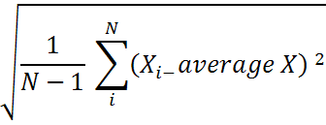

Step 2 : Calculation of the standard deviation.
The standard deviation is defined as :
S =
Step 3. Calculation of the random error σ .
The random ( standard ) error σ is defined as :
σx =

Slide 7

Example :
Assume four measurements are made for the same quantity X,
the results are: 18.6, 19.3, 17.7, and 20.4. Find the average value of X, the standard deviation S, and the random error σx,
then write the final value of x.
Calculations of the average value.
Average X =
Average X = ( 18.6 + 19.3 + 17.7 + 20.4 ) / 4 = 19.0
Calculation of the standard deviation S.
S =

Slide 8


S =
S = 1.14
Calculation of the random error σx .
σx =
σ x =
σx = 0.57
The final result is X = 19.0 ± 0.57

Slide 9
Incase of one reading only.
If we made only one measurement of some quantity, the the
Random error σ in this value is given by :
σ = 0.5 x least count of the instrument used.
Where the least count is the minimum value that the instrument used can read.
As an example, the least count of the simple ruler is 1 mm or 0.1 cm. so if we used the simple ruler to measure the length of a certain object, and we get it as 12.6 cm, the random error in our measurement is
σL = 0.5 x 0.1 = 0.05 cm
So our result of measurement is written as
Length = 12.6 ± 0.05

Slide 10




Percentage error .
Percentage error = X 100%
Where
E is the experimental value and K is theoretical value.
Example:
let theo. Value of g = 9.85 and Exp. Value of g = 9.65
then Percentage error in exp. =
Percentage difference.
Percentage difference =
Let = 9.65 and = 9.75 , then
Percentage difference =

Slide 11
Using graphs to obtain results
In many cases, we need to plot a graph to obtain unknown values
without making direct calculation and finally taking the required average.
The graph give us the average value directly.
Each experiment has a definite relation between the quantities
understudying , we shall discuss here only three cases of this
relation that will face us in our lab.

Slide 12
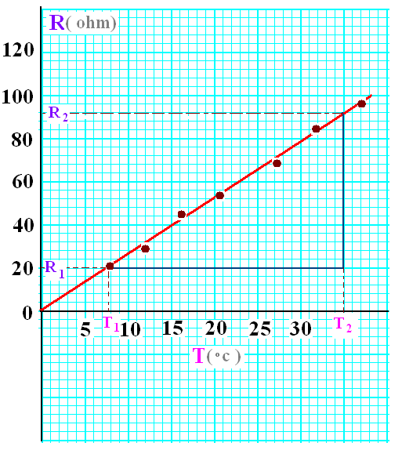

Case 1 : The form of relation is R = α T
In this relation, R and T are two experimental quantities, α is unknown constant that will be determined from the graph between R and T.
The above relation, when plotted give us the graph shown in the figure .
From the graph, the constant α is determined by
or
α = Slope of the graph

Slide 13
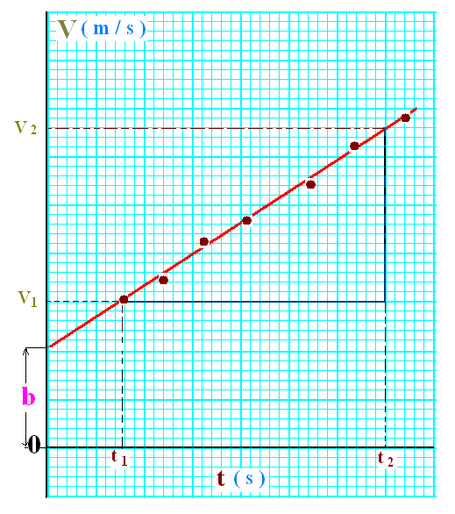

Case 2 : The form of relation is V = b + a t
In this relation, V and t are two experimental quantities, a and b are unknown constant that will be determined from the graph between V and t.
The above relation, when plotted give us the graph shown in the figure .
From the graph, the constant a is determined by
and

Slide 14
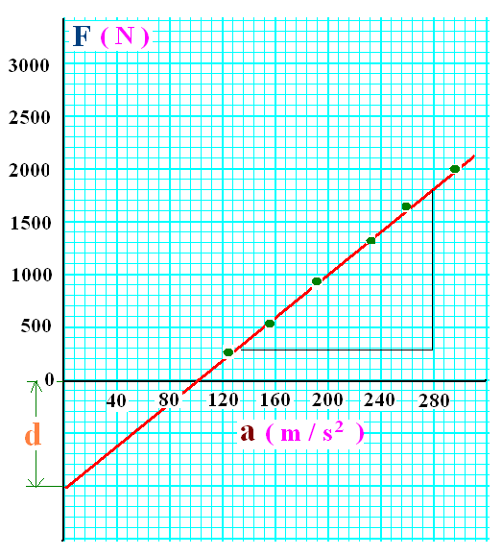
Case 3 : The form of relation is F = m a - d
In this relation, F and a are two experimental quantities, m and d are unknown constant that will be determined from the graph between F and a.
The above relation, when plotted give us the graph shown in the figure .
From the graph, the constant m is determined by
and

