Slide 1

PHYSICS LAB.
( 20147)
Experiment No. 3
Basic Measurement II
The Spherometer

Slide 2
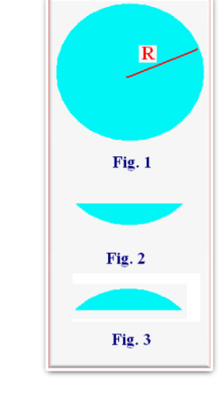
Exp.no. 3 Basic measurement II The Spherometer
A spherical surface.
It is a part of a sphere with radius of curvature R as shown in fig.1.
Concave spherical surface.
It a part of a sphere lies as shown in fig.2 which has the same radius R.
Convex spherical surface.
It is a part of a sphere lies as shown in fig.3 which has also the same radius R.

Slide 3
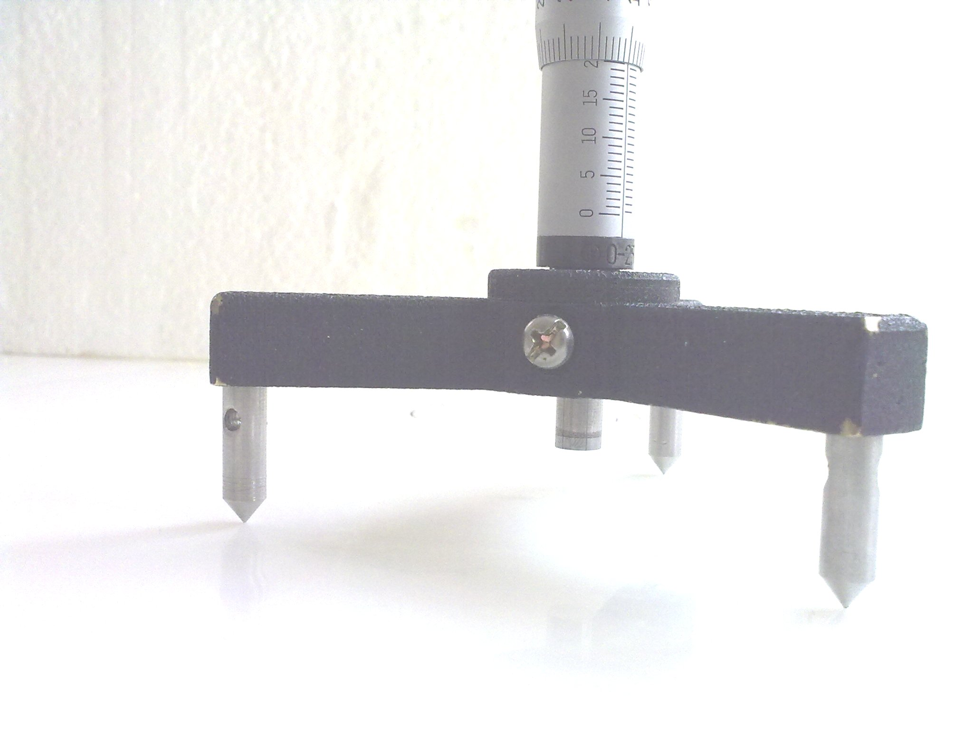




Construction of the Spherometer

Slide 4
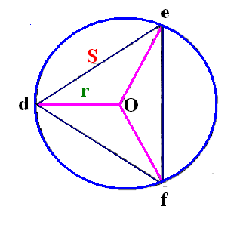

The three fixed-length legs of the spherometer lies on a circle with radius r, as shown in the figure,
While the fourth leg lie on the center of the circle which is point
O in the figure, the center of the circle and the center of the triangle are the same.
We can show that

Slide 5
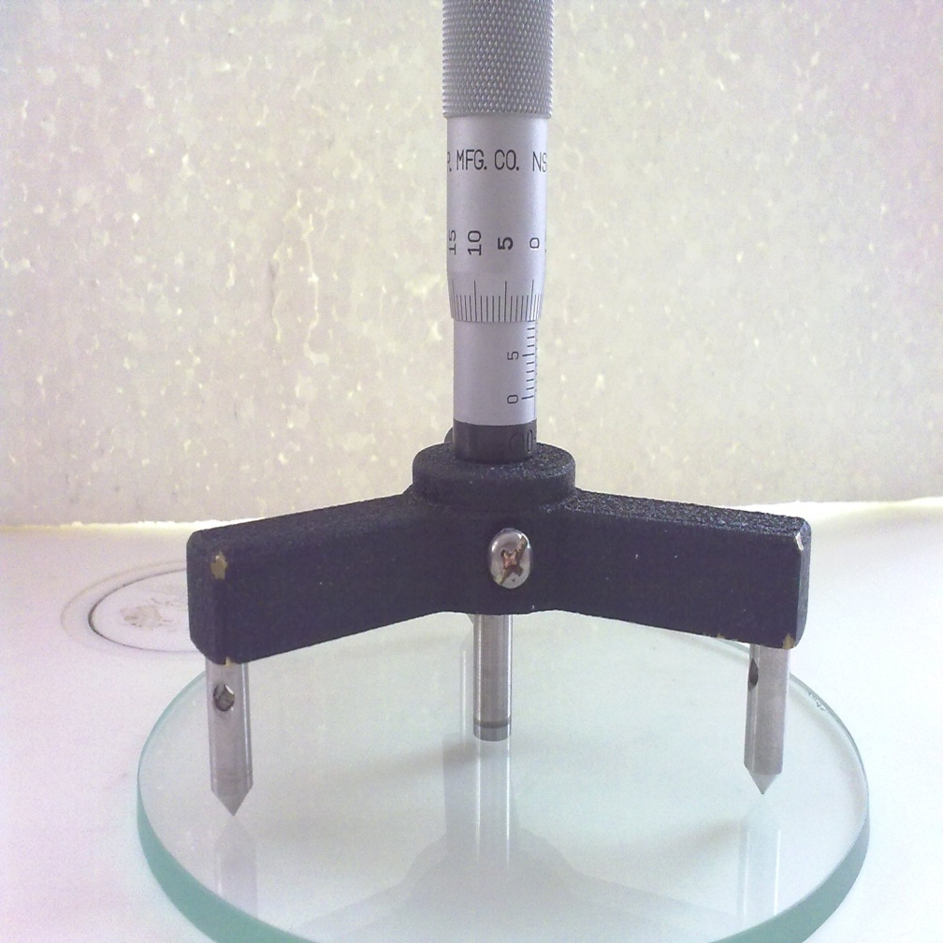
How to use the Spherometer
First to find the zero of the spherometer.
We put the spherometer on a plane surface as shown in the figure.
We adjust the fourth length so as all the legs touch the plane surface.
We read the vertical ( main ) reading,
Let it be V .
We read the circular ( vernier ) reading, let it be C.
The count value V + C is the zero of the spherometer, let it be b.
V + C = b = zero of spherometer

Slide 6
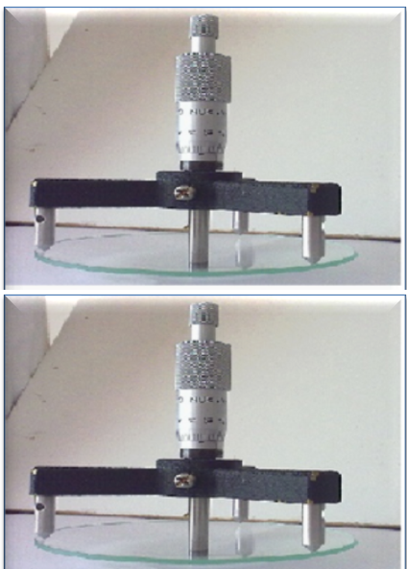
To find the radius R of a concave surface.
We put the spherometer on the concave surface.
We adjust the fourth leg so as to touch the bottom of the surface as shown in the figure1.
We take the main reading V.
We take the vernier reading C.
The count value = V + C .
The depth of the concave surface a as shown in fig.2 is given by
a = ( V + C ) - b

Slide 7
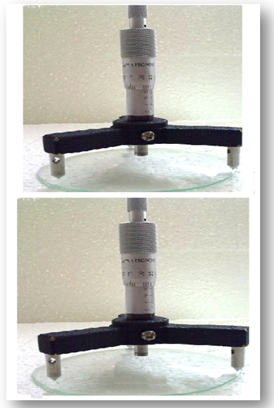
To find the radius R of a convex surface.
We put the spherometer on the covex surface.
We adjust the fourth leg so as to touch the top of the surface as shown in the figure3.
We take the main reading V.
We take the vernier reading C.
The count value = V + C .
The height of the convex surface a as shown in fig.4 is given by
a = ( V + C ) - b

Slide 8
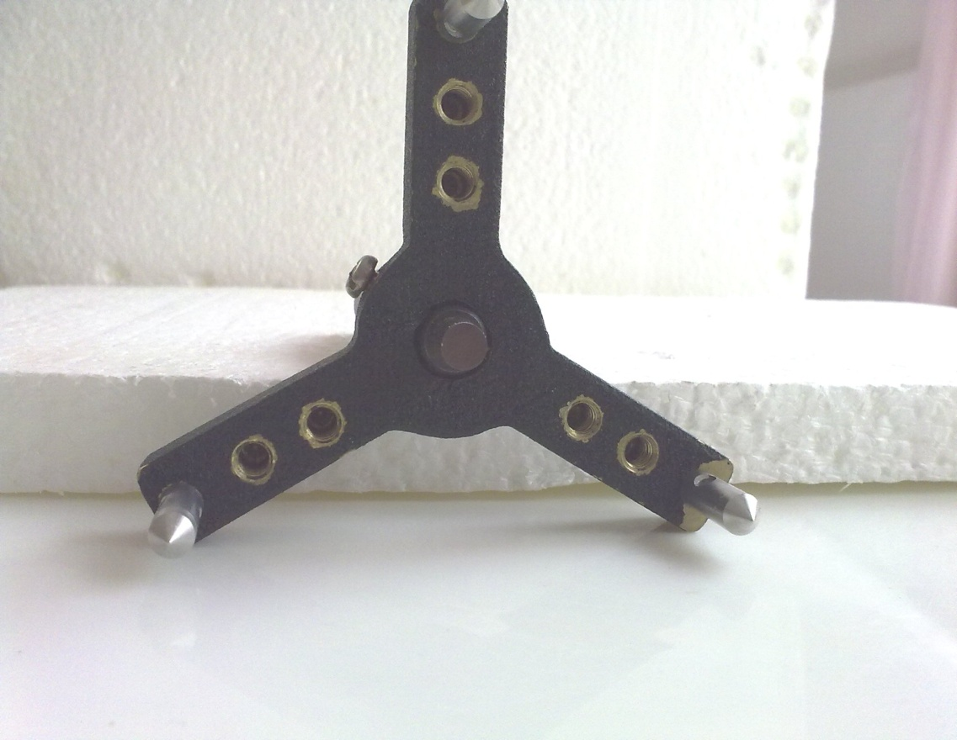

To find the legs distance S.
We measure the distance
between the legs of the
spherometer S as shown in the
figure.

Slide 9
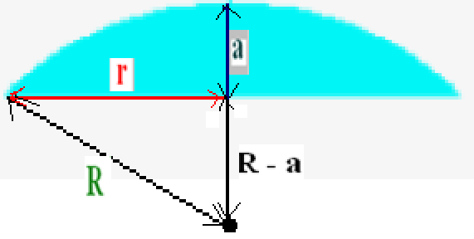



To determine the radius R of the concave surface.

Slide 10
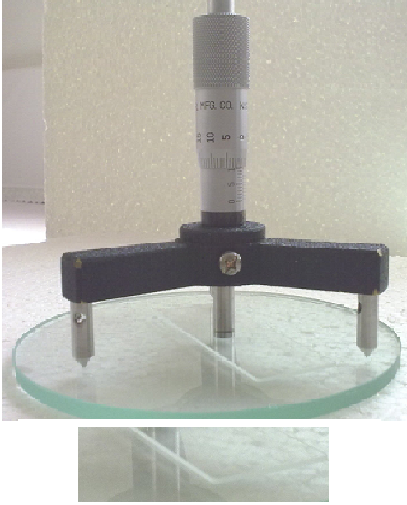

To find the thickness a of a microscopis slide.
We put the spherometer on
both plane surface and the slide
We adjust the fourth leg so as to touch the top surface of the slide as shown in the figure1.
We take the main reading V.
We take the vernier reading C.
The count value = V + C .
The thickness of the microscopic slide a as shown in fig.2 is given by
a = ( V + C ) - b

Slide 11
3. Data :
A. Determining the zero of the spherometer
Complete the following table : Sample :
Table 1 : The plane surface
Term |  | Vertical scale V ( mm ) | Circular Scale C ( mm ) | Count value b = V + C ( mm ) | Mean value b ( mm )
 | 1
Plane surface | 2

Slide 12

B. To find the radius of the Spherical surface R.
a) Complete the following table.
Table 2 Large Spherical surface.
Item | Case | Vertical reading V( mm ) | Circular reading C ( mm ) | Count value V+C(mm) | a = (V+C) –b ( mm ) | Leg distance S ( mm ) | R ( mm) | Average R (mm )
Large | Convex
 | Concave

Slide 13
b) Complete the following table.
Table 3: Small Spherical surface.
Item | Case | Vertical reading V( mm ) | Circular reading C ( mm ) | Count value V+C(mm) | a = (V+C) –b ( mm ) | Leg distance S ( mm ) | R ( mm) | Average R (mm )
Small | Convex
 | Concave

Slide 14
c) Complete the following table.
Table 4: Thickness of a slide.
Item | Vertical reading V( mm ) | Circular reading C ( mm ) | Total reading V+C(mm) | Thickness of slide a = (V+C) –b ( mm )
Slide

