Slide 1

PHYSICS LAB.
( 20147)
Experiment No. 4
Static Equilibrium
The resultant of Many Forces

Slide 2
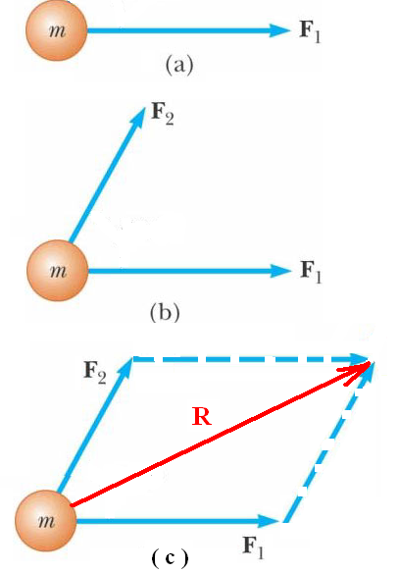
Exp.no. 4 Static equilibrium Composition of concurrent forces
If a force F₁ is applied to an object of mass m as in fig. (a), then the object will move in the direction of F_{1.}
If two forces F_{1 ,} F₂ are applied to the object as in fig. ( b ), then the object will move in the direction of resultant R of the two forces F_{1 ,} F₂ as shown in fig. ( c ).
The same rule are applied if many forces act on the object.

Slide 3
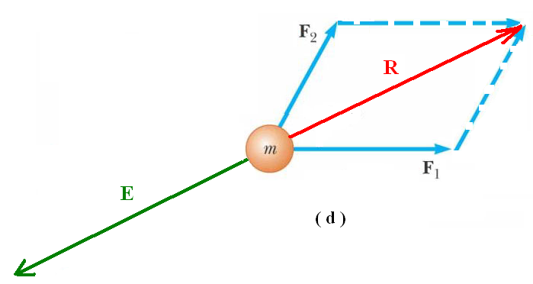
If we need to keep the object at rest or at Equilibrium , we must applied another force equal in magnitude but opposite in direction to the resultant force R, as shown in fig. ( d ).
This force that keeps the object at Equilibrium under the action of two or more forces is called Equilibrium Force E .
In our experiment, we shall determine the Equilibrium Force E experimentally for many different forces acting on a small object which has no mass and no dimensions, this object is called Point object. The forces acting on it is called Concurrent forces.

Slide 4
The resultant force R, of many forces acting on a point object
will be determined by two methods :
1. The analytical or the components method.
2.The geometrical or graphical method.
We shall explain the experimental method and both the analytical and geometrical methods.

Slide 5
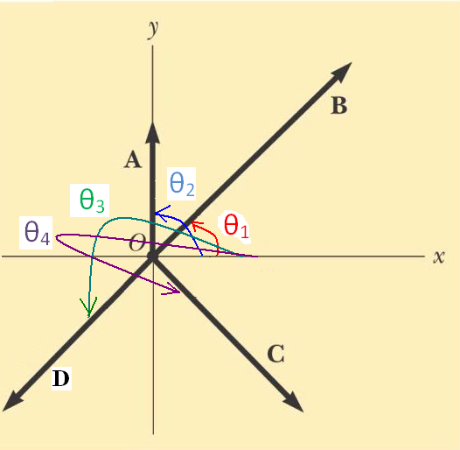
Directions of the Applied Forces
All the directions of all forces acting on a point object is determined with respect to the positive X- axis and in the counter clock wise as shown in the figure.

Slide 6
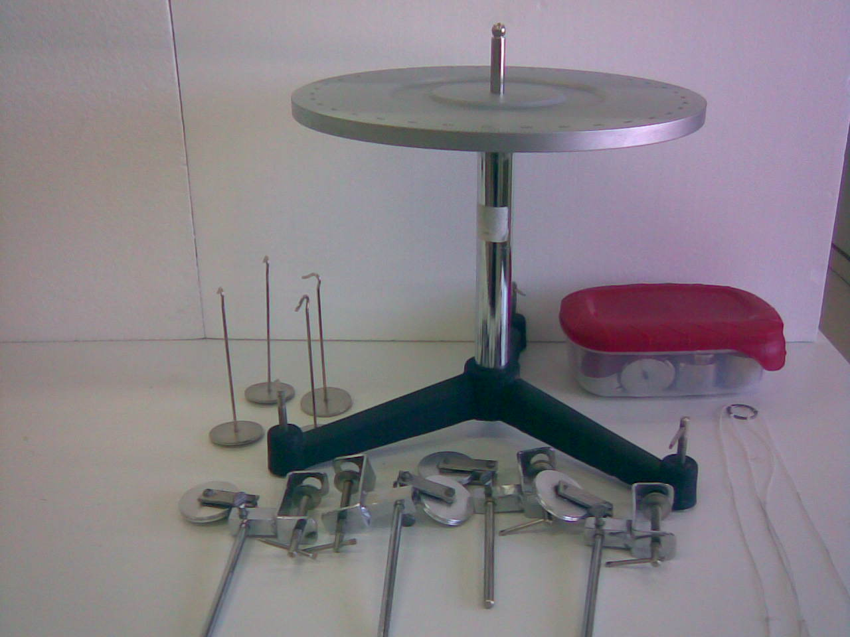

Experimental Method

Slide 7


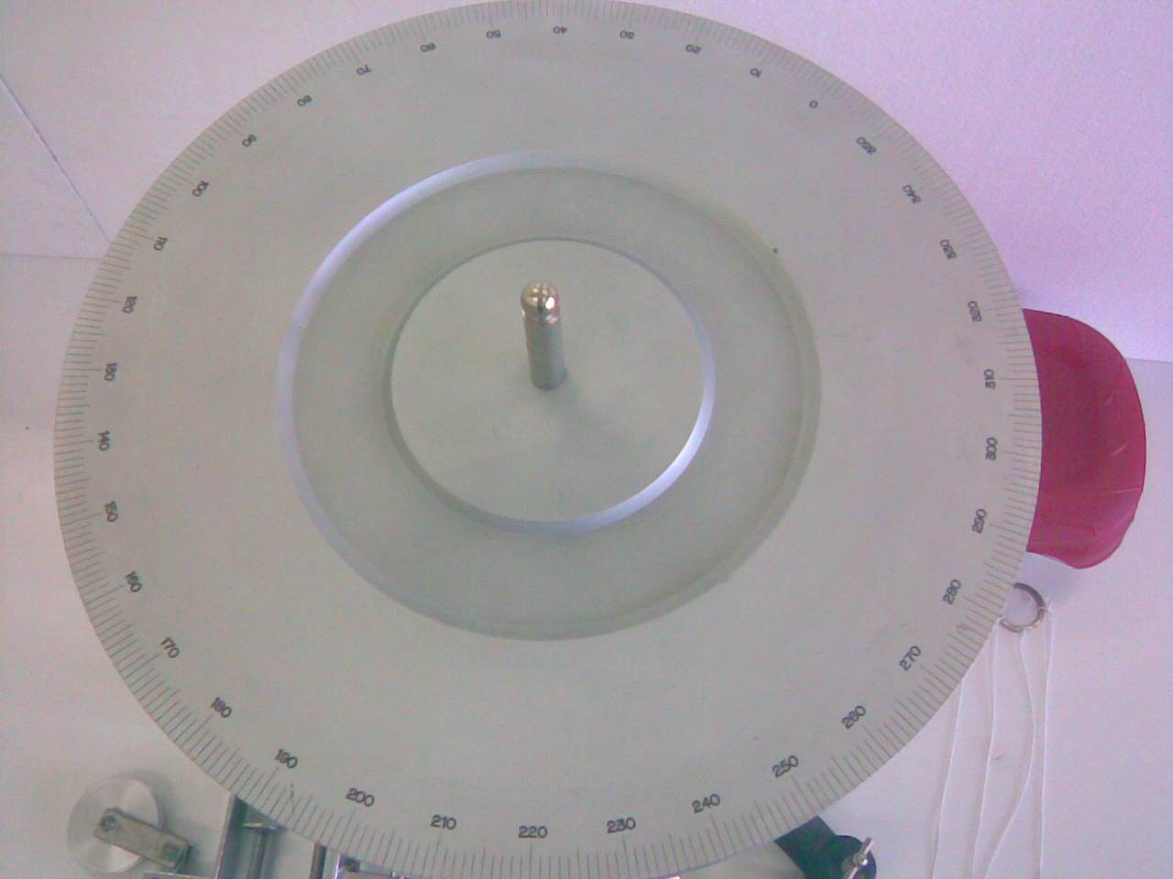
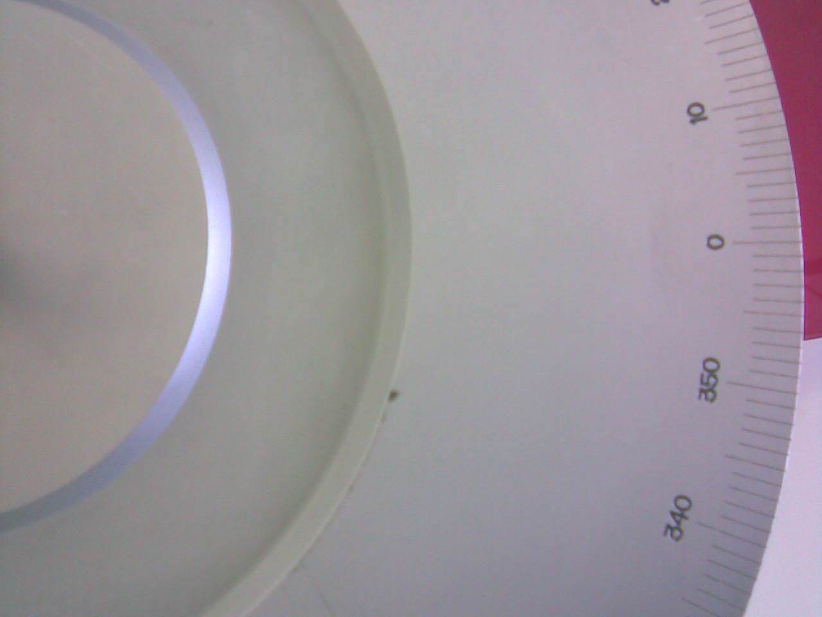
Top view of the Force table

Slide 8

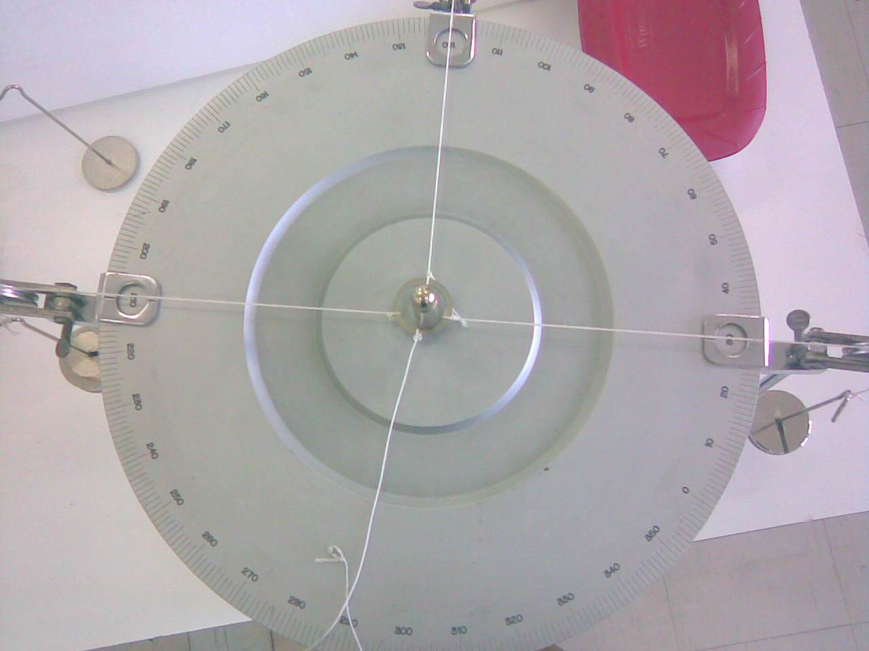
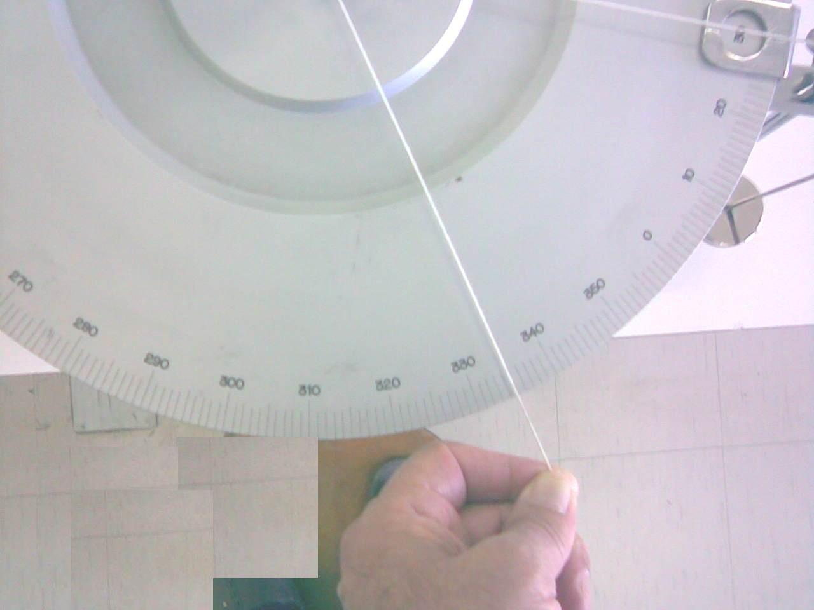



Example: Find the equilibrant for the following forces F₁ = 162 g , θ₁ = 30̊, F₂ = 212 g , θ₂ = 120̊ , F₃ = 312g , θ₃ = 210̊

Slide 9

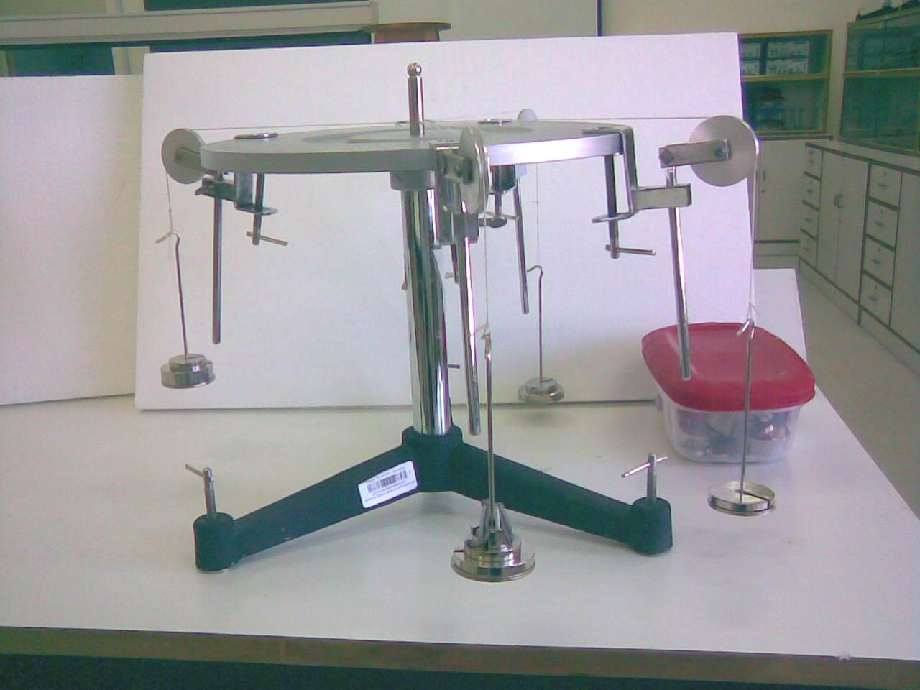
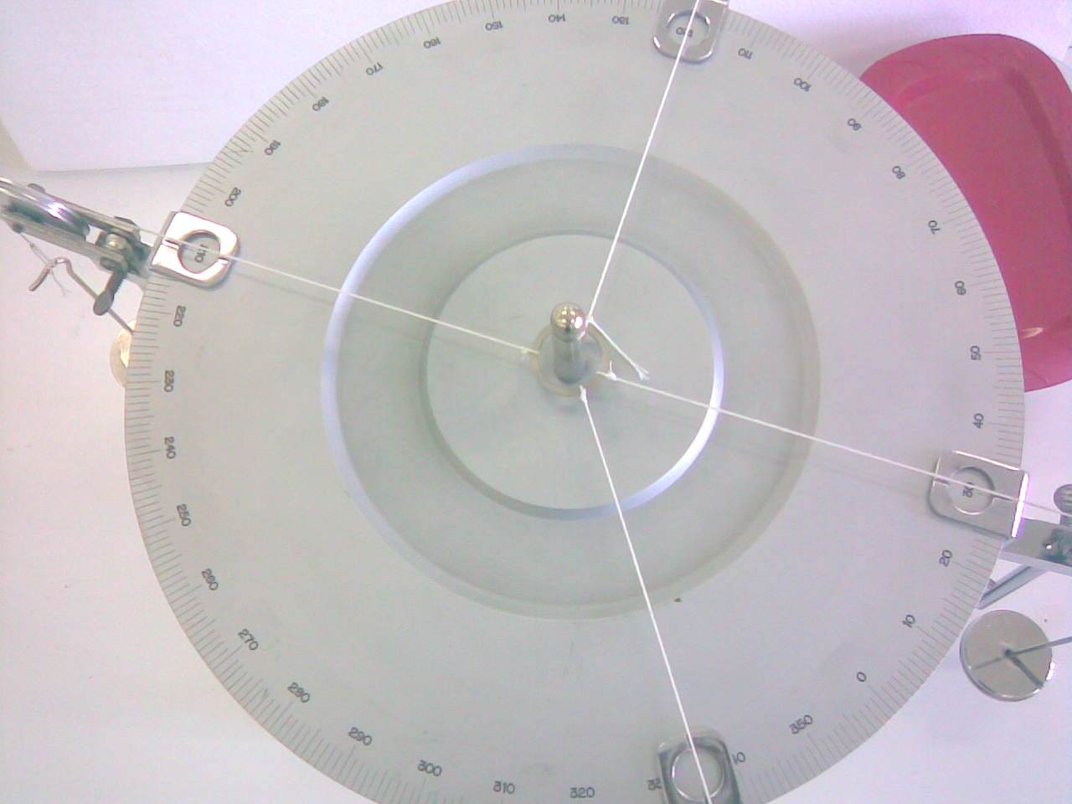




Slide 10
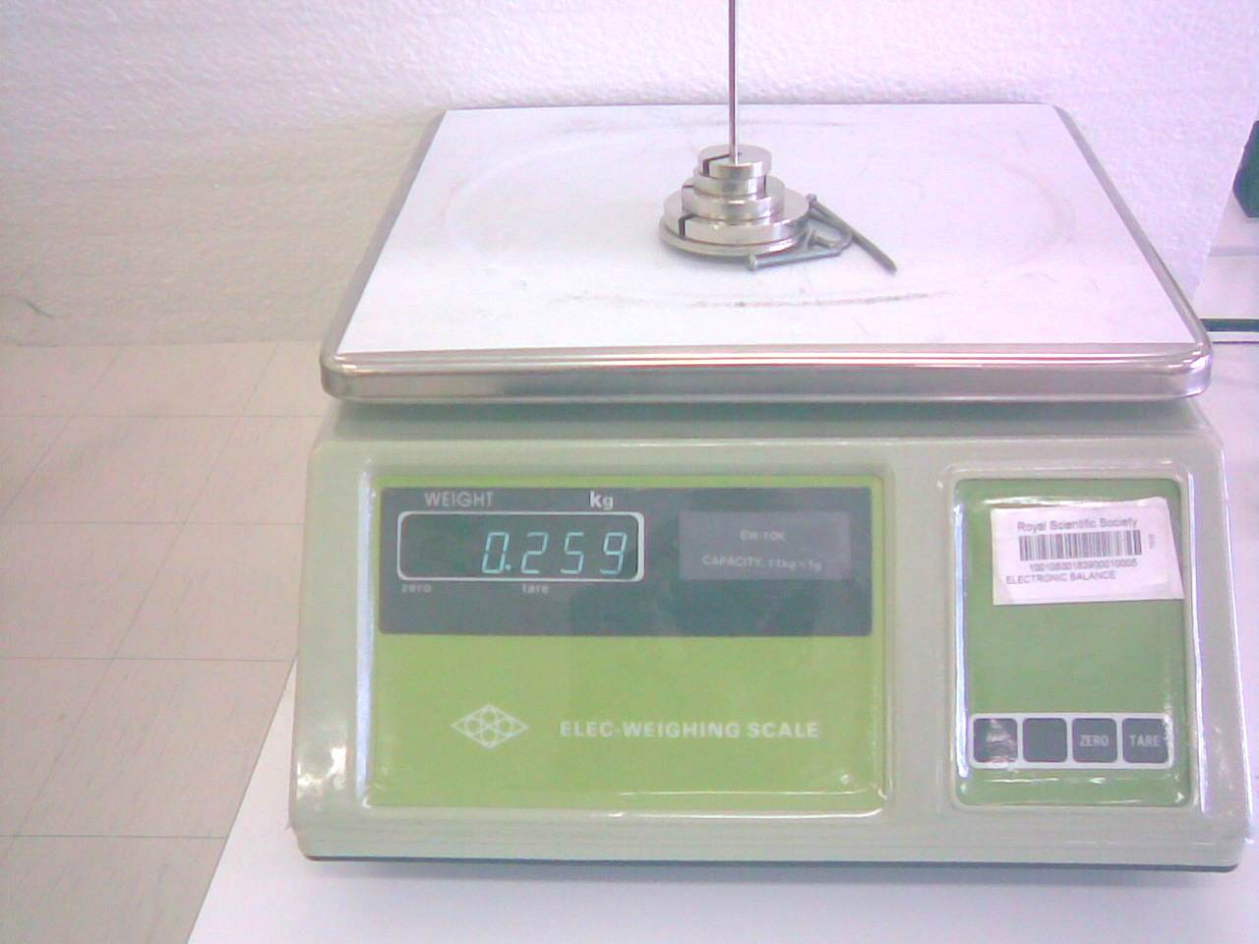


Using the electronic balance to determine the magnitude of the equilibrant force ( E )

Slide 11
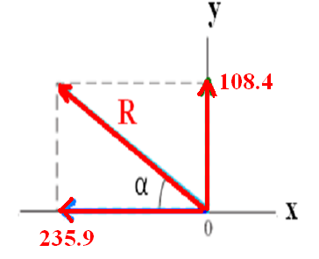
Analytical Or Components ( Theoretical ) Method
F₁ = 162 g , θ₁ = 30̊, F₂ = 212 g , θ₂ = 120̊ , F₃ = 312g , θ₃ = 210̊
_________________________________________________
F_{1x} = 162 cos 30 = 140.3 g , F_{1y} = 162 sin 30 = 81
F_{2x} = 212 cos 120 = - 106 g , F_{2y} = 212 sin 120 = 183.4 g.
F_{3x} = 312 cos 210 = - 270.2 g , F_{3y} = 312 sin 210 = - 156 g
R_{x} = 140.3 - 106 - 270.2 = - 235.9 g .
R_{y} = 81+ 183.4 – 156 = 108.4 g .
R = = 259 g.
tan α = 108.4/ 235.9 , α = 25̊
θ = 180 – 25 = 155̊
_{θ}
θ

Slide 12
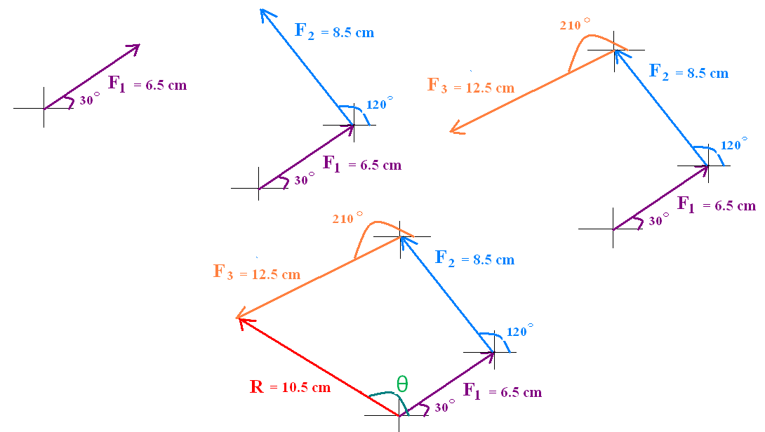
Geometrical or Graphical Method
Scale : 1 cm = 25 g.
F₁ = 162/ 25 = 6.5 cm
θ₁ = 30̊
F₂ = 212/25 = 8.5 cm.
θ₂ = 120̊
F₃ = 312/ 25 = 12.5 cm
θ₃ = 210̊
R = 10.5 x 25 = 255 g.
θ = 155̊

Slide 13
3. Data :
a) Complete the following table: Sample:
No. | F1 |  | F2 |  | F3 |  | E |  | R From calculation
 | Value g | Angle θ1 | Value g | Angle θ2 | Value g | Angle θ2 | Value g | Angle α | Value g | Angle θ
1
2
3

Slide 14
3. Data :
a) Complete the following table: 1
No. | F1 |  | F2 |  | F3 |  | E |  | R
 | Value g | Angle θ1 | Value g | Angle θ2 | Value g | Angle θ2 | Value g | Angle α | Value g | Angle θ
1 | 262 | 0 | 162 | 45 | 212 | 110
2 | 162 | 300 | 262 | 90 | 362 | 210
3 | 162 | 0 | 262 | 30 | 362 | 270

Slide 15
b. Calculate the resultant R for each case in the above table by using components method. Write your results in the table.
Theoretical Calculations:
NO.1
_________________________________________________________________
_________________________________________________________________
_________________________________________________________________
_________________________________________________________________
_________________________________________________________________
No. 2
_________________________________________________________________
_________________________________________________________________
_________________________________________________________________
_________________________________________________________________
_________________________________________________________________

Slide 16
No. 3
________________________________________________________________
________________________________________________________________
________________________________________________________________
________________________________________________________________
________________________________________________________________

Slide 17
C. Find the result ant force (R) for problem no.1 only using the graphical method.
Solution:
Scale : 1 cm = gm.
F1 = cm
F2 = cm.
F3 = cm.

Slide 18
Draw the graph below.
The results:
R = cm, R = gm.
Θ =

