Slide 1

PHYSICS LAB
( 20147 )
Experiment No. 5
Newton’s Second Law
Acceleration Due to Gravity

Slide 2



Exp.no.5 Newton’s Second Law Acceleration Due to Gravity
Newton’s second law takes the form
Where is the resultant force acting on an object and cause its motion.
is the mass of the object.
is the acceleration of the object.
We shall use this law to determine the acceleration of gravity
by studying the freely motion of an object on a frictionless
incline surface.

Slide 3
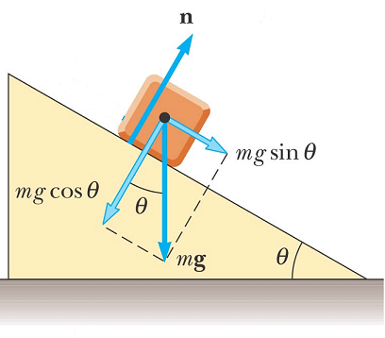
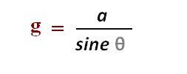
Motion of an object on an incline surface
According to Newton’s second law,
the force caused the motion of the object is
m g sin θ
We can write
m g sin θ = m a
or g sin θ = a
From which we determine the acceleration due to gravity as

Slide 4
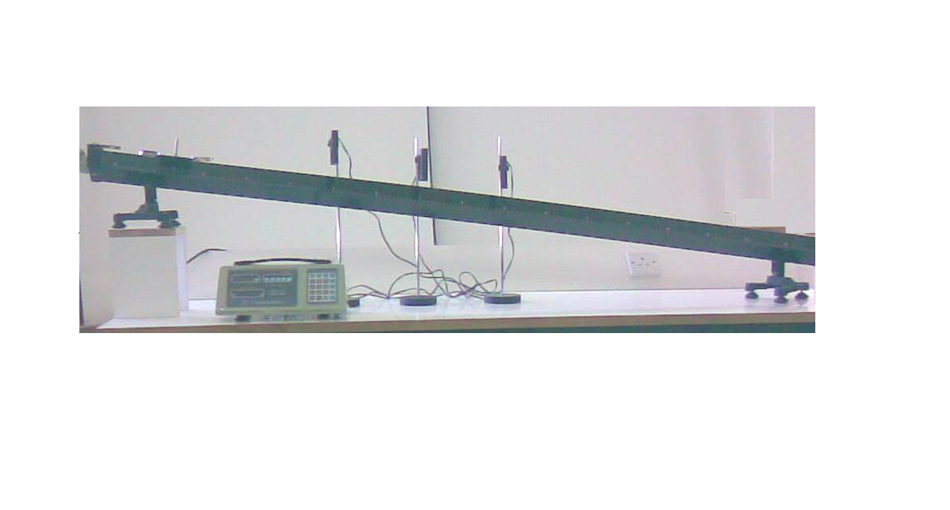




we have , but = y - x
Therefore

Slide 5

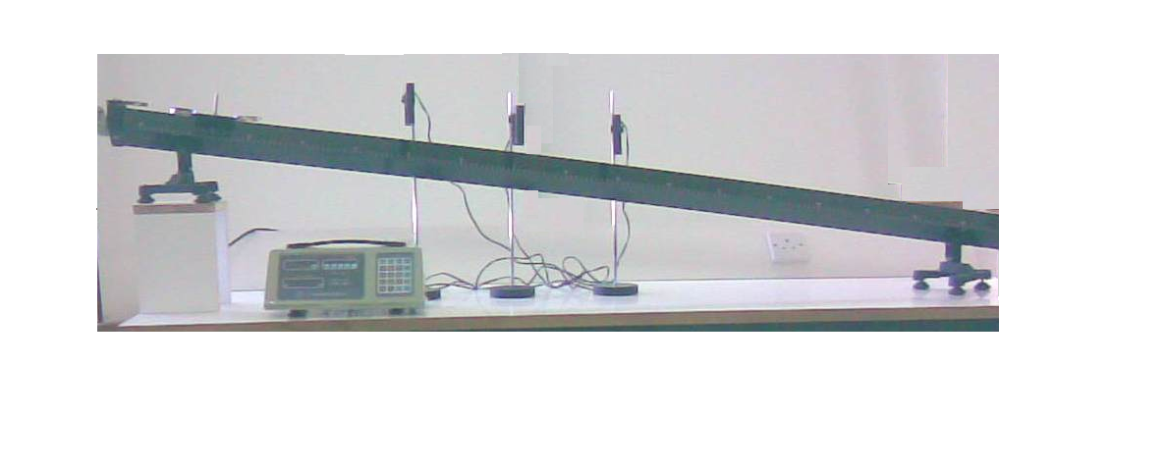



b
P₁
P₂
P₃
V₀
According to the laws of motions
S₁ = V₀ t₁ + 1/2 a t₁²……………………..( 1 )
S₂ = V₀ t₂ + 1/2 a t₂²……………………..( 2 )
Solving eqs. 1 and 2, we get
g =

Slide 6
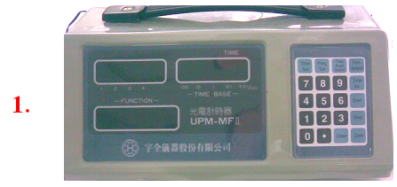
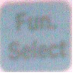

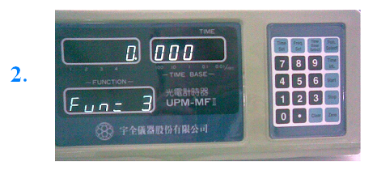

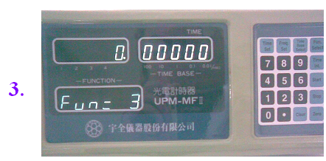
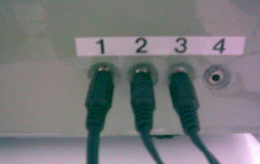
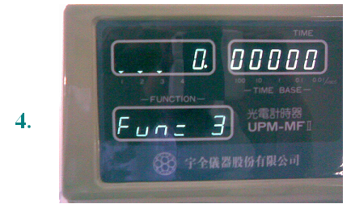
How to operate the electronic timer for the first time
1. Turn the power switch on.
2. Press +
3. Press many times.
4. Connect the photo cells in the right order.

Slide 7

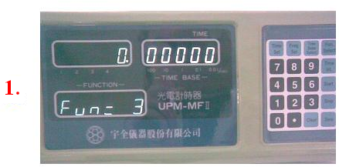
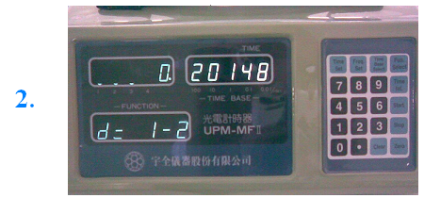


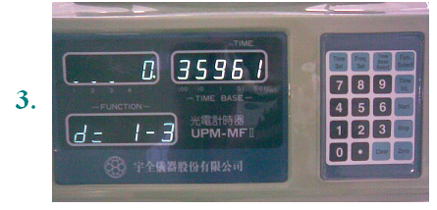
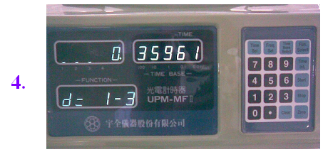
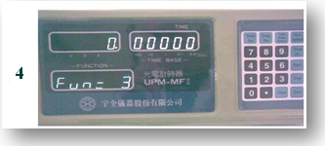

How to take readings by the electronic timer
Press
2. To find t1 , press
3. To find t2, press
4. To start new reading, press

Slide 8
Results: A) Complete the following table :
d = ……… cm , y = …….. cm , x = ……… cm , h = ……. cm
No. | P1 | P2 | P3 | S1 cm | S2 cm | t1 Sec. | t2 Sec. | a cm/s² | g cm/s²
1 | 70 | 90 | 110
2 | 80 | 95 | 125
3 | 90 | 100 | 130
Average g |  |  |  |  |  |  |  | =

Slide 9


B. Calculate the acceleration a of the trolley using the relation
and the acceleration due to gravity g using the relation in each case, write
your results in the above table.
Case 1:
________________________________________________ ________________
________________________________________________________________
________________________________________________________________
Case 2.
________________________________________________________________
________________________________________________________________
________________________________________________________________

