Slide 1

PHYSICS LAB.
( 20147)
Experiment No. 6
Simple Harmonic Motion
Single Spring

Slide 2
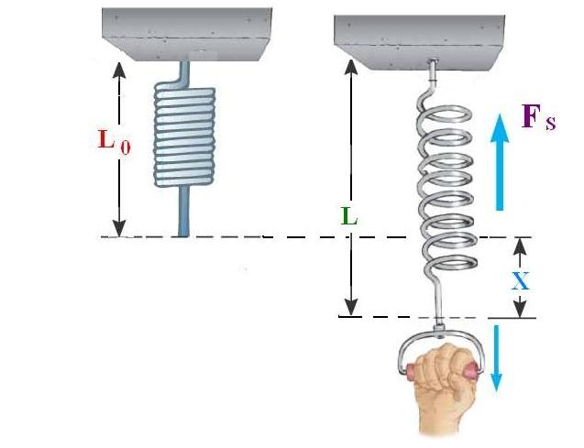
Exp.no. 6 Simple Harmonic Motion Single Spring
L0 is the original length of the spring.
L is the new length of the spring.
X is the elongation of the spring.
FS is the restoring force in the spring.
FS is proportional to X , we write it as FS α X
Or we can write it as FS = - k X
The quantity k is called “ Force Constant “ of the spring.
k is measured by N / m .

Slide 3
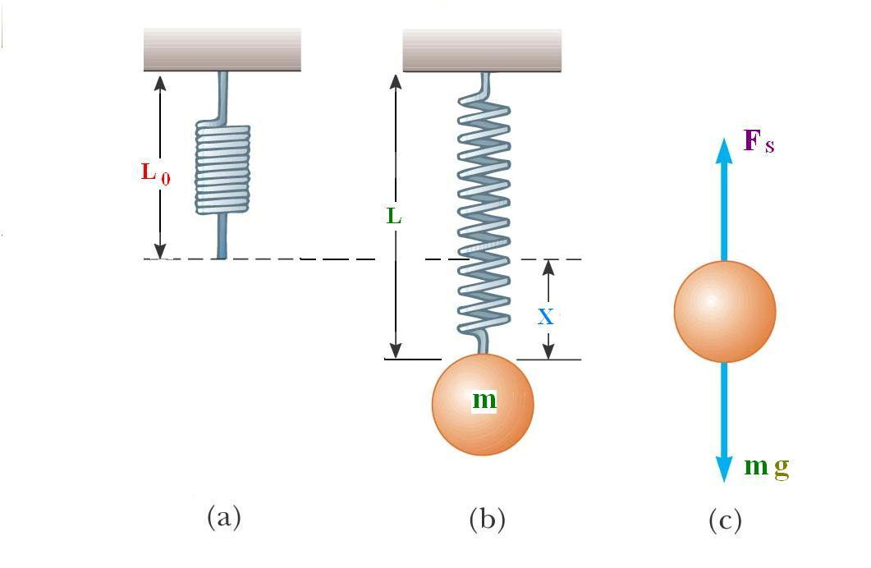

How to determine the force constant ( k ) experimentally
The force constant k depends on : The type of the material,
the number of turns of the spring,
the spacing between.
k can be found experimentally as follows:
As the mass m in fig.( b ) is at equilibrium then FS = mg, but
FS = k X, then we have

Slide 4
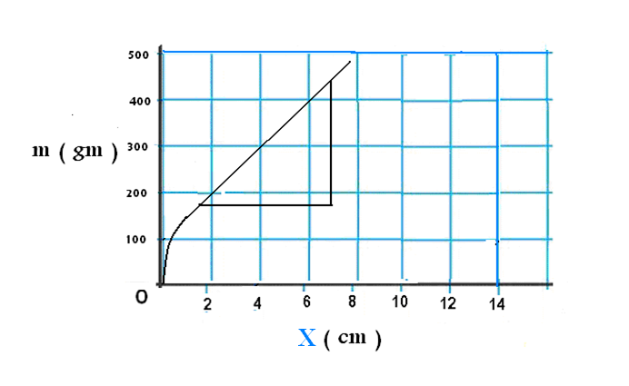

If we take several readings
of m and the corresponding values of X, we can draw a graph as shown in the figure.
From the graph,
the slope =
k = slope * g
Where g = 980 cm /
The unit of k is dyne / cm
s²

Slide 5
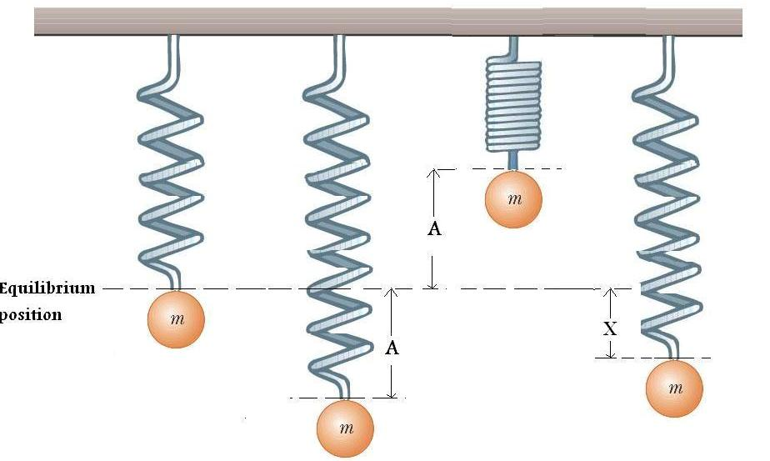


Vibrational motion of a mass attached to a spring
A is the amplitude of the vibration, which is the maximum displacement from the equilibrium position.
T is the period of one vibration. For mass less spring it is given by :
X is the displacement of the mass from the equilibrium position at any time t during vibration. It is given by

Slide 6
3. Data : a) Complete the following table for the hard spring.
Original length of the spring L0 = ……………………. cm
No. | Mass M ( g ) | Length of spring L ( cm ) | Elongation of spring X ( cm )
1 | 100
2 | 200
3 | 300
4 | 400
5 | 500
6 | 600
7 | 700
8 | 800
9 | 900

Slide 7
c) Complete the following table for the light spring.
Original length of the spring L0 = ……………………. cm
No. | Mass M ( g ) | Length of spring L ( cm ) | Elongation of spring X ( cm )
1 | 20
2 | 30
3 | 40
4 | 50
5 | 60
6 | 70
7 | 80
8 | 90
9 | 100

