Slide 1

PHYSICS LAB.
( 20147 )
Experiment No. 7
Simple Harmonic Motion
Combination of Two Springs

Slide 2
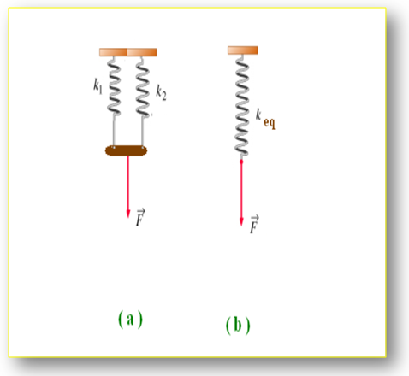
Exp.no. 7 Simple Harmonic Motion Connection of two springs
In this experiment, we shall apply the rule of parallel and series connection to a springs and to determine the equivalent form of these connections.
Parallel Connections of Two Springs.
We have two springs, of force constant
K1 and k2, are connected in parallel as shown in fig. ( a ), and we applied the
The force F to the common ends of the two springs .
We can replace the parallel connection
by a single with an equivalent force constant keq as shown in fig. ( b ) with the same applied force F .

Slide 3


We can prove that the equivalent force keq in case of parallel connection is given by :
In general, if we have n number of identical springs each of spring constant
k, and are connected in parallel, then the equivalent force constant of the combination keq is given by :

Slide 4
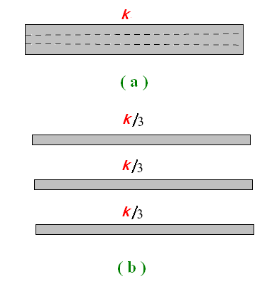

If we have elastic rubber strip
of force constant k, as shown in fig. ( a ), and we cut it into three pieces with the same length and width as shown in fig. ( b ), then the force constant of each strip is equal to

Slide 5
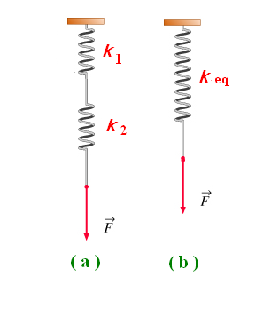
Series Connections of Two Springs.
We have two springs, of force constant K1 and k2, are connected in series as shown in fig. ( a ), and we applied the force F to the free end of the combination .
We can replace the series connection by a single spring with an equivalent force constant keq as shown in fig. ( b ) with the same applied force F .

Slide 6
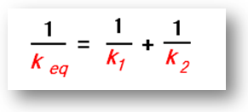

We can prove that the equivalent force keq in case of series connection is given by :
In general, if we have n number of identical springs each of spring constant
k, and are connected in series, then the equivalent force constant of the combination keq is given by :

Slide 7
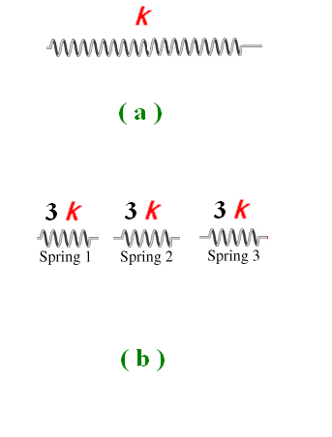

If we have a spring of force constant k, as shown in fig. ( a ), and we cut it into three equal pieces with the same length as shown in fig. ( b ), then the force constant of each piece is equal to :

Slide 8
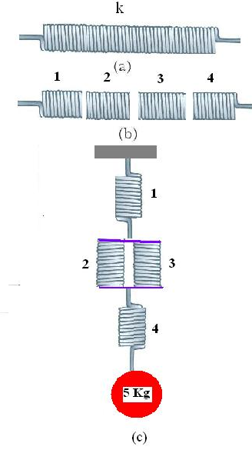




Example :
The Spring in part (a) has a force constant k = 100 N/m.
The spring is cut into four identical parts as shown in part (b).
The four parts are reconnected as shown in part (c)).
Amass of 5 kg is hanged at the free end of the combination executes a simple harmonic motion. Calculate the period of the motion.
k 1 = k2 = k3 = k4 = 400 N/m .
keq (2+3) = 800 N/m.

Slide 9
3. Data : a) Complete the following tables. 1. Single spring 1.
Original length of the spring L0 = ……………………. cm
No. | Mass M ( g ) | Length of spring L ( cm ) | Elongation of spring X ( cm )
1 | 10
2 | 20
3 | 30
4 | 40
5 | 50
6 | 60
7 | 70
8 | 80
9 | 90

Slide 10
2. Single spring 2.
Original length of the spring L0 = ……………………. cm
No. | Mass M ( g ) | Length of spring L ( cm ) | Elongation of spring X ( cm )
1 | 10
2 | 20
3 | 30
4 | 40
5 | 50
6 | 60
7 | 70
8 | 80
9 | 90

Slide 11
d) Complete the following table for the two springs in series:
Original length of the spring s L0 = ……………………. cm
No. | Mass M ( g ) | Length of spring L ( cm ) | Elongation of spring X ( cm )
1 | 10
2 | 20
3 | 30
4 | 40
5 | 50
6 | 60
7 | 70
8
9

Slide 12
e) Complete the following table for the two springs in parallel:
Original length of the spring s L0 = ……………………. cm
No. | Mass M ( g ) | Length of spring L ( cm ) | Elongation of spring X ( cm )
1 | 30
2 | 40
3 | 50
4 | 60
5 | 70
6 | 80
7 | 90
8 | 100
9 | 110

