Slide 1

PHYSICS LAB. 1
( 31148 )
Experiment No. 8
Moment of Inertia

Slide 2
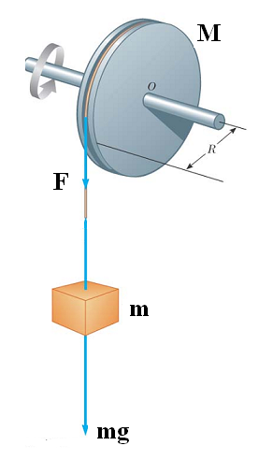

Exp.no. 8 Moment of Inertia
In a rotational motion, there is a law which is similar to the Newton’s second law in a transitional motion.
This law can be represented in the form
τ = I α
Where τ is the torque ( moment ) exerted
on the body and caused it to rotate about a certain axis.
I is the moment of inertia of the body about that axis.
α is the angular acceleration of the body.
The torque τ is positive if the rotation is counter
clockwise.
The torque τ is negative if the rotation is clockwise.

Slide 3
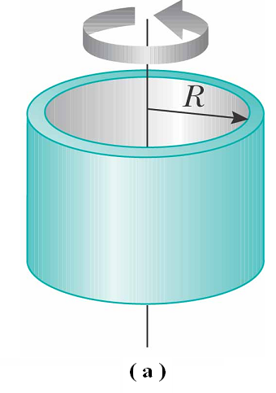
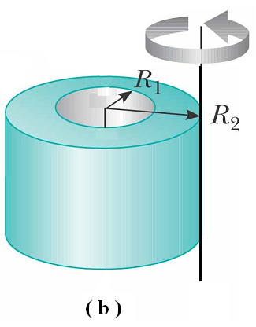
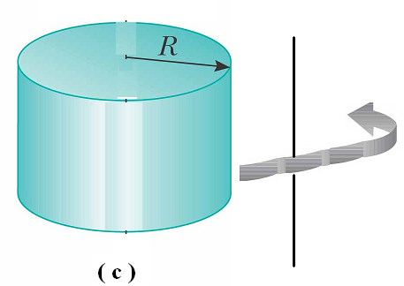
The moment of inertia I of a body depends on two factors:
1. The geometrical shape of the body.
The shape of the body may be Disk,
Ring, Cylinder, or Rod or any other shape.
2. The position of the axis of rotation.
The axis of rotation may be at the center of the body as in fig. ( a ), or tangent to the surface of the body as in fig. ( b ), or may be any where out side the body as in fig. ( c ) .
We shall determine the movement of inertia by two methods :
By theoretical calculations.
By experimental method.

Slide 4



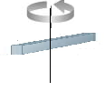

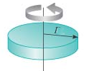
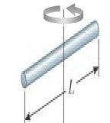
Theoretical calculation of moment of inertia
Body | Axis | Law of Moment of inertia (I) | Mass ( gm ) | Dimension ( cm ) |  | Value of I ( gm.cm² )
Disk |  | 1/2 Mr² |  | r =
Ring |  |  |  | r₁ =
 |  |  |  | r₂ =
Cylinder |  | M |  | r =
 |  |  |  | L =
Rod |  |  |  | a =
 |  |  |  | b =

Slide 5
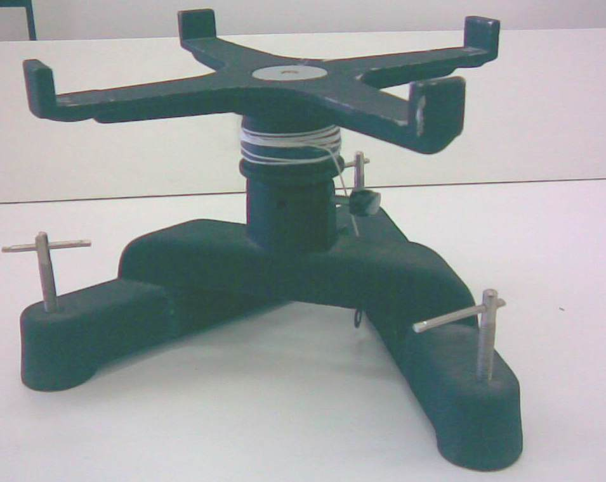


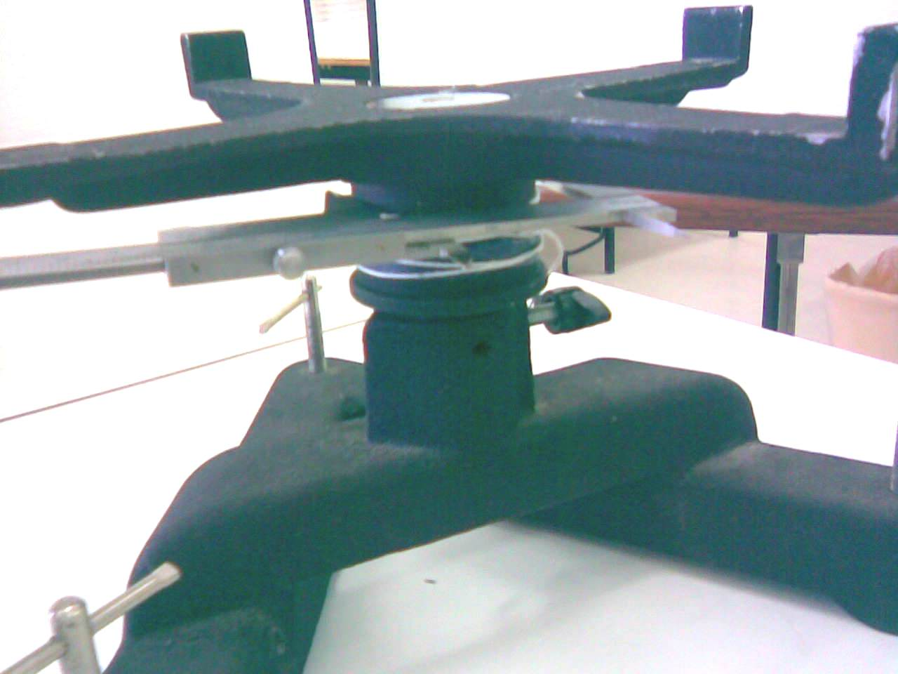


Experimental determination of moment of inertia
The apparatus used in this experiment is called the rotator, shown in fig. ( a ).
The main part of the rotator is the cylinder where the string is wrapped.
The diameter ( 2r ) of the cylinder is measured by the Vernier as shown in fig. ( b ).

Slide 6
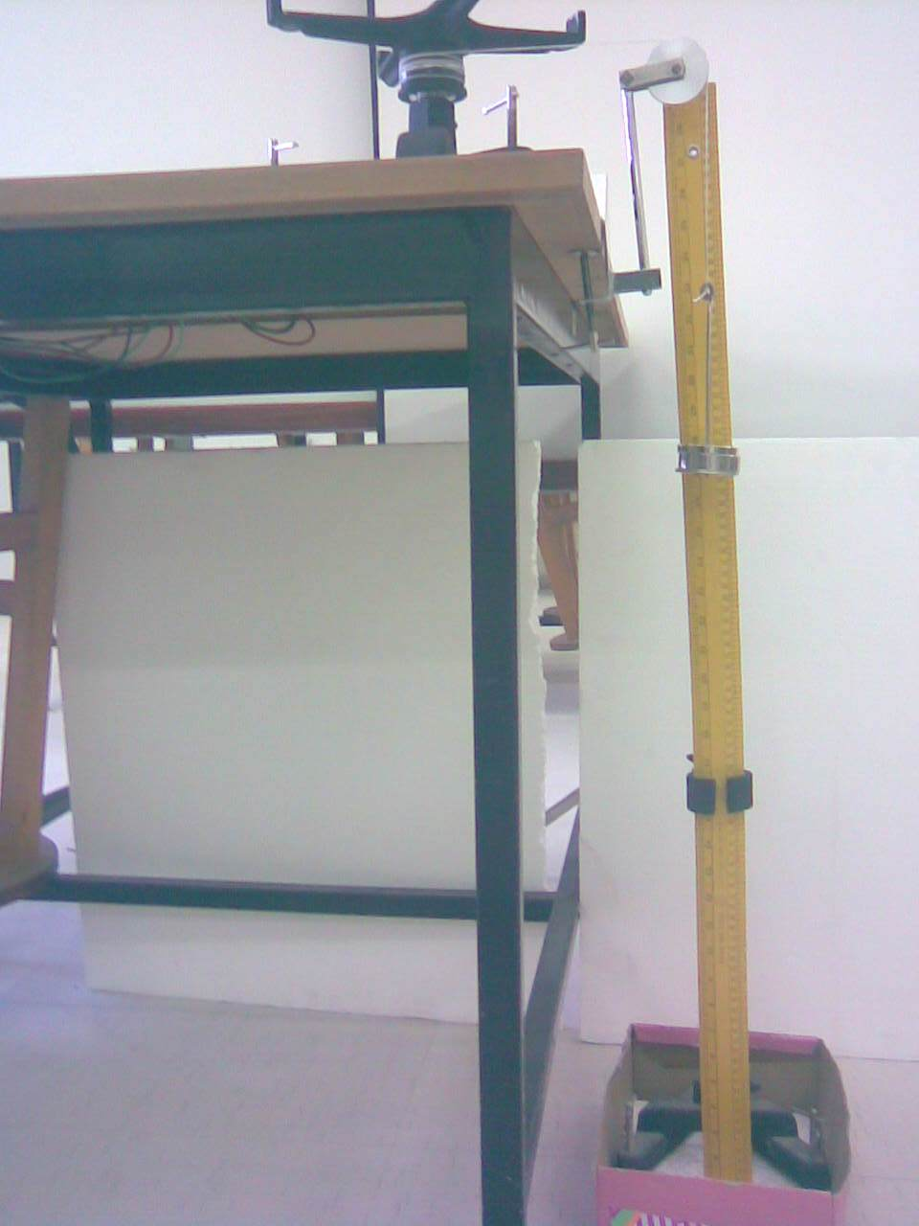






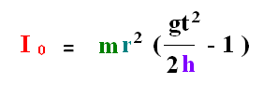
Determination of moment of inertia of the rotator I0
From the fig. when the mass m is fall down, the potential energy mgh is converted into kinetic energy of the mass and rotational kinetic
energy of the cylinder , we can write
But
And
The we get

Slide 7
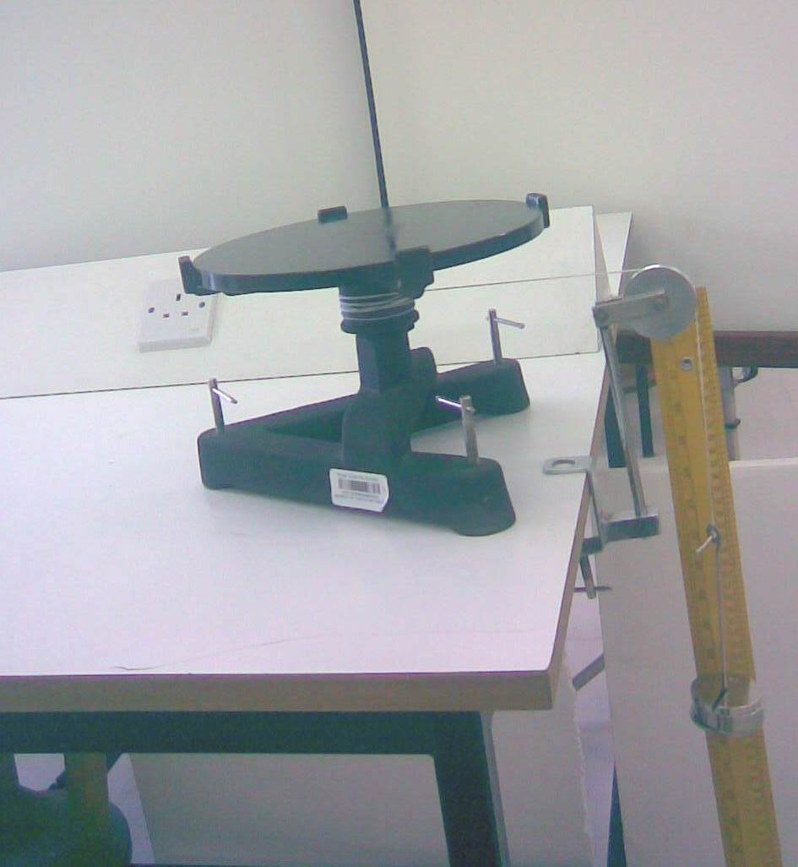

Determination of moment of inertia of any object I
If we put any object on the rotator such as a disk , and repeat the same experiment , we get the moment of inertia of both the rotator and the
disk , we mean that
To find the moment of inertia of the
disk only, we subtract from the
above equation.
The same method is applied to any other object used with the rotator.

Slide 8
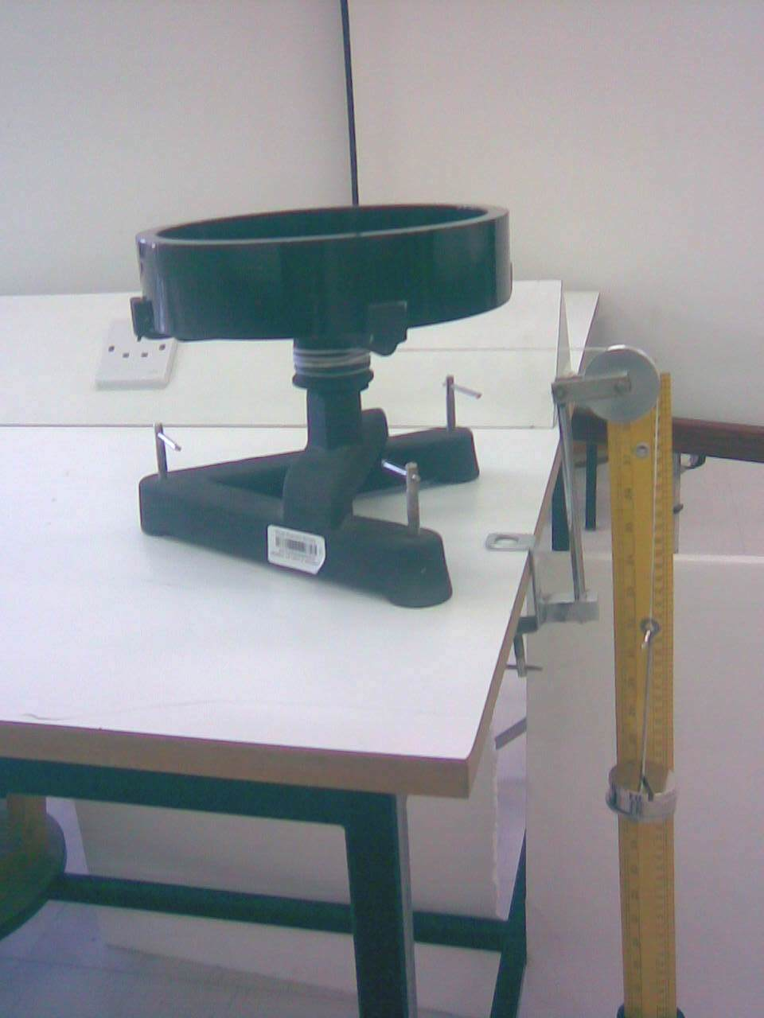
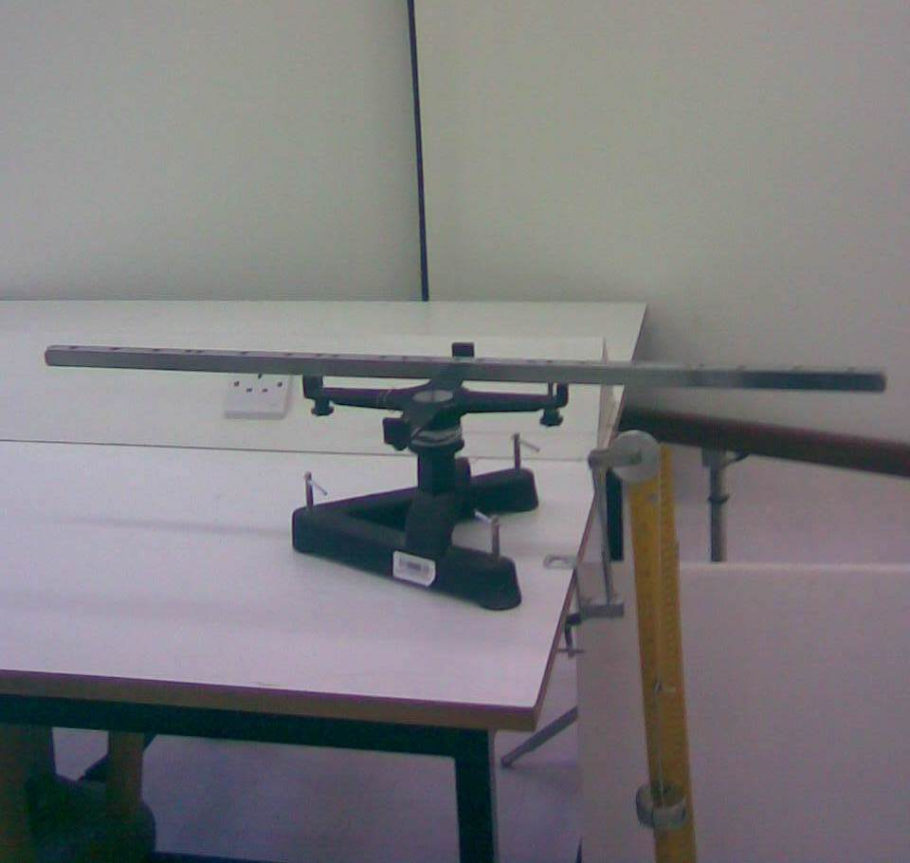
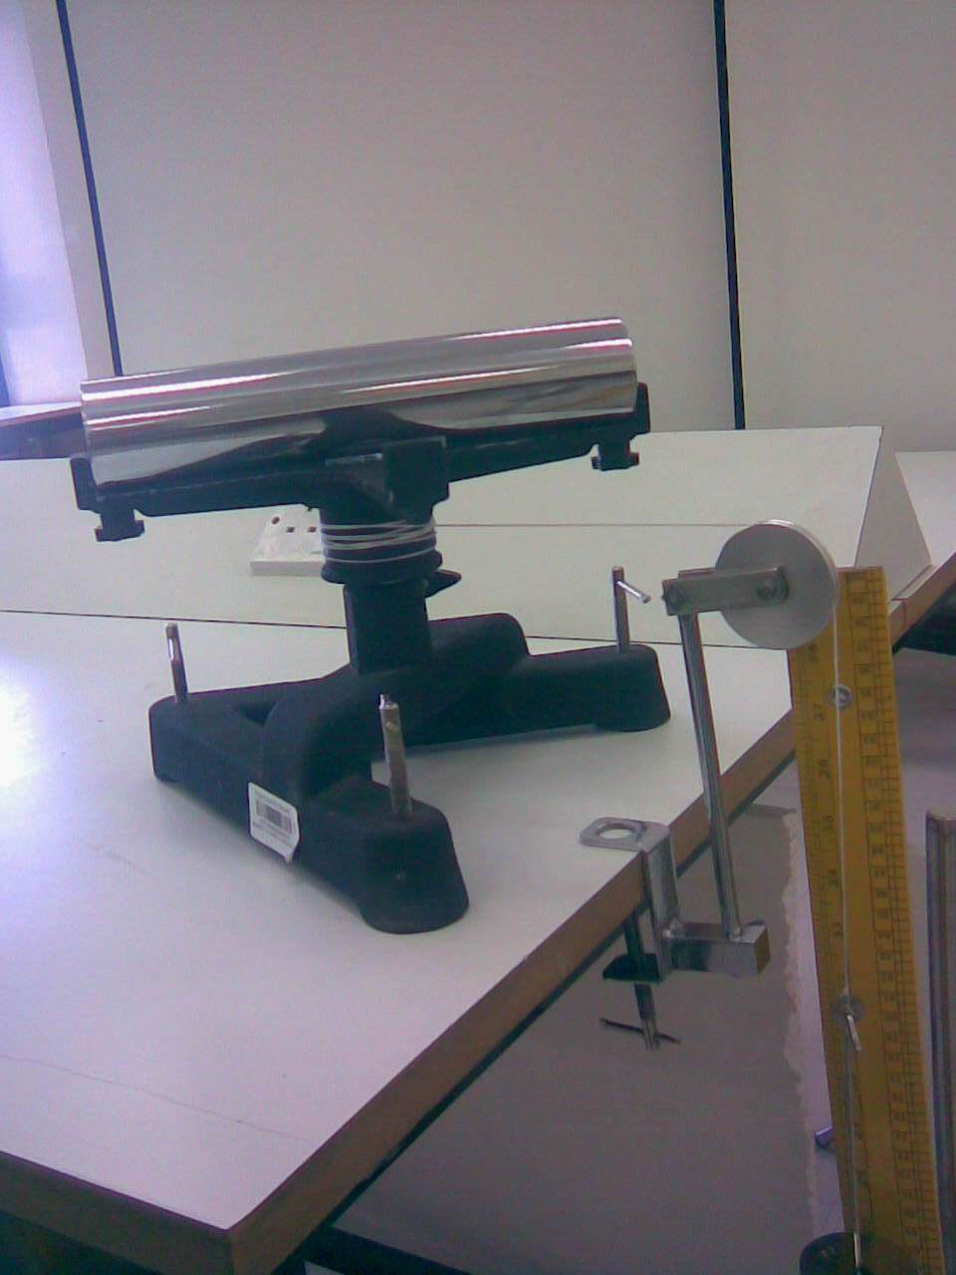

Slide 9
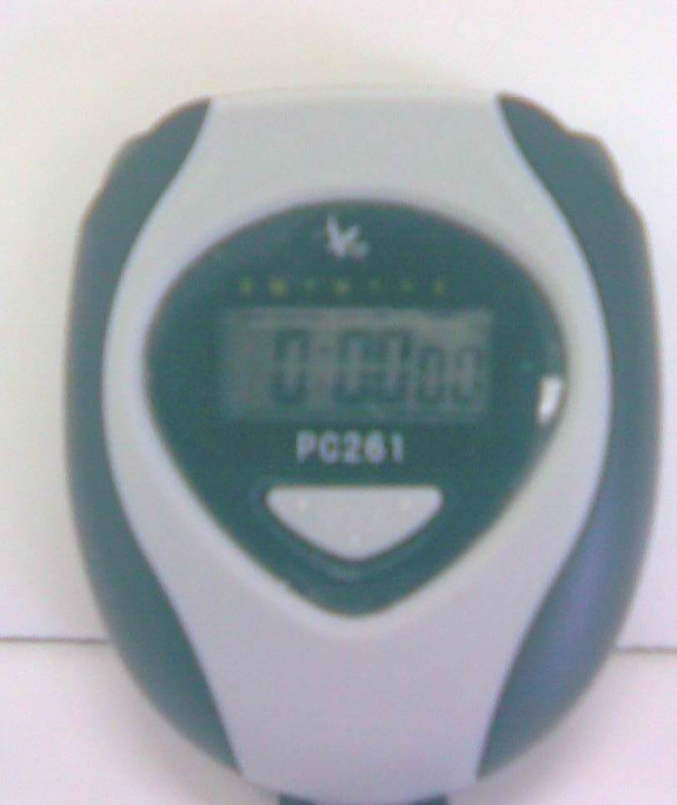
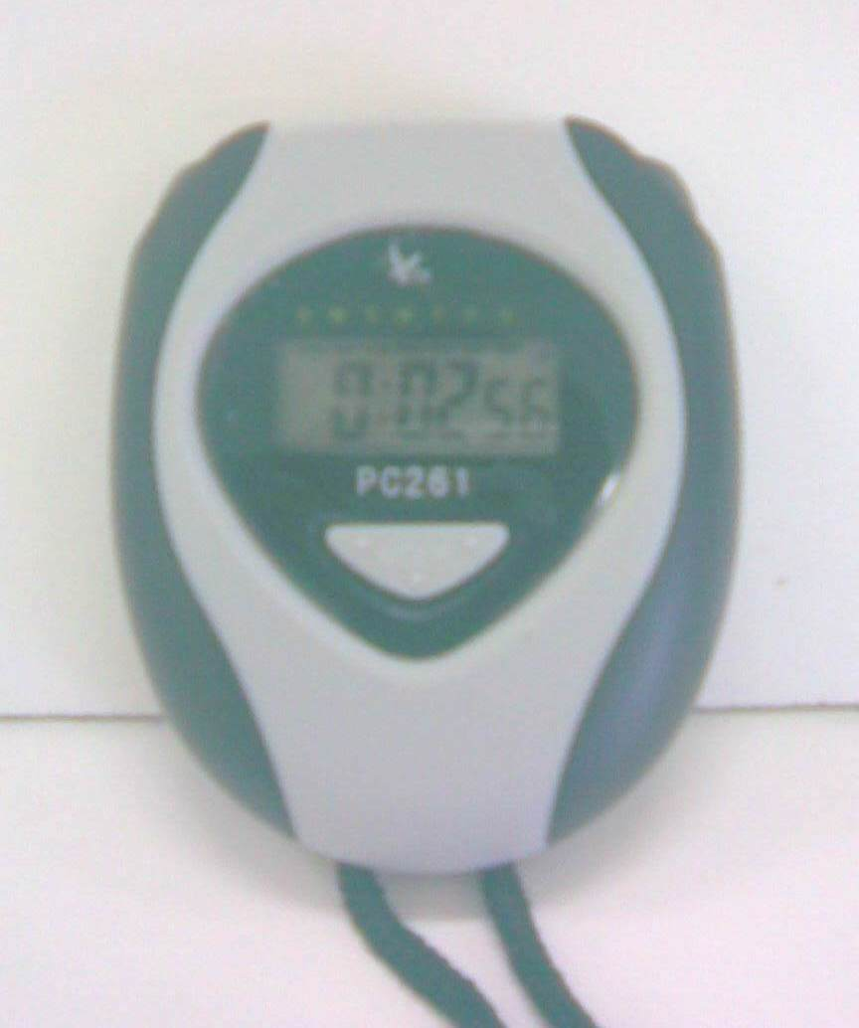


Determination of the falling time t by the stop watch

Slide 10




Slide 11
B . moment of inertia of the rotator only
r = …………………… cm
C. Moment of inertia of the disk.
Mass m ( gm ) | Height h ( cm ) | Time t ( sec. ) | Moment of inertia of the rotator I0 ( gm.cm² )
 | Mass m ( gm ) | Height h ( cm ) | Time t ( sec. ) | Moment of inertia of the rotator and disk ( I + I0 ) ( gm.cm² ) | Moment of inertia of the disk I ( I + I0 ) – I0 ( gm.cm² )

