Slide 1
Botnet detection

Slide 2
Dataset
A Realistic Cyber Defense Dataset (CSE-CIC-IDS2018)
The dataset includes seven different attack scenarios, namely Brute-force, Heartbleed, Botnet, DoS, DDoS, Web attacks, and infiltration of the network from inside.
The attacking infrastructure includes 50 machines and the victim organization has 5 departments includes 420 PCs and 30 servers.
This dataset includes the network traffic and log files of each machine from the victim side, along with 80 network traffic features extracted from captured traffic using CICFlowMeter-V3.
The data set size is 6.41 GB of 10 csv files each one represents a specific day queries, this project was made on one file containing more than one million record.
Link for dataset: https://registry.opendata.aws/cse-cic-ids2018/

Slide 3
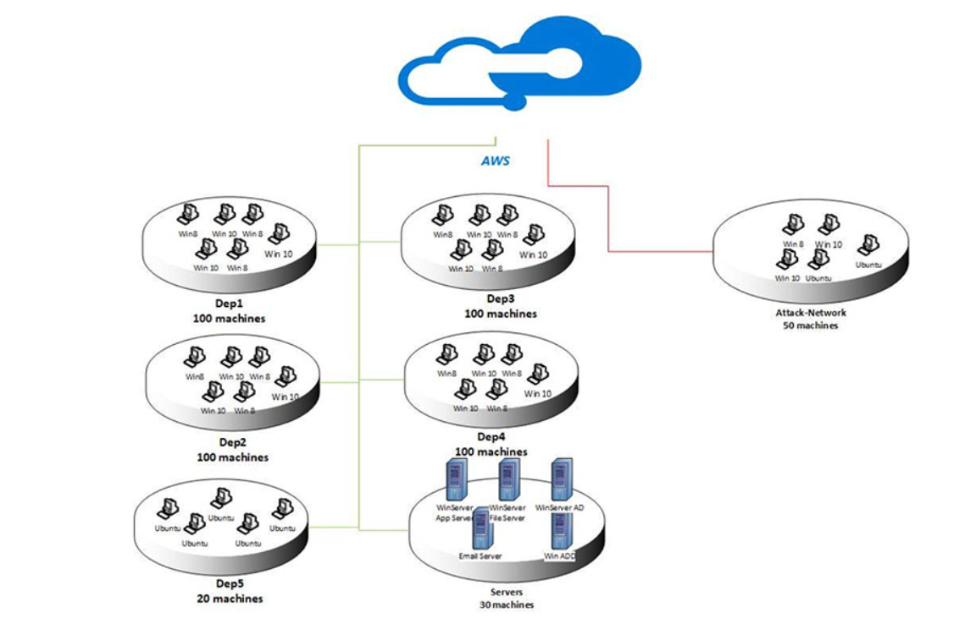

Slide 4
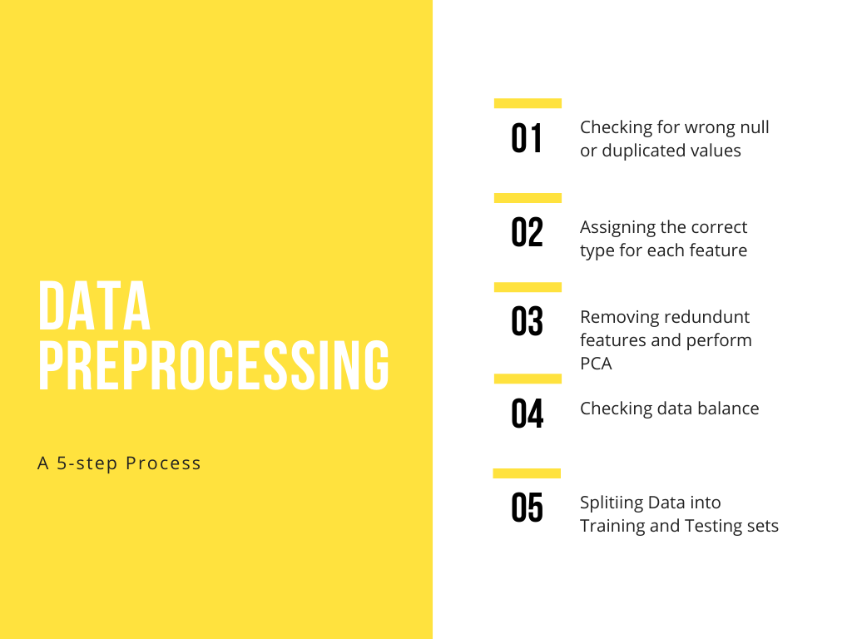

Slide 5


Slide 6
Results
Model | DT | KNN | SVM | NB | ANN
Accuracy | 99.99% | 99.92% | 75.52% | 52.10% | 99.31%
Precision | 99.99% | 99.76% | 90% | 36.11% | 98.80%
Recall | 99.99% | 99.93% | 5.6% | 98.38% | 98.31%

Slide 7
reliability of results
Referring to Spiringer journal of big data paper: A survey and analysis of intrusion detection models based on CSE-CIC-IDS2018 Big Data.
“ With regard to CICIDS2018, the RF and DT learners scored an accuracy99.99%. Tied to this accuracy, the precision was 100% and the recall was 99.99% for both learners. The of RF and DT learners also had the highest accuracy for ISOT HTTP (99.94% for RF and 99.90% for DT).”
Discussion of surveyed works:
In general, the best performance scores are unusually high for studies where scores are provided. This finding is notable. Accuracy scores are between 96 (D’hooge et al., 2020) and 100 (Atefinia & Ahmadi, 2020; Kanimozhi & Jacob, 2019a). Several papers show recall scores of 100 (Atefinia & Ahmadi, 2020; Kanimozhi & Jacob, 2019a; Kanimozhi & Jacob, 2019b; Li et al., 2020; Filho et al., 2019) and also precision scores of 100 (Atefinia & Ahmadi, 2020; Kanimozhi & Jacob, 2019a; Huancayo Ramos et al., 2020; Filho et al., 2019). In addition, three studies show a perfect AUC score (Kanimozhi & Jacob, 2019a; Kanimozhi & Jacob, 2019b ;Li et al., 2020). These noticeably high scores for the various metrics may be due to overfitting.

