Slide 1
Job Application
Data is often collected directly from users, but it may contain errors. This user-generated data needs cleaning to ensure accuracy. Cleaning helps remove mistakes, making the data usable for analysis and better decision-making.

Slide 2
Table of contents
01
03
02
04
What the project aims to achieve?
How regex helped us achieve our goals?
Advantages of using regular expressions
SAAS

Slide 3
01
What the project aims to achieve?
PROFILE DATA

Slide 4
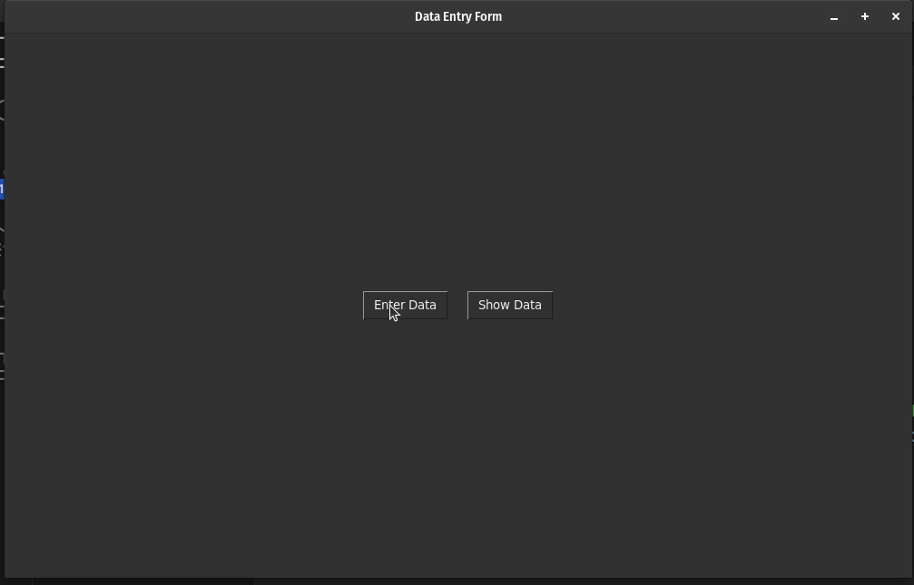

Slide 5
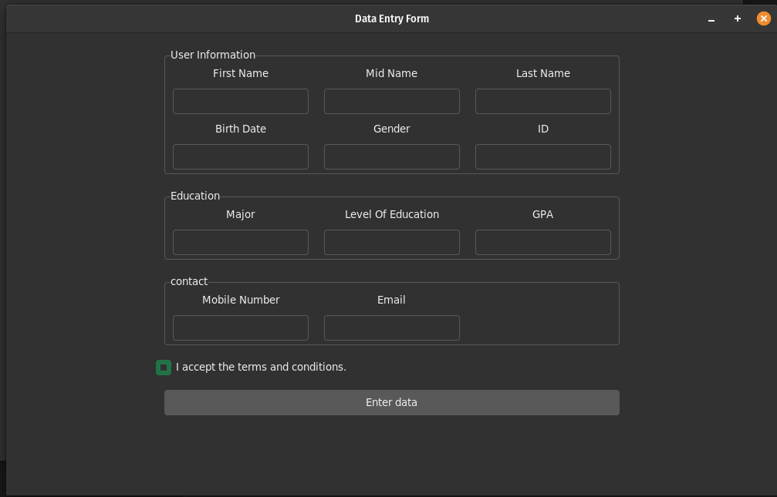

Slide 6
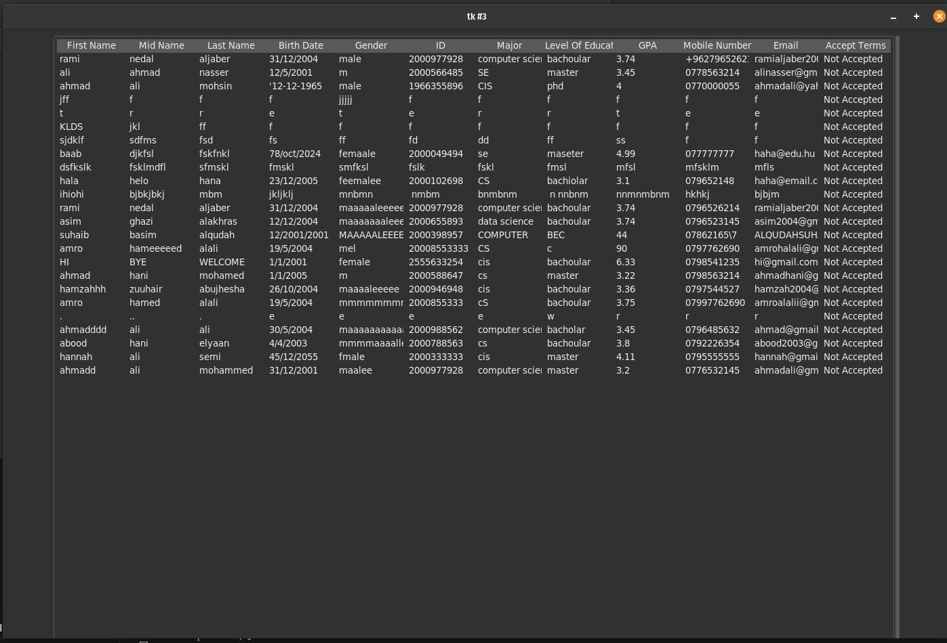
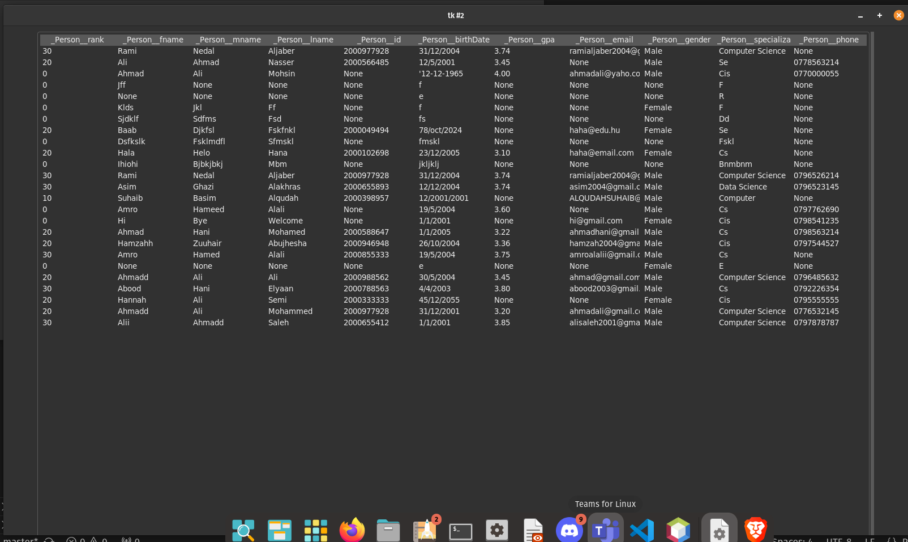

Slide 7
02
Advantages of using regular expressions
REGEX
r"^07[789][0-9]{7}$"
r"^07[789][0-9]{7}$"

Slide 8
03
How regex helped us achieve our goals?

Slide 9

04
SAAS

Slide 10
Thanks..

