Slide 1

Cat Worshippers
By Dominic, Anthony, Royce, Dominic, Anthony
Jonte and Delicia

Slide 2
Want to find Data in one place?

Slide 3
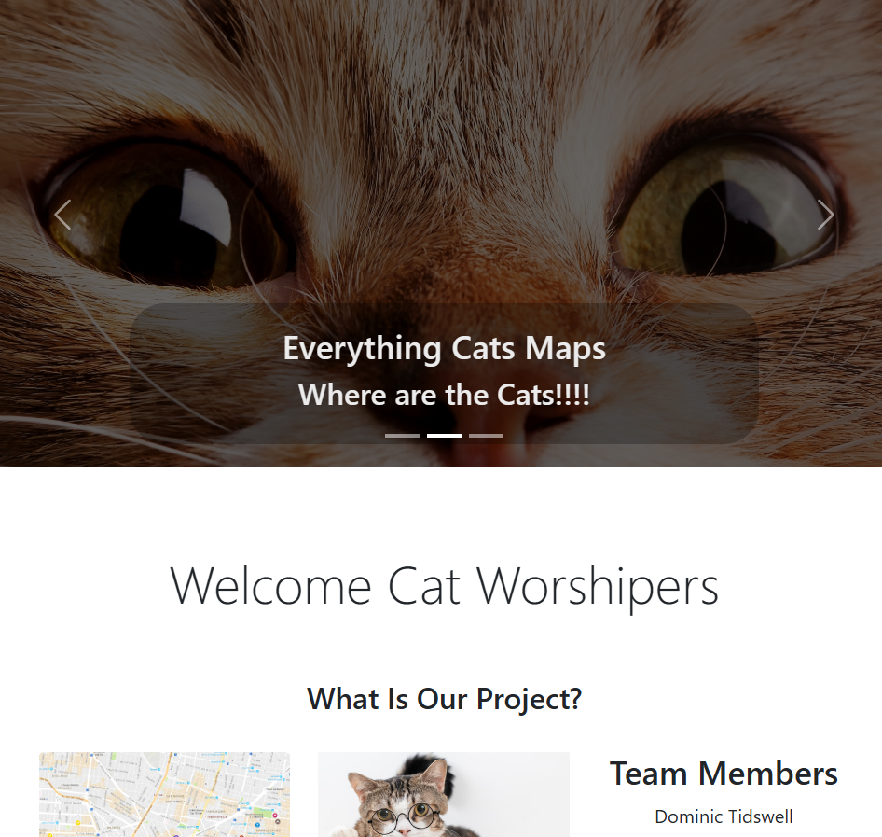
Razor Pages and Web Design
We used:
Razor Pages
ASP.NET Core Framework
Bootstrap 5 (As a CSS Framework)

Slide 4
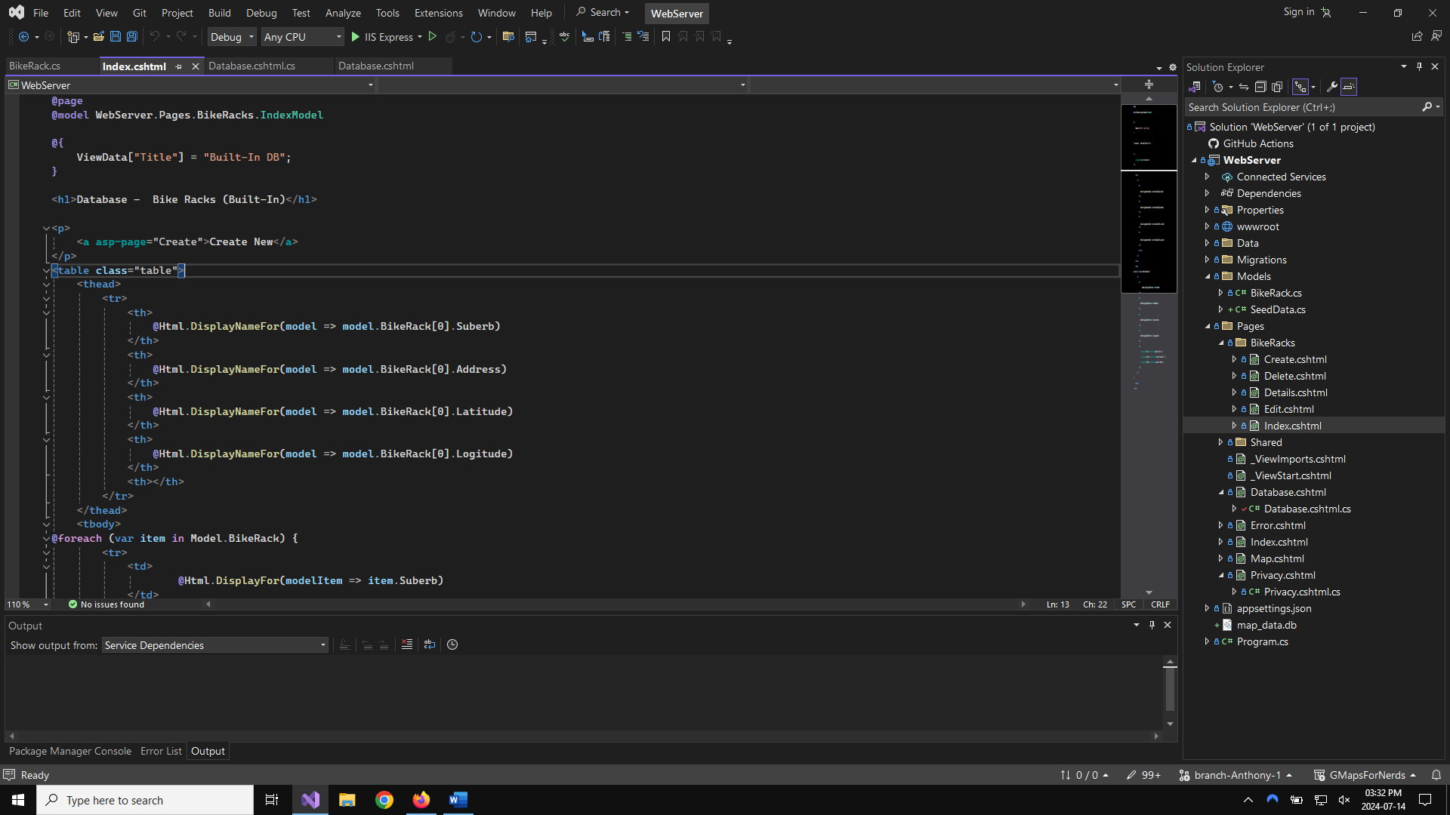
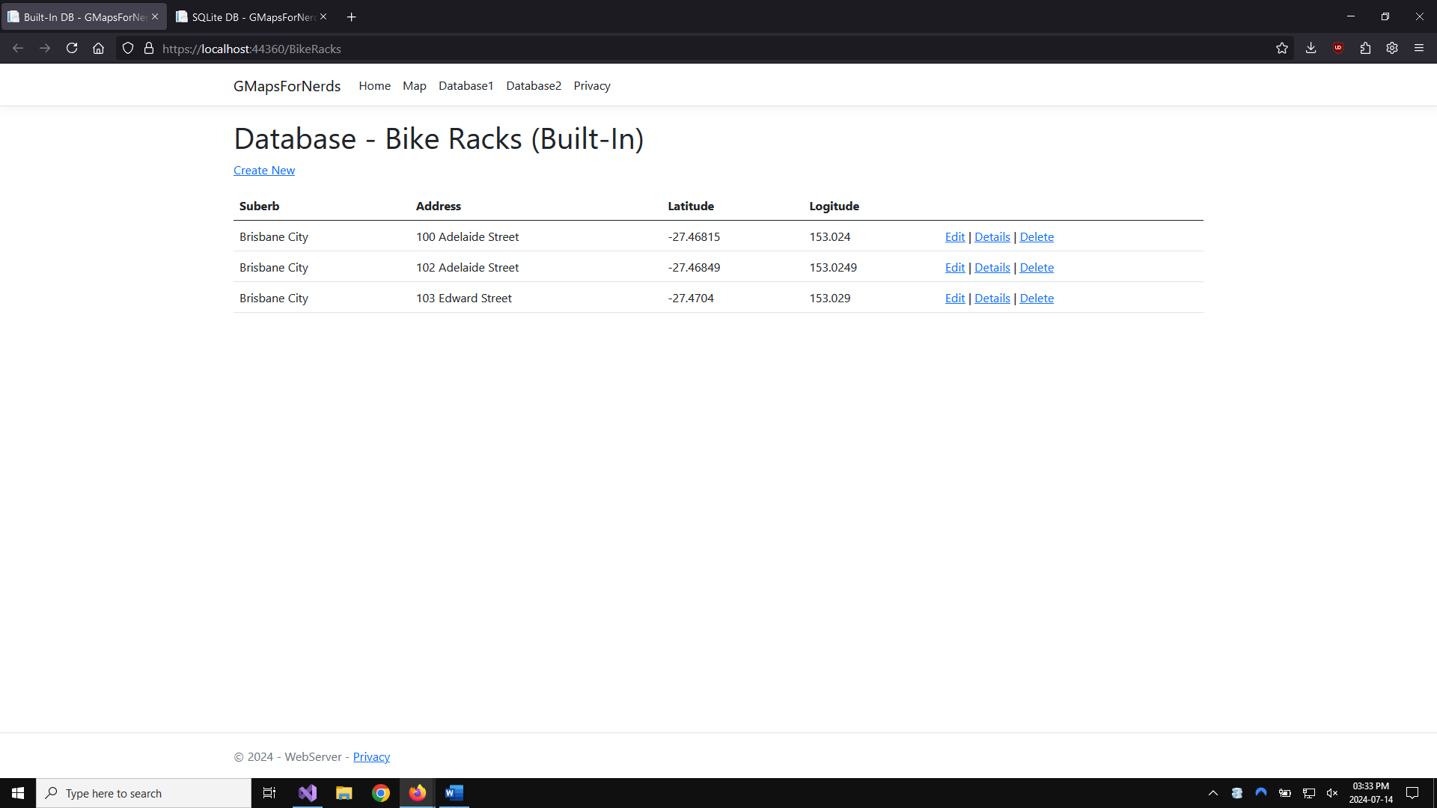
Connecting Database

Slide 5
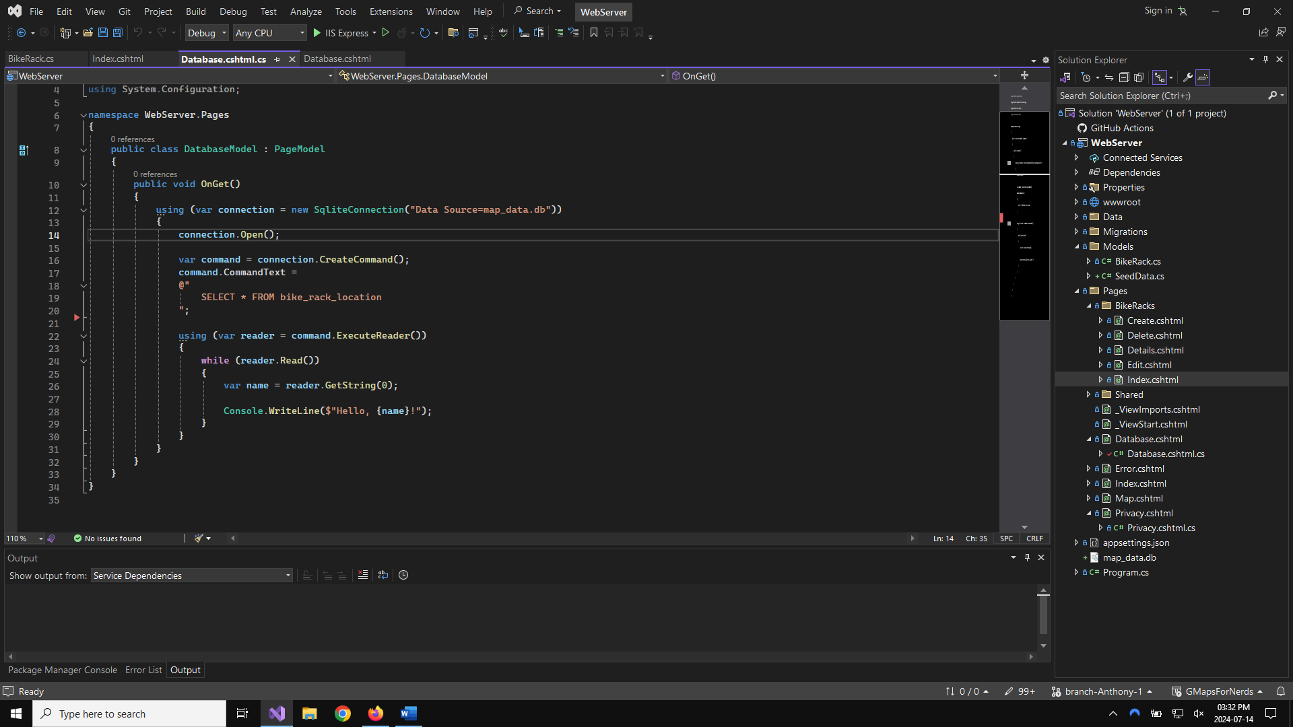
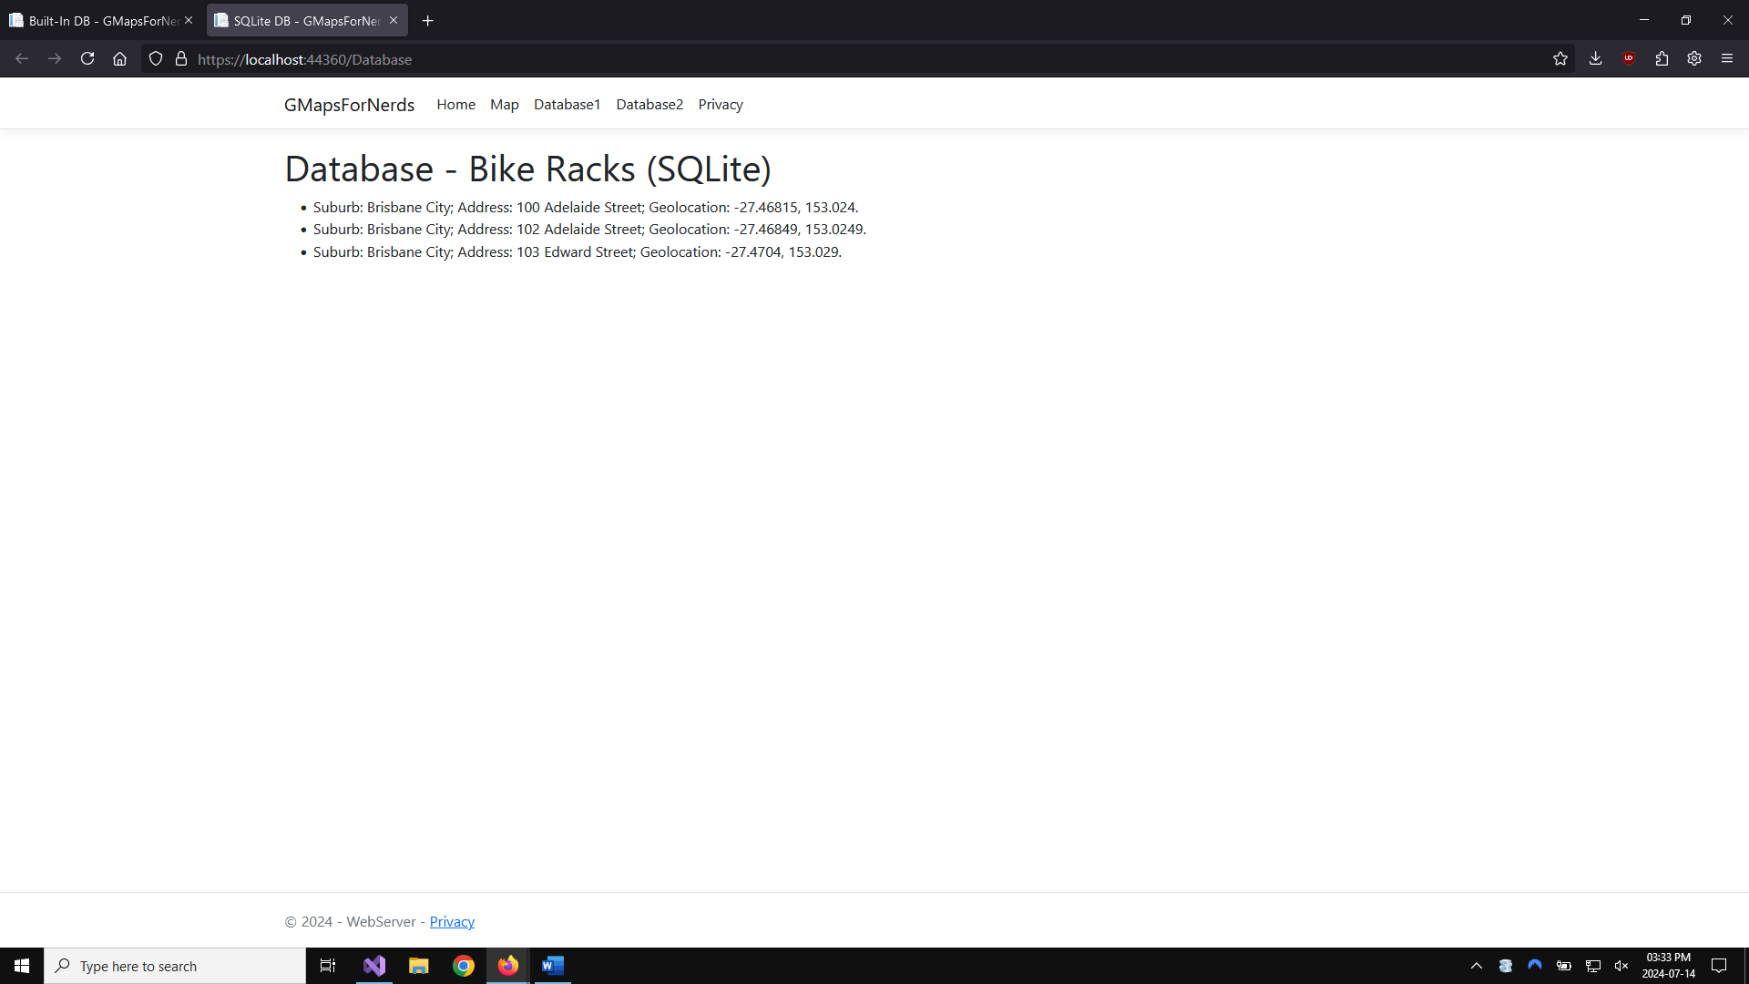
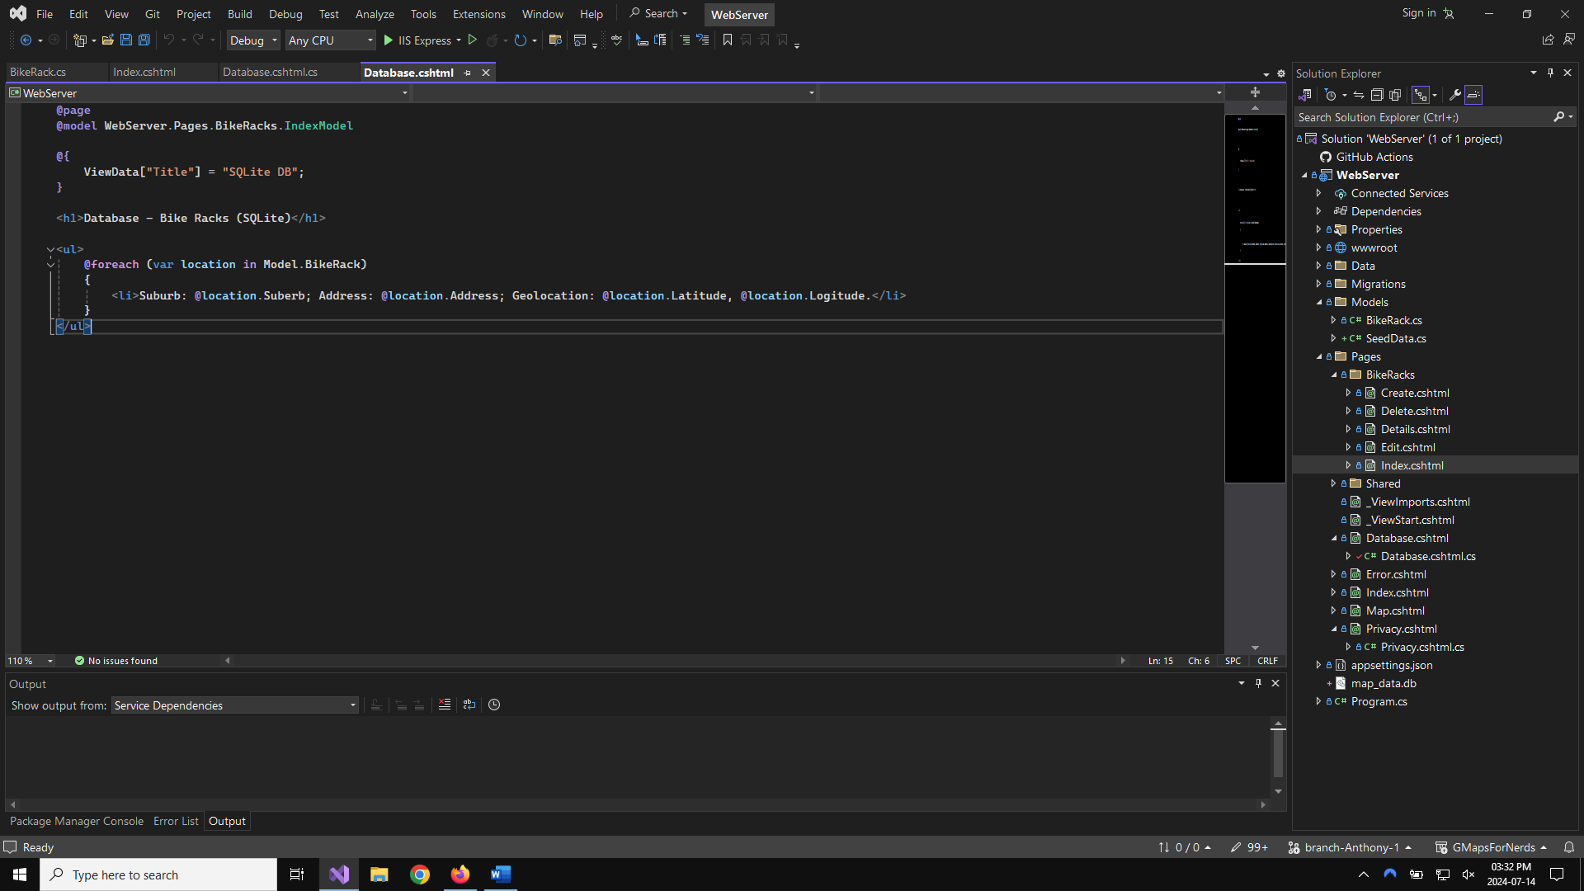
Connecting Database

Slide 6
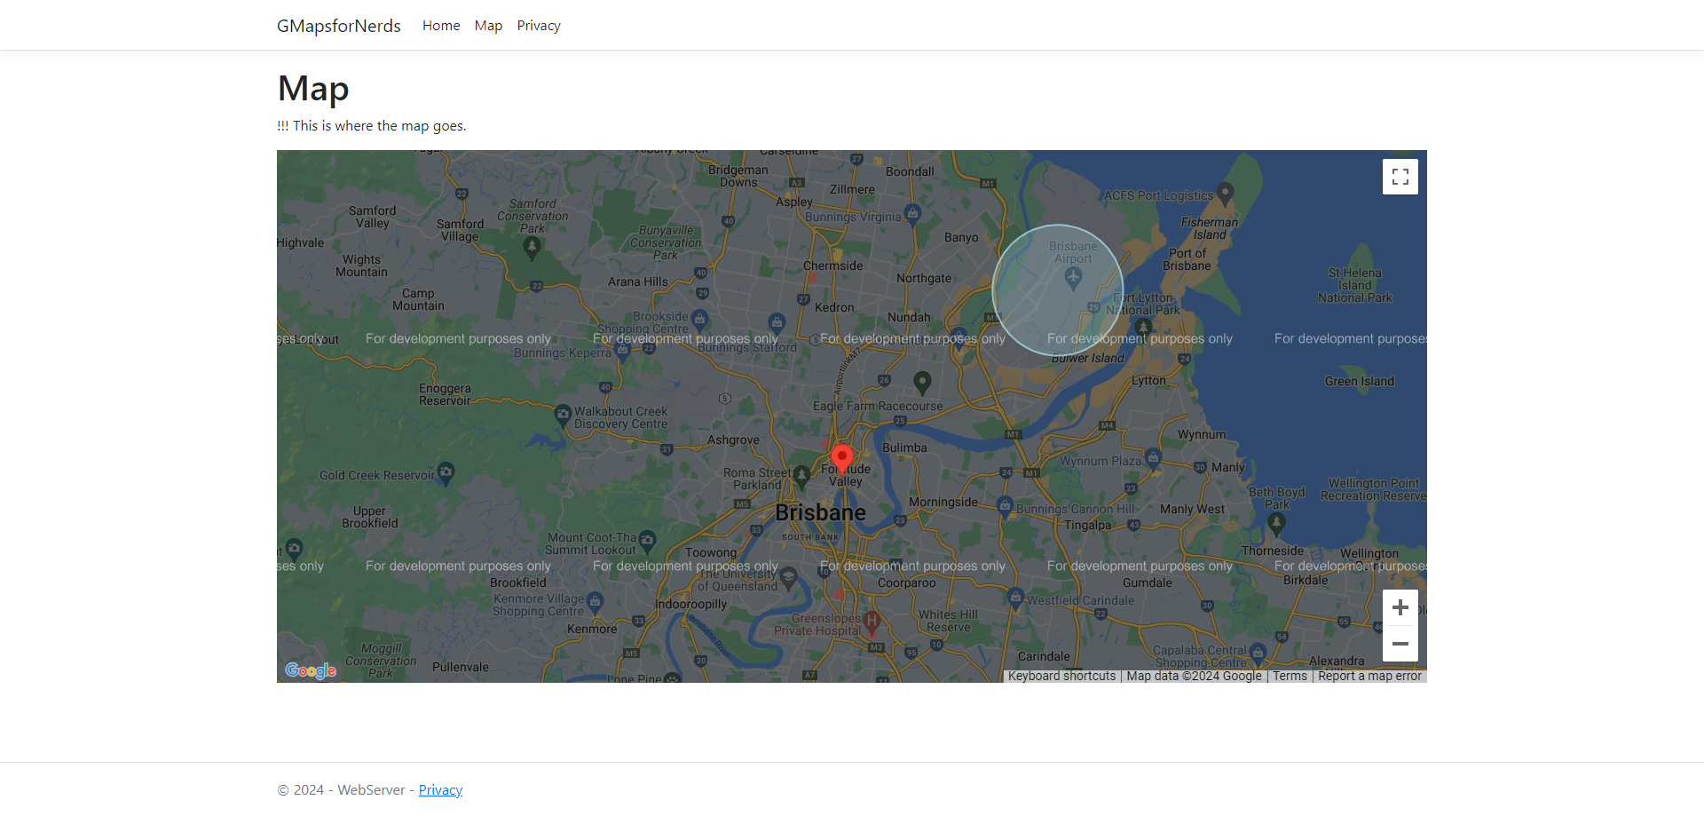
Earlier Iterations
The Plan:
Use API’s to overlay over maps.
We used:
Google API Key (Implemented in a script embedded in CSHTML).

Slide 7
Our Final Map: (Demonstration)

