Slide 1
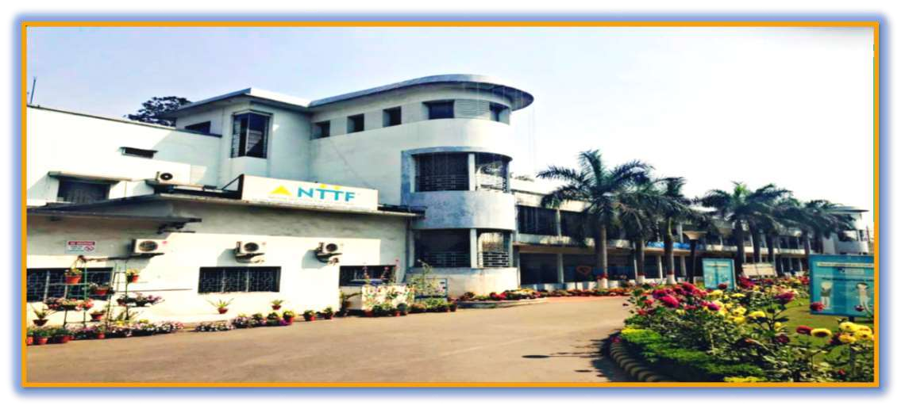
NTTF at R.D.TATA TECHNICAL EDUCATION CENTRE
JAMSHEDPUR

Slide 2



WELCOME
TO THE STUDY PRESENTATION OF
“VEHICLE SERVICING SYSTEM”
“TECH OF TURTLE”

Slide 3








T
E A M P R O F I L E
MRS. PREETA JOHN
PRINCIPAL
MR.MRINMOY KR.MAHATO
PROJECT CO-ORDINATOR
MR.CHANDAN SINGH
LEADER
MR.M.BHARGAV KR
CO-LEADER
MR. SURYA PRAKASH TIWARY
RECORD-KEEPER
MS. SONAL SINGH
TIME KEEPER

Slide 4

AGENDA
S.NO | TOPIC | PAGE NO.
1 | INTRODUCTION | 1
2 | FEASIBILITY STUDY | 2
3 | OBJECTIVE | 3
4 | TARGET AUDIENCE | 4
5 | ADVANTAGES | 5
6 | DIS-ADVANTAGES | 6
7 | MODULES AND FUNCTIONALITIES | 7
8 | FLOWCHART /ER-DAIGRAM | 8
9 | BLOCK DIAGRAM(DFD) | 9
10 | REQUIREMENTS | 10
11 | SCHEDULE FOR PROJECT / GANTT CHAT | 11
12 | BIBLIOGRAPHY | 12
13 | CONCLUSION | 13

Slide 5
INTRODUCTION
A Vehicle Service System is a comprehensive framework or software solution designed to manage and streamline the maintenance, repair, and management of vehicles. It serves as a tool for vehicle owners, fleet managers, or auto service centre's to ensure vehicles are properly serviced, maintained, and repaired in a timely and efficient manner. The primary purpose of a vehicle service system is to track the performance and condition of vehicles, schedule maintenance, manage repairs, and ensure the overall safety, reliability, and longevity of the vehicles.

Slide 6

FEASIBILITY STUDY
Market Feasibility
Technical Feasibility
Operational Feasibility
Financial Feasibility
Schedule Feasibility

Slide 7
OBJECTIVE
The primary objective of a Vehicle Servicing System is to streamline the process of scheduling, managing, and tracking appointments efficiently and effectively through an online platform. This system aims to benefit both service providers and clients by offering automation, convenience, and flexibility in appointment management.
Here are some key objectives:
Simplifying Appointment Scheduling
Enhancing Customer Convenience
Improving Time Management and Resource Utilization
Providing Real-Time Availability and Flexibility

Slide 8
TARGET AUDIENCE
Vehicle Owners: Individual seeking reliable and convenient vehicle servicing and maintenance.
Independence Service Centre's: Small to medium-sized garages offering general vehicle repair and maintenance.
Authorized Dealerships and Workshops: Service centre's of automotive brands offering specialized services and repairs.
Technicians: Personnel responsible for carrying out maintenance and repair, who will use the system to receive service assignments and track job status.

Slide 9
ADVANTAGES
Improved Vehicle Performance
Increased Vehicle Lifespan
Reduced Risk of Breakdown
Enhanced Safety
Cost Saving
Better Fuel Efficiency
Higher Resale value
Better Driving Experience

Slide 10
DISADVANTAGES
Dependence on service provider
Cost of service
Over-Scheduling and delay
Risk of over-Maintenance
Limited Service Quality
Part Availability
Lack of Transparency
Time-Consuming

Slide 11
Vehicle Maintenance Scheduling
Parts Management and Inventory
Customer Management and Communication
Vehicle Inspection and Monitoring
Cost Estimation and Billing
Repair Management
Reporting and Analytics
Mobile and Remote Access
Maintenance History and Warranty Tracking
FUNCTIONALITIES

Slide 12
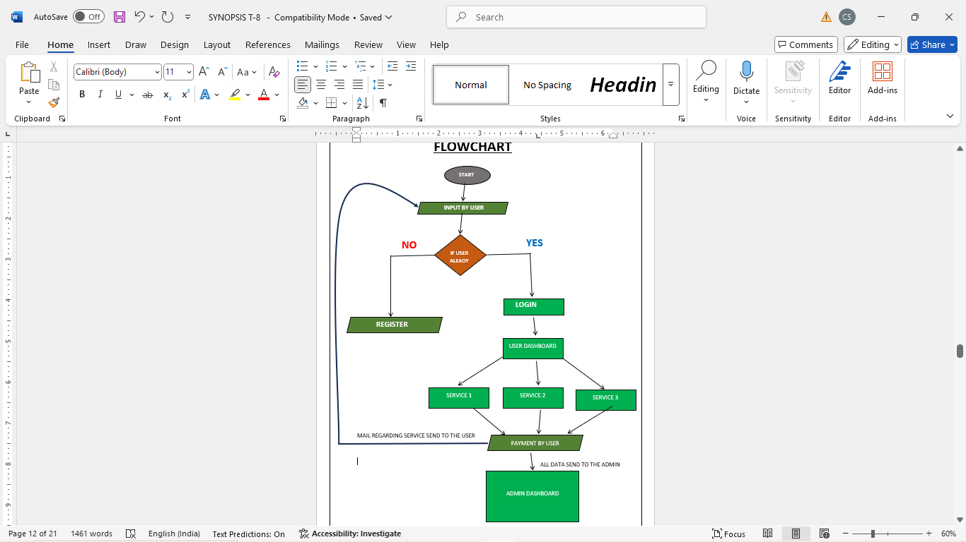
FLOWCHART

Slide 13
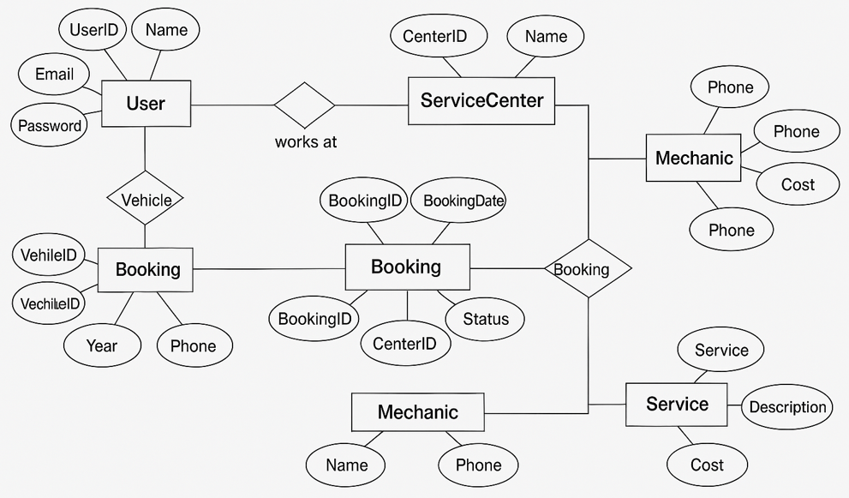
ER-DIAGRAM

Slide 14
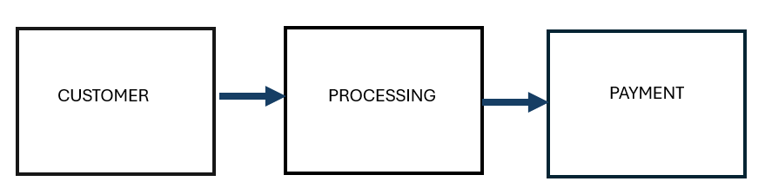
DFD-0

Slide 15
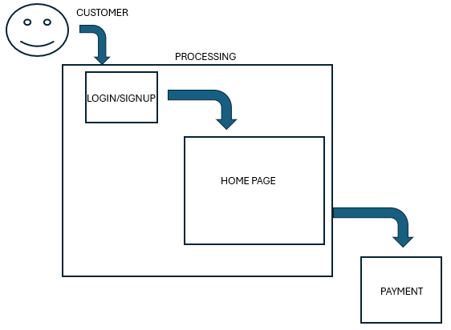
DFD-1

Slide 16
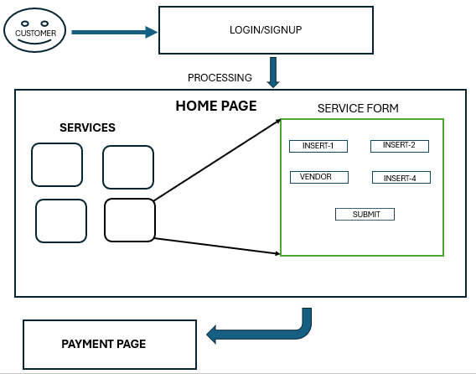
DFD-2

Slide 17
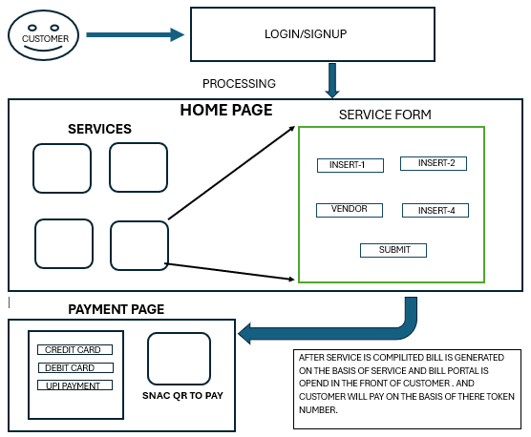
DFD-3

Slide 18
VISUAL STUDIO CODE-->For Programming .
XAMPP SERVER
PHP
HTML
CSS
JAVA-SCRIPT
Git-Hub
Font-Awesome
Any Search Engine
REQUIREMENTS

Slide 19
SCHEDULE FOR PROJECT
ACTIVITIES | WEEK 1 | WEEK 2 | WEEK 3 | WEEK 4 | WEEK 5 | WEEK 6 | WEEK 7 | WEEK 8 | WEEK 9 | WEEK 10 | WEEK 11 | WEEK 12
PREPARATION
FLOWCHAT
PROGRAMMING
FINAL MAKEOVER
PROJECT TESTING
DATA FROM GANTT CHART:-
WEEK 1-2→PREPARATION
WEEK 3→FLOW CHART
WEEK 4-8→PROGRAMMING
WEEK 9-11→FINAL MAKEOVER
WEEK 5-→PROJECT TESTING
START DATE→ 2nd January
FINISH DATE→ 31th March

Slide 20
BIBLIOGRAPHY
For the successful completion of the project we have taken references from:-
W3school.com
Fontawsome.com
Wikipedia.com
Geeksforgeeks.com
Github.com

Slide 21
CONCLUSION
The Vehicle Servicing System is to improve the appointment scheduling process for both service providers and clients by offering automation, flexibility, and efficiency. By achieving these objectives, the system enhances the overall customer experience, improves operational efficiency, reduces administrative overhead, and fosters business growth. Ultimately, it provides a more seamless and professional way to manage appointments in various industries, ranging from healthcare to beauty services and beyond.

Slide 22


