Slide 1
Data
Visualization
Solution
by Naif Alsultan

Slide 2
Presentation Content
1
3
Introduction
Step 1 Solution
Step 2 Solution
Step 3 Solution
2
4

Slide 3
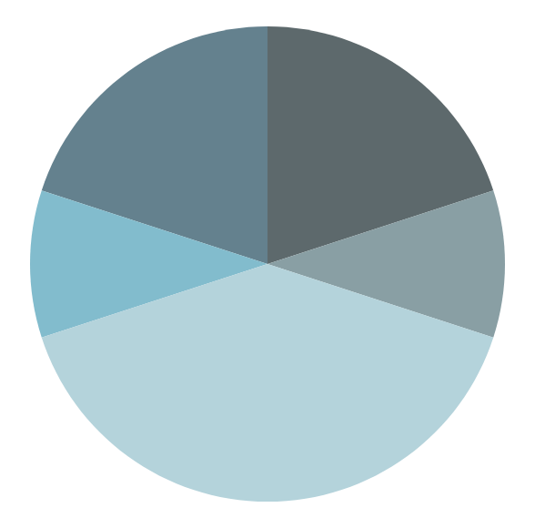
1.
Introduction

Slide 4





Introduction
Along with this presentation, I have created and deployed a Dash application to display my solution!
To see my Dash application please visit: data-visualization-solution.link
Bootstrap
Git
Plotly
Tools Used to Create
My Dash Application
GitHub
Dash
AWS

Slide 5
2.
Step 1 Solution
Analysis of the given data visualization options

Slide 6

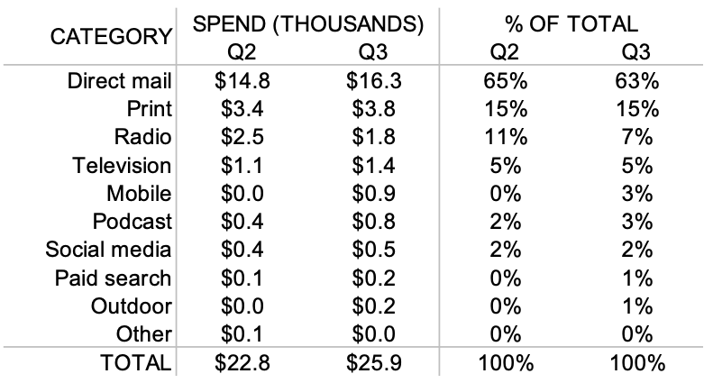
Advantages of Option 1
All spendings of the two quarters are shown.
All spendings for all relevant channels are shown.

Slide 7

Disadvantages of Option 1
Hard to analyze how spending has changed between the two quarters.
Hard to analyze how spending varies by channel.

Slide 8
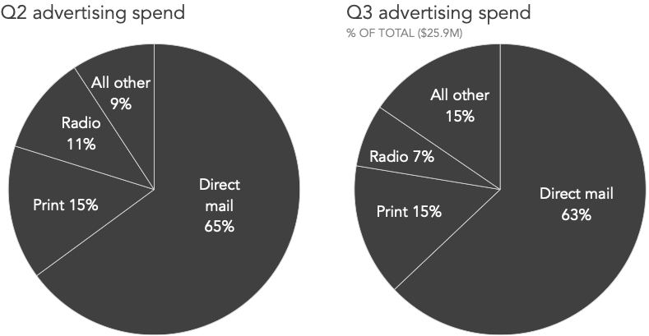
Advantages of Option 2
Easy to analyze how spending varies by channel for a quarter.
Easy to understand.

Slide 9
Disadvantages of Option 2
Total spending of Q2 is not shown. Thus, analyzing how spending has changed between the two quarters is impossible.
Cannot immediately determine the spendings by channel since only percentages are shown.
Total spending of Q3 is in millions but it is actually in thousands.
Several channels are combined into a single category.
Percentages are misleading since total spendings of the two quarters are not equal.

Slide 10
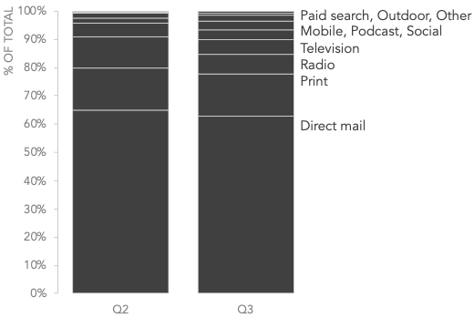
Disadvantages of Option 3
Total spendings are not shown. Thus, analyzing how spending has changed between the two quarters is impossible.
Cannot determine the spendings by channel since only percentages are shown.
Cannot immediately determine the percentage of each channel.
Hard to determine the mapping between the labels and the stacked bars.

Slide 11
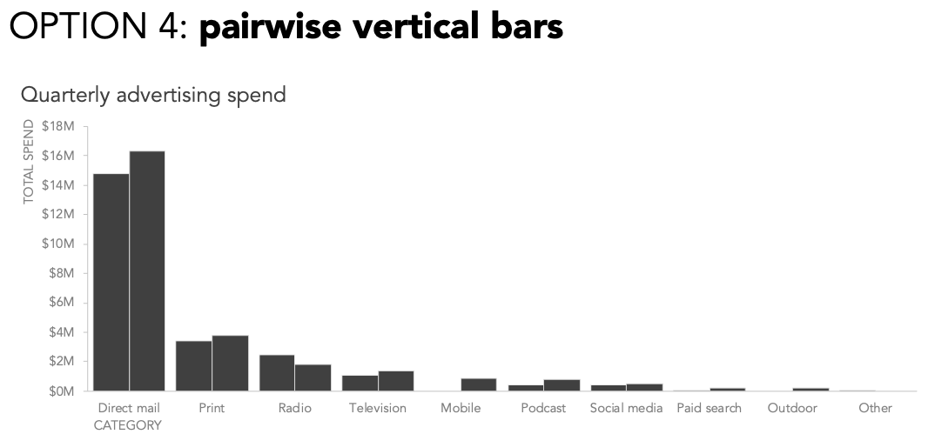
Advantages of Option 4
Easy to analyze how spending has changed between the two quarters.
Easy to analyze how spending varies by channel.

Slide 12
Disdvantages of Option 4
Cannot distinguish between Q2 and Q3 since the bars are not labeled.
Spendings are in thousands but the y-axis is in millions.

Slide 13
3.
Step 2 Solution
Analysis of more data visualization options

Slide 14
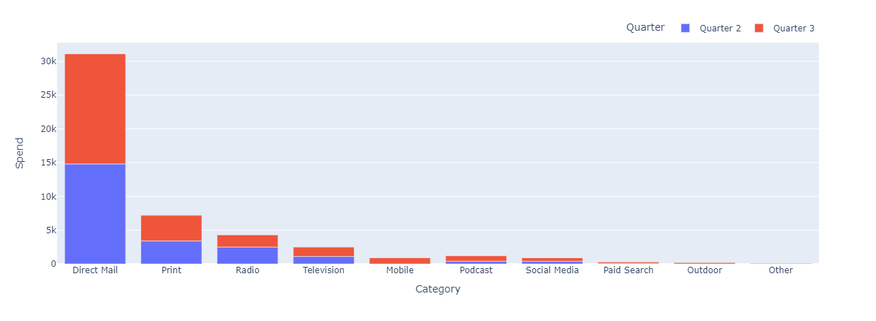
Stacked Bars
From the following chart we can see the total spendings of the two quarters for each category. However, determining the change between the two quarters cannot be done effectively. Thus, it is not ideal.

Slide 15
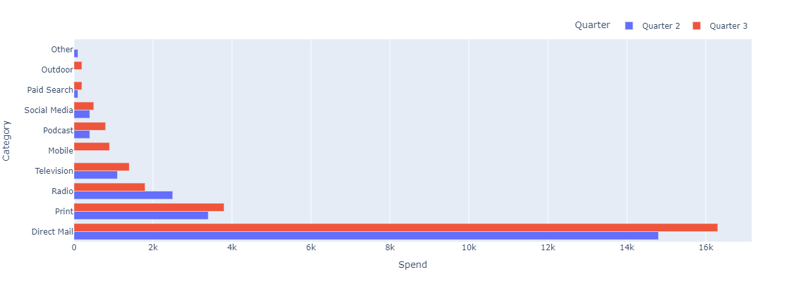
Pairwise Horizontal Bars
From the following chart we can have a side by side comparison between the spendings of the two quarters. However, we cannot determine the percentage of the change between the two quarters.

Slide 16
4.
Step 3 Solution
The most effective chart to communicate the data

Slide 17
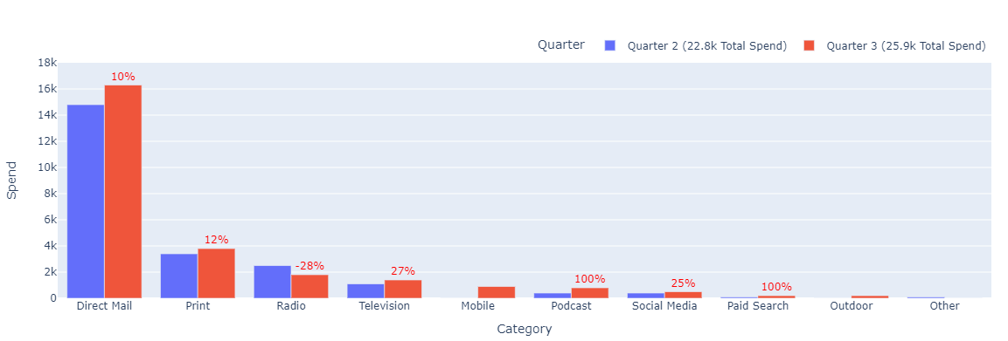
Pairwise Vertical Bars
I have chosen the following chart to be the most effective way of communicating the data because the spendings of each quarter and of each category can be compared side by side with a percentage value that indicates the changes between the two quarters.

