Slide 1
Introduction
Presentation on Solution for Technical Challenge
Presenter: Mr.NayLA

Slide 2
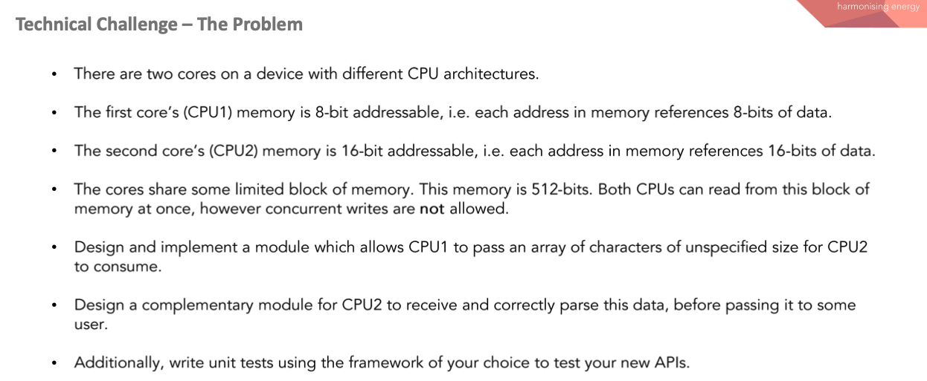
Problem statement

Slide 3
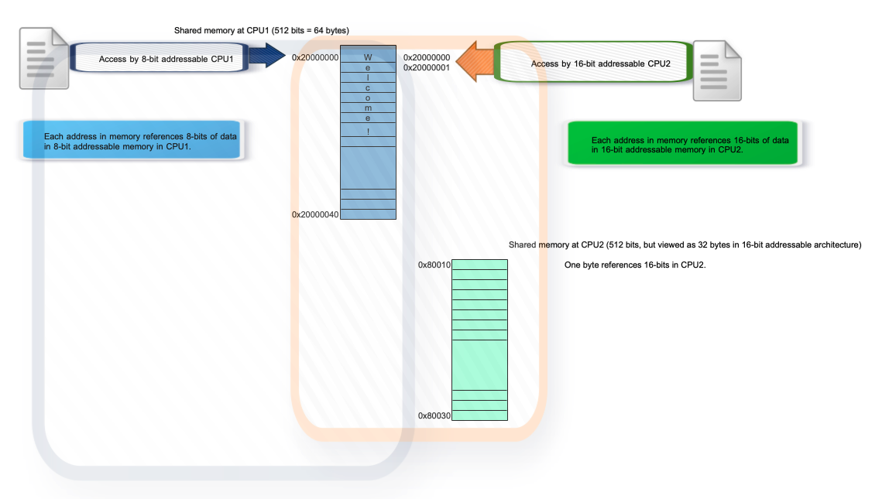
8-bit addressable memory access in CPU1 vs 16-bit addressable memory access in CPU2
In 8-bit addressable CPU, each address in memory references 8-bits of data.
In 16-bit addressable CPU, each address in memory references 16-bits of data.

Slide 4
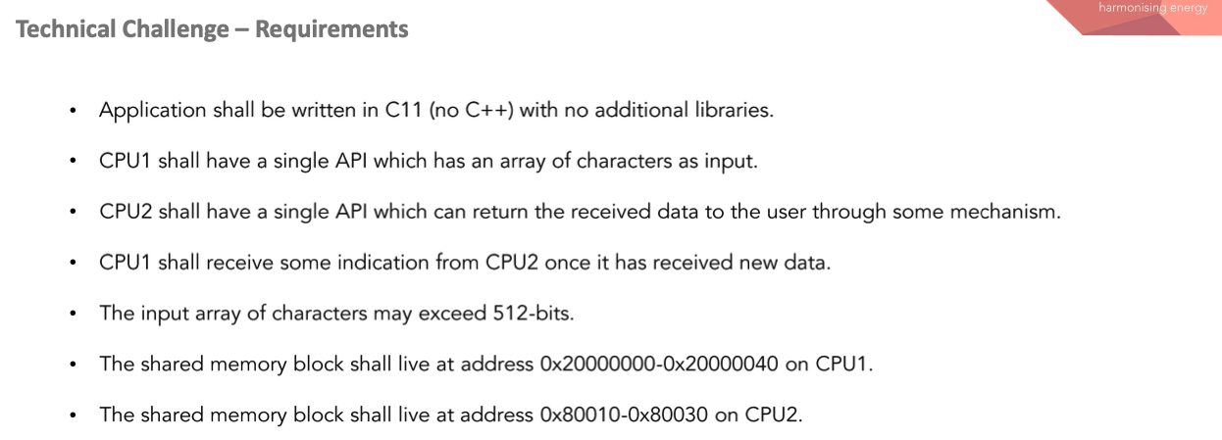
Module Requirements:

Slide 5
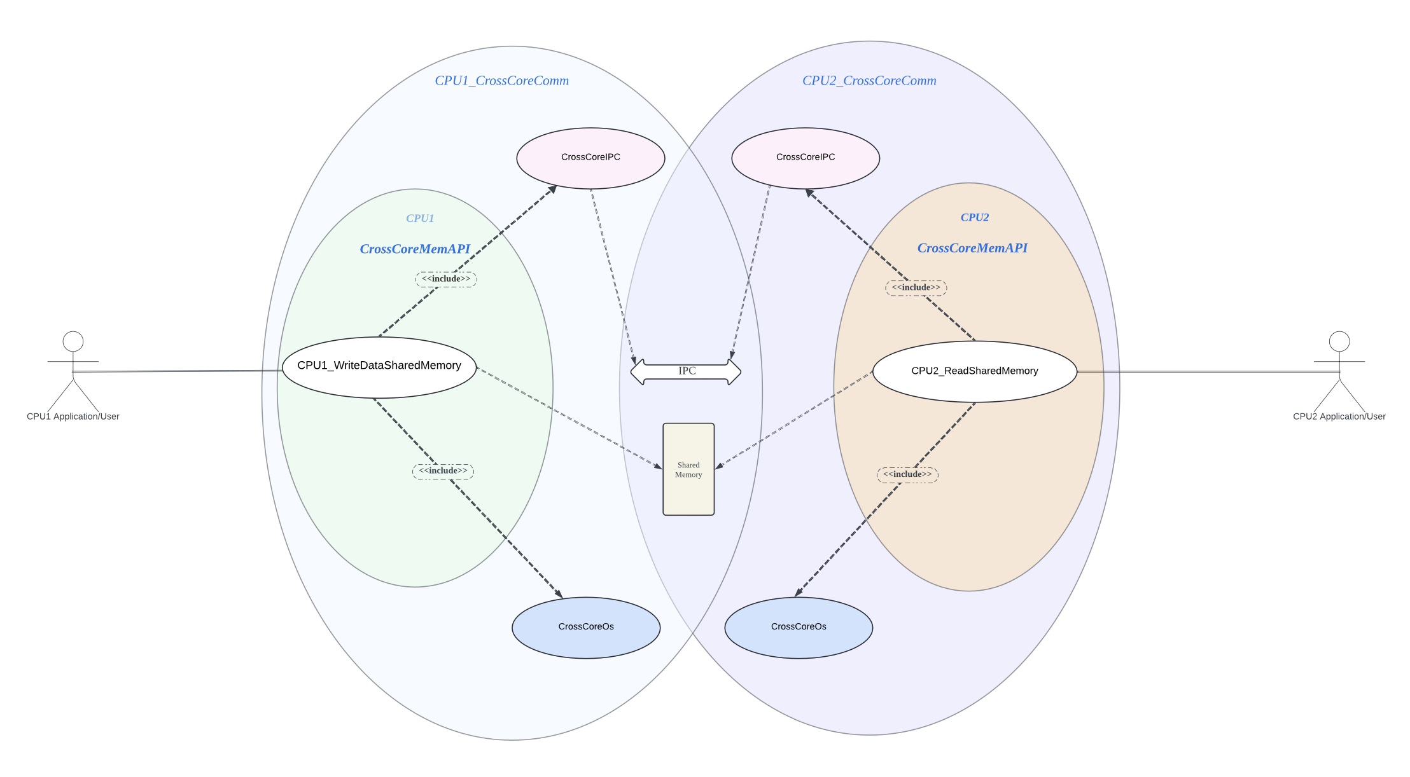
Use Case Diagram for CrossCoreComm Module:

Slide 6
Linker sections for shared memories:
It is assumed that corresponding linker sections have been defined for the specified shared memory addresses,(0x20000000 ~ 0x20000040) and (0x80010 ~ 0x80030) for corresponding cores, and these memories should have been initialised.

Slide 7
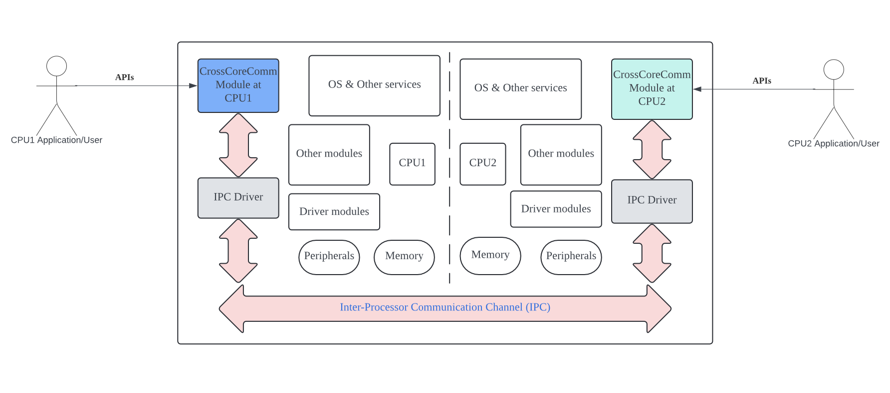
IPC (Inter-processor Communication)
Since it is a dual-core system, it is assumed that there is a hardware peripheral feature to be used for inter-processor communication(IPC) and synchronisation between the two CPUs.
But we still need to take care of the data addressing format which is different between the two cores (8-bit vs 16-bit addressable architecture).
The below picture illustrates general concept of IPC hardware layer and it is planned to use for the implementation.

Slide 8
General usage of IPC in multi-core environment:
Synchronisation between CPUs on access of shared resources
Mutual exclusion
Data passing between CPUs

Slide 9
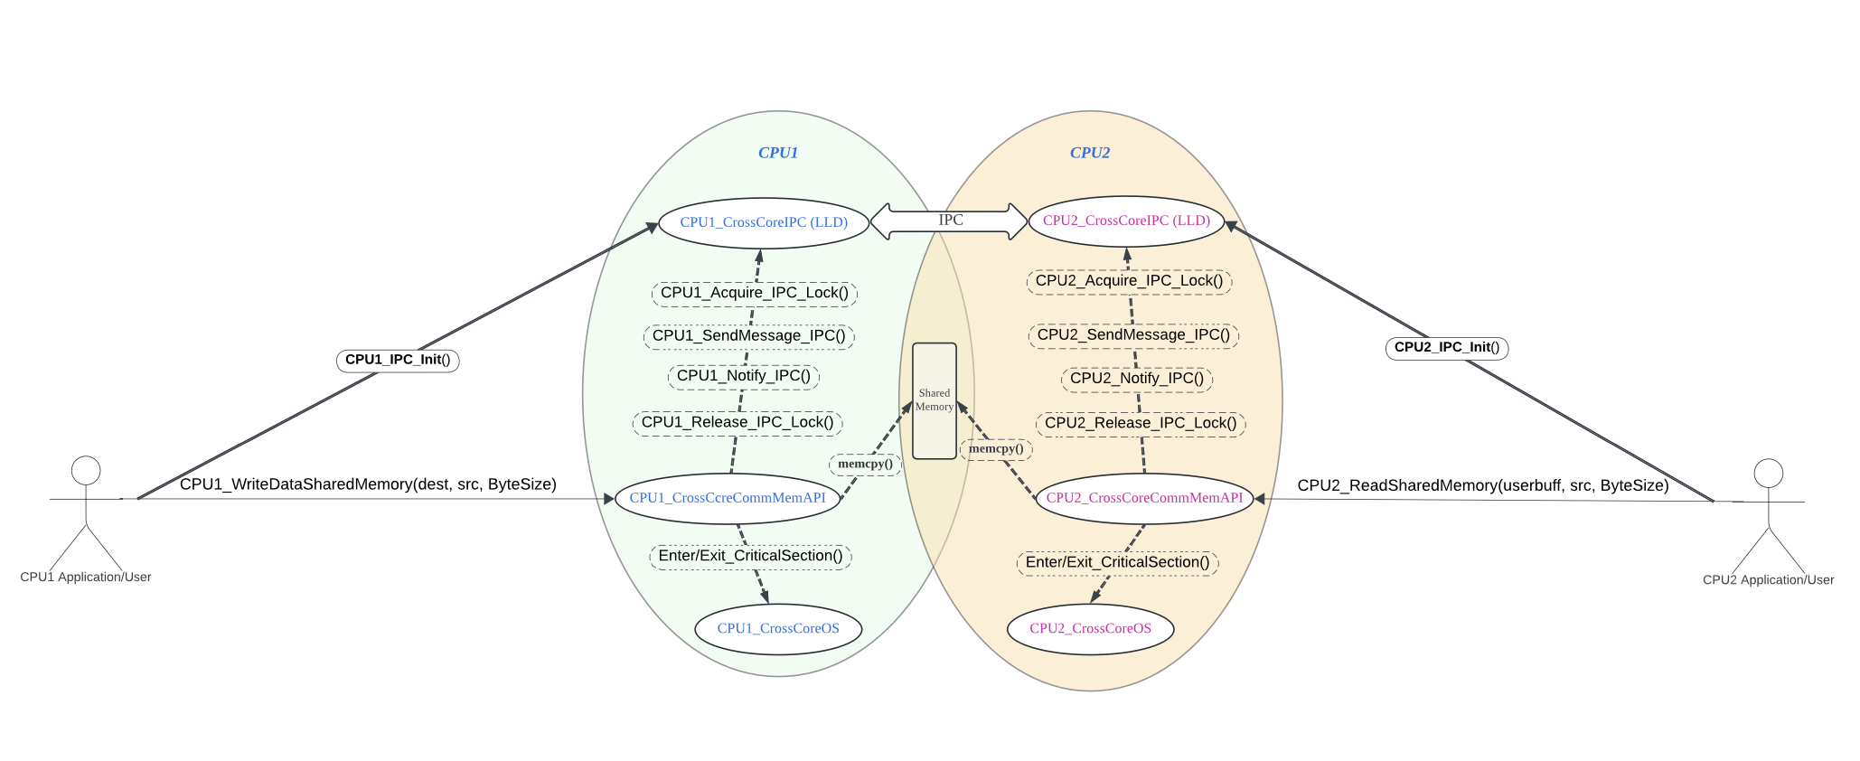
Design Concept of the Module

Slide 10
APIs
The below API is implemented in CPU1:
Include the header file “CPU1_CrossCoreMemAPI.h” in the CPU1's application system.
Write API for CPU1(8-bit addressable):
uint8_t CPU1_WriteDataSharedMemory(char *dest, char *src, uint32_t ByteSize);
The below API is implemented in CPU2:
Include the header file “CPU2_CrossCoreMemAPI.h” in the CPU2's application system.
Read API for CPU2(16-bit addressable):
uint16_t CPU2_ReadSharedMemory(char *userbuff, char *src, uint32_t ByteSize);

Slide 11
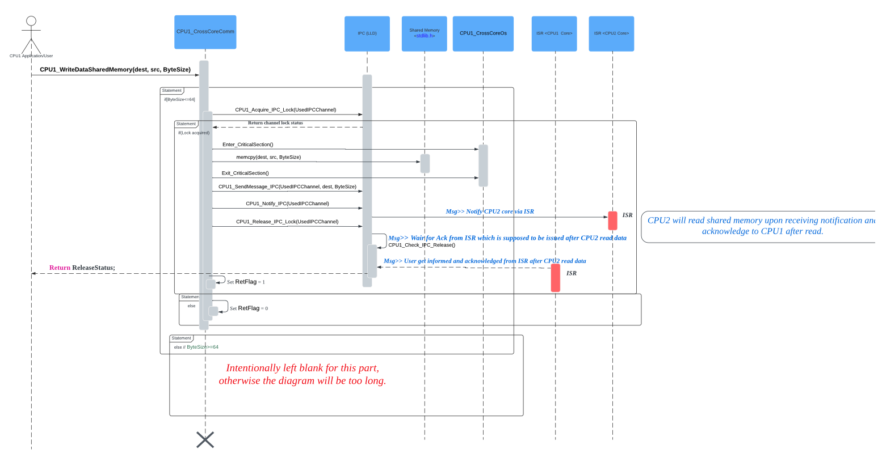
Sequence Diagram for Write API from CPU1

Slide 12
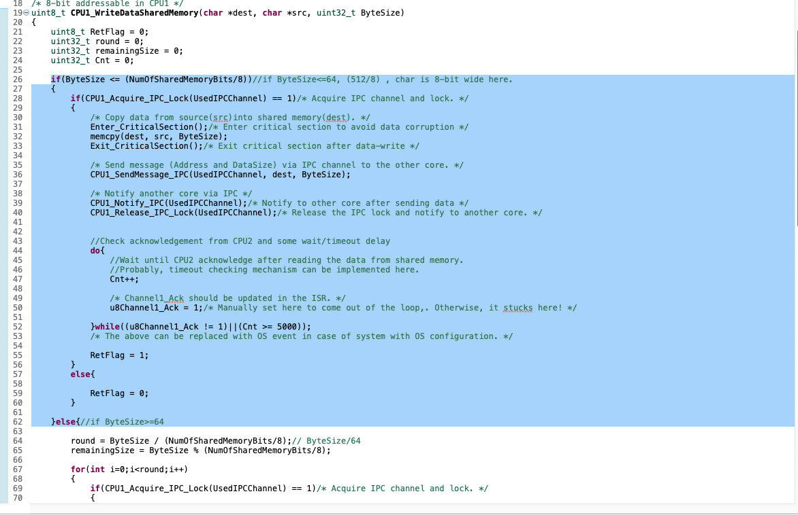
Write API Code:

Slide 13
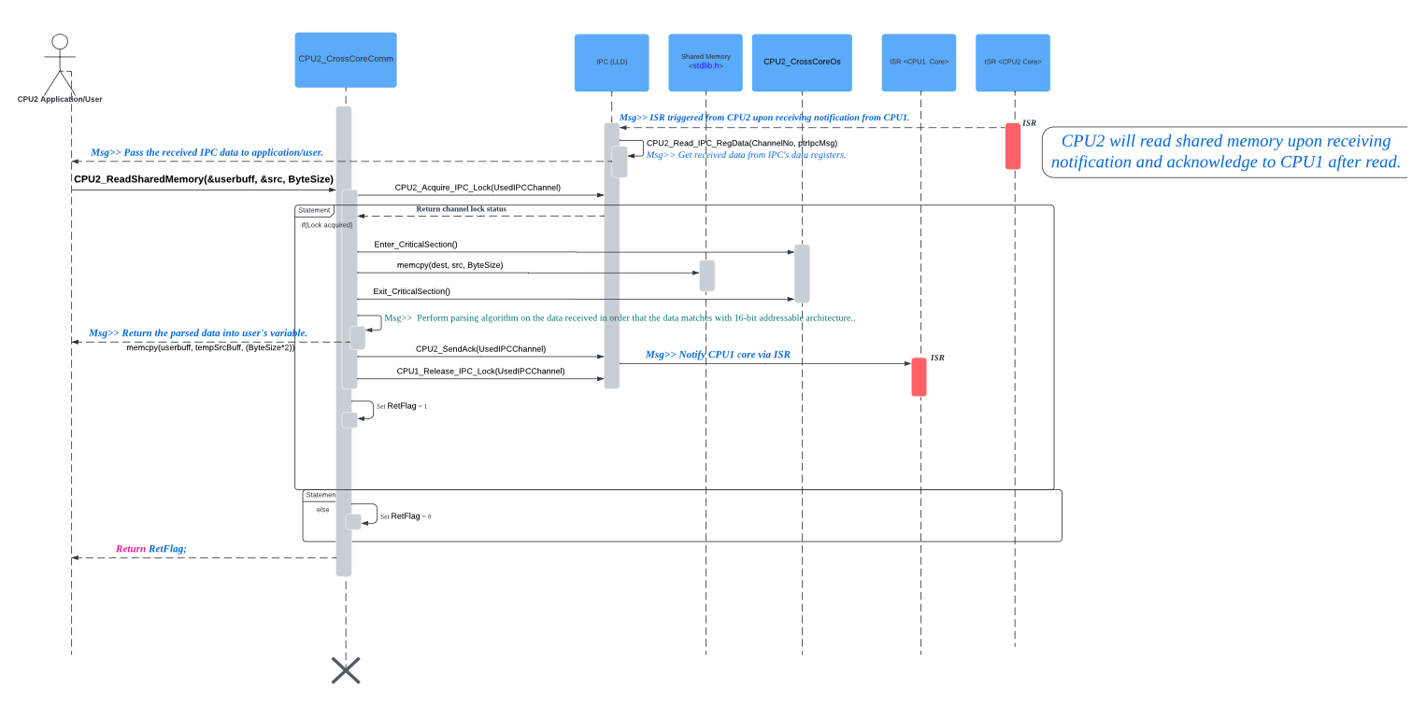
Sequence Diagram for Read API:

Slide 14
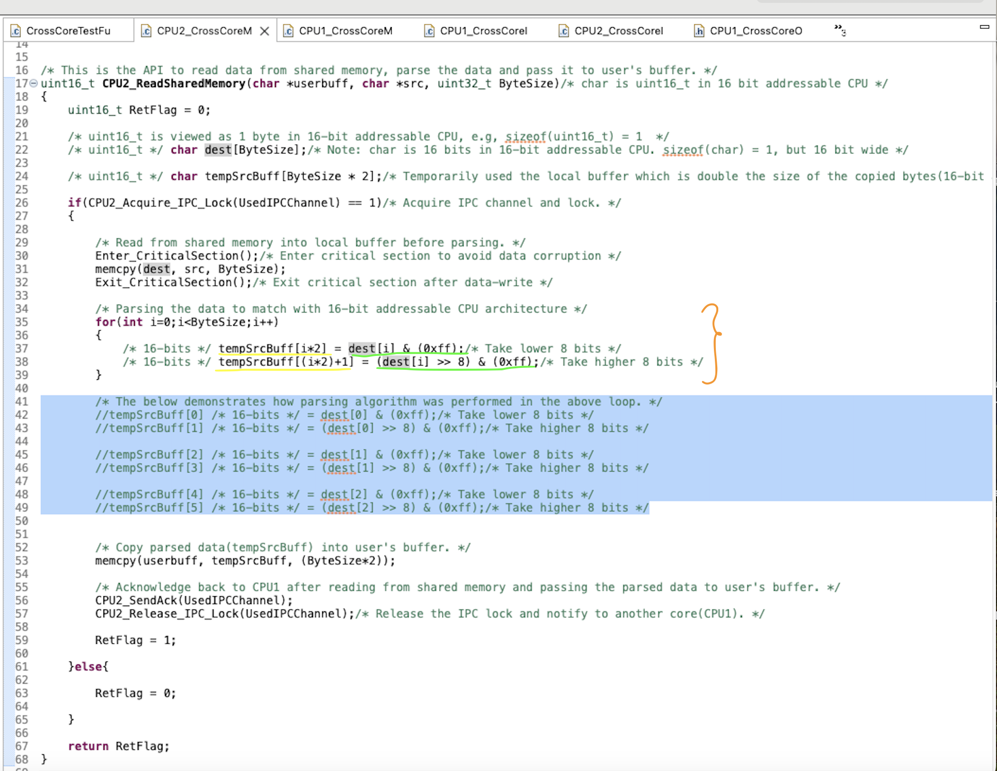
Descriptions about the Code Implementation for parsing algorithm:

Slide 15
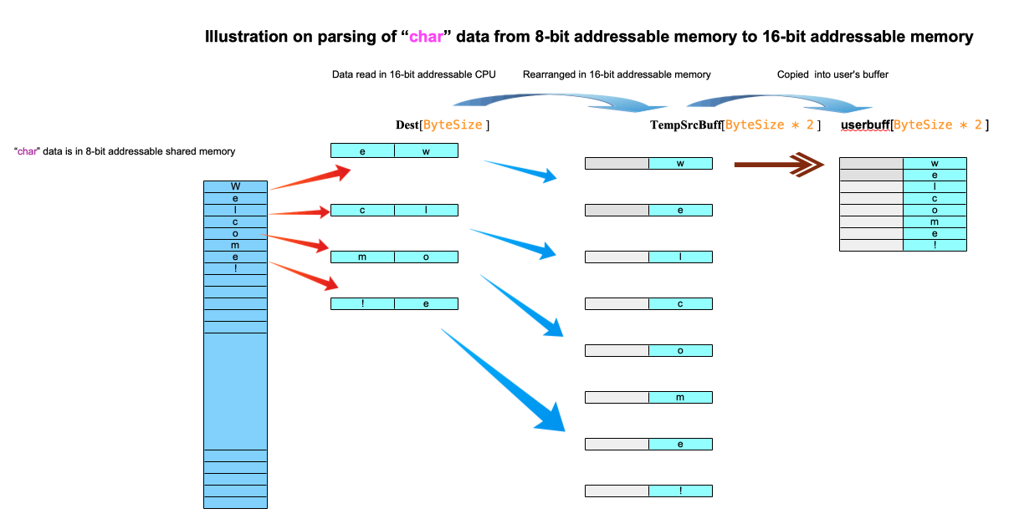
Illustration of parsing algorithm

Slide 16
Git Repo
GitHub link for the Repos:
Module:
https://github.com/MrNayLA/TechnicalChallenge/tree/main
Commit hash: a2cedbb4aac28d67020ee90766f6d245dd0e8ce2
/******************************************************/
Unit Test Frame:
https://github.com/MrNayLA/TechnicalChallenge/tree/pt/Testframe
Commit hash: 6f18dc5ad135cd70b278b56c3fd513fc70f9897c

Slide 17
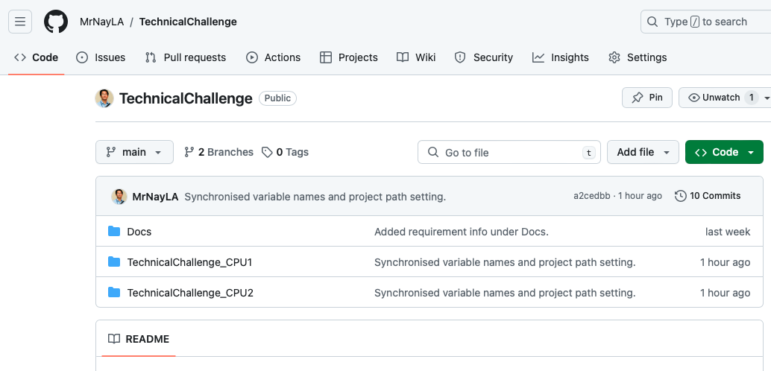
Screen Shot of GitHub Repo main branch for the modules for two different cores:

Slide 18
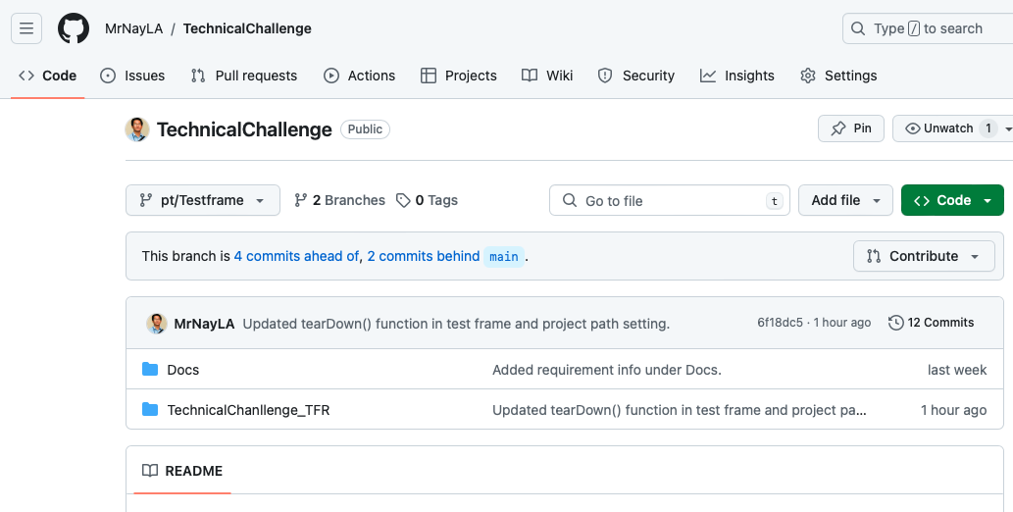
Test Frame Branch:
Used “unity” test framework for Unit Testing(module test).

Slide 19
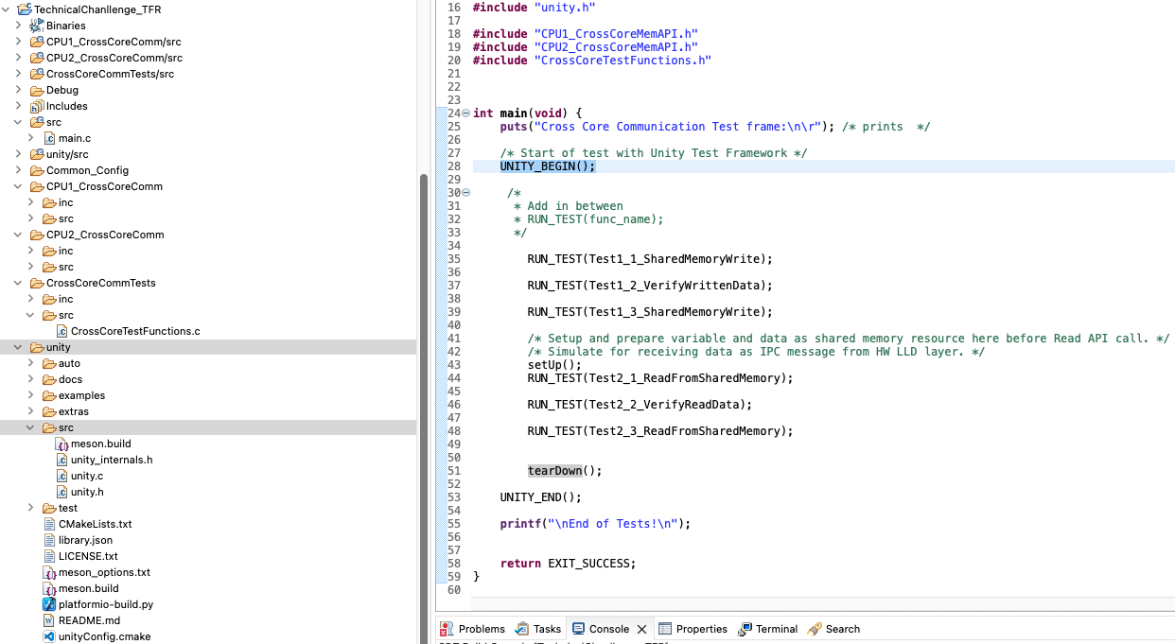
“unity” testing framework.

Slide 20
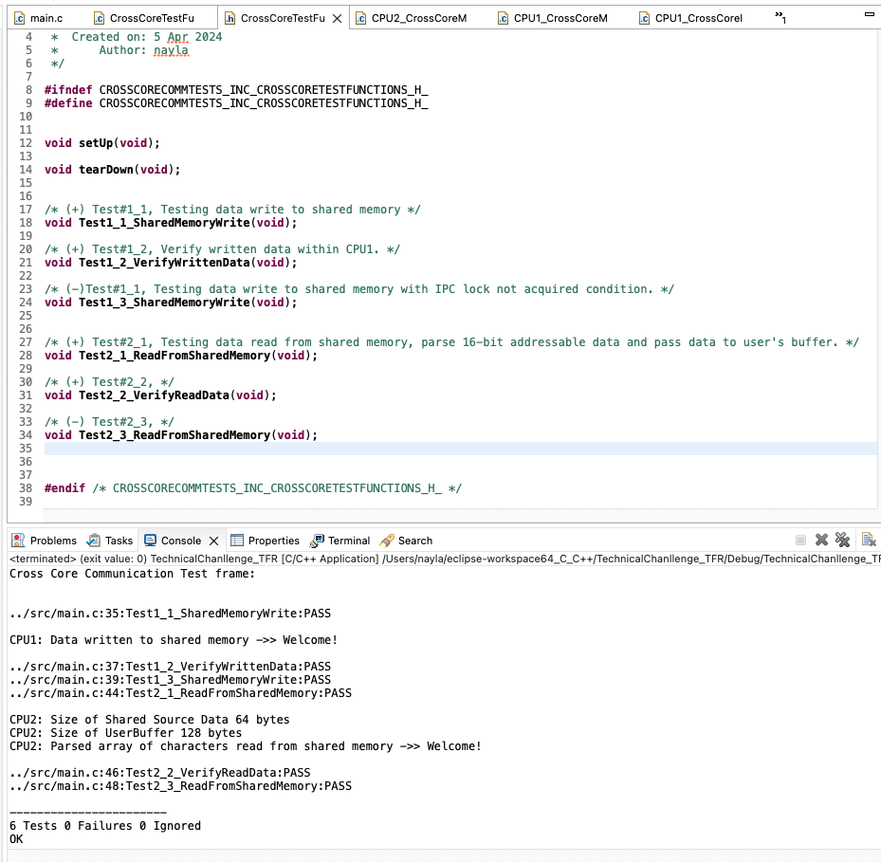
Test functions and prototypes are in “CrossCoreTestFunction.c” and “CrossCoreTestFunction.h”

Slide 21
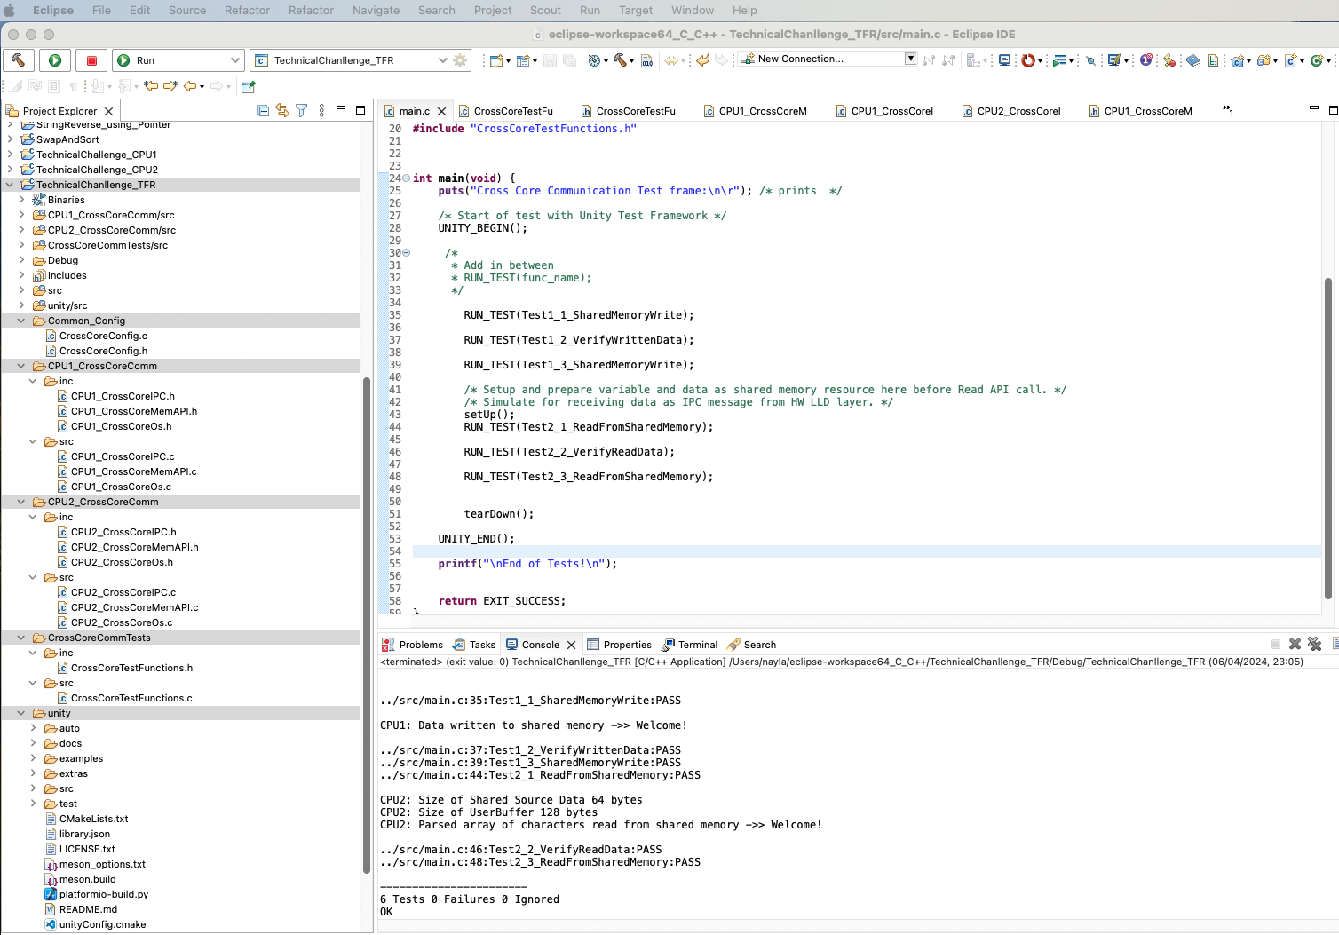

Test Results

Slide 22
Reference
App Note from TI - SPRAD88A – MARCH 2023 – REVISED APRIL 2023
“Migrating Software From 8-Bit (Byte) Addressable CPU’s to C28x CPU”
https://www.ti.com/lit/an/sprad88a/sprad88a.pdf?ts=1712588580507&ref_url=https%253A%252F%252Fwww.google.com.sg%252F

Slide 23
End of Presentation
      Thank you.

