Slide 1



sales_insights
View in Power BI
Last data refresh:
3/21/2024 12:56:14 PM UTC
Downloaded at:
3/21/2024 1:14:15 PM UTC

Slide 2
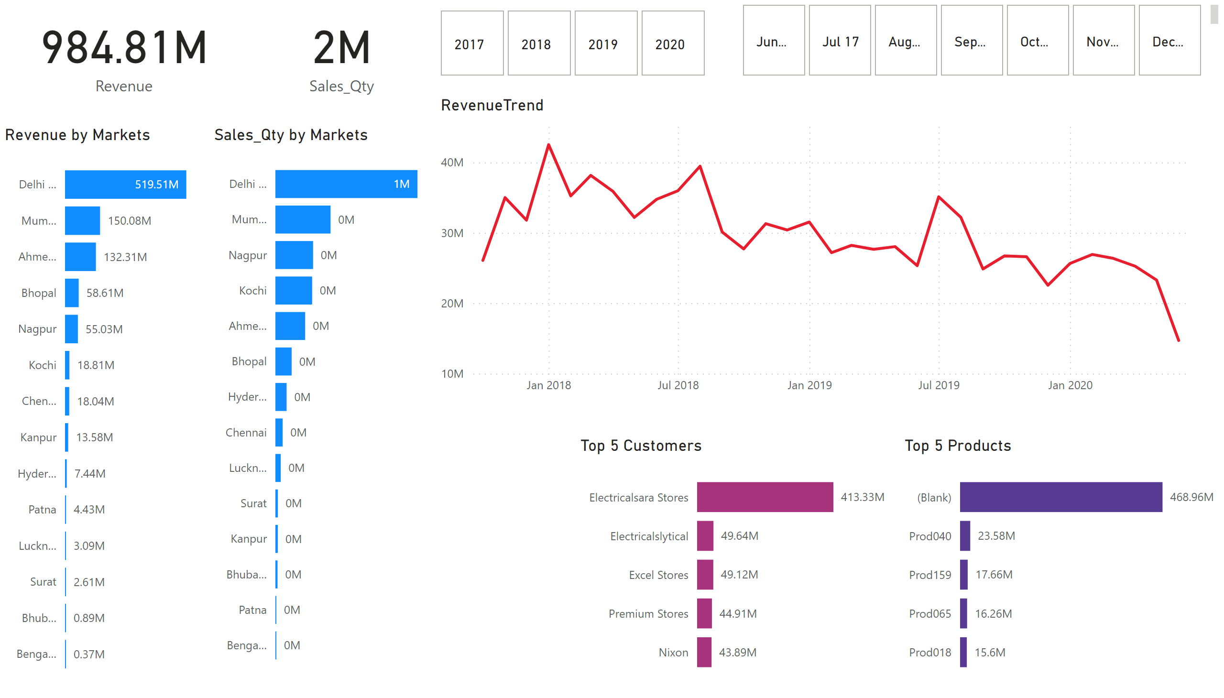
Page 1
Notes:
card
No alt text provided
card
No alt text provided
Revenue by Markets
No alt text provided
Sales_Qty by Markets
No alt text provided
advancedSlicerVisual
No alt text provided
advancedSlicerVisual
No alt text provided
Top 5 Customers
No alt text provided
Top 5 Products
No alt text provided
RevenueTrend
No alt text provided

