Slide 1
Digit Recognition using Neural Network
ADVANCED MACHINE LEARNING

Slide 2
Introduction about NN
How a NN can learn
Facing real world problem : handwritten-digit recognition
REFERENCE MATERIAL

Slide 3
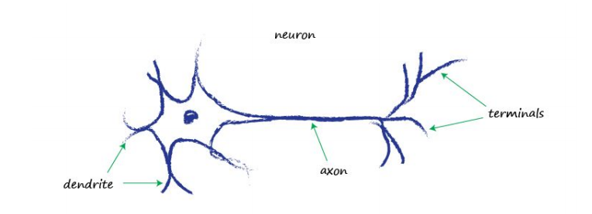
Introduction about nn

Slide 4
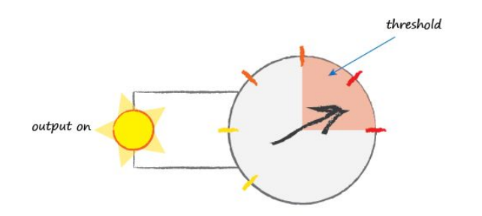
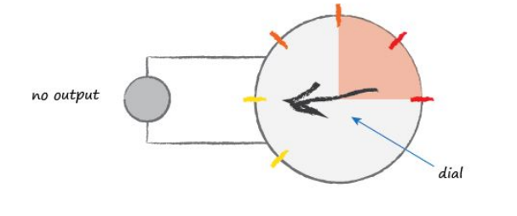
Introduction about nn

Slide 5
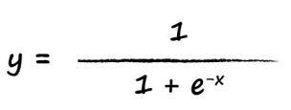
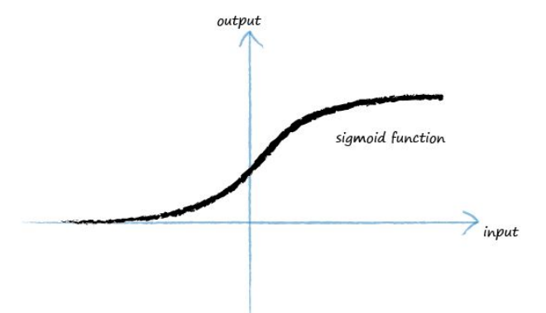
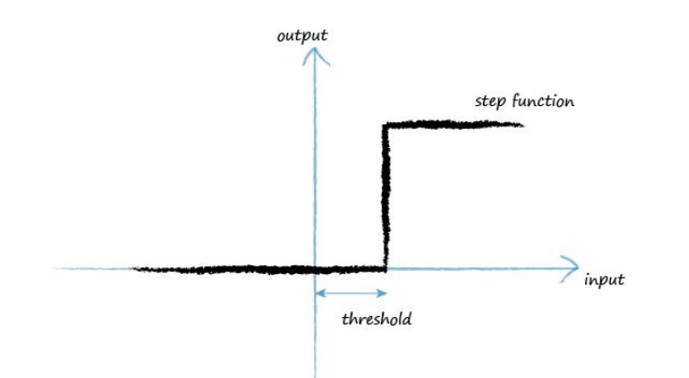
Introduction about nn

Slide 6
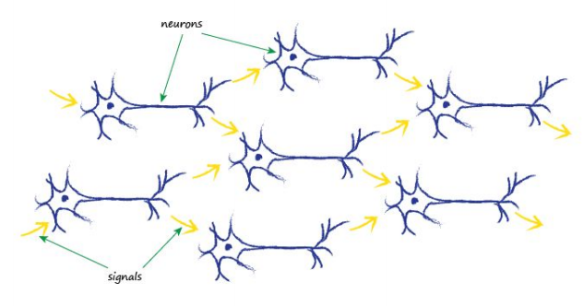
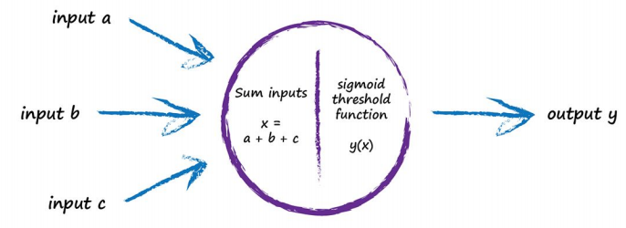
Introduction about nn

Slide 7
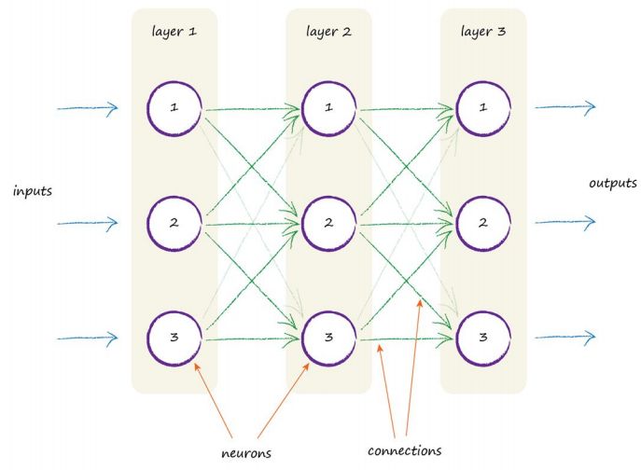
Introduction about nn

Slide 8
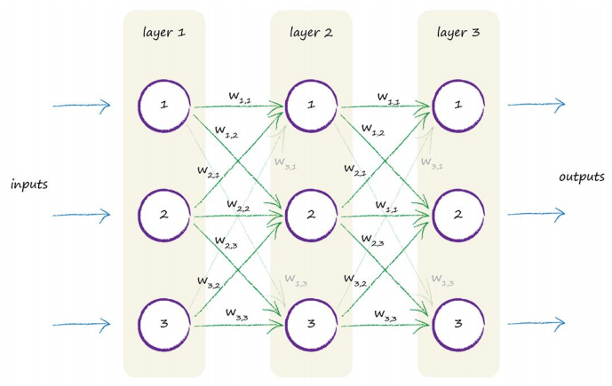
2. How a nn can learn

Slide 9
2. How a nn can learn
Take inputs, feed forward through the network, generate outputs.
From calculated outputs, compute the errors, and propagate the error backward into the network.
Update the NN base on the errors

Slide 10
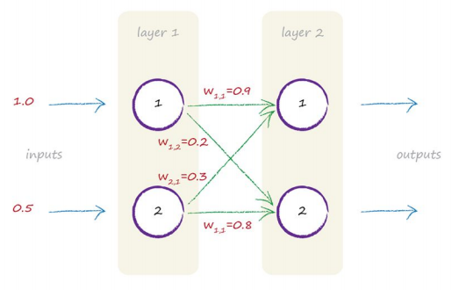
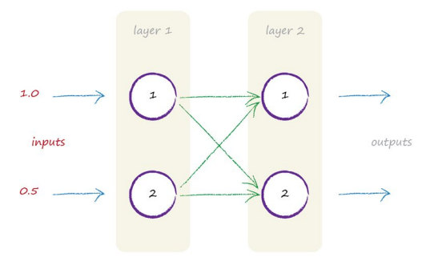

2. How a nn can learn
Take inputs, feed forward through the network, generate outputs.

Slide 11
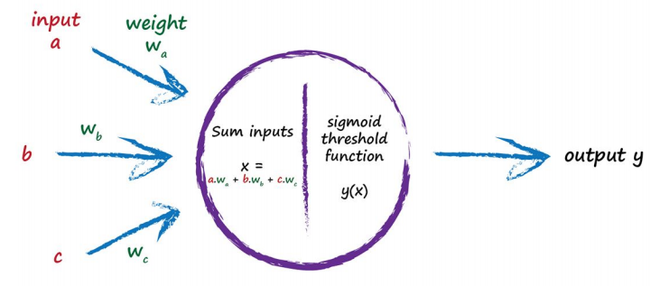
2. How a nn can learn
Take inputs, feed forward through the network, generate outputs.

Slide 12
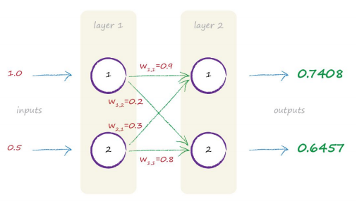
2. How a nn can learn
Take inputs, feed forward through the network, generate outputs.
i1 = 1.0 , i2 = 0.5
w11 = 0.9, w12 = 0.2
w21 = 0.3, w22 = 0.8
x1 = output of neuron 1 in layer 2
x2 = output of neuron 2 in layer 2
x1 = i1*w11 + i2*w21 = 1.05
x2 = i1*w12 + i2*w22 = 0.6
x1 => sigmoid(x1) => 0.7408
x2 => sigmoid(x2) => 0.6457

Slide 13
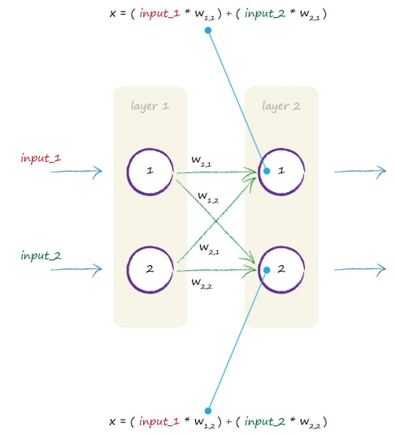
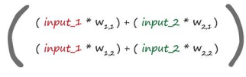
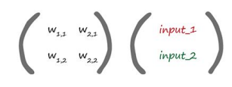
2. How a nn can learn
Take inputs, feed forward through the network, generate outputs.
=

Slide 14
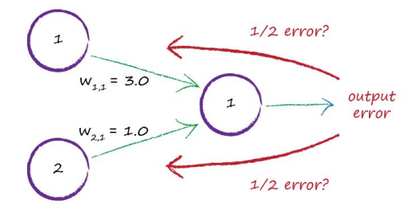
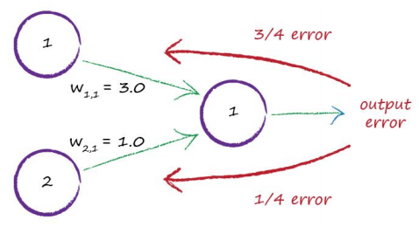
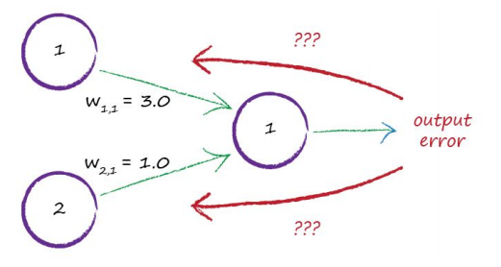
2. How a nn can learn
2. From calculated outputs, compute the errors, and propagate the error backward into the network.

Slide 15
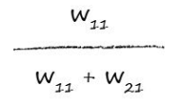
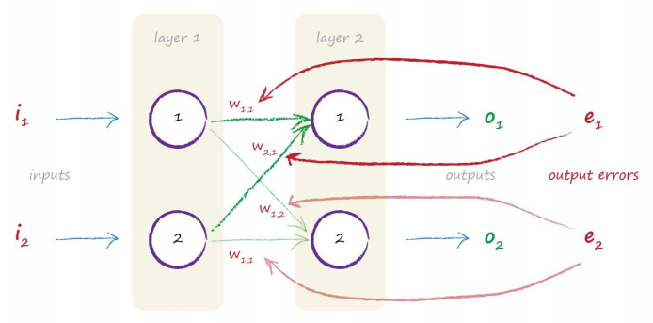
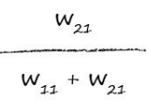
2. How a nn can learn
2. From calculated outputs, compute the errors, and propagate the error backward into the network.

Slide 16
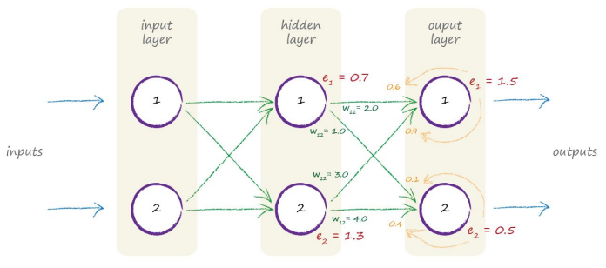
2. How a nn can learn
2. From calculated outputs, compute the errors, and propagate the error backward into the network.

Slide 17
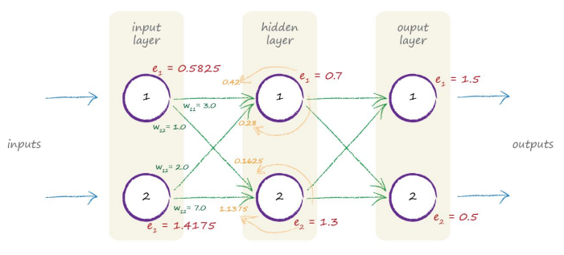
2. How a nn can learn
2. From calculated outputs, compute the errors, and propagate the error backward into the network.

Slide 18
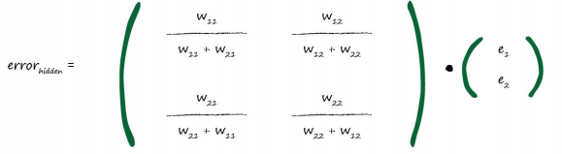
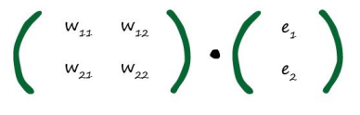
2. How a nn can learn
2. From calculated outputs, compute the errors, and propagate the error backward into the network.

Slide 19

2. How a nn can learn
2. From calculated outputs, compute the errors, and propagate the error backward into the network.

Slide 20
2. How a nn can learn
3. Update the NN base on the errors
DECADES
GRADIENT DESCENT

Slide 21


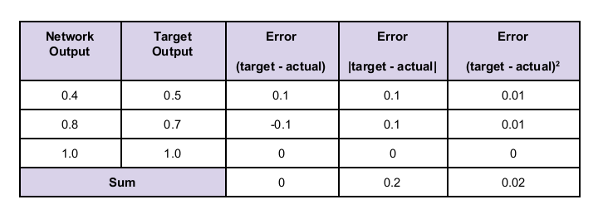
2. How a nn can learn
3. Update the NN base on the errors
=>

Slide 22
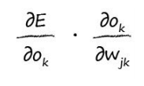



2. How a nn can learn
3. Update the NN base on the errors
=

Slide 23


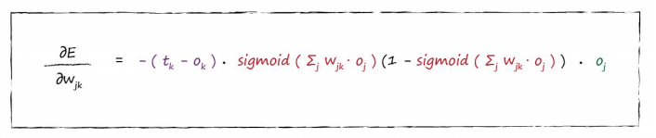
2. How a nn can learn
3. Update the NN base on the errors

Slide 24
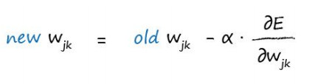
2. How a nn can learn
3. Update the NN base on the errors

Slide 25
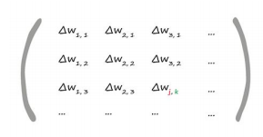
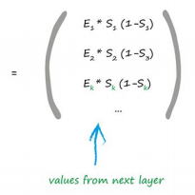
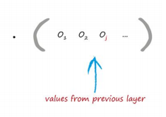
2. How a nn can learn
3. Update the NN base on the errors

Slide 26
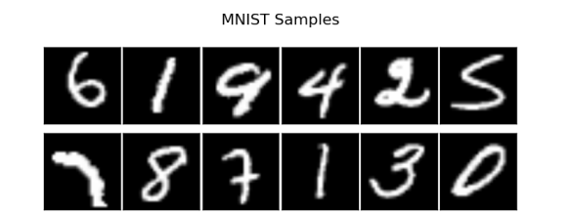
3. Facing real world problem : digit recognition
Data set: MNIST Data set
A training set: http://pjreddie.com/media/files/mnist_train.csv
A test set: http://pjreddie.com/media/files/mnist_test.csv
Training set: 60,000 labels
Test set: 10,000 labels

Slide 27
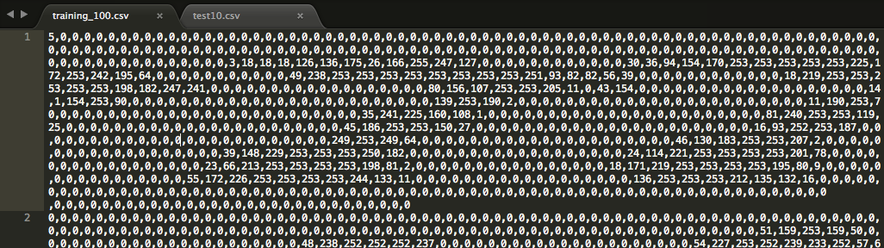
3. Facing real world problem : handwritten-digit recognition

Slide 28
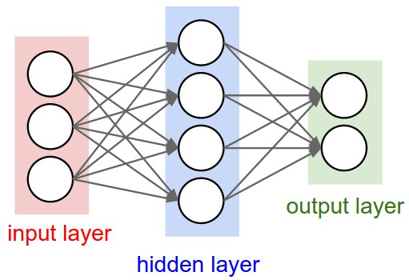
3. Facing real world problem : handwritten-digit recognition
100
synapses
10
synapses
784
synapses

Slide 29
3. Facing real world problem : handwritten-digit recognition
Draw Picture
Detect Number
Scale to 28x28
Convert from RGB to Grayscale
Convert from image to array

Slide 30
3. Facing real world problem : handwritten-digit recognition
Modify array to fit sigmoid function
NN
Output

Slide 31
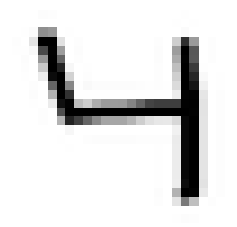
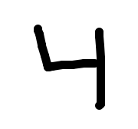
3. Facing real world problem : handwritten-digit recognition
Detect number
Resize 28x28

Slide 32
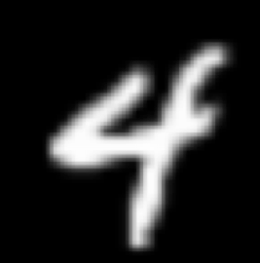
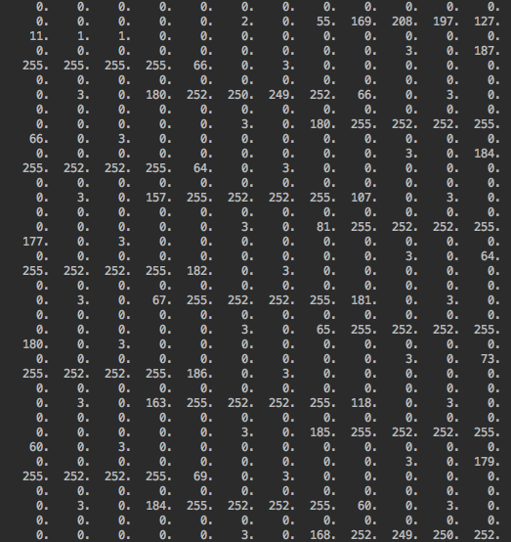
3. Facing real world problem : handwritten-digit recognition
Convert to
Grayscale
Convert to
Numpy Array

Slide 33
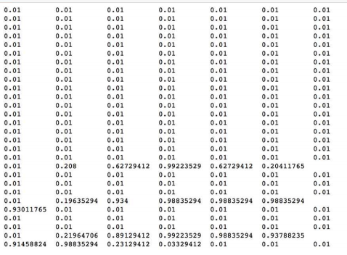
3. Facing real world problem : handwritten-digit recognition
Change to
fit sigmoid function

Slide 34
3. Facing real world problem : handwritten-digit recognition
Output

Slide 35
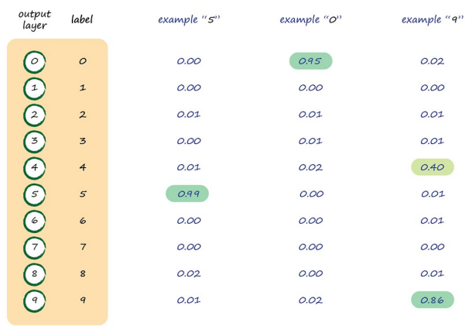
3. Facing real world problem : digit recognition

Slide 36
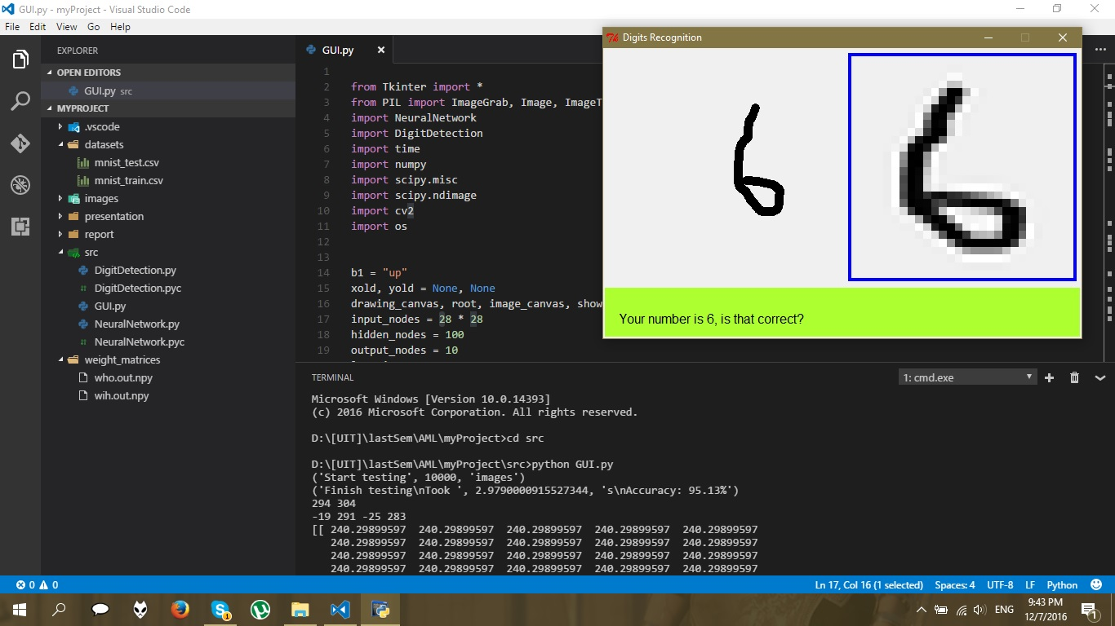
3. Facing real world problem : digit recognition

Slide 37
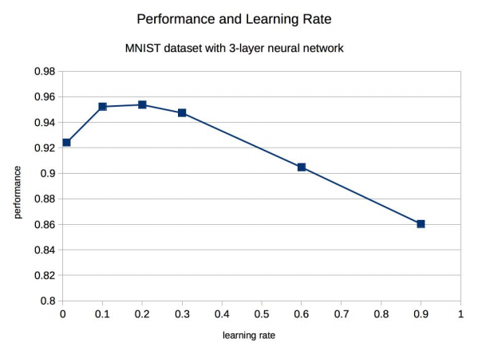
3. Facing real world problem : digit recognition

Slide 38
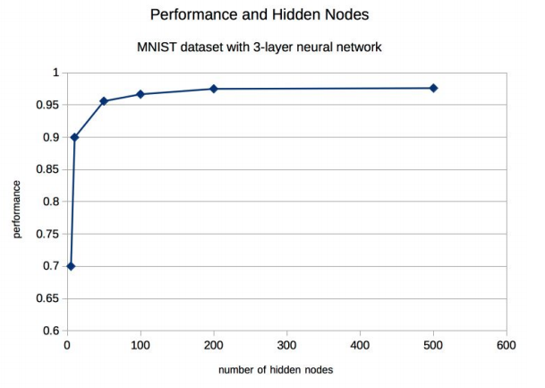
3. Facing real world problem : digit recognition

Slide 39
4. REFERENCE MATERIAL
Heaton-Introduction_to_Neural_Networks_with_Java - http://heatonresearch.com
Python Machine Learning - Sebastian Raschka
Make Your Own NeuralNetwork - Tariq Rashid
Introduction to the Math of Neural Networks – Jeff Heaton

