Slide 1
DigiPermit
Foreign-National Visa & Permit Compliance Monitoring DSOF300 / DVSF300 Major Project · DS3 × IS3 × IP2
June 2026 Mhle (22322987) — System Admin TV Manqele (22304993) — Employer HR SK Ngubane (22433510) — Foreign National S Dube (22322900) — Verification Officer KS Cebekhulu (22322695) — Immigration Officer O Luthuli (22325286) — Manager / Auditor SS Mathonsi (22339617) — University Officer NN Dlodlo (22325063) — Clinic Administrator Live: mrntuli.github.io/DPermit

Slide 2
Problem (As-Is)
Employers and institutions track permits in spreadsheets and email.
Expiry dates are missed → compliance and legal risk.
No real-time verification or audit trail at checkpoints.
Sensitive data shared without proper access control.
Academic note: DigiPermit monitors compliance — it does not issue official government visas.

Slide 3
Solution (To-Be)
Central database for permits, foreign nationals, and organisations.
Automated daily expiry job → notifications and alerts.
Multi-channel verification: manual, QR scan, RFID/IoT simulation.
Immutable verification_logs for every checkpoint check.
Role-based dashboards, in-app analytics, PDF reports, Power BI (IS3).

Slide 4
Eight user roles
Role | Purpose | Key action
System Administrator | Platform governance | Orgs, users, logs, analytics
Employer HR | Work-visa compliance | Register employees, capture permits
University Officer | Study-visa compliance | Monitor international students
Clinic Administrator | Healthcare records | Patient permit monitoring
Foreign National | Self-service | View permit, QR, renewal requests
Verification Officer | Checkpoint | Scan / verify, audit own scans
Immigration Officer | Simulated review | Validate pending permits
Manager / Auditor | Oversight | Read-only analytics & insights

Slide 5
System architecture (IP2 + IS3)
Presentation: Ionic Angular (TypeScript) — mobile-first government UI.
Business logic: Node.js + Express REST API (40+ endpoints).
Data: Supabase PostgreSQL + Supabase Auth (JWT).
Security: RBAC on routes, API middleware, row-level organisation scope.
Analytics: Chart.js dashboards, SQL views, Power BI connection.

Slide 6
IS3 design artefacts
BPMN 2.0 As-Is and To-Be process models (manual → automated expiry).
3NF ERD — 12 tables, foreign keys, analytics views.
IoT connectivity map — Packet Tracer + API simulation.
AI workflow — rule-based suspicious activity + executive insights API.

Slide 7
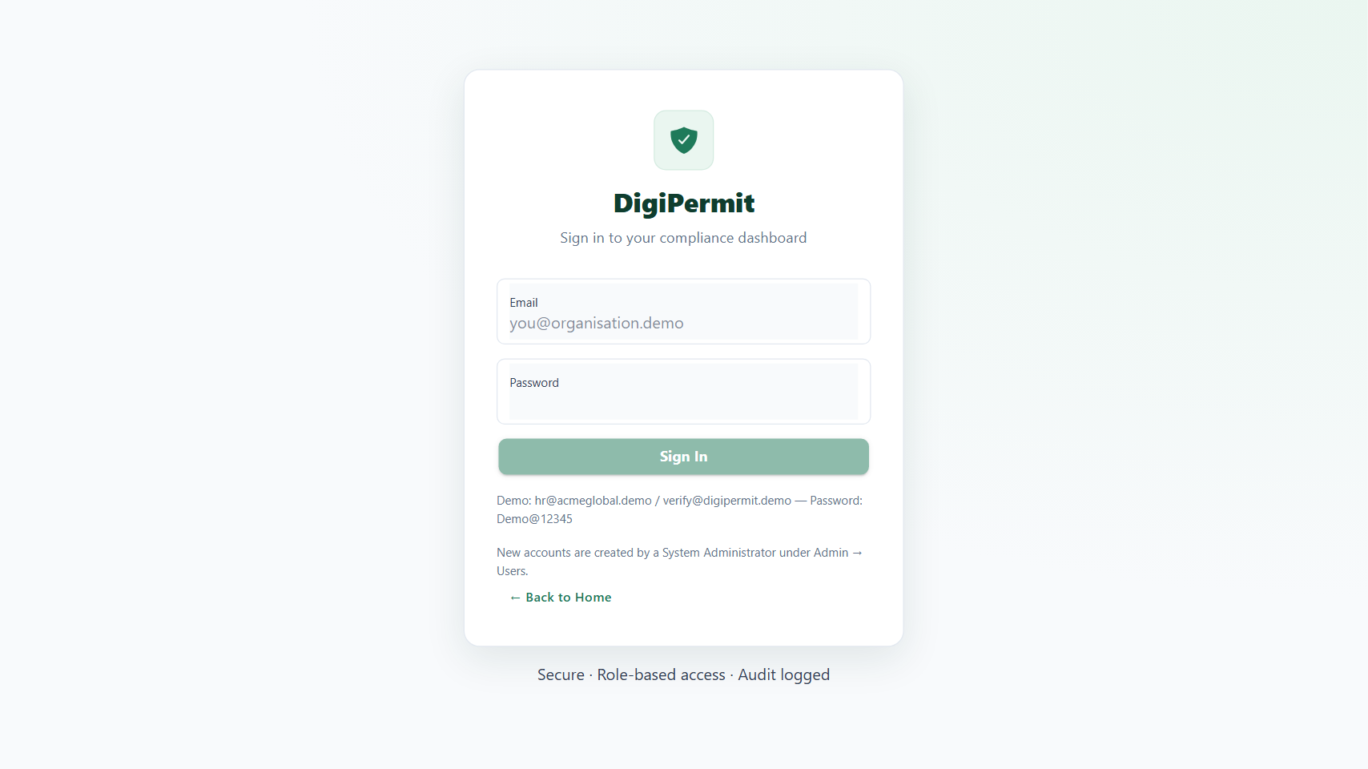
Login & secure access
JWT authentication via Supabase Auth — each user sees only authorised menus.
• Demo password for all users: Demo@12345

Slide 8
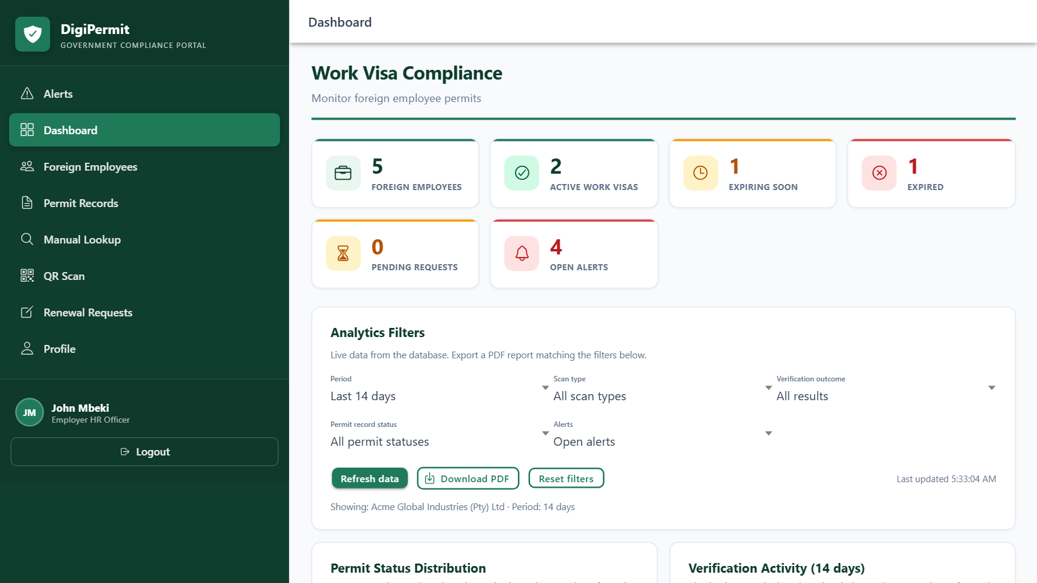
Employer HR — compliance dashboard
Organisation-scoped view: employees, permits, expiring visas, alerts.
• Registers foreign employees and captures work permits (UC-01).

Slide 9
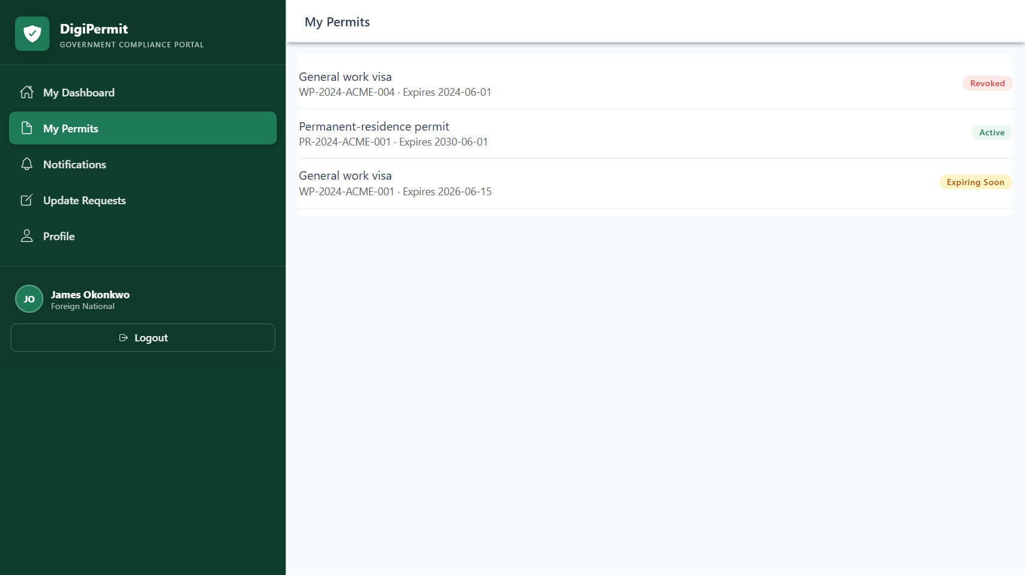
Foreign national — digital permit
Self-service: view own permits, QR code, notifications, renewal requests.
• Employee shows QR on phone; officer scans at checkpoint.

Slide 10
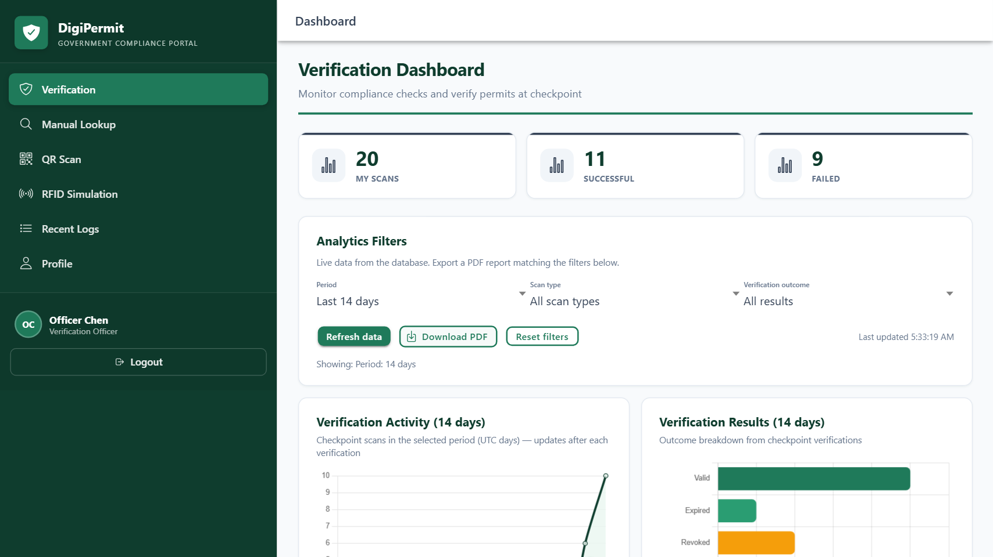
Verification officer — checkpoint dashboard
Live analytics filtered to officer's own scans; PDF export of current view.
• Separation of duties: admin governs platform; officers perform scans.

Slide 11
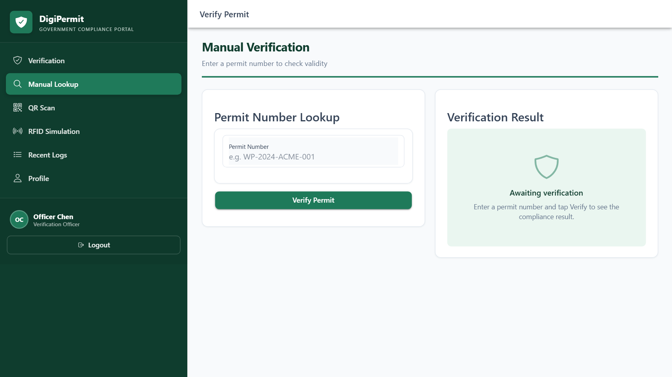
Manual & QR verification
Ten result states: Valid, Expiring soon, Expired, Revoked, Not found, etc.
• Try WP-2024-ACME-001 (valid) and WP-2023-ACME-003 (expired) in live demo.

Slide 12
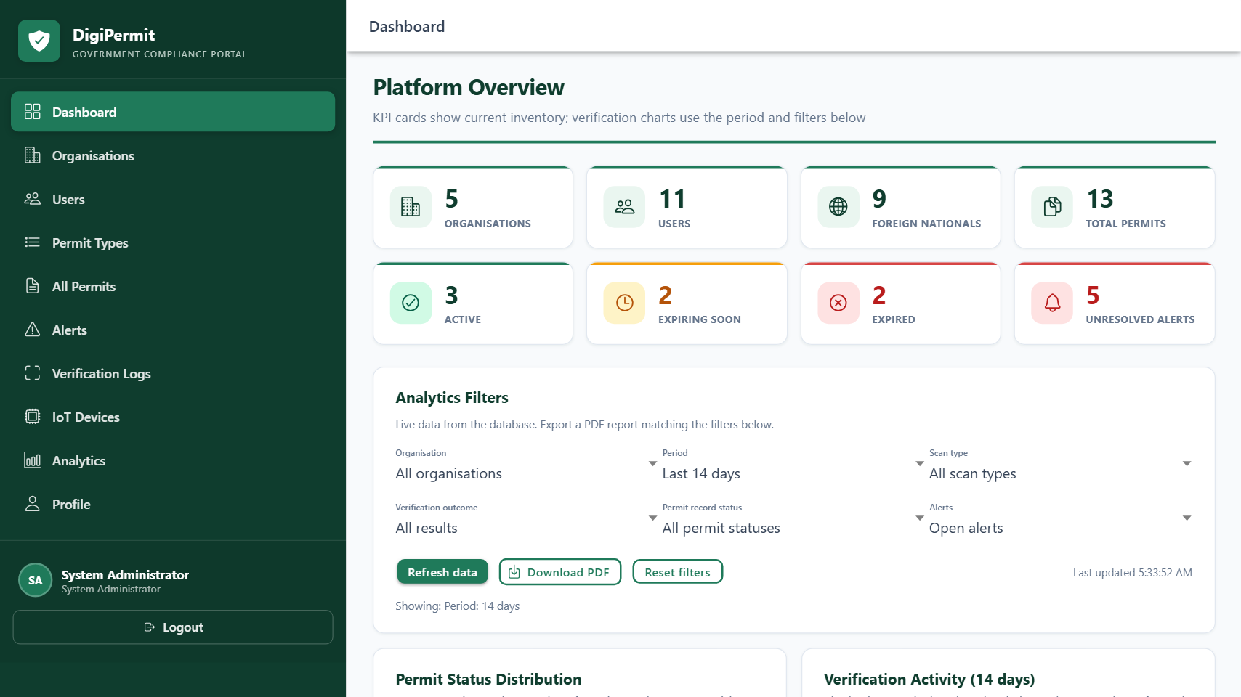
System administrator — platform overview
Cross-organisation statistics, verification logs, alerts, user management.
• Admin reviews audit trail — does not replace checkpoint verification role.

Slide 13
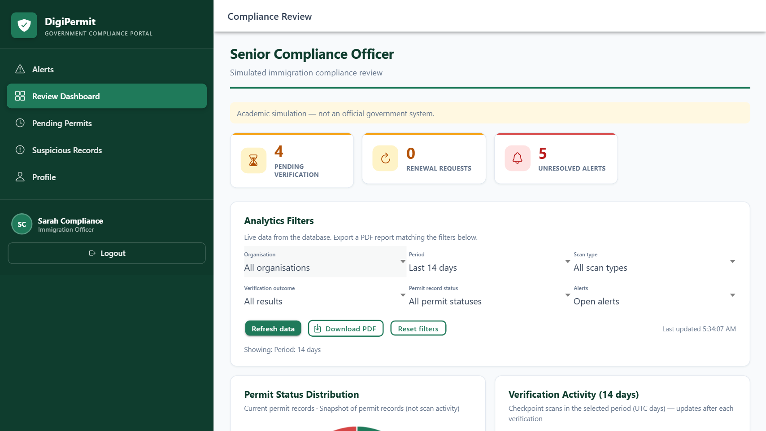
Immigration officer — simulated review
Validates pending permits; reviews suspicious activity and renewals.
• Academic simulation — not Department of Home Affairs.

Slide 14
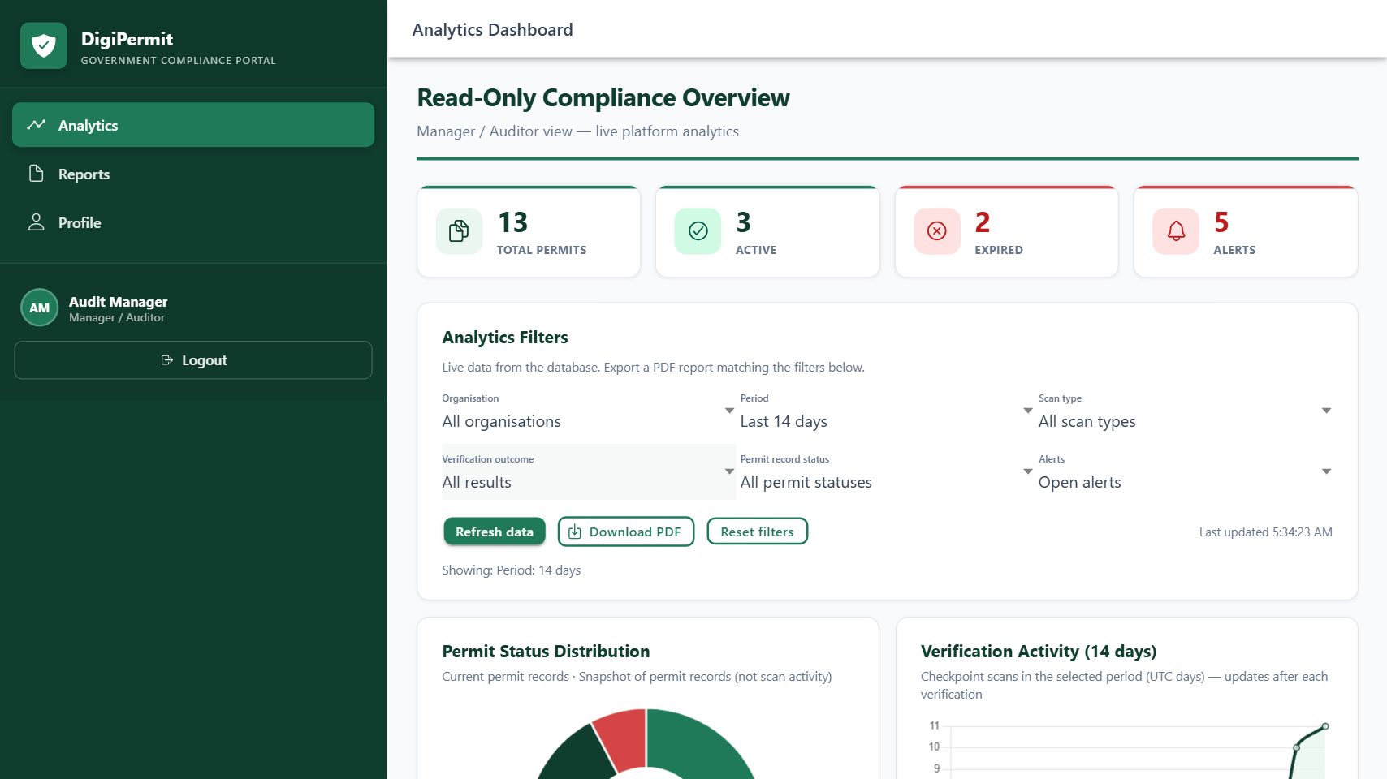
Manager / auditor — executive view
Read-only analytics and AI insight summary for compliance reporting.

Slide 15
IoT & RFID simulation (IS3)
Devices registered in platform (e.g. IOT-ACME-GATE-01).
RFID scan POSTs to /api/iot/simulate → verification_logs + iot_scan_events.
Cisco Packet Tracer topology documents network path (see lab guide).
Demonstrates live data feeding 3NF database — not offline spreadsheet.

Slide 16
Security & auditability
Role-based access control (8 roles) on frontend and API.
Verification logs are immutable; tied to officer and timestamp.
Passport masking on verification responses.
Organisation-scoped data for HR, university, clinic roles.

Slide 17
Power BI & reporting (IS3)
SQL views: vw_expiring_permits, verification trends, permit status.
Power BI Desktop connects to Supabase (live or CSV export).
In-app Download PDF report — role-specific, live data at export time.
See docs/power-bi/POWER-BI-LIVE-SUPABASE.md for setup steps.

Slide 18
Agile delivery (DS3)
Scrum over 4 sprints / 6 weeks.
Sprint 1: Database + API foundation.
Sprint 2: Verification, IoT, employer UI.
Sprint 3: All roles, analytics, AI insights.
Sprint 4: Testing, documentation, deployment, presentation.
GitHub: github.com/MrNtuli/DPermit

Slide 19
Live demo credentials
Role | Email | Password
System Admin | admin@digipermit.demo | Demo@12345
Employer HR | hr@acmeglobal.demo | Demo@12345
Foreign National | james.okonkwo@demo.mail | Demo@12345
Verification Officer | verify@digipermit.demo | Demo@12345
Immigration Officer | compliance@digipermit.demo | Demo@12345
Manager | audit@natcompliance.demo | Demo@12345

Slide 20
Speaker allocation (suggested)
Step | Speaker | Content
1–2 | TV Manqele | Problem, HR capture
3 | SK Ngubane + S Dube | QR show + scan (rehearse!)
4 | KS Cebekhulu | Immigration validate
5 | Mhle | Admin logs & analytics
6 | SS Mathonsi / NN Dlodlo | University & clinic
7 | O Luthuli | Manager insights
8 | Any member | Limitation statement + Q&A

Slide 21
Thank you
Questions?
DigiPermit — Government Compliance Portal (Academic Prototype)

