Slide 1
Datenbankmanagement – Teil 2
Anomalien in Netzwerksystemen

Slide 2
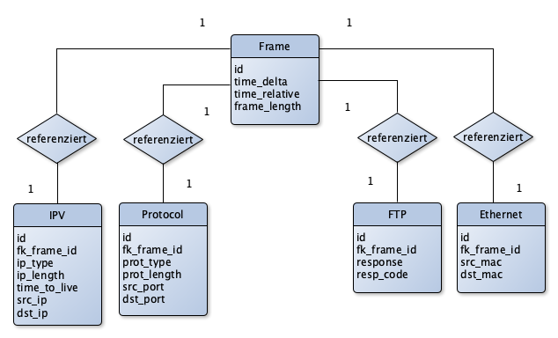
Entity-Relationship-Diagram

Slide 3
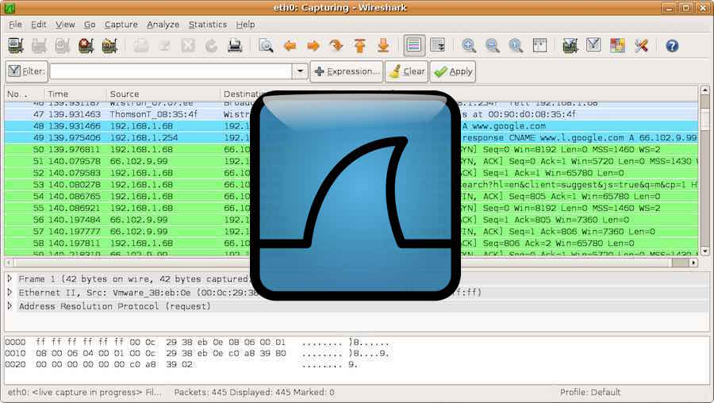
Wireshark
https://fossbytes.com/wireshark-2-0-5-released-world-most-popular-network-traffic-analyzer

