Slide 1
Browstory
MMAI Final Project
D99942025 蘇柏諺
B97901125 梁翔勝
Advisor: Winston Hsu

Slide 2
Outline
Motivation
Scenario
System
Algorithm
Demo

Slide 3
Motivation
Browse history

Slide 4
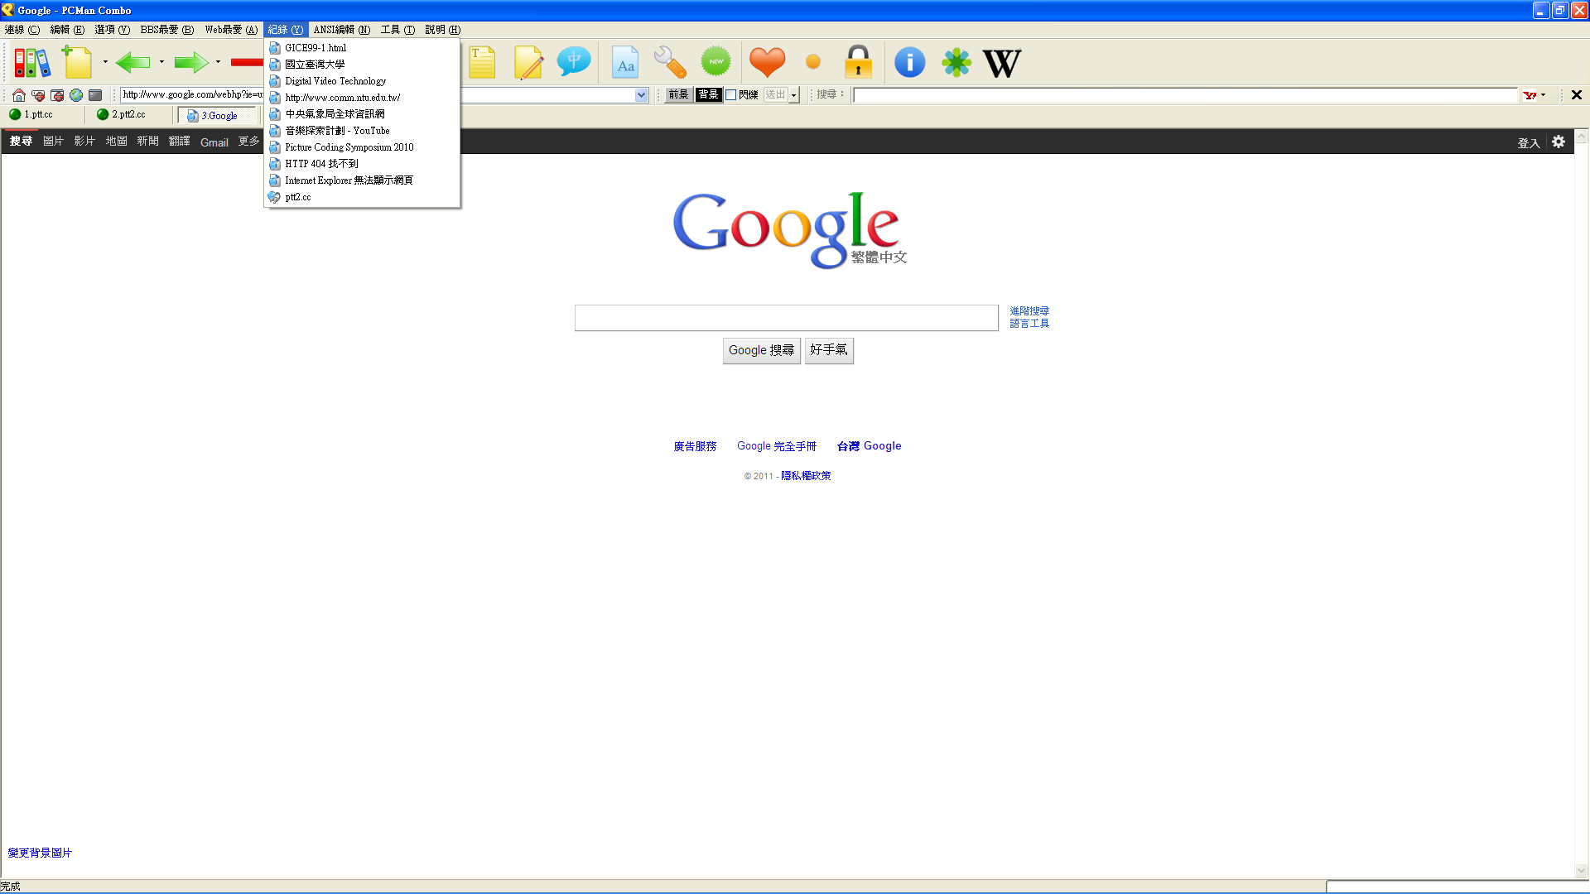
PCMan

Slide 5
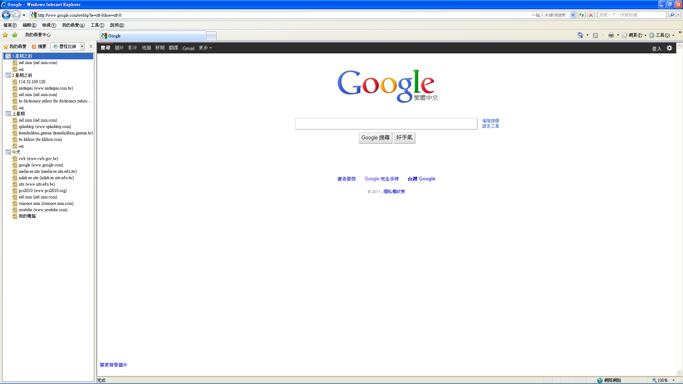
Windows Internet Explorer

Slide 6
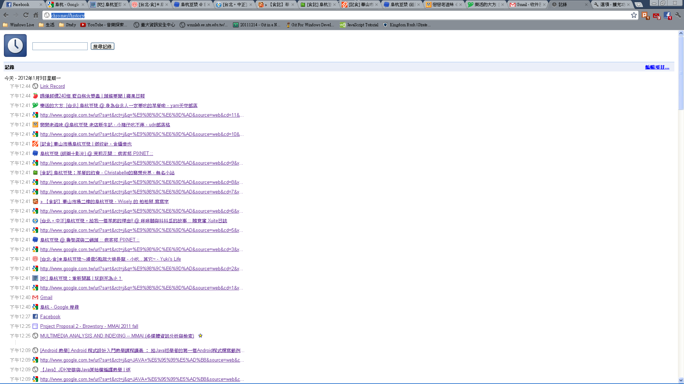
Google Chrome

Slide 7
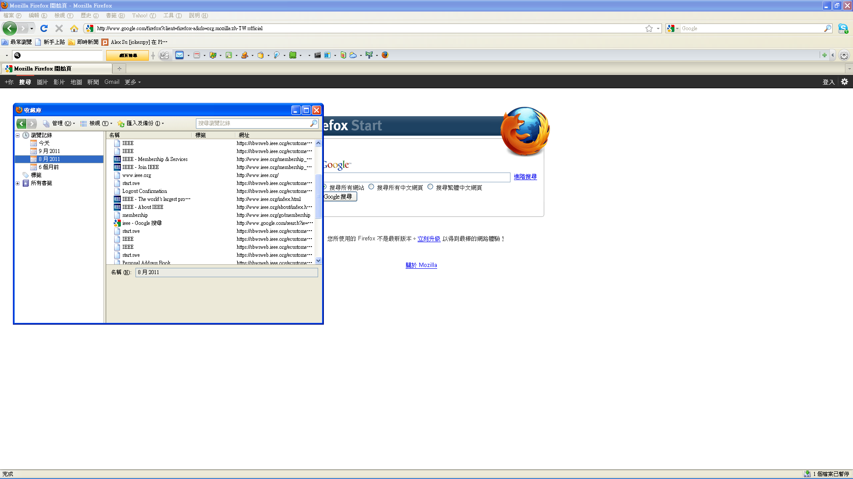
Mozilla Firefox

Slide 8
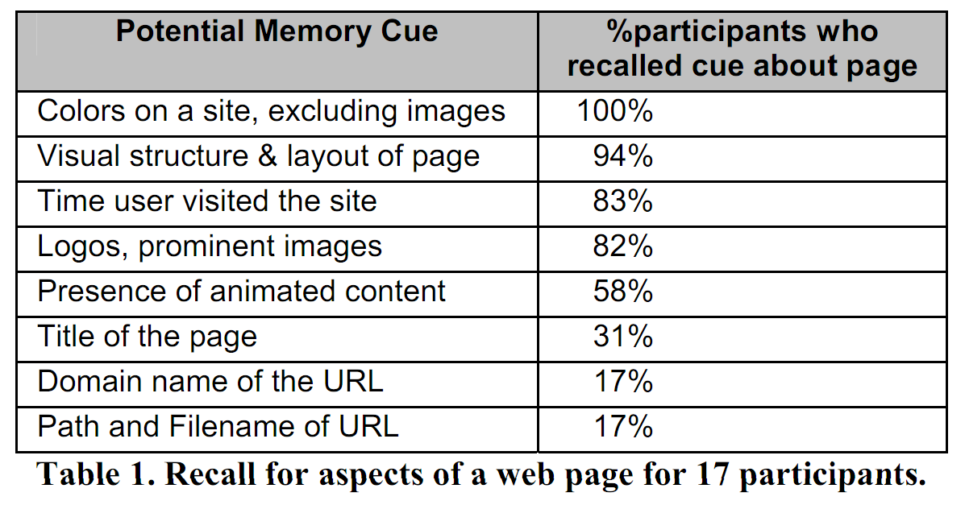
Motivation
Browse history
Sorted by browsing time
Search by keyword
Sungjoon Steve Won, Jing Jin, Jason I. Hong, “Contextual Web History: Using Visual and Contextual Cues to Improve Web Browser History,” CHI, 2009.

Slide 9
Motivation
Existing browse history searching methods are not intuitive enough
Design a browse history system applying multimedia indexing
Search by structure and color

Slide 10
Outline
Motivation
Scenario
System
Algorithm
Demo

Slide 11
Scenario
Jack wants to access a website that he browsed in the past.
First, he searches the history by the “KEYWORD”, which is the topic of the webpage, and he gets a lot of websites all related to the “KEYWORD”.
Second, he further specifies the STRUCTURE and COLOR of the website, and he gets the exact webpage he wants!

Slide 12
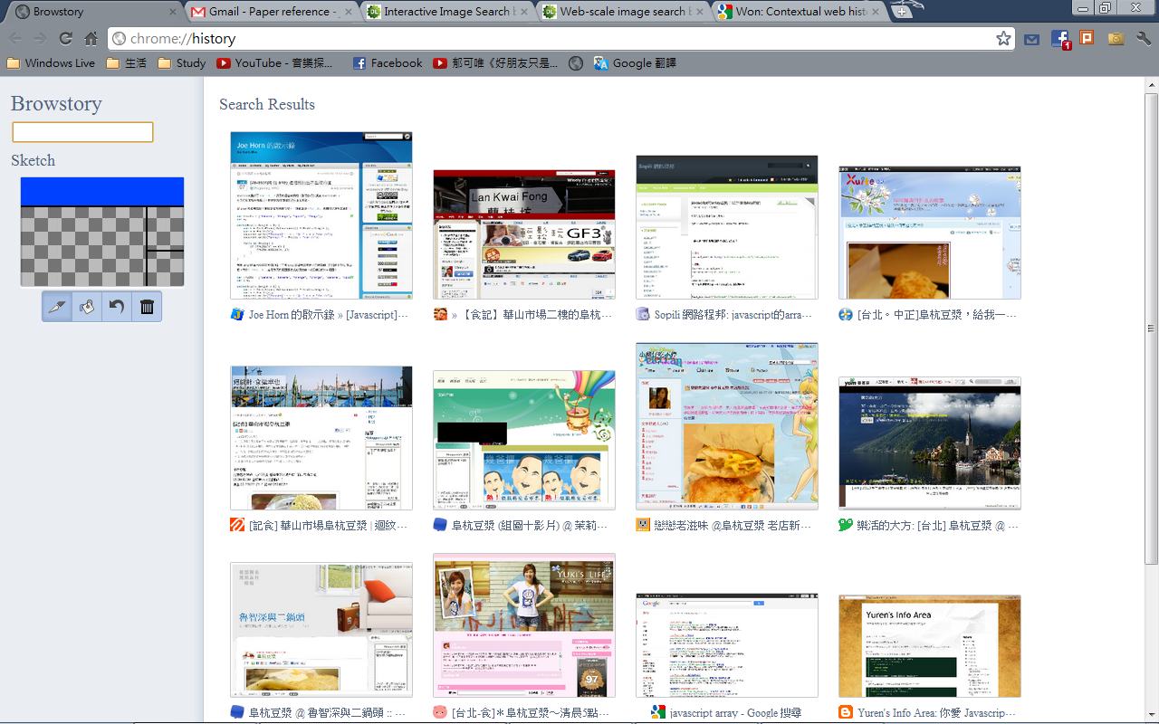
Scenario

Slide 13
Outline
Motivation
Scenario
System
Algorithm
Demo

Slide 14
System
Indexing
Retrieval
Browsed
Webpage
Database
Feature Matching
Text
content
Crop image
Color/Structure
feature
Keyword /Color /Structure Query
Retrieved Webpage
Color/Structure Feature Extraction

Slide 15
Outline
Motivation
Scenario
System
Algorithm
Demo

Slide 16
Algorithm
Save the crop image of the browsed webpage.
Segment the crop image into 3x3 blocks based on DOM information and image similarity.
Extract color feature
Extract structure feature
Browsed Webpage
Crop Image

Slide 17
Algorithm
Extract color feature
Get the color histograms of 3x3 blocks.
For each block, two colors with the highest frequency are the color features.
Quantize the colors by two hash table.
Jingdong Wang and Xian-Sheng Hua, “Web-scale image search by color sketch,” ACM MM, 2011.
Jingdong Wang and Xian-Sheng Hua, “Interactive Image Search by Color Map,” ACM TIST, 2011.

Slide 18
Algorithm
Extract structure feature
Merge nine blocks into regions based on image similarity
Count the numbers of the horizontal and vertical regions
List the numbers into a array
2 | 2 | 2
1
2
2
Crop Image
F=[1,2,2,2,2,2]

Slide 19
Algorithm
Fusion of features
Keyword
Structure
Color

Slide 20
Outline
Motivation
Scenario
System
Algorithm
Demo

Slide 21
Reference
Sungjoon Steve Won, Jing Jin, Jason I. Hong, “Contextual Web History: Using Visual and Contextual Cues to Improve Web Browser History,” CHI, 2009.
Jingdong Wang and Xian-Sheng Hua, “Web-scale image search by color sketch,” ACM MM, 2011.
Jingdong Wang and Xian-Sheng Hua, “Interactive Image Search by Color Map,” ACM TIST, 2011.

Slide 22
Thank you for your attention!
Q&A

