Slide 1
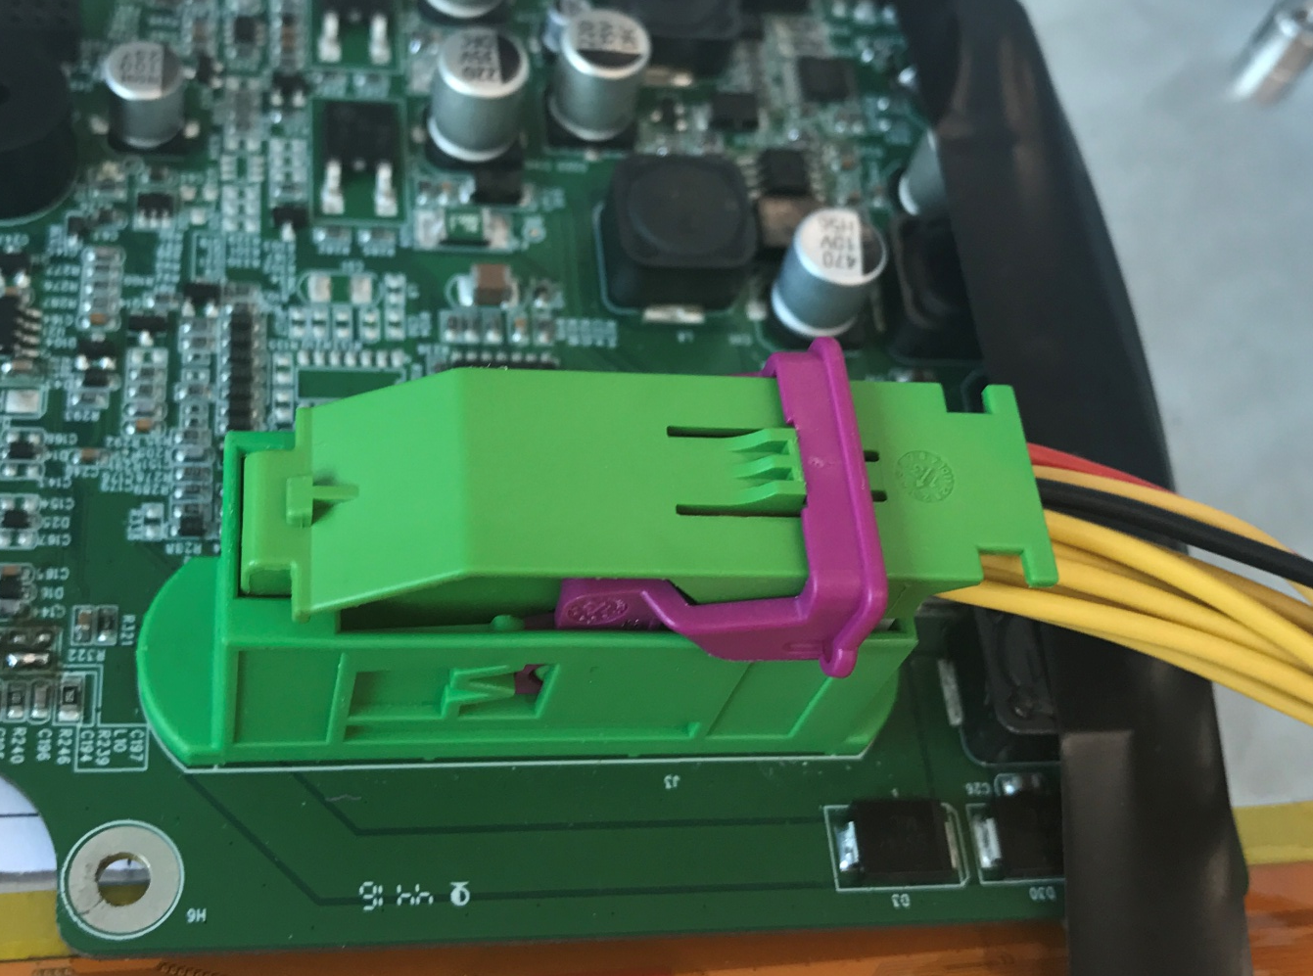
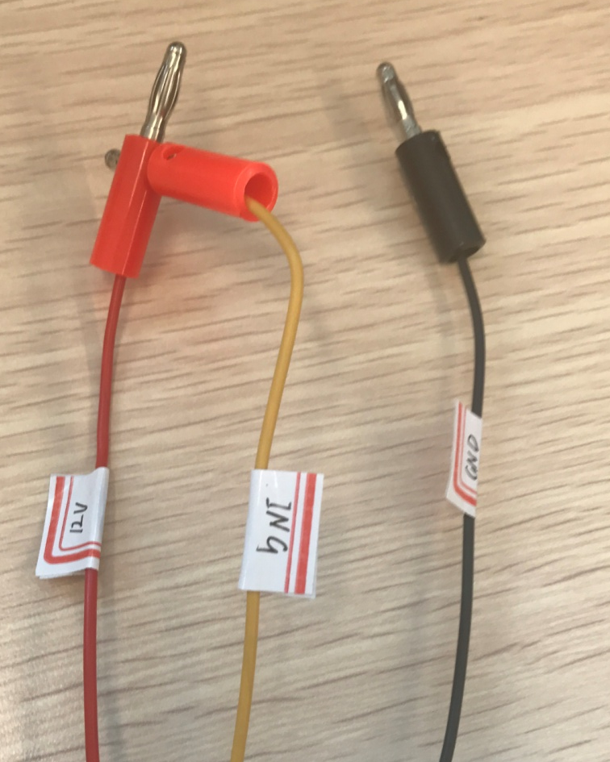
1. Power 12V
12V and IGN are connected to 12V+ of dc power
GND is connected to gnd of dc power

Slide 2
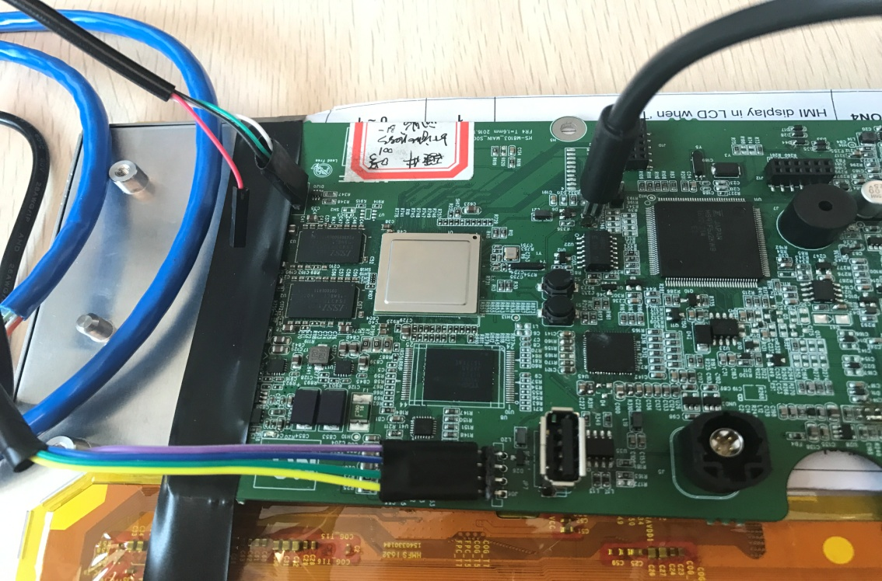
2. OTG, Serial line and network cable
Serial line
USB OTG
Attention: the direction
white
green
black
Network cable
Model Button
Two direction are both OK
Download Model: Push down this two buttons, and power on the board at the same time
Normal Model: power on the board

