Slide 1
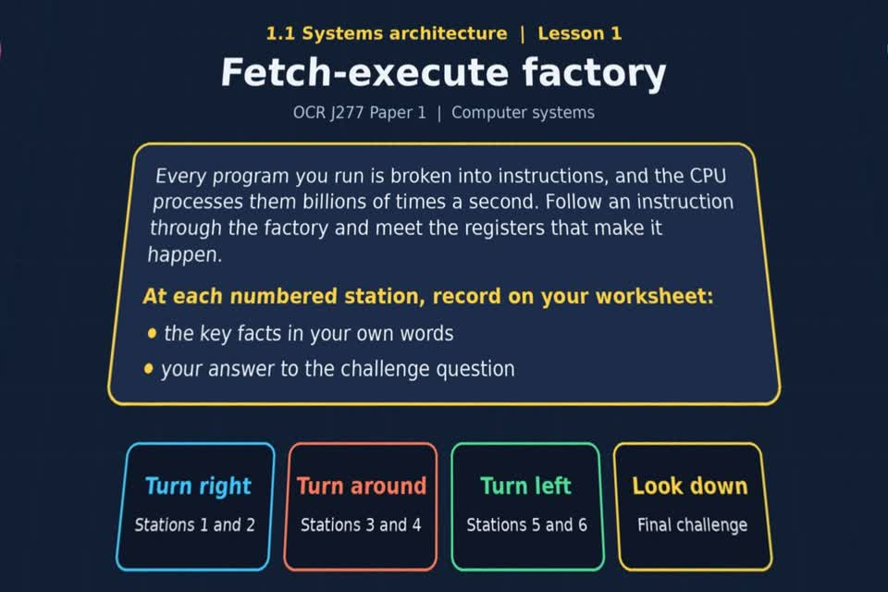
TOPIC 1.1 LESSON 01
FETCH-EXECUTE FACTORY
Purpose of the CPU
Start with your worksheet.
Open the experience after the starter answers.
Revise 360 OCR J277 1.1 Systems architecture
1 / 20
Notes:
The picture shows a straight-on perspective view of the actual 360 experience opening scene. Students should keep the experience closed until slide 7.
Sources: Revise360 experiences/sa-l01.json and worksheets/SA_L01_FetchExecuteFactory_Worksheet.docx. Indicative answers are for discussion and self-check, not an official exam-board mark scheme.

Slide 2
TOPIC 1.1 LESSON 01
By the end of this lesson
Your worksheet lists these learning outcomes:
1.
Understand what the CPU of a computer does
2.
Know what CPU registers are
3.
Know the stages of the fetch-execute cycle
4.
Know about other components of the CPU
Complete the worksheet starter before opening the experience.
Revise 360 OCR J277 1.1 Systems architecture Worksheet
2 / 20
Notes:
Read the outcomes with the class. They follow the wording of the lesson worksheet.
Sources: Revise360 experiences/sa-l01.json and worksheets/SA_L01_FetchExecuteFactory_Worksheet.docx. Indicative answers are for discussion and self-check, not an official exam-board mark scheme.

Slide 3
TOPIC 1.1 LESSON 01
Starter: before the experience
Answer the starter question in the box on your worksheet.
A chef can keep three ingredients on the worktop, twenty in the cupboard and anything else at the shop. Which is like cache, which is like RAM and which is like secondary storage? Why does the worktop make cooking faster?
Keep the experience closed until the starter and key terms are checked.
Revise 360 OCR J277 1.1 Systems architecture Worksheet starter
3 / 20
Notes:
Allow pupils to attempt the exact starter question printed on the worksheet. Take a few suggestions before showing the model answer.
Sources: Revise360 experiences/sa-l01.json and worksheets/SA_L01_FetchExecuteFactory_Worksheet.docx. Indicative answers are for discussion and self-check, not an official exam-board mark scheme.

Slide 4
TOPIC 1.1 LESSON 01
Key terminology quiz
Define the two terms listed in the key terminology section of your worksheet.
1.
CPU
2.
Fetch-decode-execute cycle
Revise 360 OCR J277 1.1 Systems architecture Worksheet key terms
4 / 20
Notes:
Students write definitions from memory. These two terms are the worksheet’s exact key terminology entries, including the recap terms in Lesson 4.
Sources: Revise360 experiences/sa-l01.json and worksheets/SA_L01_FetchExecuteFactory_Worksheet.docx. Indicative answers are for discussion and self-check, not an official exam-board mark scheme.

Slide 5
TOPIC 1.1 LESSON 01
Starter: sample answers
Compare your worksheet answer with these examples. Other accurate examples count.
1.
Worktop = cache. Cupboard = RAM. Shop = secondary storage.
2.
The worktop keeps needed ingredients close. The CPU can use cached data without waiting as long for RAM.
Revise 360 OCR J277 1.1 Systems architecture Check
5 / 20
Notes:
These are sample answers to the exact worksheet starter question. Accept other correct examples and explanations.
Sources: Revise360 experiences/sa-l01.json and worksheets/SA_L01_FetchExecuteFactory_Worksheet.docx. Indicative answers are for discussion and self-check, not an official exam-board mark scheme.

Slide 6
TOPIC 1.1 LESSON 01
Key terminology: answers
Correct or improve your two definitions before opening the experience.
CPU
The central processing unit processes data and instructions.
Fetch-decode-execute cycle
The repeated process of getting an instruction, working out its meaning and carrying it out.
Revise 360 OCR J277 1.1 Systems architecture Check
6 / 20
Notes:
Both term definitions are visible for pupils to correct their quiz. Reveal this slide after attempts.
Sources: Revise360 experiences/sa-l01.json and worksheets/SA_L01_FetchExecuteFactory_Worksheet.docx. Indicative answers are for discussion and self-check, not an official exam-board mark scheme.

Slide 7
TOPIC 1.1 LESSON 01
Open the experience now
1.
Select Fetch-execute factory from Topic 1.1. Keep your worksheet beside you.
2.
At each station, read the wall panel and write the key fact and challenge answer before tapping the badge.
3.
Tap the badge and answer on screen. Your first answer is the one that counts.
4.
When the score screen appears, copy your score into the yellow worksheet box (out of 22).
Open the experience online
Revise 360 OCR J277 1.1 Systems architecture Experience
7 / 20
Notes:
This is the first slide where students open the experience file. Leave it visible while they get set up. The link opens the matching experience.
Sources: Revise360 experiences/sa-l01.json and worksheets/SA_L01_FetchExecuteFactory_Worksheet.docx. Indicative answers are for discussion and self-check, not an official exam-board mark scheme.

Slide 8
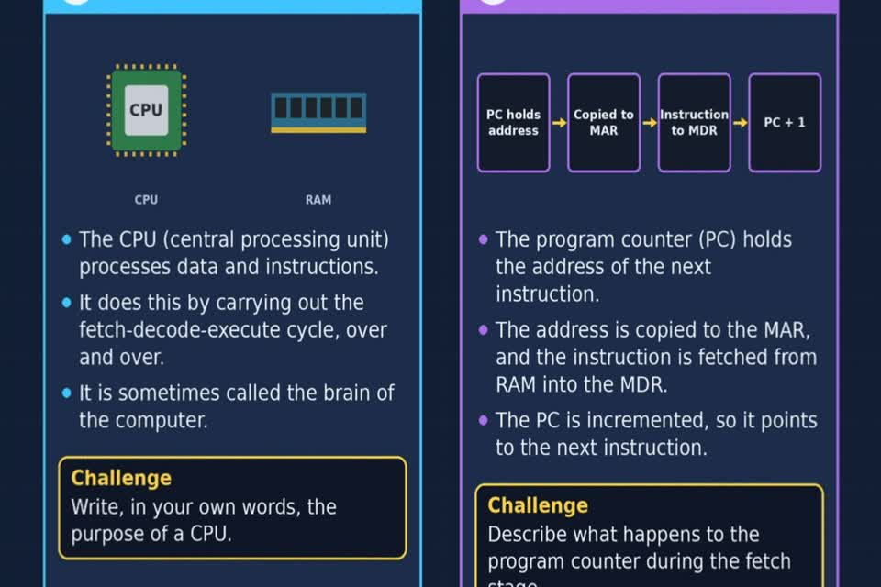
TOPIC 1.1 LESSON 01
The stations in your worksheet
Use the same route as the experience and worksheet:
RIGHT
1 Purpose of the CPU
2 Stage 1: Fetch
AROUND
3 Stage 2: Decode
4 Stage 3: Execute
LEFT
5 The registers
6 Other CPU components
DOWN
★ Final challenge
Revise 360 OCR J277 1.1 Systems architecture Experience
8 / 20
Notes:
The image is a straight-on perspective view of stations 1 and 2 in the actual experience. Students should record the key fact and their own answer before selecting each badge.
Sources: Revise360 experiences/sa-l01.json and worksheets/SA_L01_FetchExecuteFactory_Worksheet.docx. Indicative answers are for discussion and self-check, not an official exam-board mark scheme.

Slide 9
TOPIC 1.1 LESSON 01
Final challenge, score and key question
Look down. Complete the ★ final challenge table on your worksheet before tapping the star.
Copy the result from the score screen: ______ / 22
KEY QUESTION
What is the architecture of a CPU?
Revise 360 OCR J277 1.1 Systems architecture Worksheet
9 / 20
Notes:
Once students have reached the score screen, they copy the mark straight away. The key question is printed on the worksheet after the score box.
Sources: Revise360 experiences/sa-l01.json and worksheets/SA_L01_FetchExecuteFactory_Worksheet.docx. Indicative answers are for discussion and self-check, not an official exam-board mark scheme.

Slide 10
TOPIC 1.1 LESSON 01
Finished early: apply it
After completing the experience and recording your score:
The PC contains address 120. Trace the next fetch through the MAR and MDR. What address will the PC hold after it increments?
Add what the control unit does next. Give one possible action during execute.
Revise 360 OCR J277 1.1 Systems architecture Extension
10 / 20
Notes:
This extension is optional and comes after the experience. Give students time to reason in full sentences.
Sources: Revise360 experiences/sa-l01.json and worksheets/SA_L01_FetchExecuteFactory_Worksheet.docx. Indicative answers are for discussion and self-check, not an official exam-board mark scheme.

Slide 11
TOPIC 1.1 LESSON 01
Finished early: check and stretch
Use the worksheet and the experience feedback.
From memory, put the six steps in the final challenge in order. Then correct one station answer you missed and explain the correct term.
When the class is ready, close the experience and answer the plenary exam quiz.
Revise 360 OCR J277 1.1 Systems architecture Extension
11 / 20
Notes:
Keep this slide up while the rest of the class finishes. Do not reveal station answers until pupils have completed the experience.
Sources: Revise360 experiences/sa-l01.json and worksheets/SA_L01_FetchExecuteFactory_Worksheet.docx. Indicative answers are for discussion and self-check, not an official exam-board mark scheme.

Slide 12
TOPIC 1.1 LESSON 01
Finished early: sample answers
Compare your reasoning, then improve one sentence on your worksheet.
Application
PC 120 goes to MAR; the instruction comes from RAM into MDR; the PC increments to 121. The CU decodes it and the ALU could carry out a calculation.
Check and stretch
The six steps appear on the final challenge answer slide. For a missed station, use the on-screen feedback to explain the correct term.
Revise 360 OCR J277 1.1 Systems architecture Check
12 / 20
Notes:
Show the sample answers after early finishers have attempted the two extension prompts. These are examples rather than a single required wording.
Sources: Revise360 experiences/sa-l01.json and worksheets/SA_L01_FetchExecuteFactory_Worksheet.docx. Indicative answers are for discussion and self-check, not an official exam-board mark scheme.

Slide 13
TOPIC 1.1 LESSON 01
After the experience: stations 1–3
Close the experience. Check your key facts and challenge responses.
1 Purpose of the CPU
The CPU processes data and instructions by fetching, decoding and executing them.
2 Stage 1: Fetch
The PC holds the next instruction address. That address goes into the MAR, then the PC increments.
3 Stage 2: Decode
The control unit decodes the instruction: it works out what it means and what must happen.
Revise 360 OCR J277 1.1 Systems architecture Answers
13 / 20
Notes:
These are concise answers to the worksheet station prompts, shared only after pupils complete the experience. Correct wording can vary.
Sources: Revise360 experiences/sa-l01.json and worksheets/SA_L01_FetchExecuteFactory_Worksheet.docx. Indicative answers are for discussion and self-check, not an official exam-board mark scheme.

Slide 14
TOPIC 1.1 LESSON 01
After the experience: stations 4–6
Continue checking the station notes on your worksheet.
4 Stage 3: Execute
The CPU may load data, use the ALU for a calculation, jump, or store a result in RAM.
5 The registers
PC: next address. MAR: memory address. MDR: data moving to or from memory. ACC: calculation result.
6 Other CPU components
ALU calculates and makes logical decisions; CU decodes and controls; cache keeps frequently used data near the CPU.
Revise 360 OCR J277 1.1 Systems architecture Answers
14 / 20
Notes:
These are concise answers to the worksheet station prompts, shared only after pupils complete the experience. Correct wording can vary.
Sources: Revise360 experiences/sa-l01.json and worksheets/SA_L01_FetchExecuteFactory_Worksheet.docx. Indicative answers are for discussion and self-check, not an official exam-board mark scheme.

Slide 15
TOPIC 1.1 LESSON 01
Final challenge: answers
Compare your star challenge table with the answers below.
1.
PC holds the address of the next instruction
2.
Address copied into MAR
3.
Instruction fetched from RAM into MDR
4.
PC increments
5.
Control unit decodes the instruction
6.
Instruction is executed
Revise 360 OCR J277 1.1 Systems architecture Check
15 / 20
Notes:
These answers follow the final challenge in the interactive experience and the worksheet. Students should correct their table before the exam questions.
Sources: Revise360 experiences/sa-l01.json and worksheets/SA_L01_FetchExecuteFactory_Worksheet.docx. Indicative answers are for discussion and self-check, not an official exam-board mark scheme.

Slide 16
TOPIC 1.1 LESSON 01
Exam practice: questions (a–b)
Take the headset off or close the page. Answer from memory on the worksheet.
a)
Describe what the CPU does while a program is running. [2]
b)
Name two registers found in a CPU and state what each one holds. [4]
Revise 360 OCR J277 1.1 Systems architecture Plenary
16 / 20
Notes:
These are the exact exam-practice questions a and b from the worksheet. Give independent writing time before revealing the answers.
Sources: Revise360 experiences/sa-l01.json and worksheets/SA_L01_FetchExecuteFactory_Worksheet.docx. Indicative answers are for discussion and self-check, not an official exam-board mark scheme.

Slide 17
TOPIC 1.1 LESSON 01
Exam practice: question (c)
Keep the experience closed. Explain your reasoning in full sentences.
c)
A computer's cache is full. Explain the effect this has on the CPU. [3]
Use the marks in brackets to judge how much detail to include.
Revise 360 OCR J277 1.1 Systems architecture Plenary
17 / 20
Notes:
This is the exact worksheet exam-practice question c. Let students answer independently.
Sources: Revise360 experiences/sa-l01.json and worksheets/SA_L01_FetchExecuteFactory_Worksheet.docx. Indicative answers are for discussion and self-check, not an official exam-board mark scheme.

Slide 18
TOPIC 1.1 LESSON 01
Exam practice: answers (a–b)
Indicative points. Credit accurate answers in students’ own words.
a The CPU fetches, decodes and executes program instructions. It processes data as those instructions require.
b Award a register name plus its role for each pair: PC, address of next instruction; MAR, memory address; MDR, data to or from memory; ACC, calculation result.
Revise 360 OCR J277 1.1 Systems architecture Check
18 / 20
Notes:
These are classroom answer points, not an official OCR mark scheme. Ask students to improve one response in a different colour.
Sources: Revise360 experiences/sa-l01.json and worksheets/SA_L01_FetchExecuteFactory_Worksheet.docx. Indicative answers are for discussion and self-check, not an official exam-board mark scheme.

Slide 19
TOPIC 1.1 LESSON 01
Exam practice: answer (c)
Indicative points for the final question.
1.
A full cache replaces an existing entry when new data must be stored.
2.
If the next needed item is absent, the CPU fetches it from slower RAM and may wait.
3.
The effect depends on cache hits and misses. Being full alone does not guarantee a slowdown.
Revise 360 OCR J277 1.1 Systems architecture Check
19 / 20
Notes:
Use the worksheet final challenge to rehearse the six steps. The cache item is deliberately nuanced: replacement is normal; a miss causes the delay. Ask students to revise one sentence after self-check.
Sources: Revise360 experiences/sa-l01.json and worksheets/SA_L01_FetchExecuteFactory_Worksheet.docx. Indicative answers are for discussion and self-check, not an official exam-board mark scheme.

Slide 20
TOPIC 1.1 LESSON 01
How confident am I?
On the worksheet, select Not yet, Getting there or Confident for each objective.
1.
What the CPU does
2.
The CPU registers
3.
The stages of the fetch-execute cycle
4.
The ALU, CU and cache
Revise 360 OCR J277 1.1 Systems architecture Self-check
20 / 20
Notes:
End with the exact confidence objectives listed in the worksheet. Ask students to identify one item to revisit next time.
Sources: Revise360 experiences/sa-l01.json and worksheets/SA_L01_FetchExecuteFactory_Worksheet.docx. Indicative answers are for discussion and self-check, not an official exam-board mark scheme.

