Slide 1
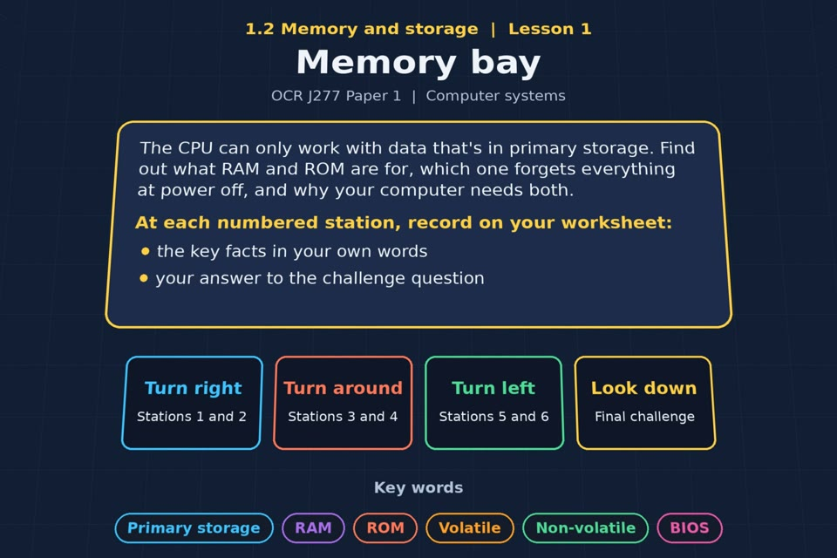

TOPIC 1.2 / LESSON 01
MEMORY BAY
RAM and ROM
KEY QUESTION
What are the differences between RAM and ROM?
1 / 19
Notes:
The image is a straight-on perspective preview of the actual experience. Start with the worksheet starter.
Sources: Revise 360 experiences/ms-l01.json and worksheets/MS_L01_MemoryBay_Worksheet.docx. Answers are indicative classroom examples, not an official OCR mark scheme. Calculations follow the worksheet’s decimal kB/MB/GB convention unless stated.

Slide 2
TOPIC 1.2 / LESSON 01 / WORKSHEET
By the end of this lesson
1.
understand the need for primary storage
2.
know the difference between RAM and ROM
3.
know the purpose of RAM and ROM
2 / 19
Notes:
These outcomes follow the wording of the lesson worksheet.
Sources: Revise 360 experiences/ms-l01.json and worksheets/MS_L01_MemoryBay_Worksheet.docx. Answers are indicative classroom examples, not an official OCR mark scheme. Calculations follow the worksheet’s decimal kB/MB/GB convention unless stated.

Slide 3
TOPIC 1.2 / LESSON 01 / WORKSHEET STARTER
Starter: before the experience
A computer loses power mid-lesson. Which of your work survives, and which does not? Explain why.
3 / 19
Notes:
Allow students to answer the exact worksheet starter before showing the sample answers.
Sources: Revise 360 experiences/ms-l01.json and worksheets/MS_L01_MemoryBay_Worksheet.docx. Answers are indicative classroom examples, not an official OCR mark scheme. Calculations follow the worksheet’s decimal kB/MB/GB convention unless stated.

Slide 4
TOPIC 1.2 / LESSON 01 / CHECK
Starter: sample answers
1.
Unsaved work in RAM is lost when power goes off. Work saved to the drive remains.
2.
ROM retains its boot instructions because it is non-volatile.
4 / 19
Notes:
Accept equivalent correct responses. These examples respond to the worksheet starter.
Sources: Revise 360 experiences/ms-l01.json and worksheets/MS_L01_MemoryBay_Worksheet.docx. Answers are indicative classroom examples, not an official OCR mark scheme. Calculations follow the worksheet’s decimal kB/MB/GB convention unless stated.

Slide 5
TOPIC 1.2 / LESSON 01 / WORKSHEET KEY TERMS
Key terminology quiz
1.
RAM
2.
ROM
5 / 19
Notes:
Students define the two terms printed on the worksheet before marking them.
Sources: Revise 360 experiences/ms-l01.json and worksheets/MS_L01_MemoryBay_Worksheet.docx. Answers are indicative classroom examples, not an official OCR mark scheme. Calculations follow the worksheet’s decimal kB/MB/GB convention unless stated.

Slide 6
TOPIC 1.2 / LESSON 01 / CHECK
Key terminology: answers
RAM
RAM: volatile, read/write primary memory holding the programs and data currently in use.
ROM
ROM: non-volatile, normally read-only primary memory holding start-up instructions.
6 / 19
Notes:
Reveal after students attempt the definitions; accept accurate wording in their own words.
Sources: Revise 360 experiences/ms-l01.json and worksheets/MS_L01_MemoryBay_Worksheet.docx. Answers are indicative classroom examples, not an official OCR mark scheme. Calculations follow the worksheet’s decimal kB/MB/GB convention unless stated.

Slide 7
TOPIC 1.2 / LESSON 01 / EXPERIENCE
Worksheet + experience
01 OPEN EXPERIENCE ↗
Open Memory bay in Topic 1.2. Keep the worksheet beside you.
02 SIX STATIONS
Read each panel. Write the key fact IN YOUR OWN WORDS and answer the worksheet challenge before tapping its badge.
03 FINAL CHALLENGE
Complete the ★ task before tapping the star. Copy your score (out of 27), then finish the worksheet task or review.
04 PLENARY
Finish the experience in this lesson. Near the end, close it for the plenary knowledge checks.
7 / 19
Notes:
Leave this board slide visible during the experience. The OPEN EXPERIENCE label is a clickable link. Everyone should complete the experience and reach the plenary near the end of the lesson. First on-screen responses count.
Sources: Revise 360 experiences/ms-l01.json and worksheets/MS_L01_MemoryBay_Worksheet.docx. Answers are indicative classroom examples, not an official OCR mark scheme. Calculations follow the worksheet’s decimal kB/MB/GB convention unless stated.

Slide 8
TOPIC 1.2 / LESSON 01 / EXTENSION
Apply your learning
Task: compare RAM and ROM. Complete the table using full sentences.
Use the task and table on your worksheet.
8 / 19
Notes:
This follows the task after the score on the worksheet. For revision, students use their results and outstanding work list.
Sources: Revise 360 experiences/ms-l01.json and worksheets/MS_L01_MemoryBay_Worksheet.docx. Answers are indicative classroom examples, not an official OCR mark scheme. Calculations follow the worksheet’s decimal kB/MB/GB convention unless stated.

Slide 9
TOPIC 1.2 / LESSON 01 / EXTENSION
Check and improve
A laptop has plenty of free RAM but still feels slow. Would adding more RAM fix it? Explain.
9 / 19
Notes:
Use this question to deepen or correct the worksheet response before the plenary.
Sources: Revise 360 experiences/ms-l01.json and worksheets/MS_L01_MemoryBay_Worksheet.docx. Answers are indicative classroom examples, not an official OCR mark scheme. Calculations follow the worksheet’s decimal kB/MB/GB convention unless stated.

Slide 10
TOPIC 1.2 / LESSON 01 / CHECK
Application: sample answers
1.
RAM = Random Access Memory; holds the running OS, apps and data; volatile; read and write.
2.
ROM = Read Only Memory; holds the boot firmware; non-volatile; normally read-only.
3.
Probably not. Extra RAM helps when the computer is short of RAM and swapping to storage. The bottleneck may instead be the CPU, drive or software.
10 / 19
Notes:
These are sample answers or a sample revision action. Ratings and open choices may vary with a justified device and context.
Sources: Revise 360 experiences/ms-l01.json and worksheets/MS_L01_MemoryBay_Worksheet.docx. Answers are indicative classroom examples, not an official OCR mark scheme. Calculations follow the worksheet’s decimal kB/MB/GB convention unless stated.

Slide 11
TOPIC 1.2 / LESSON 01 / ANSWERS
After the experience: stations 1–3
Check your key facts and challenge responses.
1 Why primary storage?
The CPU needs direct, fast access to instructions and data in primary storage; a hard drive is too slow to be working memory.
2 RAM
RAM may hold the operating system, the program you have open and its current data or unsaved work.
3 ROM
The start-up code must survive power off. ROM is non-volatile; RAM would be empty at switch-on.
11 / 19
Notes:
Show only after students have completed the experience. These concise points answer the station challenges and help students improve their own wording.
Sources: Revise 360 experiences/ms-l01.json and worksheets/MS_L01_MemoryBay_Worksheet.docx. Answers are indicative classroom examples, not an official OCR mark scheme. Calculations follow the worksheet’s decimal kB/MB/GB convention unless stated.

Slide 12
TOPIC 1.2 / LESSON 01 / ANSWERS
After the experience: stations 4–6
Check your key facts and challenge responses.
4 RAM vs ROM
RAM is volatile and read/write for current work. ROM is non-volatile and normally read-only for start-up code.
5 The boot sequence
Power on → run boot code in ROM → check hardware → load the operating system from secondary storage into RAM → OS takes control.
6 More RAM, faster computer?
More RAM helps when RAM is full: fewer pages need slower virtual memory. If RAM is not the bottleneck, adding it may do little.
12 / 19
Notes:
Show only after students have completed the experience. These concise points answer the station challenges and help students improve their own wording.
Sources: Revise 360 experiences/ms-l01.json and worksheets/MS_L01_MemoryBay_Worksheet.docx. Answers are indicative classroom examples, not an official OCR mark scheme. Calculations follow the worksheet’s decimal kB/MB/GB convention unless stated.

Slide 13
TOPIC 1.2 / LESSON 01 / CHECK
Final challenge: answers 1–5
1.
Loses its contents when the power goes off → RAM
2.
Holds the BIOS → ROM
3.
Is a type of primary storage → Both
4.
Can be written to by the operating system → RAM
5.
Keeps its contents with no power → ROM
13 / 19
Notes:
Answers are in the same order as the worksheet final challenge and the experience star task. Pixel and sound sketches should be checked against the interactive pattern or wave.
Sources: Revise 360 experiences/ms-l01.json and worksheets/MS_L01_MemoryBay_Worksheet.docx. Answers are indicative classroom examples, not an official OCR mark scheme. Calculations follow the worksheet’s decimal kB/MB/GB convention unless stated.

Slide 14
TOPIC 1.2 / LESSON 01 / CHECK
Final challenge: answers 6–8
6.
Is found on the motherboard → Both
7.
Holds the programs you currently have open → RAM
8.
Is read-only in normal use → ROM
14 / 19
Notes:
Answers are in the same order as the worksheet final challenge and the experience star task. Pixel and sound sketches should be checked against the interactive pattern or wave.
Sources: Revise 360 experiences/ms-l01.json and worksheets/MS_L01_MemoryBay_Worksheet.docx. Answers are indicative classroom examples, not an official OCR mark scheme. Calculations follow the worksheet’s decimal kB/MB/GB convention unless stated.

Slide 15
TOPIC 1.2 / LESSON 01 / PLENARY
Plenary: questions 1–2
Close the experience. Answer from memory on the worksheet.
a) State what is meant by the term volatile. [1]
b) Describe the purpose of ROM in a computer system. [2]
15 / 19
Notes:
These are the exact exam-practice questions from the worksheet. Allow independent writing before displaying the answer slides.
Sources: Revise 360 experiences/ms-l01.json and worksheets/MS_L01_MemoryBay_Worksheet.docx. Answers are indicative classroom examples, not an official OCR mark scheme. Calculations follow the worksheet’s decimal kB/MB/GB convention unless stated.

Slide 16
TOPIC 1.2 / LESSON 01 / PLENARY
Plenary: question 3
Close the experience. Answer from memory on the worksheet.
c) Explain why a computer needs primary storage. [3]
16 / 19
Notes:
These are the exact exam-practice questions from the worksheet. Allow independent writing before displaying the answer slides.
Sources: Revise 360 experiences/ms-l01.json and worksheets/MS_L01_MemoryBay_Worksheet.docx. Answers are indicative classroom examples, not an official OCR mark scheme. Calculations follow the worksheet’s decimal kB/MB/GB convention unless stated.

Slide 17
TOPIC 1.2 / LESSON 01 / CHECK
Plenary: answers 1–2
Indicative points. Credit accurate answers in students’ own words.
a) Volatile means its contents are lost when the power is switched off.
b) ROM stores the boot firmware or start-up instructions. It keeps them without power so the computer can begin loading the operating system.
17 / 19
Notes:
Classroom answer points, not an official OCR mark scheme. Ask students to correct or improve one answer.
Sources: Revise 360 experiences/ms-l01.json and worksheets/MS_L01_MemoryBay_Worksheet.docx. Answers are indicative classroom examples, not an official OCR mark scheme. Calculations follow the worksheet’s decimal kB/MB/GB convention unless stated.

Slide 18
TOPIC 1.2 / LESSON 01 / CHECK
Plenary: answer 3
Indicative points. Credit accurate answers in students’ own words.
c) The CPU needs fast, directly accessible storage for the instructions and data currently in use. Programs are loaded into RAM from slower secondary storage so the CPU can run them efficiently.
18 / 19
Notes:
Classroom answer points, not an official OCR mark scheme. Ask students to correct or improve one answer.
Sources: Revise 360 experiences/ms-l01.json and worksheets/MS_L01_MemoryBay_Worksheet.docx. Answers are indicative classroom examples, not an official OCR mark scheme. Calculations follow the worksheet’s decimal kB/MB/GB convention unless stated.

Slide 19
TOPIC 1.2 / LESSON 01 / SELF-CHECK
How confident am I?
Select Not yet, Getting there or Confident for each objective on the worksheet.
1.
The need for primary storage
2.
The purpose of RAM
3.
The purpose of ROM
19 / 19
Notes:
Use the exact confidence objectives from the worksheet. Students identify one area to revisit.
Sources: Revise 360 experiences/ms-l01.json and worksheets/MS_L01_MemoryBay_Worksheet.docx. Answers are indicative classroom examples, not an official OCR mark scheme. Calculations follow the worksheet’s decimal kB/MB/GB convention unless stated.

