Slide 1
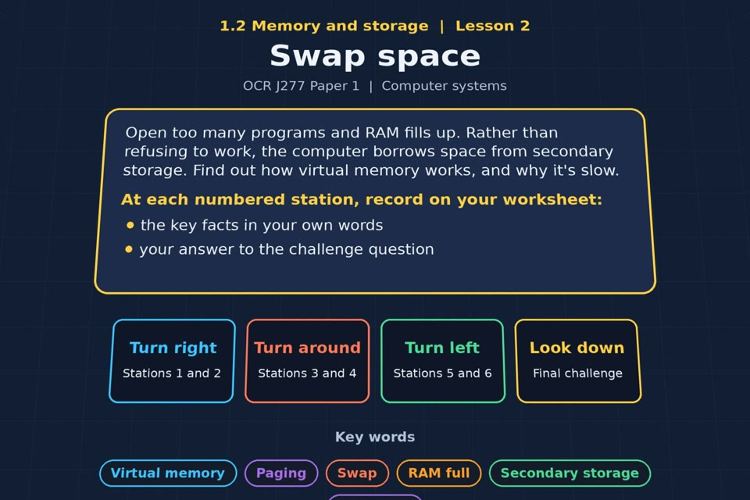

TOPIC 1.2 / LESSON 02
SWAP SPACE
Virtual memory
KEY QUESTION
Why do we need virtual memory, and what can we do to avoid using it?
1 / 19
Notes:
The image is a straight-on perspective preview of the actual experience. Start with the worksheet starter.
Sources: Revise 360 experiences/ms-l02.json and worksheets/MS_L02_SwapSpace_Worksheet.docx. Answers are indicative classroom examples, not an official OCR mark scheme. Calculations follow the worksheet’s decimal kB/MB/GB convention unless stated.

Slide 2
TOPIC 1.2 / LESSON 02 / WORKSHEET
By the end of this lesson
1.
understand the need for virtual memory
2.
understand how virtual memory works
2 / 19
Notes:
These outcomes follow the wording of the lesson worksheet.
Sources: Revise 360 experiences/ms-l02.json and worksheets/MS_L02_SwapSpace_Worksheet.docx. Answers are indicative classroom examples, not an official OCR mark scheme. Calculations follow the worksheet’s decimal kB/MB/GB convention unless stated.

Slide 3
TOPIC 1.2 / LESSON 02 / WORKSHEET STARTER
Starter: before the experience
You open ten browser tabs, a game and a video editor on an old laptop. Describe what happens and why.
3 / 19
Notes:
Allow students to answer the exact worksheet starter before showing the sample answers.
Sources: Revise 360 experiences/ms-l02.json and worksheets/MS_L02_SwapSpace_Worksheet.docx. Answers are indicative classroom examples, not an official OCR mark scheme. Calculations follow the worksheet’s decimal kB/MB/GB convention unless stated.

Slide 4
TOPIC 1.2 / LESSON 02 / CHECK
Starter: sample answers
1.
The apps and tabs fill the available RAM. The operating system moves less-used pages to secondary storage.
2.
Switching back to those pages takes longer because the drive is slower than RAM.
4 / 19
Notes:
Accept equivalent correct responses. These examples respond to the worksheet starter.
Sources: Revise 360 experiences/ms-l02.json and worksheets/MS_L02_SwapSpace_Worksheet.docx. Answers are indicative classroom examples, not an official OCR mark scheme. Calculations follow the worksheet’s decimal kB/MB/GB convention unless stated.

Slide 5
TOPIC 1.2 / LESSON 02 / WORKSHEET KEY TERMS
Key terminology quiz
1.
Virtual memory
2.
Volatile
5 / 19
Notes:
Students define the two terms printed on the worksheet before marking them.
Sources: Revise 360 experiences/ms-l02.json and worksheets/MS_L02_SwapSpace_Worksheet.docx. Answers are indicative classroom examples, not an official OCR mark scheme. Calculations follow the worksheet’s decimal kB/MB/GB convention unless stated.

Slide 6
TOPIC 1.2 / LESSON 02 / CHECK
Key terminology: answers
Virtual memory
Virtual memory: part of secondary storage used to hold pages moved out of RAM when RAM is full.
Volatile
Volatile: loses its contents when electrical power is removed.
6 / 19
Notes:
Reveal after students attempt the definitions; accept accurate wording in their own words.
Sources: Revise 360 experiences/ms-l02.json and worksheets/MS_L02_SwapSpace_Worksheet.docx. Answers are indicative classroom examples, not an official OCR mark scheme. Calculations follow the worksheet’s decimal kB/MB/GB convention unless stated.

Slide 7
TOPIC 1.2 / LESSON 02 / EXPERIENCE
Worksheet + experience
01 OPEN EXPERIENCE ↗
Open Swap space in Topic 1.2. Keep the worksheet beside you.
02 SIX STATIONS
Read each panel. Write the key fact IN YOUR OWN WORDS and answer the worksheet challenge before tapping its badge.
03 FINAL CHALLENGE
Complete the ★ task before tapping the star. Copy your score (out of 20), then finish the worksheet task or review.
04 PLENARY
Finish the experience in this lesson. Near the end, close it for the plenary knowledge checks.
7 / 19
Notes:
Leave this board slide visible during the experience. The OPEN EXPERIENCE label is a clickable link. Everyone should complete the experience and reach the plenary near the end of the lesson. First on-screen responses count.
Sources: Revise 360 experiences/ms-l02.json and worksheets/MS_L02_SwapSpace_Worksheet.docx. Answers are indicative classroom examples, not an official OCR mark scheme. Calculations follow the worksheet’s decimal kB/MB/GB convention unless stated.

Slide 8
TOPIC 1.2 / LESSON 02 / EXTENSION
Apply your learning
Why does virtual memory allow more programs to stay open, yet make a computer slower?
8 / 19
Notes:
This follows the task after the score on the worksheet. For revision, students use their results and outstanding work list.
Sources: Revise 360 experiences/ms-l02.json and worksheets/MS_L02_SwapSpace_Worksheet.docx. Answers are indicative classroom examples, not an official OCR mark scheme. Calculations follow the worksheet’s decimal kB/MB/GB convention unless stated.

Slide 9
TOPIC 1.2 / LESSON 02 / EXTENSION
Check and improve
A computer has plenty of free RAM. Would adding more RAM reduce its use of virtual memory?
9 / 19
Notes:
Use this question to deepen or correct the worksheet response before the plenary.
Sources: Revise 360 experiences/ms-l02.json and worksheets/MS_L02_SwapSpace_Worksheet.docx. Answers are indicative classroom examples, not an official OCR mark scheme. Calculations follow the worksheet’s decimal kB/MB/GB convention unless stated.

Slide 10
TOPIC 1.2 / LESSON 02 / CHECK
Application: sample answers
1.
It frees RAM by moving inactive pages to secondary storage, so more programs can remain open.
2.
Retrieving a page from the slower drive adds delay; heavy swapping makes the computer feel slow.
3.
It is already unlikely to be swapping heavily. More RAM may have little effect unless available RAM becomes the limit.
10 / 19
Notes:
These are sample answers or a sample revision action. Ratings and open choices may vary with a justified device and context.
Sources: Revise 360 experiences/ms-l02.json and worksheets/MS_L02_SwapSpace_Worksheet.docx. Answers are indicative classroom examples, not an official OCR mark scheme. Calculations follow the worksheet’s decimal kB/MB/GB convention unless stated.

Slide 11
TOPIC 1.2 / LESSON 02 / ANSWERS
After the experience: stations 1–3
Check your key facts and challenge responses.
1 When RAM runs out
When RAM fills, the operating system moves less-used pages to a swap area on secondary storage to free space.
2 What is virtual memory?
Virtual memory uses secondary storage as an overflow area for RAM; the CPU still needs a page brought back into RAM to use it.
3 Swapping
When a swapped-out page is needed, the OS loads it from the drive into RAM, perhaps moving another page out.
11 / 19
Notes:
Show only after students have completed the experience. These concise points answer the station challenges and help students improve their own wording.
Sources: Revise 360 experiences/ms-l02.json and worksheets/MS_L02_SwapSpace_Worksheet.docx. Answers are indicative classroom examples, not an official OCR mark scheme. Calculations follow the worksheet’s decimal kB/MB/GB convention unless stated.

Slide 12
TOPIC 1.2 / LESSON 02 / ANSWERS
After the experience: stations 4–6
Check your key facts and challenge responses.
4 Why it's slow
Secondary storage has much slower access than RAM. Frequent swaps cause waits and can make the system feel unresponsive.
5 Avoiding virtual memory
Close unneeded apps or add enough RAM to reduce swapping. More RAM helps chiefly when RAM shortage is the cause.
6 Virtual memory in action
Returning to the word processor triggers a page load from the swap area into RAM; the switch may pause while data moves.
12 / 19
Notes:
Show only after students have completed the experience. These concise points answer the station challenges and help students improve their own wording.
Sources: Revise 360 experiences/ms-l02.json and worksheets/MS_L02_SwapSpace_Worksheet.docx. Answers are indicative classroom examples, not an official OCR mark scheme. Calculations follow the worksheet’s decimal kB/MB/GB convention unless stated.

Slide 13
TOPIC 1.2 / LESSON 02 / CHECK
Final challenge: answers 1–5
1.
It uses secondary storage as extra memory → True
2.
The CPU can work on it directly, without using RAM → False
3.
It is slower than using RAM → True
4.
It is needed because RAM is limited → True
5.
Adding more RAM reduces how much it is used → True
13 / 19
Notes:
Answers are in the same order as the worksheet final challenge and the experience star task. Pixel and sound sketches should be checked against the interactive pattern or wave.
Sources: Revise 360 experiences/ms-l02.json and worksheets/MS_L02_SwapSpace_Worksheet.docx. Answers are indicative classroom examples, not an official OCR mark scheme. Calculations follow the worksheet’s decimal kB/MB/GB convention unless stated.

Slide 14
TOPIC 1.2 / LESSON 02 / CHECK
Final challenge: answer 6
6.
It makes a computer faster than having enough RAM → False
14 / 19
Notes:
Answers are in the same order as the worksheet final challenge and the experience star task. Pixel and sound sketches should be checked against the interactive pattern or wave.
Sources: Revise 360 experiences/ms-l02.json and worksheets/MS_L02_SwapSpace_Worksheet.docx. Answers are indicative classroom examples, not an official OCR mark scheme. Calculations follow the worksheet’s decimal kB/MB/GB convention unless stated.

Slide 15
TOPIC 1.2 / LESSON 02 / PLENARY
Plenary: questions 1–2
Close the experience. Answer from memory on the worksheet.
a) Describe what is meant by virtual memory. [2]
b) Explain why using virtual memory slows a computer down. [3]
15 / 19
Notes:
These are the exact exam-practice questions from the worksheet. Allow independent writing before displaying the answer slides.
Sources: Revise 360 experiences/ms-l02.json and worksheets/MS_L02_SwapSpace_Worksheet.docx. Answers are indicative classroom examples, not an official OCR mark scheme. Calculations follow the worksheet’s decimal kB/MB/GB convention unless stated.

Slide 16
TOPIC 1.2 / LESSON 02 / PLENARY
Plenary: question 3
Close the experience. Answer from memory on the worksheet.
c) State one way a user could reduce the need for virtual memory. [1]
16 / 19
Notes:
These are the exact exam-practice questions from the worksheet. Allow independent writing before displaying the answer slides.
Sources: Revise 360 experiences/ms-l02.json and worksheets/MS_L02_SwapSpace_Worksheet.docx. Answers are indicative classroom examples, not an official OCR mark scheme. Calculations follow the worksheet’s decimal kB/MB/GB convention unless stated.

Slide 17
TOPIC 1.2 / LESSON 02 / CHECK
Plenary: answers 1–2
Indicative points. Credit accurate answers in students’ own words.
a) Virtual memory uses space on secondary storage to hold pages moved out of RAM when RAM is full.
b) The drive is much slower than RAM. Pages must be transferred back to RAM before the CPU uses them; repeated swapping adds delays.
17 / 19
Notes:
Classroom answer points, not an official OCR mark scheme. Ask students to correct or improve one answer.
Sources: Revise 360 experiences/ms-l02.json and worksheets/MS_L02_SwapSpace_Worksheet.docx. Answers are indicative classroom examples, not an official OCR mark scheme. Calculations follow the worksheet’s decimal kB/MB/GB convention unless stated.

Slide 18
TOPIC 1.2 / LESSON 02 / CHECK
Plenary: answer 3
Indicative points. Credit accurate answers in students’ own words.
c) Close unused applications or add more RAM.
18 / 19
Notes:
Classroom answer points, not an official OCR mark scheme. Ask students to correct or improve one answer.
Sources: Revise 360 experiences/ms-l02.json and worksheets/MS_L02_SwapSpace_Worksheet.docx. Answers are indicative classroom examples, not an official OCR mark scheme. Calculations follow the worksheet’s decimal kB/MB/GB convention unless stated.

Slide 19
TOPIC 1.2 / LESSON 02 / SELF-CHECK
How confident am I?
Select Not yet, Getting there or Confident for each objective on the worksheet.
1.
What virtual memory is
2.
How data is swapped between RAM and disk
3.
Why virtual memory is slow
19 / 19
Notes:
Use the exact confidence objectives from the worksheet. Students identify one area to revisit.
Sources: Revise 360 experiences/ms-l02.json and worksheets/MS_L02_SwapSpace_Worksheet.docx. Answers are indicative classroom examples, not an official OCR mark scheme. Calculations follow the worksheet’s decimal kB/MB/GB convention unless stated.

