Slide 1
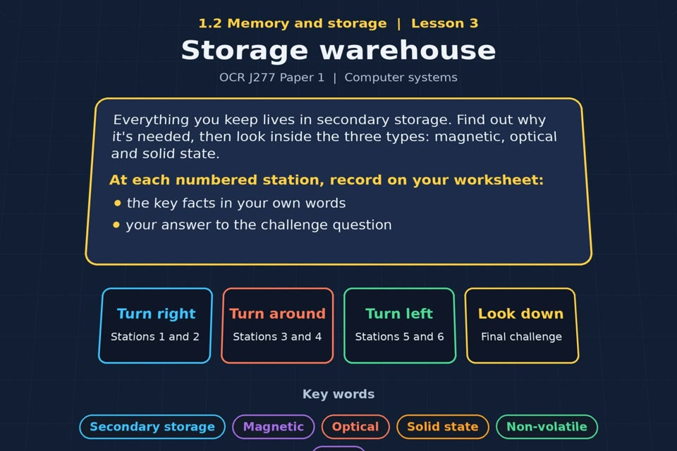

TOPIC 1.2 / LESSON 03
STORAGE WAREHOUSE
Common types of storage
KEY QUESTION
Why do computers have secondary storage?
1 / 19
Notes:
The image is a straight-on perspective preview of the actual experience. Start with the worksheet starter.
Sources: Revise 360 experiences/ms-l03.json and worksheets/MS_L03_StorageWarehouse_Worksheet.docx. Answers are indicative classroom examples, not an official OCR mark scheme. Calculations follow the worksheet’s decimal kB/MB/GB convention unless stated.

Slide 2
TOPIC 1.2 / LESSON 03 / WORKSHEET
By the end of this lesson
1.
understand the need for secondary storage
2.
know the common types of storage
3.
know how each type works
2 / 19
Notes:
These outcomes follow the wording of the lesson worksheet.
Sources: Revise 360 experiences/ms-l03.json and worksheets/MS_L03_StorageWarehouse_Worksheet.docx. Answers are indicative classroom examples, not an official OCR mark scheme. Calculations follow the worksheet’s decimal kB/MB/GB convention unless stated.

Slide 3
TOPIC 1.2 / LESSON 03 / WORKSHEET STARTER
Starter: before the experience
List everything stored on the computer you are using that must still be there tomorrow morning.
3 / 19
Notes:
Allow students to answer the exact worksheet starter before showing the sample answers.
Sources: Revise 360 experiences/ms-l03.json and worksheets/MS_L03_StorageWarehouse_Worksheet.docx. Answers are indicative classroom examples, not an official OCR mark scheme. Calculations follow the worksheet’s decimal kB/MB/GB convention unless stated.

Slide 4
TOPIC 1.2 / LESSON 03 / CHECK
Starter: sample answers
1.
Saved documents, installed programs and the operating system need non-volatile secondary storage so they remain after power off.
2.
RAM holds current work but loses its contents without power.
4 / 19
Notes:
Accept equivalent correct responses. These examples respond to the worksheet starter.
Sources: Revise 360 experiences/ms-l03.json and worksheets/MS_L03_StorageWarehouse_Worksheet.docx. Answers are indicative classroom examples, not an official OCR mark scheme. Calculations follow the worksheet’s decimal kB/MB/GB convention unless stated.

Slide 5
TOPIC 1.2 / LESSON 03 / WORKSHEET KEY TERMS
Key terminology quiz
1.
Secondary storage
2.
Non-volatile
5 / 19
Notes:
Students define the two terms printed on the worksheet before marking them.
Sources: Revise 360 experiences/ms-l03.json and worksheets/MS_L03_StorageWarehouse_Worksheet.docx. Answers are indicative classroom examples, not an official OCR mark scheme. Calculations follow the worksheet’s decimal kB/MB/GB convention unless stated.

Slide 6
TOPIC 1.2 / LESSON 03 / CHECK
Key terminology: answers
Secondary storage
Secondary storage: non-volatile storage for programs and files kept long term.
Non-volatile
Non-volatile: retains its data when the power is turned off.
6 / 19
Notes:
Reveal after students attempt the definitions; accept accurate wording in their own words.
Sources: Revise 360 experiences/ms-l03.json and worksheets/MS_L03_StorageWarehouse_Worksheet.docx. Answers are indicative classroom examples, not an official OCR mark scheme. Calculations follow the worksheet’s decimal kB/MB/GB convention unless stated.

Slide 7
TOPIC 1.2 / LESSON 03 / EXPERIENCE
Worksheet + experience
01 OPEN EXPERIENCE ↗
Open Storage warehouse in Topic 1.2. Keep the worksheet beside you.
02 SIX STATIONS
Read each panel. Write the key fact IN YOUR OWN WORDS and answer the worksheet challenge before tapping its badge.
03 FINAL CHALLENGE
Complete the ★ task before tapping the star. Copy your score (out of 25), then finish the worksheet task or review.
04 PLENARY
Finish the experience in this lesson. Near the end, close it for the plenary knowledge checks.
7 / 19
Notes:
Leave this board slide visible during the experience. The OPEN EXPERIENCE label is a clickable link. Everyone should complete the experience and reach the plenary near the end of the lesson. First on-screen responses count.
Sources: Revise 360 experiences/ms-l03.json and worksheets/MS_L03_StorageWarehouse_Worksheet.docx. Answers are indicative classroom examples, not an official OCR mark scheme. Calculations follow the worksheet’s decimal kB/MB/GB convention unless stated.

Slide 8
TOPIC 1.2 / LESSON 03 / EXTENSION
Apply your learning
Which storage would you use for a school file server, and which for a laptop system drive? Justify both.
8 / 19
Notes:
This follows the task after the score on the worksheet. For revision, students use their results and outstanding work list.
Sources: Revise 360 experiences/ms-l03.json and worksheets/MS_L03_StorageWarehouse_Worksheet.docx. Answers are indicative classroom examples, not an official OCR mark scheme. Calculations follow the worksheet’s decimal kB/MB/GB convention unless stated.

Slide 9
TOPIC 1.2 / LESSON 03 / EXTENSION
Check and improve
Rank CD, DVD and Blu-ray by capacity. How does an optical drive read their data?
9 / 19
Notes:
Use this question to deepen or correct the worksheet response before the plenary.
Sources: Revise 360 experiences/ms-l03.json and worksheets/MS_L03_StorageWarehouse_Worksheet.docx. Answers are indicative classroom examples, not an official OCR mark scheme. Calculations follow the worksheet’s decimal kB/MB/GB convention unless stated.

Slide 10
TOPIC 1.2 / LESSON 03 / CHECK
Application: sample answers
1.
A hard disk can give the server high capacity at low cost per GB for bulk files.
2.
An SSD suits a laptop system drive: fast access and no moving parts when the laptop is carried.
3.
CD < DVD < Blu-ray. A laser detects changes in reflected light from the disc surface to read the encoded data.
10 / 19
Notes:
These are sample answers or a sample revision action. Ratings and open choices may vary with a justified device and context.
Sources: Revise 360 experiences/ms-l03.json and worksheets/MS_L03_StorageWarehouse_Worksheet.docx. Answers are indicative classroom examples, not an official OCR mark scheme. Calculations follow the worksheet’s decimal kB/MB/GB convention unless stated.

Slide 11
TOPIC 1.2 / LESSON 03 / ANSWERS
After the experience: stations 1–3
Check your key facts and challenge responses.
1 Why secondary storage?
Secondary storage keeps files, programs and the OS when power is off; RAM is volatile and mainly holds current work.
2 Magnetic storage
A hard disk stores bits as magnetic patterns on spinning platters. Moving parts can be damaged by bumps in a laptop.
3 Optical storage
A laser reads patterns of pits and lands on a disc. Typical capacity order: CD < DVD < Blu-ray.
11 / 19
Notes:
Show only after students have completed the experience. These concise points answer the station challenges and help students improve their own wording.
Sources: Revise 360 experiences/ms-l03.json and worksheets/MS_L03_StorageWarehouse_Worksheet.docx. Answers are indicative classroom examples, not an official OCR mark scheme. Calculations follow the worksheet’s decimal kB/MB/GB convention unless stated.

Slide 12
TOPIC 1.2 / LESSON 03 / ANSWERS
After the experience: stations 4–6
Check your key facts and challenge responses.
4 Solid state storage
Flash memory holds electrical charges without moving parts. An SSD is fast and more resistant to knocks.
5 Inside the devices
A hard disk has spinning platters, a spindle, an actuator arm and a read/write head.
6 Choosing a type
For bulk files, a high-capacity HDD can offer low cost per GB. For a portable system drive, an SSD is faster and more durable.
12 / 19
Notes:
Show only after students have completed the experience. These concise points answer the station challenges and help students improve their own wording.
Sources: Revise 360 experiences/ms-l03.json and worksheets/MS_L03_StorageWarehouse_Worksheet.docx. Answers are indicative classroom examples, not an official OCR mark scheme. Calculations follow the worksheet’s decimal kB/MB/GB convention unless stated.

Slide 13
TOPIC 1.2 / LESSON 03 / CHECK
Final challenge: answers 1–5
1.
Hard disk drive → Magnetic
2.
Blu-ray disc → Optical
3.
USB memory stick → Solid state
4.
Backup tape → Magnetic
5.
DVD → Optical
13 / 19
Notes:
Answers are in the same order as the worksheet final challenge and the experience star task. Pixel and sound sketches should be checked against the interactive pattern or wave.
Sources: Revise 360 experiences/ms-l03.json and worksheets/MS_L03_StorageWarehouse_Worksheet.docx. Answers are indicative classroom examples, not an official OCR mark scheme. Calculations follow the worksheet’s decimal kB/MB/GB convention unless stated.

Slide 14
TOPIC 1.2 / LESSON 03 / CHECK
Final challenge: answers 6–9
6.
SD card in a camera → Solid state
7.
Spinning platters and a read/write head → Magnetic
8.
A laser reading pits and lands → Optical
9.
Flash memory with no moving parts → Solid state
14 / 19
Notes:
Answers are in the same order as the worksheet final challenge and the experience star task. Pixel and sound sketches should be checked against the interactive pattern or wave.
Sources: Revise 360 experiences/ms-l03.json and worksheets/MS_L03_StorageWarehouse_Worksheet.docx. Answers are indicative classroom examples, not an official OCR mark scheme. Calculations follow the worksheet’s decimal kB/MB/GB convention unless stated.

Slide 15
TOPIC 1.2 / LESSON 03 / PLENARY
Plenary: questions 1–2
Close the experience. Answer from memory on the worksheet.
a) State what is meant by non-volatile storage. [1]
b) Describe how a hard disk drive stores data. [2]
15 / 19
Notes:
These are the exact exam-practice questions from the worksheet. Allow independent writing before displaying the answer slides.
Sources: Revise 360 experiences/ms-l03.json and worksheets/MS_L03_StorageWarehouse_Worksheet.docx. Answers are indicative classroom examples, not an official OCR mark scheme. Calculations follow the worksheet’s decimal kB/MB/GB convention unless stated.

Slide 16
TOPIC 1.2 / LESSON 03 / PLENARY
Plenary: question 3
Close the experience. Answer from memory on the worksheet.
c) Describe how data is read from an optical disc. [2]
16 / 19
Notes:
These are the exact exam-practice questions from the worksheet. Allow independent writing before displaying the answer slides.
Sources: Revise 360 experiences/ms-l03.json and worksheets/MS_L03_StorageWarehouse_Worksheet.docx. Answers are indicative classroom examples, not an official OCR mark scheme. Calculations follow the worksheet’s decimal kB/MB/GB convention unless stated.

Slide 17
TOPIC 1.2 / LESSON 03 / CHECK
Plenary: answers 1–2
Indicative points. Credit accurate answers in students’ own words.
a) Non-volatile storage keeps its data when the power is off.
b) A hard disk has spinning platters. Its read/write head changes or senses magnetic patterns representing bits.
17 / 19
Notes:
Classroom answer points, not an official OCR mark scheme. Ask students to correct or improve one answer.
Sources: Revise 360 experiences/ms-l03.json and worksheets/MS_L03_StorageWarehouse_Worksheet.docx. Answers are indicative classroom examples, not an official OCR mark scheme. Calculations follow the worksheet’s decimal kB/MB/GB convention unless stated.

Slide 18
TOPIC 1.2 / LESSON 03 / CHECK
Plenary: answer 3
Indicative points. Credit accurate answers in students’ own words.
c) An optical drive shines a laser at the disc and detects differences in reflected light from its encoded surface.
18 / 19
Notes:
Classroom answer points, not an official OCR mark scheme. Ask students to correct or improve one answer.
Sources: Revise 360 experiences/ms-l03.json and worksheets/MS_L03_StorageWarehouse_Worksheet.docx. Answers are indicative classroom examples, not an official OCR mark scheme. Calculations follow the worksheet’s decimal kB/MB/GB convention unless stated.

Slide 19
TOPIC 1.2 / LESSON 03 / SELF-CHECK
How confident am I?
Select Not yet, Getting there or Confident for each objective on the worksheet.
1.
The need for secondary storage
2.
Magnetic, optical and solid state
3.
How each type works
19 / 19
Notes:
Use the exact confidence objectives from the worksheet. Students identify one area to revisit.
Sources: Revise 360 experiences/ms-l03.json and worksheets/MS_L03_StorageWarehouse_Worksheet.docx. Answers are indicative classroom examples, not an official OCR mark scheme. Calculations follow the worksheet’s decimal kB/MB/GB convention unless stated.

