Slide 1
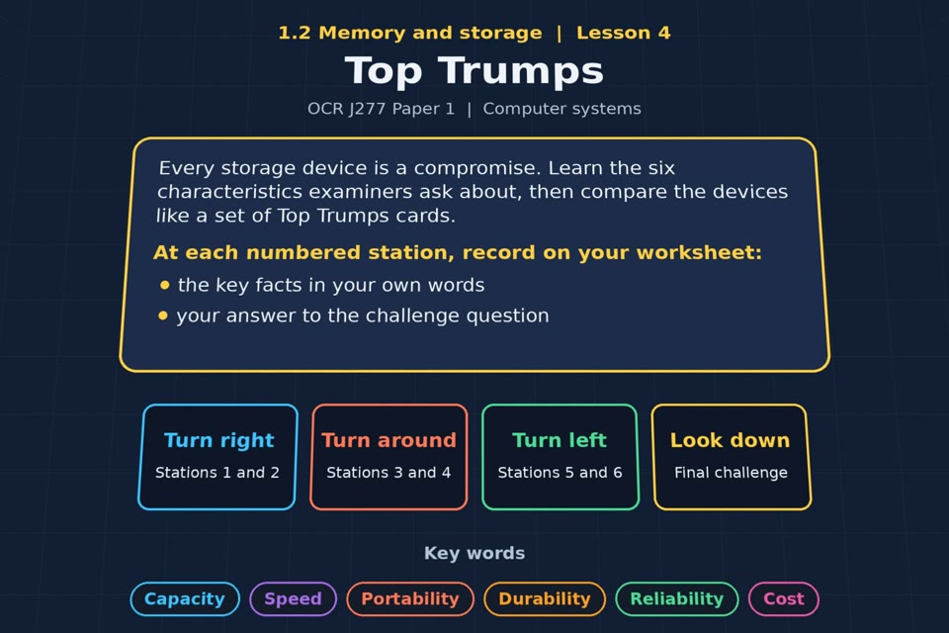

TOPIC 1.2 / LESSON 04
TOP TRUMPS
Characteristics of storage devices
KEY QUESTION
What are the differences between secondary storage devices?
1 / 17
Notes:
The image is a straight-on perspective preview of the actual experience. Start with the worksheet starter.
Sources: Revise 360 experiences/ms-l04.json and worksheets/MS_L04_TopTrumps_Worksheet.docx. Answers are indicative classroom examples, not an official OCR mark scheme. Calculations follow the worksheet’s decimal kB/MB/GB convention unless stated.

Slide 2
TOPIC 1.2 / LESSON 04 / WORKSHEET
By the end of this lesson
1.
know the characteristics of storage devices
2.
be able to compare devices using those characteristics
2 / 17
Notes:
These outcomes follow the wording of the lesson worksheet.
Sources: Revise 360 experiences/ms-l04.json and worksheets/MS_L04_TopTrumps_Worksheet.docx. Answers are indicative classroom examples, not an official OCR mark scheme. Calculations follow the worksheet’s decimal kB/MB/GB convention unless stated.

Slide 3
TOPIC 1.2 / LESSON 04 / WORKSHEET STARTER
Starter: before the experience
You are buying storage for a school trip camera. Write the five questions you would ask before choosing.
3 / 17
Notes:
Allow students to answer the exact worksheet starter before showing the sample answers.
Sources: Revise 360 experiences/ms-l04.json and worksheets/MS_L04_TopTrumps_Worksheet.docx. Answers are indicative classroom examples, not an official OCR mark scheme. Calculations follow the worksheet’s decimal kB/MB/GB convention unless stated.

Slide 4
TOPIC 1.2 / LESSON 04 / CHECK
Starter: sample answers
1.
Ask about capacity, speed, portability, durability and cost or reliability.
2.
For a trip camera, check that the card is compatible and can hold enough photos or video.
4 / 17
Notes:
Accept equivalent correct responses. These examples respond to the worksheet starter.
Sources: Revise 360 experiences/ms-l04.json and worksheets/MS_L04_TopTrumps_Worksheet.docx. Answers are indicative classroom examples, not an official OCR mark scheme. Calculations follow the worksheet’s decimal kB/MB/GB convention unless stated.

Slide 5
TOPIC 1.2 / LESSON 04 / WORKSHEET KEY TERMS
Key terminology quiz
1.
Capacity
2.
Durability
5 / 17
Notes:
Students define the two terms printed on the worksheet before marking them.
Sources: Revise 360 experiences/ms-l04.json and worksheets/MS_L04_TopTrumps_Worksheet.docx. Answers are indicative classroom examples, not an official OCR mark scheme. Calculations follow the worksheet’s decimal kB/MB/GB convention unless stated.

Slide 6
TOPIC 1.2 / LESSON 04 / CHECK
Key terminology: answers
Capacity
Capacity: the amount of data a storage device can hold, measured in bytes and larger units.
Durability
Durability: how well a device withstands handling, knocks or movement without damage.
6 / 17
Notes:
Reveal after students attempt the definitions; accept accurate wording in their own words.
Sources: Revise 360 experiences/ms-l04.json and worksheets/MS_L04_TopTrumps_Worksheet.docx. Answers are indicative classroom examples, not an official OCR mark scheme. Calculations follow the worksheet’s decimal kB/MB/GB convention unless stated.

Slide 7
TOPIC 1.2 / LESSON 04 / EXPERIENCE
Worksheet + experience
01 OPEN EXPERIENCE ↗
Open Top Trumps in Topic 1.2. Keep the worksheet beside you.
02 SIX STATIONS
Read each panel. Write the key fact IN YOUR OWN WORDS and answer the worksheet challenge before tapping its badge.
03 FINAL CHALLENGE
Complete the ★ task before tapping the star. Copy your score (out of 24), then finish the worksheet task or review.
04 PLENARY
Finish the experience in this lesson. Near the end, close it for the plenary knowledge checks.
7 / 17
Notes:
Leave this board slide visible during the experience. The OPEN EXPERIENCE label is a clickable link. Everyone should complete the experience and reach the plenary near the end of the lesson. First on-screen responses count.
Sources: Revise 360 experiences/ms-l04.json and worksheets/MS_L04_TopTrumps_Worksheet.docx. Answers are indicative classroom examples, not an official OCR mark scheme. Calculations follow the worksheet’s decimal kB/MB/GB convention unless stated.

Slide 8
TOPIC 1.2 / LESSON 04 / EXTENSION
Apply your learning
Top Trumps cards. Rate each device out of 5 for each characteristic, then add a typical capacity.
Use the task and table on your worksheet.
8 / 17
Notes:
This follows the task after the score on the worksheet. For revision, students use their results and outstanding work list.
Sources: Revise 360 experiences/ms-l04.json and worksheets/MS_L04_TopTrumps_Worksheet.docx. Answers are indicative classroom examples, not an official OCR mark scheme. Calculations follow the worksheet’s decimal kB/MB/GB convention unless stated.

Slide 9
TOPIC 1.2 / LESSON 04 / EXTENSION
Check and improve
A school needs fast laptop boot drives and cheap bulk storage for a server. Should it buy the same device for both?
9 / 17
Notes:
Use this question to deepen or correct the worksheet response before the plenary.
Sources: Revise 360 experiences/ms-l04.json and worksheets/MS_L04_TopTrumps_Worksheet.docx. Answers are indicative classroom examples, not an official OCR mark scheme. Calculations follow the worksheet’s decimal kB/MB/GB convention unless stated.

Slide 10
TOPIC 1.2 / LESSON 04 / CHECK
Application: sample answers
1.
Example ratings out of 5 (5 is best; for cost, 5 means low cost per GB): HDD 5/2/2/2/5; optical 2/1/4/2/4.
2.
SSD 4/5/5/5/2; tape 5/1/1/2/5. Ratings and typical capacities vary by model; justify the comparison.
3.
No. SSDs suit laptop boot drives for speed and resilience; high-capacity HDDs can be cheaper per GB for bulk server files.
10 / 17
Notes:
These are sample answers or a sample revision action. Ratings and open choices may vary with a justified device and context.
Sources: Revise 360 experiences/ms-l04.json and worksheets/MS_L04_TopTrumps_Worksheet.docx. Answers are indicative classroom examples, not an official OCR mark scheme. Calculations follow the worksheet’s decimal kB/MB/GB convention unless stated.

Slide 11
TOPIC 1.2 / LESSON 04 / ANSWERS
After the experience: stations 1–3
Check your key facts and challenge responses.
1 The six characteristics
Compare capacity, speed, portability, durability, reliability and cost. A server may prioritise capacity and reliability or cost per GB.
2 Magnetic: the card
A hard disk offers large capacity at low cost per GB, but spinning parts make it slower and less durable when moved.
3 Optical: the card
A Blu-ray disc is inexpensive to duplicate and distribute; it is slower to access and can be scratched.
11 / 17
Notes:
Show only after students have completed the experience. These concise points answer the station challenges and help students improve their own wording.
Sources: Revise 360 experiences/ms-l04.json and worksheets/MS_L04_TopTrumps_Worksheet.docx. Answers are indicative classroom examples, not an official OCR mark scheme. Calculations follow the worksheet’s decimal kB/MB/GB convention unless stated.

Slide 12
TOPIC 1.2 / LESSON 04 / ANSWERS
After the experience: stations 4–6
Check your key facts and challenge responses.
4 Solid state: the card
An SSD has no moving parts, so it is fast and durable for a laptop. Flash cells have a finite write life.
5 Head to head
The winner depends on the characteristic: SSD for speed and portable durability; HDD or tape for inexpensive bulk capacity.
6 Justify your choice
A camera uses a compatible SD card: it is small, portable, durable and fast enough to record images or video.
12 / 17
Notes:
Show only after students have completed the experience. These concise points answer the station challenges and help students improve their own wording.
Sources: Revise 360 experiences/ms-l04.json and worksheets/MS_L04_TopTrumps_Worksheet.docx. Answers are indicative classroom examples, not an official OCR mark scheme. Calculations follow the worksheet’s decimal kB/MB/GB convention unless stated.

Slide 13
TOPIC 1.2 / LESSON 04 / CHECK
Final challenge: answers 1–5
1.
Several terabytes, cheap, with spinning platters → Hard disk
2.
About 25 GB, thin, light and easily scratched → Optical disc
3.
The fastest of the four, with no moving parts → SSD
4.
Read in sequence, ideal for huge cheap archives → Tape
5.
Best for a laptop that gets carried everywhere → SSD
13 / 17
Notes:
Answers are in the same order as the worksheet final challenge and the experience star task. Pixel and sound sketches should be checked against the interactive pattern or wave.
Sources: Revise 360 experiences/ms-l04.json and worksheets/MS_L04_TopTrumps_Worksheet.docx. Answers are indicative classroom examples, not an official OCR mark scheme. Calculations follow the worksheet’s decimal kB/MB/GB convention unless stated.

Slide 14
TOPIC 1.2 / LESSON 04 / CHECK
Final challenge: answers 6–8
6.
Best for distributing a film to millions of homes → Optical disc
7.
Best value for a school server's bulk storage → Hard disk
8.
Best for backing up 500 TB for ten years → Tape
14 / 17
Notes:
Answers are in the same order as the worksheet final challenge and the experience star task. Pixel and sound sketches should be checked against the interactive pattern or wave.
Sources: Revise 360 experiences/ms-l04.json and worksheets/MS_L04_TopTrumps_Worksheet.docx. Answers are indicative classroom examples, not an official OCR mark scheme. Calculations follow the worksheet’s decimal kB/MB/GB convention unless stated.

Slide 15
TOPIC 1.2 / LESSON 04 / PLENARY
Plenary: questions
Close the experience. Answer from memory on the worksheet.
a) State two characteristics used to compare storage devices. [2]
b) Explain why an SSD is more suitable than a hard disk for a laptop. [4]
15 / 17
Notes:
These are the exact exam-practice questions from the worksheet. Allow independent writing before displaying the answer slides.
Sources: Revise 360 experiences/ms-l04.json and worksheets/MS_L04_TopTrumps_Worksheet.docx. Answers are indicative classroom examples, not an official OCR mark scheme. Calculations follow the worksheet’s decimal kB/MB/GB convention unless stated.

Slide 16
TOPIC 1.2 / LESSON 04 / CHECK
Plenary: answers
Indicative points. Credit accurate answers in students’ own words.
a) Any two valid characteristics, for example capacity and speed (also portability, durability, reliability or cost).
b) An SSD has no moving parts, so it tolerates carrying and knocks better than an HDD. It also offers faster access for booting and opening files; it can use less power.
16 / 17
Notes:
Classroom answer points, not an official OCR mark scheme. Ask students to correct or improve one answer.
Sources: Revise 360 experiences/ms-l04.json and worksheets/MS_L04_TopTrumps_Worksheet.docx. Answers are indicative classroom examples, not an official OCR mark scheme. Calculations follow the worksheet’s decimal kB/MB/GB convention unless stated.

Slide 17
TOPIC 1.2 / LESSON 04 / SELF-CHECK
How confident am I?
Select Not yet, Getting there or Confident for each objective on the worksheet.
1.
The six characteristics
2.
Comparing the three types
3.
Justifying a choice of device
17 / 17
Notes:
Use the exact confidence objectives from the worksheet. Students identify one area to revisit.
Sources: Revise 360 experiences/ms-l04.json and worksheets/MS_L04_TopTrumps_Worksheet.docx. Answers are indicative classroom examples, not an official OCR mark scheme. Calculations follow the worksheet’s decimal kB/MB/GB convention unless stated.

