Slide 1
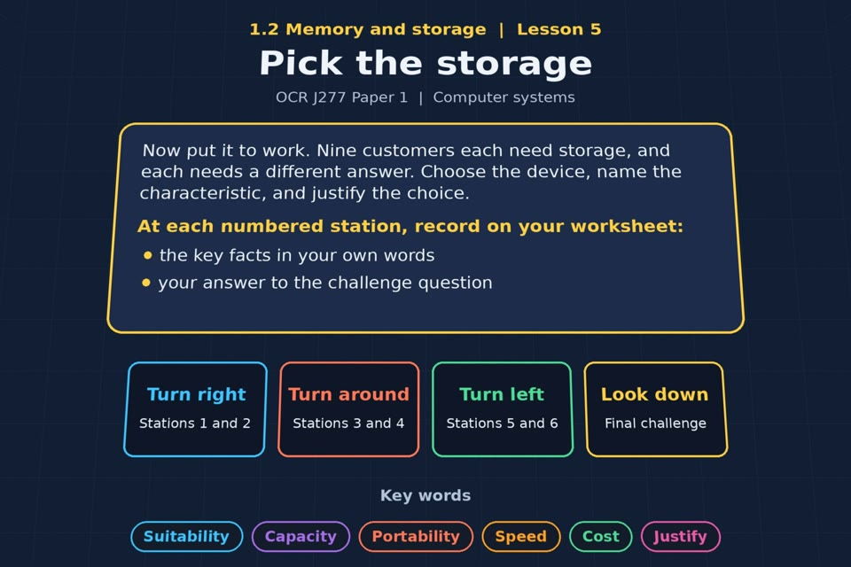

TOPIC 1.2 / LESSON 05
PICK THE STORAGE
Applications of storage
KEY QUESTION
What features of secondary storage make devices suitable for different situations?
1 / 17
Notes:
The image is a straight-on perspective preview of the actual experience. Start with the worksheet starter.
Sources: Revise 360 experiences/ms-l05.json and worksheets/MS_L05_PickTheStorage_Worksheet.docx. Answers are indicative classroom examples, not an official OCR mark scheme. Calculations follow the worksheet’s decimal kB/MB/GB convention unless stated.

Slide 2
TOPIC 1.2 / LESSON 05 / WORKSHEET
By the end of this lesson
1.
understand the suitability of storage devices for certain applications
2.
understand the advantages and disadvantages of devices based on their characteristics
2 / 17
Notes:
These outcomes follow the wording of the lesson worksheet.
Sources: Revise 360 experiences/ms-l05.json and worksheets/MS_L05_PickTheStorage_Worksheet.docx. Answers are indicative classroom examples, not an official OCR mark scheme. Calculations follow the worksheet’s decimal kB/MB/GB convention unless stated.

Slide 3
TOPIC 1.2 / LESSON 05 / WORKSHEET STARTER
Starter: before the experience
Pick three devices in the room and say what kind of storage each one uses, and why that suits it.
3 / 17
Notes:
Allow students to answer the exact worksheet starter before showing the sample answers.
Sources: Revise 360 experiences/ms-l05.json and worksheets/MS_L05_PickTheStorage_Worksheet.docx. Answers are indicative classroom examples, not an official OCR mark scheme. Calculations follow the worksheet’s decimal kB/MB/GB convention unless stated.

Slide 4
TOPIC 1.2 / LESSON 05 / CHECK
Starter: sample answers
1.
Examples: an SSD for a computer OS (speed), a USB flash drive for moving files (portability), and an HDD for shared files (capacity at low cost).
2.
Other devices earn credit when the storage type and reason fit the actual room.
4 / 17
Notes:
Accept equivalent correct responses. These examples respond to the worksheet starter.
Sources: Revise 360 experiences/ms-l05.json and worksheets/MS_L05_PickTheStorage_Worksheet.docx. Answers are indicative classroom examples, not an official OCR mark scheme. Calculations follow the worksheet’s decimal kB/MB/GB convention unless stated.

Slide 5
TOPIC 1.2 / LESSON 05 / WORKSHEET KEY TERMS
Key terminology quiz
1.
Portability
2.
Suitability
5 / 17
Notes:
Students define the two terms printed on the worksheet before marking them.
Sources: Revise 360 experiences/ms-l05.json and worksheets/MS_L05_PickTheStorage_Worksheet.docx. Answers are indicative classroom examples, not an official OCR mark scheme. Calculations follow the worksheet’s decimal kB/MB/GB convention unless stated.

Slide 6
TOPIC 1.2 / LESSON 05 / CHECK
Key terminology: answers
Portability
Portability: how easy a storage device is to carry and use in different places.
Suitability
Suitability: how well a device’s capacity, speed, durability, portability and cost meet a specific need.
6 / 17
Notes:
Reveal after students attempt the definitions; accept accurate wording in their own words.
Sources: Revise 360 experiences/ms-l05.json and worksheets/MS_L05_PickTheStorage_Worksheet.docx. Answers are indicative classroom examples, not an official OCR mark scheme. Calculations follow the worksheet’s decimal kB/MB/GB convention unless stated.

Slide 7
TOPIC 1.2 / LESSON 05 / EXPERIENCE
Worksheet + experience
01 OPEN EXPERIENCE ↗
Open Pick the storage in Topic 1.2. Keep the worksheet beside you.
02 SIX STATIONS
Read each panel. Write the key fact IN YOUR OWN WORDS and answer the worksheet challenge before tapping its badge.
03 FINAL CHALLENGE
Complete the ★ task before tapping the star. Copy your score (out of 23), then finish the worksheet task or review.
04 PLENARY
Finish the experience in this lesson. Near the end, close it for the plenary knowledge checks.
7 / 17
Notes:
Leave this board slide visible during the experience. The OPEN EXPERIENCE label is a clickable link. Everyone should complete the experience and reach the plenary near the end of the lesson. First on-screen responses count.
Sources: Revise 360 experiences/ms-l05.json and worksheets/MS_L05_PickTheStorage_Worksheet.docx. Answers are indicative classroom examples, not an official OCR mark scheme. Calculations follow the worksheet’s decimal kB/MB/GB convention unless stated.

Slide 8
TOPIC 1.2 / LESSON 05 / EXTENSION
Apply your learning
Nine situations. Name the device and justify your choice using a characteristic.
Use the task and table on your worksheet.
8 / 17
Notes:
This follows the task after the score on the worksheet. For revision, students use their results and outstanding work list.
Sources: Revise 360 experiences/ms-l05.json and worksheets/MS_L05_PickTheStorage_Worksheet.docx. Answers are indicative classroom examples, not an official OCR mark scheme. Calculations follow the worksheet’s decimal kB/MB/GB convention unless stated.

Slide 9
TOPIC 1.2 / LESSON 05 / EXTENSION
Check and improve
Why is “choose a hard disk because it is cheap” too weak as an exam justification?
9 / 17
Notes:
Use this question to deepen or correct the worksheet response before the plenary.
Sources: Revise 360 experiences/ms-l05.json and worksheets/MS_L05_PickTheStorage_Worksheet.docx. Answers are indicative classroom examples, not an official OCR mark scheme. Calculations follow the worksheet’s decimal kB/MB/GB convention unless stated.

Slide 10
TOPIC 1.2 / LESSON 05 / CHECK
Application: sample answers
1.
Film to shops → Blu-ray: cheap to duplicate. Work between sites → USB flash drive: small and portable.
2.
MP3 player → flash; video camera → SD card: compact, durable storage. Console game → optical disc for physical distribution.
3.
School network → HDD: high capacity at low cost per GB. Operating system → SSD: fast access.
4.
Training-video archive → magnetic tape: cheap for huge, rarely accessed data. Photo backup → external HDD: high capacity; keep more than one copy.
5.
Link a named characteristic to the use case: an HDD provides large capacity at low cost per GB for a school’s bulk files, where portability is less important.
10 / 17
Notes:
These are sample answers or a sample revision action. Ratings and open choices may vary with a justified device and context.
Sources: Revise 360 experiences/ms-l05.json and worksheets/MS_L05_PickTheStorage_Worksheet.docx. Answers are indicative classroom examples, not an official OCR mark scheme. Calculations follow the worksheet’s decimal kB/MB/GB convention unless stated.

Slide 11
TOPIC 1.2 / LESSON 05 / ANSWERS
After the experience: stations 1–3
Check your key facts and challenge responses.
1 How to choose
Ask about the amount of data, required speed, portability, durability, compatibility and budget.
2 Distributing a film
An optical Blu-ray disc can distribute a film widely at a low unit cost and can be read by compatible players.
3 Carrying work home
A USB flash drive or portable SSD carries work easily between sites; protect important work with a backup.
11 / 17
Notes:
Show only after students have completed the experience. These concise points answer the station challenges and help students improve their own wording.
Sources: Revise 360 experiences/ms-l05.json and worksheets/MS_L05_PickTheStorage_Worksheet.docx. Answers are indicative classroom examples, not an official OCR mark scheme. Calculations follow the worksheet’s decimal kB/MB/GB convention unless stated.

Slide 12
TOPIC 1.2 / LESSON 05 / ANSWERS
After the experience: stations 4–6
Check your key facts and challenge responses.
4 Music, cameras and consoles
An MP3 player and camera commonly use flash memory; a physical console game may use an optical disc.
5 Servers and operating systems
A server may use HDDs for cheap bulk capacity and SSDs for fast system or frequently used data.
6 Long-term archives
Magnetic tape can suit very large, seldom-used archives. An external HDD can back up photos; keep a second copy.
12 / 17
Notes:
Show only after students have completed the experience. These concise points answer the station challenges and help students improve their own wording.
Sources: Revise 360 experiences/ms-l05.json and worksheets/MS_L05_PickTheStorage_Worksheet.docx. Answers are indicative classroom examples, not an official OCR mark scheme. Calculations follow the worksheet’s decimal kB/MB/GB convention unless stated.

Slide 13
TOPIC 1.2 / LESSON 05 / CHECK
Final challenge: answers 1–5
1.
Distributing a film to shops → Optical
2.
Transferring work between home and an office → Solid state
3.
Storing tracks on an MP3 player → Solid state
4.
Main storage for a school network → Magnetic
5.
Storing video on a video camera → Solid state
13 / 17
Notes:
Answers are in the same order as the worksheet final challenge and the experience star task. Pixel and sound sketches should be checked against the interactive pattern or wave.
Sources: Revise 360 experiences/ms-l05.json and worksheets/MS_L05_PickTheStorage_Worksheet.docx. Answers are indicative classroom examples, not an official OCR mark scheme. Calculations follow the worksheet’s decimal kB/MB/GB convention unless stated.

Slide 14
TOPIC 1.2 / LESSON 05 / CHECK
Final challenge: answers 6–9
6.
Distributing a video game for a console → Optical
7.
Storing a computer's operating system → Solid state
8.
Long-term storage of training videos → Magnetic
9.
Long-term backup of photos → Magnetic
14 / 17
Notes:
Answers are in the same order as the worksheet final challenge and the experience star task. Pixel and sound sketches should be checked against the interactive pattern or wave.
Sources: Revise 360 experiences/ms-l05.json and worksheets/MS_L05_PickTheStorage_Worksheet.docx. Answers are indicative classroom examples, not an official OCR mark scheme. Calculations follow the worksheet’s decimal kB/MB/GB convention unless stated.

Slide 15
TOPIC 1.2 / LESSON 05 / PLENARY
Plenary: questions
Close the experience. Answer from memory on the worksheet.
a) A photographer needs storage for use on location. Recommend a device and justify your choice. [4]
b) Explain why a school uses magnetic hard disks rather than SSDs for its main file storage. [3]
15 / 17
Notes:
These are the exact exam-practice questions from the worksheet. Allow independent writing before displaying the answer slides.
Sources: Revise 360 experiences/ms-l05.json and worksheets/MS_L05_PickTheStorage_Worksheet.docx. Answers are indicative classroom examples, not an official OCR mark scheme. Calculations follow the worksheet’s decimal kB/MB/GB convention unless stated.

Slide 16
TOPIC 1.2 / LESSON 05 / CHECK
Plenary: answers
Indicative points. Credit accurate answers in students’ own words.
a) A compatible SD card is small and light for use on location, resists knocks because it has no moving parts, and offers enough capacity and write speed for photos.
b) A school may need many terabytes of bulk capacity. HDDs offer a lower cost per GB than SSDs, and maximum speed may matter less for archived or shared files.
16 / 17
Notes:
Classroom answer points, not an official OCR mark scheme. Ask students to correct or improve one answer.
Sources: Revise 360 experiences/ms-l05.json and worksheets/MS_L05_PickTheStorage_Worksheet.docx. Answers are indicative classroom examples, not an official OCR mark scheme. Calculations follow the worksheet’s decimal kB/MB/GB convention unless stated.

Slide 17
TOPIC 1.2 / LESSON 05 / SELF-CHECK
How confident am I?
Select Not yet, Getting there or Confident for each objective on the worksheet.
1.
Choosing a device for a situation
2.
Justifying with characteristics
3.
Advantages and disadvantages
17 / 17
Notes:
Use the exact confidence objectives from the worksheet. Students identify one area to revisit.
Sources: Revise 360 experiences/ms-l05.json and worksheets/MS_L05_PickTheStorage_Worksheet.docx. Answers are indicative classroom examples, not an official OCR mark scheme. Calculations follow the worksheet’s decimal kB/MB/GB convention unless stated.

