Slide 1
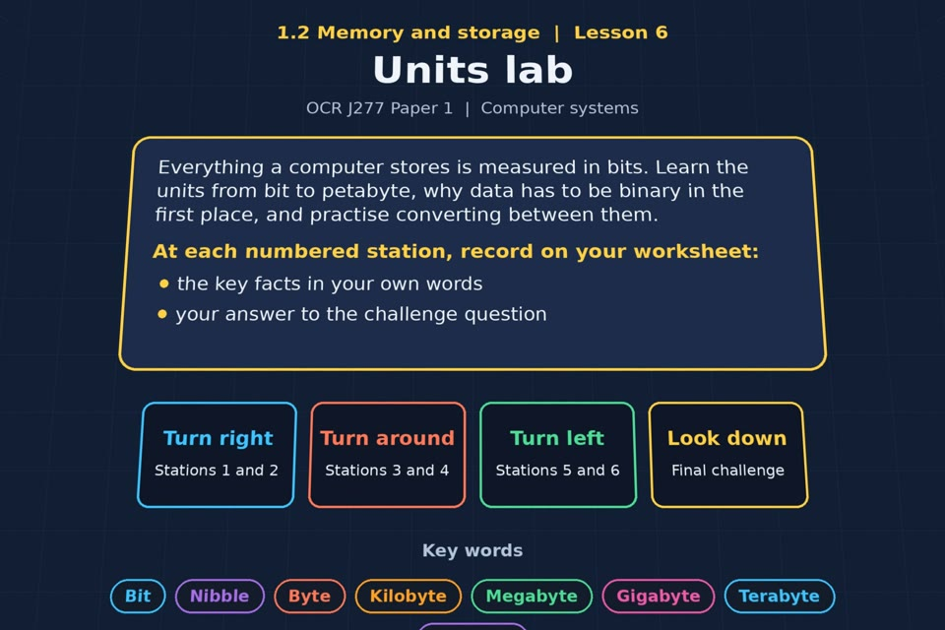

TOPIC 1.2 / LESSON 06
UNITS LAB
Units of data storage
KEY QUESTION
Why is data stored in binary?
1 / 19
Notes:
The image is a straight-on perspective preview of the actual experience. Start with the worksheet starter.
Sources: Revise 360 experiences/ms-l06.json and worksheets/MS_L06_UnitsLab_Worksheet.docx. Answers are indicative classroom examples, not an official OCR mark scheme. Calculations follow the worksheet’s decimal kB/MB/GB convention unless stated.

Slide 2
TOPIC 1.2 / LESSON 06 / WORKSHEET
By the end of this lesson
1.
know the units bit, nibble, byte, kilobyte, megabyte, gigabyte, terabyte and petabyte
2.
be able to convert between units
3.
understand that data must be converted to binary to be processed
2 / 19
Notes:
These outcomes follow the wording of the lesson worksheet.
Sources: Revise 360 experiences/ms-l06.json and worksheets/MS_L06_UnitsLab_Worksheet.docx. Answers are indicative classroom examples, not an official OCR mark scheme. Calculations follow the worksheet’s decimal kB/MB/GB convention unless stated.

Slide 3
TOPIC 1.2 / LESSON 06 / WORKSHEET STARTER
Starter: before the experience
A light switch has two positions. Explain how you could send a message to a friend using only that switch.
3 / 19
Notes:
Allow students to answer the exact worksheet starter before showing the sample answers.
Sources: Revise 360 experiences/ms-l06.json and worksheets/MS_L06_UnitsLab_Worksheet.docx. Answers are indicative classroom examples, not an official OCR mark scheme. Calculations follow the worksheet’s decimal kB/MB/GB convention unless stated.

Slide 4
TOPIC 1.2 / LESSON 06 / CHECK
Starter: sample answers
1.
Agree a code: switch off = 0 and on = 1. Send a sequence of states or timed flashes that the friend can decode.
2.
Two reliable states can represent binary digits; combining more digits gives more possible messages.
4 / 19
Notes:
Accept equivalent correct responses. These examples respond to the worksheet starter.
Sources: Revise 360 experiences/ms-l06.json and worksheets/MS_L06_UnitsLab_Worksheet.docx. Answers are indicative classroom examples, not an official OCR mark scheme. Calculations follow the worksheet’s decimal kB/MB/GB convention unless stated.

Slide 5
TOPIC 1.2 / LESSON 06 / WORKSHEET KEY TERMS
Key terminology quiz
1.
Bit
2.
Byte
5 / 19
Notes:
Students define the two terms printed on the worksheet before marking them.
Sources: Revise 360 experiences/ms-l06.json and worksheets/MS_L06_UnitsLab_Worksheet.docx. Answers are indicative classroom examples, not an official OCR mark scheme. Calculations follow the worksheet’s decimal kB/MB/GB convention unless stated.

Slide 6
TOPIC 1.2 / LESSON 06 / CHECK
Key terminology: answers
Bit
Bit: one binary digit, either 0 or 1.
Byte
Byte: a group of 8 bits.
6 / 19
Notes:
Reveal after students attempt the definitions; accept accurate wording in their own words.
Sources: Revise 360 experiences/ms-l06.json and worksheets/MS_L06_UnitsLab_Worksheet.docx. Answers are indicative classroom examples, not an official OCR mark scheme. Calculations follow the worksheet’s decimal kB/MB/GB convention unless stated.

Slide 7
TOPIC 1.2 / LESSON 06 / EXPERIENCE
Worksheet + experience
01 OPEN EXPERIENCE ↗
Open Units lab in Topic 1.2. Keep the worksheet beside you.
02 SIX STATIONS
Read each panel. Write the key fact IN YOUR OWN WORDS and answer the worksheet challenge before tapping its badge.
03 FINAL CHALLENGE
Complete the ★ task before tapping the star. Copy your score (out of 27), then finish the worksheet task or review.
04 PLENARY
Finish the experience in this lesson. Near the end, close it for the plenary knowledge checks.
7 / 19
Notes:
Leave this board slide visible during the experience. The OPEN EXPERIENCE label is a clickable link. Everyone should complete the experience and reach the plenary near the end of the lesson. First on-screen responses count.
Sources: Revise 360 experiences/ms-l06.json and worksheets/MS_L06_UnitsLab_Worksheet.docx. Answers are indicative classroom examples, not an official OCR mark scheme. Calculations follow the worksheet’s decimal kB/MB/GB convention unless stated.

Slide 8
TOPIC 1.2 / LESSON 06 / EXTENSION
Apply your learning
Task: unit conversions. Complete the conversions. Use 1,000 for each step.
Use the task and table on your worksheet.
8 / 19
Notes:
This follows the task after the score on the worksheet. For revision, students use their results and outstanding work list.
Sources: Revise 360 experiences/ms-l06.json and worksheets/MS_L06_UnitsLab_Worksheet.docx. Answers are indicative classroom examples, not an official OCR mark scheme. Calculations follow the worksheet’s decimal kB/MB/GB convention unless stated.

Slide 9
TOPIC 1.2 / LESSON 06 / EXTENSION
Check and improve
Show 5 in a nibble and 65 in a byte. Why must the leading zeros be written?
9 / 19
Notes:
Use this question to deepen or correct the worksheet response before the plenary.
Sources: Revise 360 experiences/ms-l06.json and worksheets/MS_L06_UnitsLab_Worksheet.docx. Answers are indicative classroom examples, not an official OCR mark scheme. Calculations follow the worksheet’s decimal kB/MB/GB convention unless stated.

Slide 10
TOPIC 1.2 / LESSON 06 / CHECK
Application: sample answers
1.
4 kB = 4,000 bytes; 3,500 MB = 3.5 GB; 2 GB = 2,000 MB.
2.
6,000 bits = 750 bytes; 0.5 TB = 500 GB. Use 1,000 for each decimal unit step and 8 bits per byte.
3.
5 = 0101 (4 bits). 65 = 01000001 (8 bits). Leading zeros show the required number of places, even though they do not change the value.
10 / 19
Notes:
These are sample answers or a sample revision action. Ratings and open choices may vary with a justified device and context.
Sources: Revise 360 experiences/ms-l06.json and worksheets/MS_L06_UnitsLab_Worksheet.docx. Answers are indicative classroom examples, not an official OCR mark scheme. Calculations follow the worksheet’s decimal kB/MB/GB convention unless stated.

Slide 11
TOPIC 1.2 / LESSON 06 / ANSWERS
After the experience: stations 1–3
Check your key facts and challenge responses.
1 Why binary?
Electronic circuits can represent two reliable states, so data is encoded as sequences of 0s and 1s.
2 Bits, nibbles and bytes
A bit is one 0 or 1; a nibble is 4 bits; a byte is 8 bits. Five in a nibble is 0101.
3 Kilo, mega, giga
Order: bit, nibble, byte, kB, MB, GB, TB, PB. The worksheet uses decimal steps of 1,000; 1 GB = 1,000 MB.
11 / 19
Notes:
Show only after students have completed the experience. These concise points answer the station challenges and help students improve their own wording.
Sources: Revise 360 experiences/ms-l06.json and worksheets/MS_L06_UnitsLab_Worksheet.docx. Answers are indicative classroom examples, not an official OCR mark scheme. Calculations follow the worksheet’s decimal kB/MB/GB convention unless stated.

Slide 12
TOPIC 1.2 / LESSON 06 / ANSWERS
After the experience: stations 4–6
Check your key facts and challenge responses.
4 Converting units
Move three decimal-unit places per step: 4,500 MB = 4.5 GB; 3 GB = 3,000 MB; 2 kB = 2,000 bytes.
5 Storing a number
65 is 64 + 1, so its 8-bit binary representation is 01000001.
6 How big is a petabyte?
1 PB = 1,000,000 GB in decimal units. At 8 GB per stick, that is 125,000 sticks.
12 / 19
Notes:
Show only after students have completed the experience. These concise points answer the station challenges and help students improve their own wording.
Sources: Revise 360 experiences/ms-l06.json and worksheets/MS_L06_UnitsLab_Worksheet.docx. Answers are indicative classroom examples, not an official OCR mark scheme. Calculations follow the worksheet’s decimal kB/MB/GB convention unless stated.

Slide 13
TOPIC 1.2 / LESSON 06 / CHECK
Final challenge: answers 1–5
1.
Show the number 200 in 8-bit binary → 11001000. 200 is 11001000.
2.
1,000 bytes → Kilobyte
3.
1,000,000 bytes → Megabyte
4.
1,000 kB → Megabyte
5.
1,000 MB → Gigabyte
13 / 19
Notes:
Answers are in the same order as the worksheet final challenge and the experience star task. Pixel and sound sketches should be checked against the interactive pattern or wave.
Sources: Revise 360 experiences/ms-l06.json and worksheets/MS_L06_UnitsLab_Worksheet.docx. Answers are indicative classroom examples, not an official OCR mark scheme. Calculations follow the worksheet’s decimal kB/MB/GB convention unless stated.

Slide 14
TOPIC 1.2 / LESSON 06 / CHECK
Final challenge: answers 6–7
6.
10⁹ bytes → Gigabyte
7.
A typical short photo file → Megabyte
14 / 19
Notes:
Answers are in the same order as the worksheet final challenge and the experience star task. Pixel and sound sketches should be checked against the interactive pattern or wave.
Sources: Revise 360 experiences/ms-l06.json and worksheets/MS_L06_UnitsLab_Worksheet.docx. Answers are indicative classroom examples, not an official OCR mark scheme. Calculations follow the worksheet’s decimal kB/MB/GB convention unless stated.

Slide 15
TOPIC 1.2 / LESSON 06 / PLENARY
Plenary: questions 1–2
Close the experience. Answer from memory on the worksheet.
a) State how many bits there are in a byte. [1]
b) Show how the denary number 5 is stored in a nibble. [1]
15 / 19
Notes:
These are the exact exam-practice questions from the worksheet. Allow independent writing before displaying the answer slides.
Sources: Revise 360 experiences/ms-l06.json and worksheets/MS_L06_UnitsLab_Worksheet.docx. Answers are indicative classroom examples, not an official OCR mark scheme. Calculations follow the worksheet’s decimal kB/MB/GB convention unless stated.

Slide 16
TOPIC 1.2 / LESSON 06 / PLENARY
Plenary: questions 3–4
Close the experience. Answer from memory on the worksheet.
c) A file is 2,500 MB. Convert this to gigabytes. [1]
d) Explain why data must be converted to binary. [2]
16 / 19
Notes:
These are the exact exam-practice questions from the worksheet. Allow independent writing before displaying the answer slides.
Sources: Revise 360 experiences/ms-l06.json and worksheets/MS_L06_UnitsLab_Worksheet.docx. Answers are indicative classroom examples, not an official OCR mark scheme. Calculations follow the worksheet’s decimal kB/MB/GB convention unless stated.

Slide 17
TOPIC 1.2 / LESSON 06 / CHECK
Plenary: answers 1–2
Indicative points. Credit accurate answers in students’ own words.
a) 8 bits.
b) 5 in a 4-bit nibble is 0101.
17 / 19
Notes:
Classroom answer points, not an official OCR mark scheme. Ask students to correct or improve one answer.
Sources: Revise 360 experiences/ms-l06.json and worksheets/MS_L06_UnitsLab_Worksheet.docx. Answers are indicative classroom examples, not an official OCR mark scheme. Calculations follow the worksheet’s decimal kB/MB/GB convention unless stated.

Slide 18
TOPIC 1.2 / LESSON 06 / CHECK
Plenary: answers 3–4
Indicative points. Credit accurate answers in students’ own words.
c) 2,500 MB ÷ 1,000 = 2.5 GB.
d) Digital circuits can reliably represent two states. Encoding data as 0s and 1s lets the computer store and process it.
18 / 19
Notes:
Classroom answer points, not an official OCR mark scheme. Ask students to correct or improve one answer.
Sources: Revise 360 experiences/ms-l06.json and worksheets/MS_L06_UnitsLab_Worksheet.docx. Answers are indicative classroom examples, not an official OCR mark scheme. Calculations follow the worksheet’s decimal kB/MB/GB convention unless stated.

Slide 19
TOPIC 1.2 / LESSON 06 / SELF-CHECK
How confident am I?
Select Not yet, Getting there or Confident for each objective on the worksheet.
1.
Why data is binary
2.
The units from bit to petabyte
3.
Converting between units
19 / 19
Notes:
Use the exact confidence objectives from the worksheet. Students identify one area to revisit.
Sources: Revise 360 experiences/ms-l06.json and worksheets/MS_L06_UnitsLab_Worksheet.docx. Answers are indicative classroom examples, not an official OCR mark scheme. Calculations follow the worksheet’s decimal kB/MB/GB convention unless stated.

