Slide 1
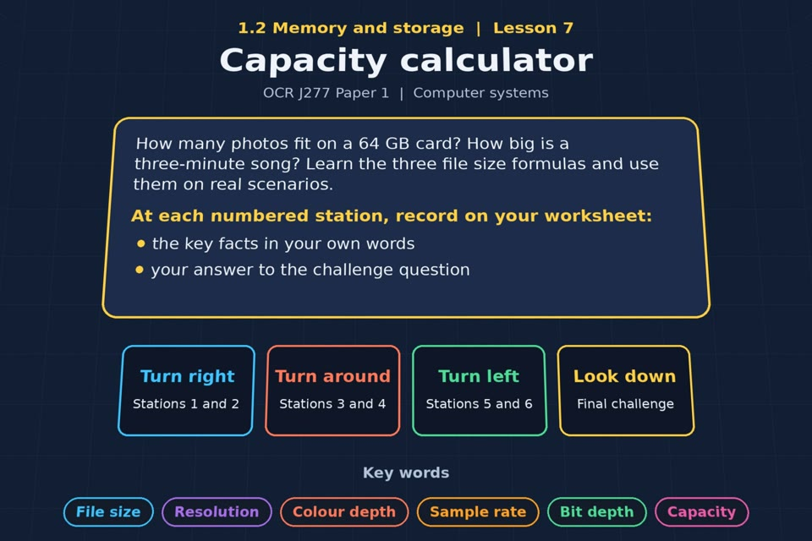

TOPIC 1.2 / LESSON 07
CAPACITY CALCULATOR
Data capacity and calculations
KEY QUESTION
How do you calculate data capacity?
1 / 18
Notes:
The image is a straight-on perspective preview of the actual experience. Start with the worksheet starter.
Sources: Revise 360 experiences/ms-l07.json and worksheets/MS_L07_CapacityCalculator_Worksheet.docx. Answers are indicative classroom examples, not an official OCR mark scheme. Calculations follow the worksheet’s decimal kB/MB/GB convention unless stated.

Slide 2
TOPIC 1.2 / LESSON 07 / WORKSHEET
By the end of this lesson
1.
know what data capacity means
2.
understand how to calculate data capacity requirements
2 / 18
Notes:
These outcomes follow the wording of the lesson worksheet.
Sources: Revise 360 experiences/ms-l07.json and worksheets/MS_L07_CapacityCalculator_Worksheet.docx. Answers are indicative classroom examples, not an official OCR mark scheme. Calculations follow the worksheet’s decimal kB/MB/GB convention unless stated.

Slide 3
TOPIC 1.2 / LESSON 07 / WORKSHEET STARTER
Starter: before the experience
A phone advert says 128 GB of storage. Work out roughly how many 4 MB photos that is, and check with a partner.
3 / 18
Notes:
Allow students to answer the exact worksheet starter before showing the sample answers.
Sources: Revise 360 experiences/ms-l07.json and worksheets/MS_L07_CapacityCalculator_Worksheet.docx. Answers are indicative classroom examples, not an official OCR mark scheme. Calculations follow the worksheet’s decimal kB/MB/GB convention unless stated.

Slide 4
TOPIC 1.2 / LESSON 07 / CHECK
Starter: sample answers
1.
Using the worksheet’s decimal units: 128 GB = 128,000 MB. At 4 MB each, about 32,000 photos fit.
2.
The real number may be lower because of system files, metadata and varying photo sizes.
4 / 18
Notes:
Accept equivalent correct responses. These examples respond to the worksheet starter.
Sources: Revise 360 experiences/ms-l07.json and worksheets/MS_L07_CapacityCalculator_Worksheet.docx. Answers are indicative classroom examples, not an official OCR mark scheme. Calculations follow the worksheet’s decimal kB/MB/GB convention unless stated.

Slide 5
TOPIC 1.2 / LESSON 07 / WORKSHEET KEY TERMS
Key terminology quiz
1.
Data capacity
2.
File size
5 / 18
Notes:
Students define the two terms printed on the worksheet before marking them.
Sources: Revise 360 experiences/ms-l07.json and worksheets/MS_L07_CapacityCalculator_Worksheet.docx. Answers are indicative classroom examples, not an official OCR mark scheme. Calculations follow the worksheet’s decimal kB/MB/GB convention unless stated.

Slide 6
TOPIC 1.2 / LESSON 07 / CHECK
Key terminology: answers
Data capacity
Data capacity: the maximum amount of data a storage device can hold.
File size
File size: the amount of storage one file uses, usually measured in bytes.
6 / 18
Notes:
Reveal after students attempt the definitions; accept accurate wording in their own words.
Sources: Revise 360 experiences/ms-l07.json and worksheets/MS_L07_CapacityCalculator_Worksheet.docx. Answers are indicative classroom examples, not an official OCR mark scheme. Calculations follow the worksheet’s decimal kB/MB/GB convention unless stated.

Slide 7
TOPIC 1.2 / LESSON 07 / EXPERIENCE
Worksheet + experience
01 OPEN EXPERIENCE ↗
Open Capacity calculator in Topic 1.2. Keep the worksheet beside you.
02 SIX STATIONS
Read each panel. Write the key fact IN YOUR OWN WORDS and answer the worksheet challenge before tapping its badge.
03 FINAL CHALLENGE
Complete the ★ task before tapping the star. Copy your score (out of 15), then finish the worksheet task or review.
04 PLENARY
Finish the experience in this lesson. Near the end, close it for the plenary knowledge checks.
7 / 18
Notes:
Leave this board slide visible during the experience. The OPEN EXPERIENCE label is a clickable link. Everyone should complete the experience and reach the plenary near the end of the lesson. First on-screen responses count.
Sources: Revise 360 experiences/ms-l07.json and worksheets/MS_L07_CapacityCalculator_Worksheet.docx. Answers are indicative classroom examples, not an official OCR mark scheme. Calculations follow the worksheet’s decimal kB/MB/GB convention unless stated.

Slide 8
TOPIC 1.2 / LESSON 07 / EXTENSION
Apply your learning
Three capacity scenarios. Show your working for each, and give the answer in a sensible unit.
Use the task and table on your worksheet.
8 / 18
Notes:
This follows the task after the score on the worksheet. For revision, students use their results and outstanding work list.
Sources: Revise 360 experiences/ms-l07.json and worksheets/MS_L07_CapacityCalculator_Worksheet.docx. Answers are indicative classroom examples, not an official OCR mark scheme. Calculations follow the worksheet’s decimal kB/MB/GB convention unless stated.

Slide 9
TOPIC 1.2 / LESSON 07 / EXTENSION
Check and improve
A student gets 1,920,000 for a 600 × 400 image at 8-bit colour depth and calls the answer bytes. What is wrong?
9 / 18
Notes:
Use this question to deepen or correct the worksheet response before the plenary.
Sources: Revise 360 experiences/ms-l07.json and worksheets/MS_L07_CapacityCalculator_Worksheet.docx. Answers are indicative classroom examples, not an official OCR mark scheme. Calculations follow the worksheet’s decimal kB/MB/GB convention unless stated.

Slide 10
TOPIC 1.2 / LESSON 07 / CHECK
Application: sample answers
1.
Image: 1,200 × 900 × 24 = 25,920,000 bits = 3,240,000 bytes = 3.24 MB.
2.
Mono sound: 180 × 44,100 × 16 = 127,008,000 bits = 15,876,000 bytes = 15.876 MB.
3.
Text: 5,000 × 8 = 40,000 bits = 5,000 bytes = 5 kB.
4.
600 × 400 × 8 = 1,920,000 bits. Divide by 8 to get 240,000 bytes, then by 1,000 to get 240 kB.
10 / 18
Notes:
These are sample answers or a sample revision action. Ratings and open choices may vary with a justified device and context.
Sources: Revise 360 experiences/ms-l07.json and worksheets/MS_L07_CapacityCalculator_Worksheet.docx. Answers are indicative classroom examples, not an official OCR mark scheme. Calculations follow the worksheet’s decimal kB/MB/GB convention unless stated.

Slide 11
TOPIC 1.2 / LESSON 07 / ANSWERS
After the experience: stations 1–3
Check your key facts and challenge responses.
1 What is data capacity?
Put capacity and file size in the same unit, then divide capacity by the size per file.
2 Image file size
Image size = width × height × colour depth. 1,000 × 800 × 8 = 6,400,000 bits = 800,000 bytes.
3 Sound file size
Mono sound size = sample rate × bit depth × duration. 44,100 × 16 × 30 = 21,168,000 bits.
11 / 18
Notes:
Show only after students have completed the experience. These concise points answer the station challenges and help students improve their own wording.
Sources: Revise 360 experiences/ms-l07.json and worksheets/MS_L07_CapacityCalculator_Worksheet.docx. Answers are indicative classroom examples, not an official OCR mark scheme. Calculations follow the worksheet’s decimal kB/MB/GB convention unless stated.

Slide 12
TOPIC 1.2 / LESSON 07 / ANSWERS
After the experience: stations 4–6
Check your key facts and challenge responses.
4 Text file size
Text size = characters × bits per character. 2,000 × 8 = 16,000 bits = 2,000 bytes.
5 Scenario practice
300 × 3 MB = 900 MB, so the photos fit on a 1 GB (1,000 MB) stick, ignoring overhead.
6 Estimating
The formula gives an uncompressed estimate. JPEG compression often makes the actual file smaller; metadata adds some data.
12 / 18
Notes:
Show only after students have completed the experience. These concise points answer the station challenges and help students improve their own wording.
Sources: Revise 360 experiences/ms-l07.json and worksheets/MS_L07_CapacityCalculator_Worksheet.docx. Answers are indicative classroom examples, not an official OCR mark scheme. Calculations follow the worksheet’s decimal kB/MB/GB convention unless stated.

Slide 13
TOPIC 1.2 / LESSON 07 / CHECK
Final challenge: answers
1.
480,000. 800 × 600 × 8 = 3,840,000 bits, and ÷ 8 = 480,000 bytes.
2.
19,200,000. 20,000 × 16 × 60 = 19,200,000 bits.
3.
8,000. 4,000 × 16 = 64,000 bits, and ÷ 8 = 8,000 bytes.
13 / 18
Notes:
Answers are in the same order as the worksheet final challenge and the experience star task. Pixel and sound sketches should be checked against the interactive pattern or wave.
Sources: Revise 360 experiences/ms-l07.json and worksheets/MS_L07_CapacityCalculator_Worksheet.docx. Answers are indicative classroom examples, not an official OCR mark scheme. Calculations follow the worksheet’s decimal kB/MB/GB convention unless stated.

Slide 14
TOPIC 1.2 / LESSON 07 / PLENARY
Plenary: questions 1–2
Close the experience. Answer from memory on the worksheet.
a) State the formula for calculating the file size of a bitmap image. [1]
b) An image is 600 × 400 pixels with a colour depth of 8 bits. Calculate the file size in kilobytes. Show your working. [3]
14 / 18
Notes:
These are the exact exam-practice questions from the worksheet. Allow independent writing before displaying the answer slides.
Sources: Revise 360 experiences/ms-l07.json and worksheets/MS_L07_CapacityCalculator_Worksheet.docx. Answers are indicative classroom examples, not an official OCR mark scheme. Calculations follow the worksheet’s decimal kB/MB/GB convention unless stated.

Slide 15
TOPIC 1.2 / LESSON 07 / PLENARY
Plenary: question 3
Close the experience. Answer from memory on the worksheet.
c) A sound is sampled at 16,000 Hz with a bit depth of 8 for 20 seconds. Calculate the file size in kilobytes. [3]
15 / 18
Notes:
These are the exact exam-practice questions from the worksheet. Allow independent writing before displaying the answer slides.
Sources: Revise 360 experiences/ms-l07.json and worksheets/MS_L07_CapacityCalculator_Worksheet.docx. Answers are indicative classroom examples, not an official OCR mark scheme. Calculations follow the worksheet’s decimal kB/MB/GB convention unless stated.

Slide 16
TOPIC 1.2 / LESSON 07 / CHECK
Plenary: answers 1–2
Indicative points. Credit accurate answers in students’ own words.
a) Bitmap size in bits = width in pixels × height in pixels × colour depth in bits per pixel.
b) 600 × 400 × 8 = 1,920,000 bits; ÷ 8 = 240,000 bytes; ÷ 1,000 = 240 kB.
16 / 18
Notes:
Classroom answer points, not an official OCR mark scheme. Ask students to correct or improve one answer.
Sources: Revise 360 experiences/ms-l07.json and worksheets/MS_L07_CapacityCalculator_Worksheet.docx. Answers are indicative classroom examples, not an official OCR mark scheme. Calculations follow the worksheet’s decimal kB/MB/GB convention unless stated.

Slide 17
TOPIC 1.2 / LESSON 07 / CHECK
Plenary: answer 3
Indicative points. Credit accurate answers in students’ own words.
c) 16,000 × 8 × 20 = 2,560,000 bits; ÷ 8 = 320,000 bytes; ÷ 1,000 = 320 kB (mono, uncompressed).
17 / 18
Notes:
Classroom answer points, not an official OCR mark scheme. Ask students to correct or improve one answer.
Sources: Revise 360 experiences/ms-l07.json and worksheets/MS_L07_CapacityCalculator_Worksheet.docx. Answers are indicative classroom examples, not an official OCR mark scheme. Calculations follow the worksheet’s decimal kB/MB/GB convention unless stated.

Slide 18
TOPIC 1.2 / LESSON 07 / SELF-CHECK
How confident am I?
Select Not yet, Getting there or Confident for each objective on the worksheet.
1.
Image file size calculations
2.
Sound file size calculations
3.
Converting to sensible units
18 / 18
Notes:
Use the exact confidence objectives from the worksheet. Students identify one area to revisit.
Sources: Revise 360 experiences/ms-l07.json and worksheets/MS_L07_CapacityCalculator_Worksheet.docx. Answers are indicative classroom examples, not an official OCR mark scheme. Calculations follow the worksheet’s decimal kB/MB/GB convention unless stated.

