Slide 1
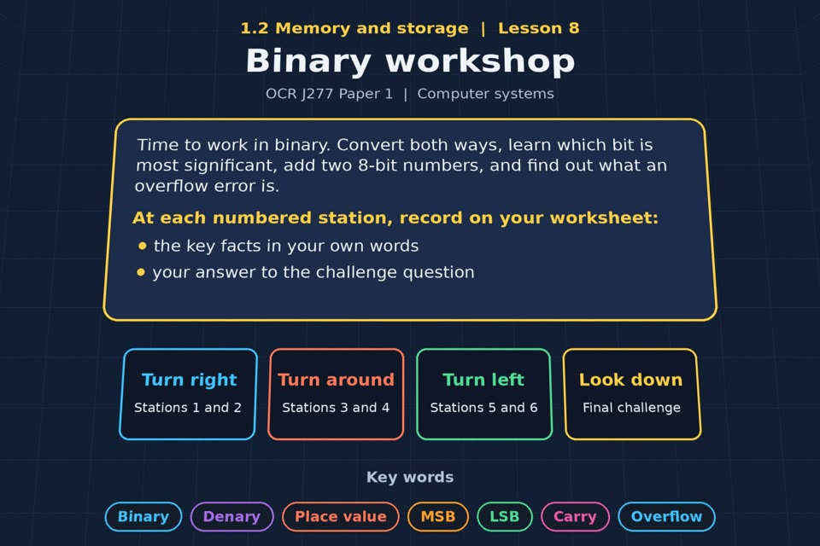

TOPIC 1.2 / LESSON 08
BINARY WORKSHOP
Binary conversion and addition
KEY QUESTION
What can happen when you add two binary numbers together?
1 / 18
Notes:
The image is a straight-on perspective preview of the actual experience. Start with the worksheet starter.
Sources: Revise 360 experiences/ms-l08.json and worksheets/MS_L08_BinaryWorkshop_Worksheet.docx. Answers are indicative classroom examples, not an official OCR mark scheme. Calculations follow the worksheet’s decimal kB/MB/GB convention unless stated.

Slide 2
TOPIC 1.2 / LESSON 08 / WORKSHEET
By the end of this lesson
1.
convert positive denary whole numbers (0-255) to 8-bit binary and back
2.
add two 8-bit binary integers
3.
understand the terms most and least significant bit
4.
understand how overflow errors occur
2 / 18
Notes:
These outcomes follow the wording of the lesson worksheet.
Sources: Revise 360 experiences/ms-l08.json and worksheets/MS_L08_BinaryWorkshop_Worksheet.docx. Answers are indicative classroom examples, not an official OCR mark scheme. Calculations follow the worksheet’s decimal kB/MB/GB convention unless stated.

Slide 3
TOPIC 1.2 / LESSON 08 / WORKSHEET STARTER
Starter: before the experience
An 8-bit counter reads 11111111. What do you think happens when it counts one more?
3 / 18
Notes:
Allow students to answer the exact worksheet starter before showing the sample answers.
Sources: Revise 360 experiences/ms-l08.json and worksheets/MS_L08_BinaryWorkshop_Worksheet.docx. Answers are indicative classroom examples, not an official OCR mark scheme. Calculations follow the worksheet’s decimal kB/MB/GB convention unless stated.

Slide 4
TOPIC 1.2 / LESSON 08 / CHECK
Starter: sample answers
1.
11111111 is 255. Adding 1 needs a ninth bit: 1 00000000.
2.
In an 8-bit register the carry may be lost, leaving 00000000: an overflow error.
4 / 18
Notes:
Accept equivalent correct responses. These examples respond to the worksheet starter.
Sources: Revise 360 experiences/ms-l08.json and worksheets/MS_L08_BinaryWorkshop_Worksheet.docx. Answers are indicative classroom examples, not an official OCR mark scheme. Calculations follow the worksheet’s decimal kB/MB/GB convention unless stated.

Slide 5
TOPIC 1.2 / LESSON 08 / WORKSHEET KEY TERMS
Key terminology quiz
1.
Binary
2.
Overflow error
5 / 18
Notes:
Students define the two terms printed on the worksheet before marking them.
Sources: Revise 360 experiences/ms-l08.json and worksheets/MS_L08_BinaryWorkshop_Worksheet.docx. Answers are indicative classroom examples, not an official OCR mark scheme. Calculations follow the worksheet’s decimal kB/MB/GB convention unless stated.

Slide 6
TOPIC 1.2 / LESSON 08 / CHECK
Key terminology: answers
Binary
Binary: base-2 number system using only 0 and 1.
Overflow error
Overflow error: a result needs more bits than the available register can hold.
6 / 18
Notes:
Reveal after students attempt the definitions; accept accurate wording in their own words.
Sources: Revise 360 experiences/ms-l08.json and worksheets/MS_L08_BinaryWorkshop_Worksheet.docx. Answers are indicative classroom examples, not an official OCR mark scheme. Calculations follow the worksheet’s decimal kB/MB/GB convention unless stated.

Slide 7
TOPIC 1.2 / LESSON 08 / EXPERIENCE
Worksheet + experience
01 OPEN EXPERIENCE ↗
Open Binary workshop in Topic 1.2. Keep the worksheet beside you.
02 SIX STATIONS
Read each panel. Write the key fact IN YOUR OWN WORDS and answer the worksheet challenge before tapping its badge.
03 FINAL CHALLENGE
Complete the ★ task before tapping the star. Copy your score (out of 15), then finish the worksheet task or review.
04 PLENARY
Finish the experience in this lesson. Near the end, close it for the plenary knowledge checks.
7 / 18
Notes:
Leave this board slide visible during the experience. The OPEN EXPERIENCE label is a clickable link. Everyone should complete the experience and reach the plenary near the end of the lesson. First on-screen responses count.
Sources: Revise 360 experiences/ms-l08.json and worksheets/MS_L08_BinaryWorkshop_Worksheet.docx. Answers are indicative classroom examples, not an official OCR mark scheme. Calculations follow the worksheet’s decimal kB/MB/GB convention unless stated.

Slide 8
TOPIC 1.2 / LESSON 08 / EXTENSION
Apply your learning
Task: conversions. Convert each number, showing the place values you used.
Use the task and table on your worksheet.
8 / 18
Notes:
This follows the task after the score on the worksheet. For revision, students use their results and outstanding work list.
Sources: Revise 360 experiences/ms-l08.json and worksheets/MS_L08_BinaryWorkshop_Worksheet.docx. Answers are indicative classroom examples, not an official OCR mark scheme. Calculations follow the worksheet’s decimal kB/MB/GB convention unless stated.

Slide 9
TOPIC 1.2 / LESSON 08 / EXTENSION
Check and improve
Add 11110000 and 00010100 in 8 bits. Explain the two different answers you can see.
9 / 18
Notes:
Use this question to deepen or correct the worksheet response before the plenary.
Sources: Revise 360 experiences/ms-l08.json and worksheets/MS_L08_BinaryWorkshop_Worksheet.docx. Answers are indicative classroom examples, not an official OCR mark scheme. Calculations follow the worksheet’s decimal kB/MB/GB convention unless stated.

Slide 10
TOPIC 1.2 / LESSON 08 / CHECK
Application: sample answers
1.
37 = 00100101; 11001010 = 202; 190 = 10111110.
2.
00110110 = 54; 255 = 11111111. Check with the 128, 64, 32, 16, 8, 4, 2, 1 columns.
3.
The mathematical sum is 260 = 1 00000100. Only eight low bits fit, giving 00000100 (4) plus an overflow carry.
10 / 18
Notes:
These are sample answers or a sample revision action. Ratings and open choices may vary with a justified device and context.
Sources: Revise 360 experiences/ms-l08.json and worksheets/MS_L08_BinaryWorkshop_Worksheet.docx. Answers are indicative classroom examples, not an official OCR mark scheme. Calculations follow the worksheet’s decimal kB/MB/GB convention unless stated.

Slide 11
TOPIC 1.2 / LESSON 08 / ANSWERS
After the experience: stations 1–3
Check your key facts and challenge responses.
1 Place values
8-bit place values are 128, 64, 32, 16, 8, 4, 2, 1; all ones add to 255.
2 Denary to binary
173 = 128 + 32 + 8 + 4 + 1, so its 8-bit form is 10101101.
3 MSB and LSB
The MSB is the leftmost and largest place value (128); the LSB is the rightmost (1).
11 / 18
Notes:
Show only after students have completed the experience. These concise points answer the station challenges and help students improve their own wording.
Sources: Revise 360 experiences/ms-l08.json and worksheets/MS_L08_BinaryWorkshop_Worksheet.docx. Answers are indicative classroom examples, not an official OCR mark scheme. Calculations follow the worksheet’s decimal kB/MB/GB convention unless stated.

Slide 12
TOPIC 1.2 / LESSON 08 / ANSWERS
After the experience: stations 4–6
Check your key facts and challenge responses.
4 Binary addition
00101101 (45) + 00011011 (27) = 01001000 (72); there is no overflow.
5 Overflow
11110000 (240) + 00010100 (20) = 1 00000100 (260): ninth-bit carry, so 8-bit overflow.
6 Why it matters
Overflow could corrupt a counter or control value. Use enough bits and check the result’s range.
12 / 18
Notes:
Show only after students have completed the experience. These concise points answer the station challenges and help students improve their own wording.
Sources: Revise 360 experiences/ms-l08.json and worksheets/MS_L08_BinaryWorkshop_Worksheet.docx. Answers are indicative classroom examples, not an official OCR mark scheme. Calculations follow the worksheet’s decimal kB/MB/GB convention unless stated.

Slide 13
TOPIC 1.2 / LESSON 08 / CHECK
Final challenge: answers
1.
Convert 214 into 8-bit binary → 11010110. 128 + 64 + 16 + 4 + 2 = 214, so 11010110.
2.
Convert 01101110 into denary → 110. 64 + 32 + 8 + 4 + 2 = 110.
3.
198 + 87 = 285, which needs a 9th bit, so there is an overflow error.
13 / 18
Notes:
Answers are in the same order as the worksheet final challenge and the experience star task. Pixel and sound sketches should be checked against the interactive pattern or wave.
Sources: Revise 360 experiences/ms-l08.json and worksheets/MS_L08_BinaryWorkshop_Worksheet.docx. Answers are indicative classroom examples, not an official OCR mark scheme. Calculations follow the worksheet’s decimal kB/MB/GB convention unless stated.

Slide 14
TOPIC 1.2 / LESSON 08 / PLENARY
Plenary: questions 1–2
Close the experience. Answer from memory on the worksheet.
a) Convert the denary number 173 into 8-bit binary. [1]
b) Convert the binary number 01101110 into denary. [1]
14 / 18
Notes:
These are the exact exam-practice questions from the worksheet. Allow independent writing before displaying the answer slides.
Sources: Revise 360 experiences/ms-l08.json and worksheets/MS_L08_BinaryWorkshop_Worksheet.docx. Answers are indicative classroom examples, not an official OCR mark scheme. Calculations follow the worksheet’s decimal kB/MB/GB convention unless stated.

Slide 15
TOPIC 1.2 / LESSON 08 / PLENARY
Plenary: questions 3–4
Close the experience. Answer from memory on the worksheet.
c) Add the binary numbers 11000110 and 01010111. State whether an overflow error occurs. [3]
d) Explain what is meant by an overflow error. [2]
15 / 18
Notes:
These are the exact exam-practice questions from the worksheet. Allow independent writing before displaying the answer slides.
Sources: Revise 360 experiences/ms-l08.json and worksheets/MS_L08_BinaryWorkshop_Worksheet.docx. Answers are indicative classroom examples, not an official OCR mark scheme. Calculations follow the worksheet’s decimal kB/MB/GB convention unless stated.

Slide 16
TOPIC 1.2 / LESSON 08 / CHECK
Plenary: answers 1–2
Indicative points. Credit accurate answers in students’ own words.
a) 173 = 10101101.
b) 01101110 = 64 + 32 + 8 + 4 + 2 = 110.
16 / 18
Notes:
Classroom answer points, not an official OCR mark scheme. Ask students to correct or improve one answer.
Sources: Revise 360 experiences/ms-l08.json and worksheets/MS_L08_BinaryWorkshop_Worksheet.docx. Answers are indicative classroom examples, not an official OCR mark scheme. Calculations follow the worksheet’s decimal kB/MB/GB convention unless stated.

Slide 17
TOPIC 1.2 / LESSON 08 / CHECK
Plenary: answers 3–4
Indicative points. Credit accurate answers in students’ own words.
c) 11000110 (198) + 01010111 (87) = 1 00011101 (285). The 8-bit result is 00011101 and an overflow occurs.
d) An overflow occurs when the result is too large for the available number of bits; an extra carry bit cannot be stored in the 8-bit result.
17 / 18
Notes:
Classroom answer points, not an official OCR mark scheme. Ask students to correct or improve one answer.
Sources: Revise 360 experiences/ms-l08.json and worksheets/MS_L08_BinaryWorkshop_Worksheet.docx. Answers are indicative classroom examples, not an official OCR mark scheme. Calculations follow the worksheet’s decimal kB/MB/GB convention unless stated.

Slide 18
TOPIC 1.2 / LESSON 08 / SELF-CHECK
How confident am I?
Select Not yet, Getting there or Confident for each objective on the worksheet.
1.
Denary to binary
2.
Binary to denary
3.
Binary addition and overflow
18 / 18
Notes:
Use the exact confidence objectives from the worksheet. Students identify one area to revisit.
Sources: Revise 360 experiences/ms-l08.json and worksheets/MS_L08_BinaryWorkshop_Worksheet.docx. Answers are indicative classroom examples, not an official OCR mark scheme. Calculations follow the worksheet’s decimal kB/MB/GB convention unless stated.

