Slide 1
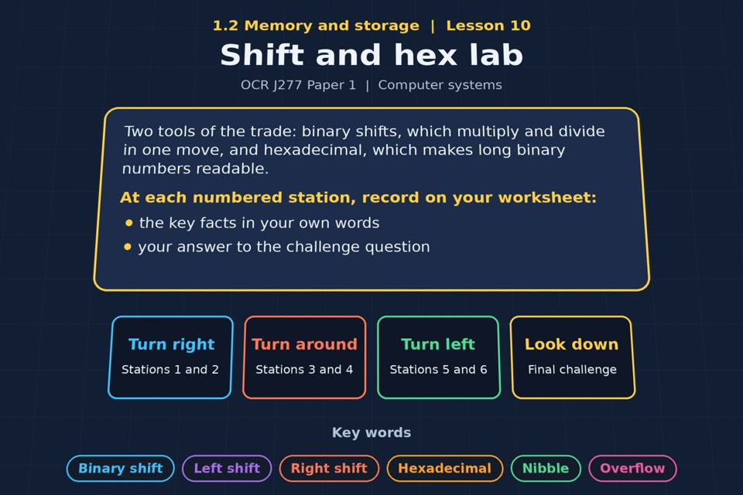

TOPIC 1.2 / LESSON 10
SHIFT AND HEX LAB
Binary shift and hexadecimal
KEY QUESTION
What is the relationship between denary, binary and hexadecimal?
1 / 18
Notes:
The image is a straight-on perspective preview of the actual experience. Start with the worksheet starter.
Sources: Revise 360 experiences/ms-l10.json and worksheets/MS_L10_ShiftAndHexLab_Worksheet.docx. Answers are indicative classroom examples, not an official OCR mark scheme. Calculations follow the worksheet’s decimal kB/MB/GB convention unless stated.

Slide 2
TOPIC 1.2 / LESSON 10 / WORKSHEET
By the end of this lesson
1.
know how to perform left and right binary shifts
2.
understand what a binary shift achieves
3.
convert denary to 2-digit hexadecimal and back
4.
convert between binary and hexadecimal
2 / 18
Notes:
These outcomes follow the wording of the lesson worksheet.
Sources: Revise 360 experiences/ms-l10.json and worksheets/MS_L10_ShiftAndHexLab_Worksheet.docx. Answers are indicative classroom examples, not an official OCR mark scheme. Calculations follow the worksheet’s decimal kB/MB/GB convention unless stated.

Slide 3
TOPIC 1.2 / LESSON 10 / WORKSHEET STARTER
Starter: before the experience
Why might a programmer prefer to write FF rather than 11111111? Suggest two reasons.
3 / 18
Notes:
Allow students to answer the exact worksheet starter before showing the sample answers.
Sources: Revise 360 experiences/ms-l10.json and worksheets/MS_L10_ShiftAndHexLab_Worksheet.docx. Answers are indicative classroom examples, not an official OCR mark scheme. Calculations follow the worksheet’s decimal kB/MB/GB convention unless stated.

Slide 4
TOPIC 1.2 / LESSON 10 / CHECK
Starter: sample answers
1.
FF is two symbols instead of eight binary digits and is easier to read or copy without mistakes.
2.
Each hexadecimal digit represents exactly four binary bits; FF = 11111111.
4 / 18
Notes:
Accept equivalent correct responses. These examples respond to the worksheet starter.
Sources: Revise 360 experiences/ms-l10.json and worksheets/MS_L10_ShiftAndHexLab_Worksheet.docx. Answers are indicative classroom examples, not an official OCR mark scheme. Calculations follow the worksheet’s decimal kB/MB/GB convention unless stated.

Slide 5
TOPIC 1.2 / LESSON 10 / WORKSHEET KEY TERMS
Key terminology quiz
1.
Binary shift
2.
Hexadecimal
5 / 18
Notes:
Students define the two terms printed on the worksheet before marking them.
Sources: Revise 360 experiences/ms-l10.json and worksheets/MS_L10_ShiftAndHexLab_Worksheet.docx. Answers are indicative classroom examples, not an official OCR mark scheme. Calculations follow the worksheet’s decimal kB/MB/GB convention unless stated.

Slide 6
TOPIC 1.2 / LESSON 10 / CHECK
Key terminology: answers
Binary shift
Binary shift: moving each bit left or right by a stated number of places; bits that leave the width are lost.
Hexadecimal
Hexadecimal: base-16 number system using 0–9 and A–F; one hex digit represents four bits.
6 / 18
Notes:
Reveal after students attempt the definitions; accept accurate wording in their own words.
Sources: Revise 360 experiences/ms-l10.json and worksheets/MS_L10_ShiftAndHexLab_Worksheet.docx. Answers are indicative classroom examples, not an official OCR mark scheme. Calculations follow the worksheet’s decimal kB/MB/GB convention unless stated.

Slide 7
TOPIC 1.2 / LESSON 10 / EXPERIENCE
Worksheet + experience
01 OPEN EXPERIENCE ↗
Open Shift and hex lab in Topic 1.2. Keep the worksheet beside you.
02 SIX STATIONS
Read each panel. Write the key fact IN YOUR OWN WORDS and answer the worksheet challenge before tapping its badge.
03 FINAL CHALLENGE
Complete the ★ task before tapping the star. Copy your score (out of 15), then finish the worksheet task or review.
04 PLENARY
Finish the experience in this lesson. Near the end, close it for the plenary knowledge checks.
7 / 18
Notes:
Leave this board slide visible during the experience. The OPEN EXPERIENCE label is a clickable link. Everyone should complete the experience and reach the plenary near the end of the lesson. First on-screen responses count.
Sources: Revise 360 experiences/ms-l10.json and worksheets/MS_L10_ShiftAndHexLab_Worksheet.docx. Answers are indicative classroom examples, not an official OCR mark scheme. Calculations follow the worksheet’s decimal kB/MB/GB convention unless stated.

Slide 8
TOPIC 1.2 / LESSON 10 / EXTENSION
Apply your learning
Task: conversions. Complete the table.
Use the task and table on your worksheet.
8 / 18
Notes:
This follows the task after the score on the worksheet. For revision, students use their results and outstanding work list.
Sources: Revise 360 experiences/ms-l10.json and worksheets/MS_L10_ShiftAndHexLab_Worksheet.docx. Answers are indicative classroom examples, not an official OCR mark scheme. Calculations follow the worksheet’s decimal kB/MB/GB convention unless stated.

Slide 9
TOPIC 1.2 / LESSON 10 / EXTENSION
Check and improve
A student says every left shift doubles a number exactly. When does that claim fail?
9 / 18
Notes:
Use this question to deepen or correct the worksheet response before the plenary.
Sources: Revise 360 experiences/ms-l10.json and worksheets/MS_L10_ShiftAndHexLab_Worksheet.docx. Answers are indicative classroom examples, not an official OCR mark scheme. Calculations follow the worksheet’s decimal kB/MB/GB convention unless stated.

Slide 10
TOPIC 1.2 / LESSON 10 / CHECK
Application: sample answers
1.
45 = 00101101 = 2D; 11100100 = 228 = E4.
2.
B7 = 183 = 10110111; 208 = 11010000 = D0.
3.
For a fixed width such as 8 bits, a 1 shifted off the left is lost. Overflow then means the stored result is not the full doubled value.
10 / 18
Notes:
These are sample answers or a sample revision action. Ratings and open choices may vary with a justified device and context.
Sources: Revise 360 experiences/ms-l10.json and worksheets/MS_L10_ShiftAndHexLab_Worksheet.docx. Answers are indicative classroom examples, not an official OCR mark scheme. Calculations follow the worksheet’s decimal kB/MB/GB convention unless stated.

Slide 11
TOPIC 1.2 / LESSON 10 / ANSWERS
After the experience: stations 1–3
Check your key facts and challenge responses.
1 Left shift
00011010 (26) shifted left one place becomes 00110100 (52): double, with no overflow.
2 Right shift
01001100 (76) shifted right one place becomes 00100110 (38): halve, dropping a bit if one leaves the right end.
3 Shifts and precision
00110010 (50) shifted left twice is 11001000 (200): ×4, provided the result fits the chosen bit width.
11 / 18
Notes:
Show only after students have completed the experience. These concise points answer the station challenges and help students improve their own wording.
Sources: Revise 360 experiences/ms-l10.json and worksheets/MS_L10_ShiftAndHexLab_Worksheet.docx. Answers are indicative classroom examples, not an official OCR mark scheme. Calculations follow the worksheet’s decimal kB/MB/GB convention unless stated.

Slide 12
TOPIC 1.2 / LESSON 10 / ANSWERS
After the experience: stations 4–6
Check your key facts and challenge responses.
4 Why hexadecimal?
Hex is compact and maps directly to binary nibbles. Digits 0–9 mean 0–9 and A–F mean 10–15.
5 Denary and hex
207 ÷ 16 = 12 remainder 15: 12 is C and 15 is F, so 207 = CF.
6 Binary and hex
Split 10111010 into 1011 and 1010. Those nibbles are B and A, so the result is BA.
12 / 18
Notes:
Show only after students have completed the experience. These concise points answer the station challenges and help students improve their own wording.
Sources: Revise 360 experiences/ms-l10.json and worksheets/MS_L10_ShiftAndHexLab_Worksheet.docx. Answers are indicative classroom examples, not an official OCR mark scheme. Calculations follow the worksheet’s decimal kB/MB/GB convention unless stated.

Slide 13
TOPIC 1.2 / LESSON 10 / CHECK
Final challenge: answers
1.
100 × 2 = 200, which still fits.
2.
Convert 11010110 into hexadecimal → D6. 1101 = D and 0110 = 6, so D6.
3.
Convert 9F into denary → 159. 9 × 16 = 144, plus F (15) = 159.
13 / 18
Notes:
Answers are in the same order as the worksheet final challenge and the experience star task. Pixel and sound sketches should be checked against the interactive pattern or wave.
Sources: Revise 360 experiences/ms-l10.json and worksheets/MS_L10_ShiftAndHexLab_Worksheet.docx. Answers are indicative classroom examples, not an official OCR mark scheme. Calculations follow the worksheet’s decimal kB/MB/GB convention unless stated.

Slide 14
TOPIC 1.2 / LESSON 10 / PLENARY
Plenary: questions 1–2
Close the experience. Answer from memory on the worksheet.
a) Explain what a left shift of one place achieves. [2]
b) Perform a right shift of two places on 10110000 and state the denary result. [2]
14 / 18
Notes:
These are the exact exam-practice questions from the worksheet. Allow independent writing before displaying the answer slides.
Sources: Revise 360 experiences/ms-l10.json and worksheets/MS_L10_ShiftAndHexLab_Worksheet.docx. Answers are indicative classroom examples, not an official OCR mark scheme. Calculations follow the worksheet’s decimal kB/MB/GB convention unless stated.

Slide 15
TOPIC 1.2 / LESSON 10 / PLENARY
Plenary: questions 3–4
Close the experience. Answer from memory on the worksheet.
c) Convert the denary number 207 into hexadecimal. [1]
d) Convert the binary number 10111010 into hexadecimal. [1]
15 / 18
Notes:
These are the exact exam-practice questions from the worksheet. Allow independent writing before displaying the answer slides.
Sources: Revise 360 experiences/ms-l10.json and worksheets/MS_L10_ShiftAndHexLab_Worksheet.docx. Answers are indicative classroom examples, not an official OCR mark scheme. Calculations follow the worksheet’s decimal kB/MB/GB convention unless stated.

Slide 16
TOPIC 1.2 / LESSON 10 / CHECK
Plenary: answers 1–2
Indicative points. Credit accurate answers in students’ own words.
a) A one-place left shift moves each bit to a place worth twice as much, multiplying the value by 2 if no significant bit is lost.
b) 10110000 → 00101100 after two right shifts; 00101100 = 44 in denary.
16 / 18
Notes:
Classroom answer points, not an official OCR mark scheme. Ask students to correct or improve one answer.
Sources: Revise 360 experiences/ms-l10.json and worksheets/MS_L10_ShiftAndHexLab_Worksheet.docx. Answers are indicative classroom examples, not an official OCR mark scheme. Calculations follow the worksheet’s decimal kB/MB/GB convention unless stated.

Slide 17
TOPIC 1.2 / LESSON 10 / CHECK
Plenary: answers 3–4
Indicative points. Credit accurate answers in students’ own words.
c) 207 = CF (12 sixteens and 15 ones).
d) 1011 1010 = BA.
17 / 18
Notes:
Classroom answer points, not an official OCR mark scheme. Ask students to correct or improve one answer.
Sources: Revise 360 experiences/ms-l10.json and worksheets/MS_L10_ShiftAndHexLab_Worksheet.docx. Answers are indicative classroom examples, not an official OCR mark scheme. Calculations follow the worksheet’s decimal kB/MB/GB convention unless stated.

Slide 18
TOPIC 1.2 / LESSON 10 / SELF-CHECK
How confident am I?
Select Not yet, Getting there or Confident for each objective on the worksheet.
1.
Left and right shifts
2.
Denary and hexadecimal
3.
Binary and hexadecimal
18 / 18
Notes:
Use the exact confidence objectives from the worksheet. Students identify one area to revisit.
Sources: Revise 360 experiences/ms-l10.json and worksheets/MS_L10_ShiftAndHexLab_Worksheet.docx. Answers are indicative classroom examples, not an official OCR mark scheme. Calculations follow the worksheet’s decimal kB/MB/GB convention unless stated.

