Slide 1
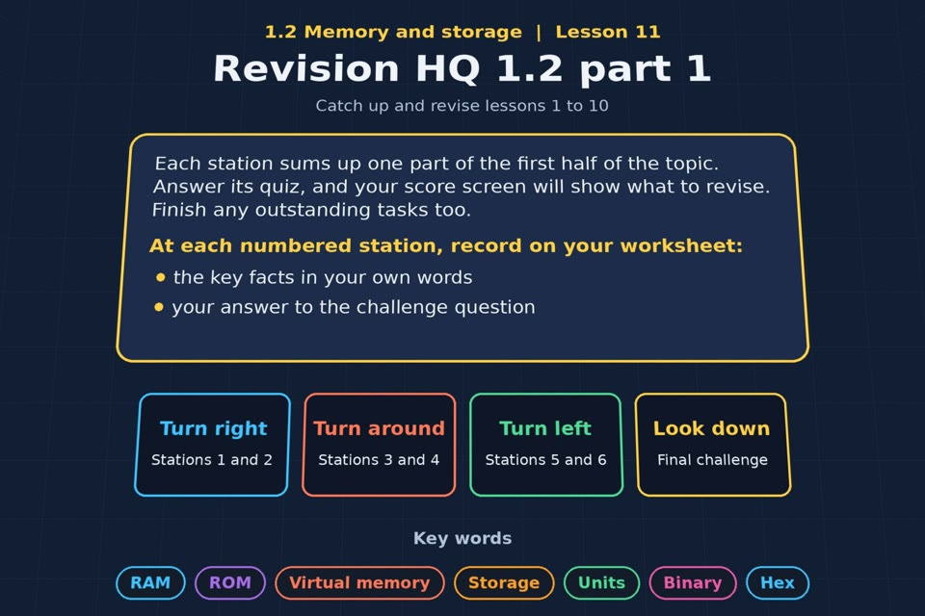

TOPIC 1.2 / LESSON 11
REVISION HQ 1.2 PART 1
Catch-up and revision: lessons 1 to 10
REVISION FOCUS
Which areas need more practice?
1 / 15
Notes:
The image is a straight-on perspective preview of the actual experience. Start with the worksheet starter.
Sources: Revise 360 experiences/ms-l11.json and worksheets/MS_L11_RevisionHQ12Part1_Worksheet.docx. Answers are indicative classroom examples, not an official OCR mark scheme. Calculations follow the worksheet’s decimal kB/MB/GB convention unless stated.

Slide 2
TOPIC 1.2 / LESSON 11 / WORKSHEET
By the end of this lesson
1.
know which parts of the topic I am secure on
2.
finish any outstanding tasks from lessons 1 to 10
2 / 15
Notes:
These outcomes follow the wording of the lesson worksheet.
Sources: Revise 360 experiences/ms-l11.json and worksheets/MS_L11_RevisionHQ12Part1_Worksheet.docx. Answers are indicative classroom examples, not an official OCR mark scheme. Calculations follow the worksheet’s decimal kB/MB/GB convention unless stated.

Slide 3
TOPIC 1.2 / LESSON 11 / WORKSHEET STARTER
Starter: before the experience
Without notes, write down the eight units of storage in order, and the eight place values of an 8-bit number.
3 / 15
Notes:
Allow students to answer the exact worksheet starter before showing the sample answers.
Sources: Revise 360 experiences/ms-l11.json and worksheets/MS_L11_RevisionHQ12Part1_Worksheet.docx. Answers are indicative classroom examples, not an official OCR mark scheme. Calculations follow the worksheet’s decimal kB/MB/GB convention unless stated.

Slide 4
TOPIC 1.2 / LESSON 11 / CHECK
Starter: sample answers
1.
Units: bit, nibble, byte, kilobyte, megabyte, gigabyte, terabyte, petabyte.
2.
8-bit place values from left to right: 128, 64, 32, 16, 8, 4, 2, 1.
4 / 15
Notes:
Accept equivalent correct responses. These examples respond to the worksheet starter.
Sources: Revise 360 experiences/ms-l11.json and worksheets/MS_L11_RevisionHQ12Part1_Worksheet.docx. Answers are indicative classroom examples, not an official OCR mark scheme. Calculations follow the worksheet’s decimal kB/MB/GB convention unless stated.

Slide 5
TOPIC 1.2 / LESSON 11 / EXPERIENCE
Worksheet + experience
01 OPEN EXPERIENCE ↗
Open Revision HQ 1.2 part 1 in Topic 1.2. Keep the worksheet beside you.
02 SIX STATIONS
Read each panel. Write THREE key facts IN YOUR OWN WORDS and answer the worksheet challenge before tapping its badge.
03 FINAL CHALLENGE
Complete the ★ task before tapping the star. Copy your score (out of 21), then finish the worksheet task or review.
04 PLENARY
Finish the experience in this lesson. Near the end, close it for the plenary knowledge checks.
5 / 15
Notes:
Leave this board slide visible during the experience. The OPEN EXPERIENCE label is a clickable link. Everyone should complete the experience and reach the plenary near the end of the lesson. First on-screen responses count.
Sources: Revise 360 experiences/ms-l11.json and worksheets/MS_L11_RevisionHQ12Part1_Worksheet.docx. Answers are indicative classroom examples, not an official OCR mark scheme. Calculations follow the worksheet’s decimal kB/MB/GB convention unless stated.

Slide 6
TOPIC 1.2 / LESSON 11 / EXTENSION
Apply your learning
Record each station score, then choose one area to revisit from the outstanding programs checklist.
Use the task and table on your worksheet.
6 / 15
Notes:
This follows the task after the score on the worksheet. For revision, students use their results and outstanding work list.
Sources: Revise 360 experiences/ms-l11.json and worksheets/MS_L11_RevisionHQ12Part1_Worksheet.docx. Answers are indicative classroom examples, not an official OCR mark scheme. Calculations follow the worksheet’s decimal kB/MB/GB convention unless stated.

Slide 7
TOPIC 1.2 / LESSON 11 / EXTENSION
Check and improve
Convert 149 to 8-bit binary, then explain why virtual memory can keep a program open but slow it down.
7 / 15
Notes:
Use this question to deepen or correct the worksheet response before the plenary.
Sources: Revise 360 experiences/ms-l11.json and worksheets/MS_L11_RevisionHQ12Part1_Worksheet.docx. Answers are indicative classroom examples, not an official OCR mark scheme. Calculations follow the worksheet’s decimal kB/MB/GB convention unless stated.

Slide 8
TOPIC 1.2 / LESSON 11 / CHECK
Application: sample answers
1.
Use the score and experience feedback to choose a specific station. A lower score is a reason to review that concept.
2.
Write a concrete next step, such as “redo the Units lab conversions and check every unit step.”
3.
149 = 10010101. Virtual memory holds pages on secondary storage when RAM is full; moving them back into RAM takes time.
8 / 15
Notes:
These are sample answers or a sample revision action. Ratings and open choices may vary with a justified device and context.
Sources: Revise 360 experiences/ms-l11.json and worksheets/MS_L11_RevisionHQ12Part1_Worksheet.docx. Answers are indicative classroom examples, not an official OCR mark scheme. Calculations follow the worksheet’s decimal kB/MB/GB convention unless stated.

Slide 9
TOPIC 1.2 / LESSON 11 / ANSWERS
After the experience: stations 1–3
Check your key facts and challenge responses.
1 Primary storage
RAM is volatile, read/write working memory; ROM is non-volatile, normally read-only boot memory.
2 Virtual memory
Virtual memory borrows secondary storage when RAM is full. Swapping pages is slower than accessing RAM.
3 Secondary storage
An SSD suits a carried laptop because it is fast and has no moving parts to damage.
9 / 15
Notes:
Show only after students have completed the experience. These concise points answer the station challenges and help students improve their own wording.
Sources: Revise 360 experiences/ms-l11.json and worksheets/MS_L11_RevisionHQ12Part1_Worksheet.docx. Answers are indicative classroom examples, not an official OCR mark scheme. Calculations follow the worksheet’s decimal kB/MB/GB convention unless stated.

Slide 10
TOPIC 1.2 / LESSON 11 / ANSWERS
After the experience: stations 4–6
Check your key facts and challenge responses.
4 Units and capacity
400 × 300 × 8 = 960,000 bits = 120,000 bytes = 120 kB.
5 Binary and addition
173 = 10101101. Adding 00001111 (15) gives 10111100 (188), with no overflow.
6 Shifts and hex
Split 11010110 into 1101 and 0110: D6 in hexadecimal.
10 / 15
Notes:
Show only after students have completed the experience. These concise points answer the station challenges and help students improve their own wording.
Sources: Revise 360 experiences/ms-l11.json and worksheets/MS_L11_RevisionHQ12Part1_Worksheet.docx. Answers are indicative classroom examples, not an official OCR mark scheme. Calculations follow the worksheet’s decimal kB/MB/GB convention unless stated.

Slide 11
TOPIC 1.2 / LESSON 11 / CHECK
Final challenge: answers
1.
Convert 149 into 8-bit binary → 10010101. 128 + 16 + 4 + 1 = 149.
2.
180 + 95 = 275, so there is an overflow.
3.
Convert 10110010 into hexadecimal → B2. 1011 = B and 0010 = 2, so B2.
11 / 15
Notes:
Answers are in the same order as the worksheet final challenge and the experience star task. Pixel and sound sketches should be checked against the interactive pattern or wave.
Sources: Revise 360 experiences/ms-l11.json and worksheets/MS_L11_RevisionHQ12Part1_Worksheet.docx. Answers are indicative classroom examples, not an official OCR mark scheme. Calculations follow the worksheet’s decimal kB/MB/GB convention unless stated.

Slide 12
TOPIC 1.2 / LESSON 11 / PLENARY
Plenary: questions
Close the experience. Answer from memory on the worksheet.
a) Convert 149 into 8-bit binary. [1]
b) Explain why a computer uses virtual memory. [3]
12 / 15
Notes:
These are the exact exam-practice questions from the worksheet. Allow independent writing before displaying the answer slides.
Sources: Revise 360 experiences/ms-l11.json and worksheets/MS_L11_RevisionHQ12Part1_Worksheet.docx. Answers are indicative classroom examples, not an official OCR mark scheme. Calculations follow the worksheet’s decimal kB/MB/GB convention unless stated.

Slide 13
TOPIC 1.2 / LESSON 11 / CHECK
Plenary: answers
Indicative points. Credit accurate answers in students’ own words.
a) 149 = 128 + 16 + 4 + 1 = 10010101.
b) When RAM is full, virtual memory holds less-used pages on secondary storage so more programs can remain open. Needed pages must be brought back into RAM, which is slower.
13 / 15
Notes:
Classroom answer points, not an official OCR mark scheme. Ask students to correct or improve one answer.
Sources: Revise 360 experiences/ms-l11.json and worksheets/MS_L11_RevisionHQ12Part1_Worksheet.docx. Answers are indicative classroom examples, not an official OCR mark scheme. Calculations follow the worksheet’s decimal kB/MB/GB convention unless stated.

Slide 14
TOPIC 1.2 / LESSON 11 / WORKSHEET
Revision checklist
RAG the Topic 1.2 areas on your worksheet.
1.
RAM and ROM
2.
Virtual memory
3.
Types of secondary storage
4.
Characteristics and suitability
5.
Units of storage
6.
Capacity calculations
7.
Binary conversion and addition
8.
Shifts and hexadecimal
14 / 15
Notes:
This checklist follows the revision worksheet. Students mark red, amber or green and select a next task from their results.
Sources: Revise 360 experiences/ms-l11.json and worksheets/MS_L11_RevisionHQ12Part1_Worksheet.docx. Answers are indicative classroom examples, not an official OCR mark scheme. Calculations follow the worksheet’s decimal kB/MB/GB convention unless stated.

Slide 15
TOPIC 1.2 / LESSON 11 / SELF-CHECK
How confident am I?
Select Not yet, Getting there or Confident for each objective on the worksheet.
1.
Memory and storage
2.
Units and capacity
3.
Binary, shifts and hex
15 / 15
Notes:
Use the exact confidence objectives from the worksheet. Students identify one area to revisit.
Sources: Revise 360 experiences/ms-l11.json and worksheets/MS_L11_RevisionHQ12Part1_Worksheet.docx. Answers are indicative classroom examples, not an official OCR mark scheme. Calculations follow the worksheet’s decimal kB/MB/GB convention unless stated.

