Slide 1
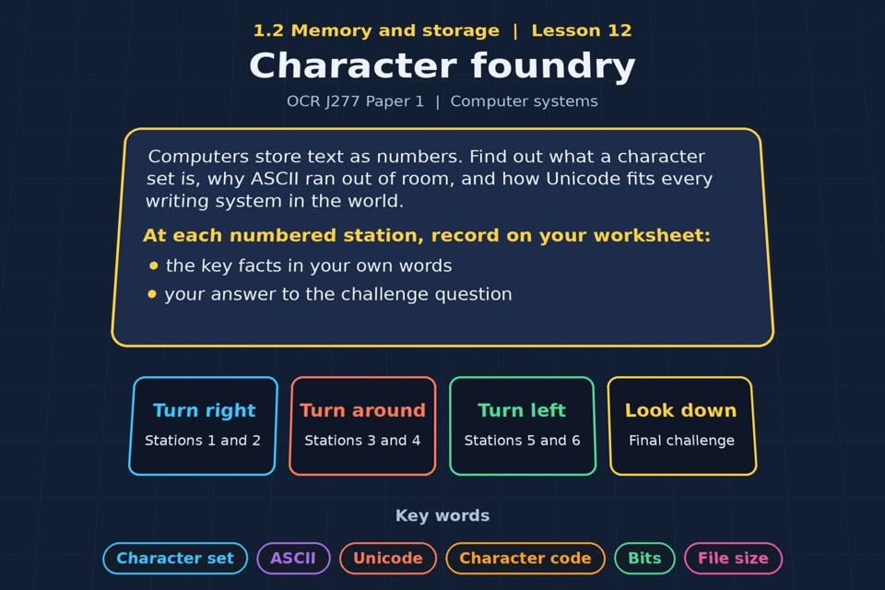

TOPIC 1.2 / LESSON 12
CHARACTER FOUNDRY
Character sets
KEY QUESTION
How does a computer store characters, and what are the implications for the number of bits used?
1 / 19
Notes:
The image is a straight-on perspective preview of the actual experience. Start with the worksheet starter.
Sources: Revise 360 experiences/ms-l12.json and worksheets/MS_L12_CharacterFoundry_Worksheet.docx. Answers are indicative classroom examples, not an official OCR mark scheme. Calculations follow the worksheet’s decimal kB/MB/GB convention unless stated.

Slide 2
TOPIC 1.2 / LESSON 12 / WORKSHEET
By the end of this lesson
1.
understand that all data, including text, is represented in binary
2.
know what is meant by a character set
3.
understand the relationship between the number of bits and the number of characters
4.
know about ASCII and Unicode
2 / 19
Notes:
These outcomes follow the wording of the lesson worksheet.
Sources: Revise 360 experiences/ms-l12.json and worksheets/MS_L12_CharacterFoundry_Worksheet.docx. Answers are indicative classroom examples, not an official OCR mark scheme. Calculations follow the worksheet’s decimal kB/MB/GB convention unless stated.

Slide 3
TOPIC 1.2 / LESSON 12 / WORKSHEET STARTER
Starter: before the experience
A vending machine has 4 buttons. How many different combinations of two presses are there? What about 8 buttons?
3 / 19
Notes:
Allow students to answer the exact worksheet starter before showing the sample answers.
Sources: Revise 360 experiences/ms-l12.json and worksheets/MS_L12_CharacterFoundry_Worksheet.docx. Answers are indicative classroom examples, not an official OCR mark scheme. Calculations follow the worksheet’s decimal kB/MB/GB convention unless stated.

Slide 4
TOPIC 1.2 / LESSON 12 / CHECK
Starter: sample answers
1.
If the order of two button presses matters and repetition is allowed, 4 buttons give 4 × 4 = 16 sequences.
2.
8 buttons give 8 × 8 = 64 sequences. More choices per position mean more combinations.
4 / 19
Notes:
Accept equivalent correct responses. These examples respond to the worksheet starter.
Sources: Revise 360 experiences/ms-l12.json and worksheets/MS_L12_CharacterFoundry_Worksheet.docx. Answers are indicative classroom examples, not an official OCR mark scheme. Calculations follow the worksheet’s decimal kB/MB/GB convention unless stated.

Slide 5
TOPIC 1.2 / LESSON 12 / WORKSHEET KEY TERMS
Key terminology quiz
1.
Character set
2.
Unicode
5 / 19
Notes:
Students define the two terms printed on the worksheet before marking them.
Sources: Revise 360 experiences/ms-l12.json and worksheets/MS_L12_CharacterFoundry_Worksheet.docx. Answers are indicative classroom examples, not an official OCR mark scheme. Calculations follow the worksheet’s decimal kB/MB/GB convention unless stated.

Slide 6
TOPIC 1.2 / LESSON 12 / CHECK
Key terminology: answers
Character set
Character set: an agreed mapping between characters and numeric codes stored as binary.
Unicode
Unicode: a standard assigning codes to characters across many writing systems and symbols.
6 / 19
Notes:
Reveal after students attempt the definitions; accept accurate wording in their own words.
Sources: Revise 360 experiences/ms-l12.json and worksheets/MS_L12_CharacterFoundry_Worksheet.docx. Answers are indicative classroom examples, not an official OCR mark scheme. Calculations follow the worksheet’s decimal kB/MB/GB convention unless stated.

Slide 7
TOPIC 1.2 / LESSON 12 / EXPERIENCE
Worksheet + experience
01 OPEN EXPERIENCE ↗
Open Character foundry in Topic 1.2. Keep the worksheet beside you.
02 SIX STATIONS
Read each panel. Write the key fact IN YOUR OWN WORDS and answer the worksheet challenge before tapping its badge.
03 FINAL CHALLENGE
Complete the ★ task before tapping the star. Copy your score (out of 20), then finish the worksheet task or review.
04 PLENARY
Finish the experience in this lesson. Near the end, close it for the plenary knowledge checks.
7 / 19
Notes:
Leave this board slide visible during the experience. The OPEN EXPERIENCE label is a clickable link. Everyone should complete the experience and reach the plenary near the end of the lesson. First on-screen responses count.
Sources: Revise 360 experiences/ms-l12.json and worksheets/MS_L12_CharacterFoundry_Worksheet.docx. Answers are indicative classroom examples, not an official OCR mark scheme. Calculations follow the worksheet’s decimal kB/MB/GB convention unless stated.

Slide 8
TOPIC 1.2 / LESSON 12 / EXTENSION
Apply your learning
Task: your name in binary. Use the ASCII codes (A = 65, a = 97) to write the first five letters of your name.
Use the task and table on your worksheet.
8 / 19
Notes:
This follows the task after the score on the worksheet. For revision, students use their results and outstanding work list.
Sources: Revise 360 experiences/ms-l12.json and worksheets/MS_L12_CharacterFoundry_Worksheet.docx. Answers are indicative classroom examples, not an official OCR mark scheme. Calculations follow the worksheet’s decimal kB/MB/GB convention unless stated.

Slide 9
TOPIC 1.2 / LESSON 12 / EXTENSION
Check and improve
Why can eight bits represent 256 different character codes rather than just eight?
9 / 19
Notes:
Use this question to deepen or correct the worksheet response before the plenary.
Sources: Revise 360 experiences/ms-l12.json and worksheets/MS_L12_CharacterFoundry_Worksheet.docx. Answers are indicative classroom examples, not an official OCR mark scheme. Calculations follow the worksheet’s decimal kB/MB/GB convention unless stated.

Slide 10
TOPIC 1.2 / LESSON 12 / CHECK
Application: sample answers
1.
Example ALICE: A 65 = 01000001; L 76 = 01001100; I 73 = 01001001.
2.
C 67 = 01000011; E 69 = 01000101. Your own answer depends on the letters of your name.
3.
Every bit has two choices, 0 or 1. Eight independent positions give 2⁸ = 256 distinct patterns.
10 / 19
Notes:
These are sample answers or a sample revision action. Ratings and open choices may vary with a justified device and context.
Sources: Revise 360 experiences/ms-l12.json and worksheets/MS_L12_CharacterFoundry_Worksheet.docx. Answers are indicative classroom examples, not an official OCR mark scheme. Calculations follow the worksheet’s decimal kB/MB/GB convention unless stated.

Slide 11
TOPIC 1.2 / LESSON 12 / ANSWERS
After the experience: stations 1–3
Check your key facts and challenge responses.
1 Text as numbers
Each character has a numeric code stored in binary. For example, A has ASCII code 65 = 01000001.
2 ASCII
7 bits provide 2⁷ = 128 codes, enough for the original ASCII set.
3 The ASCII pattern
ASCII capital letters run in order: A = 65, E = 69; lower-case e = 101.
11 / 19
Notes:
Show only after students have completed the experience. These concise points answer the station challenges and help students improve their own wording.
Sources: Revise 360 experiences/ms-l12.json and worksheets/MS_L12_CharacterFoundry_Worksheet.docx. Answers are indicative classroom examples, not an official OCR mark scheme. Calculations follow the worksheet’s decimal kB/MB/GB convention unless stated.

Slide 12
TOPIC 1.2 / LESSON 12 / ANSWERS
After the experience: stations 4–6
Check your key facts and challenge responses.
4 Unicode
Unicode covers many scripts and symbols, including emoji; some encodings use more bytes for some characters than ASCII.
5 Bits and characters
With n bits there are 2ⁿ possible patterns: 2 bits → 4, 4 bits → 16, 8 bits → 256.
6 Text file size
1,000 characters in 8-bit ASCII take 1,000 bytes. At a fixed 16 bits per character, they take 2,000 bytes.
12 / 19
Notes:
Show only after students have completed the experience. These concise points answer the station challenges and help students improve their own wording.
Sources: Revise 360 experiences/ms-l12.json and worksheets/MS_L12_CharacterFoundry_Worksheet.docx. Answers are indicative classroom examples, not an official OCR mark scheme. Calculations follow the worksheet’s decimal kB/MB/GB convention unless stated.

Slide 13
TOPIC 1.2 / LESSON 12 / CHECK
Final challenge: answers 1–5
1.
The letter H has the character code 72. Show 72 in 8-bit binary → 01001000. 72 is 01001000.
2.
This binary is a character code: what is it in denary? (It is the letter i.) → 105. 01101001 is 105, the code for lower-case i.
3.
Uses 7 bits for 128 characters → ASCII
4.
Represents every writing system in the world → Unicode
5.
Uses 16 bits or more per character → Unicode
13 / 19
Notes:
Answers are in the same order as the worksheet final challenge and the experience star task. Pixel and sound sketches should be checked against the interactive pattern or wave.
Sources: Revise 360 experiences/ms-l12.json and worksheets/MS_L12_CharacterFoundry_Worksheet.docx. Answers are indicative classroom examples, not an official OCR mark scheme. Calculations follow the worksheet’s decimal kB/MB/GB convention unless stated.

Slide 14
TOPIC 1.2 / LESSON 12 / CHECK
Final challenge: answers 6–8
6.
Enough for English letters, digits and punctuation → ASCII
7.
Includes emoji → Unicode
8.
Produces smaller text files → ASCII
14 / 19
Notes:
Answers are in the same order as the worksheet final challenge and the experience star task. Pixel and sound sketches should be checked against the interactive pattern or wave.
Sources: Revise 360 experiences/ms-l12.json and worksheets/MS_L12_CharacterFoundry_Worksheet.docx. Answers are indicative classroom examples, not an official OCR mark scheme. Calculations follow the worksheet’s decimal kB/MB/GB convention unless stated.

Slide 15
TOPIC 1.2 / LESSON 12 / PLENARY
Plenary: questions 1–2
Close the experience. Answer from memory on the worksheet.
a) State what is meant by a character set. [1]
b) Explain why Unicode uses more storage than ASCII. [2]
15 / 19
Notes:
These are the exact exam-practice questions from the worksheet. Allow independent writing before displaying the answer slides.
Sources: Revise 360 experiences/ms-l12.json and worksheets/MS_L12_CharacterFoundry_Worksheet.docx. Answers are indicative classroom examples, not an official OCR mark scheme. Calculations follow the worksheet’s decimal kB/MB/GB convention unless stated.

Slide 16
TOPIC 1.2 / LESSON 12 / PLENARY
Plenary: question 3
Close the experience. Answer from memory on the worksheet.
c) A character set uses 8 bits per character. State how many characters it can represent. [1]
16 / 19
Notes:
These are the exact exam-practice questions from the worksheet. Allow independent writing before displaying the answer slides.
Sources: Revise 360 experiences/ms-l12.json and worksheets/MS_L12_CharacterFoundry_Worksheet.docx. Answers are indicative classroom examples, not an official OCR mark scheme. Calculations follow the worksheet’s decimal kB/MB/GB convention unless stated.

Slide 17
TOPIC 1.2 / LESSON 12 / CHECK
Plenary: answers 1–2
Indicative points. Credit accurate answers in students’ own words.
a) A character set maps each character to a numeric code that can be represented in binary.
b) Unicode supports many more characters than ASCII. In an encoding that uses more bits for a character, each such character needs more storage; actual size depends on the encoding.
17 / 19
Notes:
Classroom answer points, not an official OCR mark scheme. Ask students to correct or improve one answer.
Sources: Revise 360 experiences/ms-l12.json and worksheets/MS_L12_CharacterFoundry_Worksheet.docx. Answers are indicative classroom examples, not an official OCR mark scheme. Calculations follow the worksheet’s decimal kB/MB/GB convention unless stated.

Slide 18
TOPIC 1.2 / LESSON 12 / CHECK
Plenary: answer 3
Indicative points. Credit accurate answers in students’ own words.
c) 2⁸ = 256 different codes.
18 / 19
Notes:
Classroom answer points, not an official OCR mark scheme. Ask students to correct or improve one answer.
Sources: Revise 360 experiences/ms-l12.json and worksheets/MS_L12_CharacterFoundry_Worksheet.docx. Answers are indicative classroom examples, not an official OCR mark scheme. Calculations follow the worksheet’s decimal kB/MB/GB convention unless stated.

Slide 19
TOPIC 1.2 / LESSON 12 / SELF-CHECK
How confident am I?
Select Not yet, Getting there or Confident for each objective on the worksheet.
1.
What a character set is
2.
ASCII and Unicode
3.
Bits, characters and file size
19 / 19
Notes:
Use the exact confidence objectives from the worksheet. Students identify one area to revisit.
Sources: Revise 360 experiences/ms-l12.json and worksheets/MS_L12_CharacterFoundry_Worksheet.docx. Answers are indicative classroom examples, not an official OCR mark scheme. Calculations follow the worksheet’s decimal kB/MB/GB convention unless stated.

