Slide 1
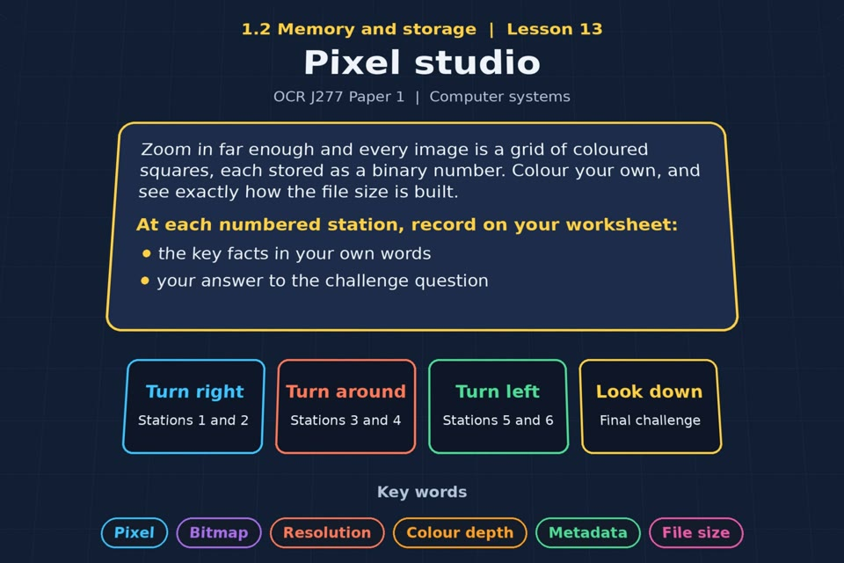

TOPIC 1.2 / LESSON 13
PIXEL STUDIO
Bitmaps
KEY QUESTION
How does a computer store graphics?
1 / 19
Notes:
The image is a straight-on perspective preview of the actual experience. Start with the worksheet starter.
Sources: Revise 360 experiences/ms-l13.json and worksheets/MS_L13_PixelStudio_Worksheet.docx. Answers are indicative classroom examples, not an official OCR mark scheme. Calculations follow the worksheet’s decimal kB/MB/GB convention unless stated.

Slide 2
TOPIC 1.2 / LESSON 13 / WORKSHEET
By the end of this lesson
1.
understand how an image is a series of pixels represented in binary
2.
know what is meant by metadata
3.
understand the effect of colour depth and resolution on file size
2 / 19
Notes:
These outcomes follow the wording of the lesson worksheet.
Sources: Revise 360 experiences/ms-l13.json and worksheets/MS_L13_PixelStudio_Worksheet.docx. Answers are indicative classroom examples, not an official OCR mark scheme. Calculations follow the worksheet’s decimal kB/MB/GB convention unless stated.

Slide 3
TOPIC 1.2 / LESSON 13 / WORKSHEET STARTER
Starter: before the experience
Zoom right into a photo on your phone until it goes blocky. What are you actually looking at, and what is stored for each square?
3 / 19
Notes:
Allow students to answer the exact worksheet starter before showing the sample answers.
Sources: Revise 360 experiences/ms-l13.json and worksheets/MS_L13_PixelStudio_Worksheet.docx. Answers are indicative classroom examples, not an official OCR mark scheme. Calculations follow the worksheet’s decimal kB/MB/GB convention unless stated.

Slide 4
TOPIC 1.2 / LESSON 13 / CHECK
Starter: sample answers
1.
You see individual pixels, the coloured squares that make up a bitmap image.
2.
For each pixel, a binary value encodes its colour; more bits per pixel allow more colours.
4 / 19
Notes:
Accept equivalent correct responses. These examples respond to the worksheet starter.
Sources: Revise 360 experiences/ms-l13.json and worksheets/MS_L13_PixelStudio_Worksheet.docx. Answers are indicative classroom examples, not an official OCR mark scheme. Calculations follow the worksheet’s decimal kB/MB/GB convention unless stated.

Slide 5
TOPIC 1.2 / LESSON 13 / WORKSHEET KEY TERMS
Key terminology quiz
1.
Pixel
2.
Metadata
5 / 19
Notes:
Students define the two terms printed on the worksheet before marking them.
Sources: Revise 360 experiences/ms-l13.json and worksheets/MS_L13_PixelStudio_Worksheet.docx. Answers are indicative classroom examples, not an official OCR mark scheme. Calculations follow the worksheet’s decimal kB/MB/GB convention unless stated.

Slide 6
TOPIC 1.2 / LESSON 13 / CHECK
Key terminology: answers
Pixel
Pixel: one picture element in a bitmap, storing a colour value.
Metadata
Metadata: data describing an image, such as its dimensions, date or camera settings.
6 / 19
Notes:
Reveal after students attempt the definitions; accept accurate wording in their own words.
Sources: Revise 360 experiences/ms-l13.json and worksheets/MS_L13_PixelStudio_Worksheet.docx. Answers are indicative classroom examples, not an official OCR mark scheme. Calculations follow the worksheet’s decimal kB/MB/GB convention unless stated.

Slide 7
TOPIC 1.2 / LESSON 13 / EXPERIENCE
Worksheet + experience
01 OPEN EXPERIENCE ↗
Open Pixel studio in Topic 1.2. Keep the worksheet beside you.
02 SIX STATIONS
Read each panel. Write the key fact IN YOUR OWN WORDS and answer the worksheet challenge before tapping its badge.
03 FINAL CHALLENGE
Complete the ★ task before tapping the star. Copy your score (out of 15), then finish the worksheet task or review.
04 PLENARY
Finish the experience in this lesson. Near the end, close it for the plenary knowledge checks.
7 / 19
Notes:
Leave this board slide visible during the experience. The OPEN EXPERIENCE label is a clickable link. Everyone should complete the experience and reach the plenary near the end of the lesson. First on-screen responses count.
Sources: Revise 360 experiences/ms-l13.json and worksheets/MS_L13_PixelStudio_Worksheet.docx. Answers are indicative classroom examples, not an official OCR mark scheme. Calculations follow the worksheet’s decimal kB/MB/GB convention unless stated.

Slide 8
TOPIC 1.2 / LESSON 13 / EXTENSION
Apply your learning
Task: file size. Calculate the raw file size for each image. Show your working.
Use the task and table on your worksheet.
8 / 19
Notes:
This follows the task after the score on the worksheet. For revision, students use their results and outstanding work list.
Sources: Revise 360 experiences/ms-l13.json and worksheets/MS_L13_PixelStudio_Worksheet.docx. Answers are indicative classroom examples, not an official OCR mark scheme. Calculations follow the worksheet’s decimal kB/MB/GB convention unless stated.

Slide 9
TOPIC 1.2 / LESSON 13 / EXTENSION
Check and improve
If width and height both double but colour depth stays the same, what happens to raw file size?
9 / 19
Notes:
Use this question to deepen or correct the worksheet response before the plenary.
Sources: Revise 360 experiences/ms-l13.json and worksheets/MS_L13_PixelStudio_Worksheet.docx. Answers are indicative classroom examples, not an official OCR mark scheme. Calculations follow the worksheet’s decimal kB/MB/GB convention unless stated.

Slide 10
TOPIC 1.2 / LESSON 13 / CHECK
Application: sample answers
1.
8 × 8 × 1 = 64 bits = 8 bytes; 8 × 8 × 2 = 128 bits = 16 bytes.
2.
640 × 480 × 8 = 2,457,600 bits = 307.2 kB; 1920 × 1080 × 24 = 49,766,400 bits = 6.2208 MB.
3.
There are four times as many pixels, so the raw pixel data becomes four times as large. Compression and metadata can change the real file size.
10 / 19
Notes:
These are sample answers or a sample revision action. Ratings and open choices may vary with a justified device and context.
Sources: Revise 360 experiences/ms-l13.json and worksheets/MS_L13_PixelStudio_Worksheet.docx. Answers are indicative classroom examples, not an official OCR mark scheme. Calculations follow the worksheet’s decimal kB/MB/GB convention unless stated.

Slide 11
TOPIC 1.2 / LESSON 13 / ANSWERS
After the experience: stations 1–3
Check your key facts and challenge responses.
1 Pixels and bitmaps
A bitmap is a grid of pixels. The 8 × 8, 1-bit image has 64 bits = 8 bytes before metadata or compression.
2 Colour depth
Colour depth is bits per pixel. Four bits allow 2⁴ = 16 colours; two bits allow four colours.
3 Resolution
Resolution is pixel dimensions. Doubling width and height gives four times as many pixels and about four times the raw data.
11 / 19
Notes:
Show only after students have completed the experience. These concise points answer the station challenges and help students improve their own wording.
Sources: Revise 360 experiences/ms-l13.json and worksheets/MS_L13_PixelStudio_Worksheet.docx. Answers are indicative classroom examples, not an official OCR mark scheme. Calculations follow the worksheet’s decimal kB/MB/GB convention unless stated.

Slide 12
TOPIC 1.2 / LESSON 13 / ANSWERS
After the experience: stations 4–6
Check your key facts and challenge responses.
4 Metadata
Metadata can include dimensions, date created, camera model and location; it describes the image rather than its pixel colours.
5 Calculating file size
200 × 100 × 4 = 80,000 bits = 10,000 bytes = 10 kB of raw pixel data.
6 Quality against size
A website may use fewer pixels so images load quickly; print needs more detail at larger physical size.
12 / 19
Notes:
Show only after students have completed the experience. These concise points answer the station challenges and help students improve their own wording.
Sources: Revise 360 experiences/ms-l13.json and worksheets/MS_L13_PixelStudio_Worksheet.docx. Answers are indicative classroom examples, not an official OCR mark scheme. Calculations follow the worksheet’s decimal kB/MB/GB convention unless stated.

Slide 13
TOPIC 1.2 / LESSON 13 / CHECK
Final challenge: answers
1.
Match the 8 × 8 grid shown on the next slide. 8 × 8 × 2 = 128 bits, or 16 bytes.
2.
500. 1,000 × 500 × 8 = 4,000,000 bits, ÷ 8 = 500,000 bytes, ÷ 1,000 = 500 kB.
3.
The image's dimensions and the date it was created. Metadata describes the image, not the device showing it.
13 / 19
Notes:
Answers are in the same order as the worksheet final challenge and the experience star task. Pixel and sound sketches should be checked against the interactive pattern or wave.
Sources: Revise 360 experiences/ms-l13.json and worksheets/MS_L13_PixelStudio_Worksheet.docx. Answers are indicative classroom examples, not an official OCR mark scheme. Calculations follow the worksheet’s decimal kB/MB/GB convention unless stated.

Slide 14
TOPIC 1.2 / LESSON 13 / CHECK
Final challenge: pixel grid
The completed 2-bit image from the experience:
00 black
01 red
10 green
11 white
8 × 8 × 2 = 128 bits = 16 bytes
14 / 19
Notes:
This grid copies the exact target array in the experience final challenge. Values 0–3 map to the same four colours as the interactive pixel task.
Sources: Revise 360 experiences/ms-l13.json and worksheets/MS_L13_PixelStudio_Worksheet.docx. Answers are indicative classroom examples, not an official OCR mark scheme. Calculations follow the worksheet’s decimal kB/MB/GB convention unless stated.

Slide 15
TOPIC 1.2 / LESSON 13 / PLENARY
Plenary: questions 1–2
Close the experience. Answer from memory on the worksheet.
a) Describe what metadata is, and give two examples stored with a photo. [3]
b) An image is 320 × 240 pixels with a colour depth of 4 bits. Calculate the file size in kilobytes, showing your working. [4]
15 / 19
Notes:
These are the exact exam-practice questions from the worksheet. Allow independent writing before displaying the answer slides.
Sources: Revise 360 experiences/ms-l13.json and worksheets/MS_L13_PixelStudio_Worksheet.docx. Answers are indicative classroom examples, not an official OCR mark scheme. Calculations follow the worksheet’s decimal kB/MB/GB convention unless stated.

Slide 16
TOPIC 1.2 / LESSON 13 / PLENARY
Plenary: question 3
Close the experience. Answer from memory on the worksheet.
c) Explain what happens to the quality and the file size when colour depth is increased. [3]
16 / 19
Notes:
These are the exact exam-practice questions from the worksheet. Allow independent writing before displaying the answer slides.
Sources: Revise 360 experiences/ms-l13.json and worksheets/MS_L13_PixelStudio_Worksheet.docx. Answers are indicative classroom examples, not an official OCR mark scheme. Calculations follow the worksheet’s decimal kB/MB/GB convention unless stated.

Slide 17
TOPIC 1.2 / LESSON 13 / CHECK
Plenary: answers 1–2
Indicative points. Credit accurate answers in students’ own words.
a) Metadata describes the image rather than its pixel colours; examples include its dimensions and date created (or camera model/location).
b) 320 × 240 × 4 = 307,200 bits; ÷ 8 = 38,400 bytes; ÷ 1,000 = 38.4 kB.
17 / 19
Notes:
Classroom answer points, not an official OCR mark scheme. Ask students to correct or improve one answer.
Sources: Revise 360 experiences/ms-l13.json and worksheets/MS_L13_PixelStudio_Worksheet.docx. Answers are indicative classroom examples, not an official OCR mark scheme. Calculations follow the worksheet’s decimal kB/MB/GB convention unless stated.

Slide 18
TOPIC 1.2 / LESSON 13 / CHECK
Plenary: answer 3
Indicative points. Credit accurate answers in students’ own words.
c) Higher colour depth gives more possible colours and smoother colour detail. It uses more bits for each pixel, so uncompressed file size increases.
18 / 19
Notes:
Classroom answer points, not an official OCR mark scheme. Ask students to correct or improve one answer.
Sources: Revise 360 experiences/ms-l13.json and worksheets/MS_L13_PixelStudio_Worksheet.docx. Answers are indicative classroom examples, not an official OCR mark scheme. Calculations follow the worksheet’s decimal kB/MB/GB convention unless stated.

Slide 19
TOPIC 1.2 / LESSON 13 / SELF-CHECK
How confident am I?
Select Not yet, Getting there or Confident for each objective on the worksheet.
1.
Pixels and bitmaps
2.
Colour depth and resolution
3.
Metadata and file size
19 / 19
Notes:
Use the exact confidence objectives from the worksheet. Students identify one area to revisit.
Sources: Revise 360 experiences/ms-l13.json and worksheets/MS_L13_PixelStudio_Worksheet.docx. Answers are indicative classroom examples, not an official OCR mark scheme. Calculations follow the worksheet’s decimal kB/MB/GB convention unless stated.

