Slide 1
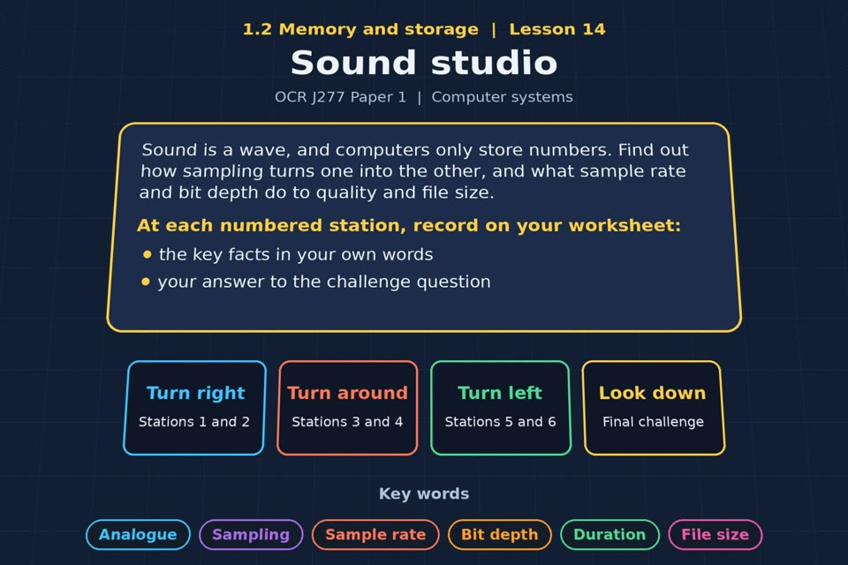

TOPIC 1.2 / LESSON 14
SOUND STUDIO
Sound
KEY QUESTION
How do computers store sound, and what are the implications for sample rate, duration and bit depth?
1 / 18
Notes:
The image is a straight-on perspective preview of the actual experience. Start with the worksheet starter.
Sources: Revise 360 experiences/ms-l14.json and worksheets/MS_L14_SoundStudio_Worksheet.docx. Answers are indicative classroom examples, not an official OCR mark scheme. Calculations follow the worksheet’s decimal kB/MB/GB convention unless stated.

Slide 2
TOPIC 1.2 / LESSON 14 / WORKSHEET
By the end of this lesson
1.
understand how sound is sampled and stored in digital form
2.
understand how sample rate, duration and bit depth affect file size and quality
2 / 18
Notes:
These outcomes follow the wording of the lesson worksheet.
Sources: Revise 360 experiences/ms-l14.json and worksheets/MS_L14_SoundStudio_Worksheet.docx. Answers are indicative classroom examples, not an official OCR mark scheme. Calculations follow the worksheet’s decimal kB/MB/GB convention unless stated.

Slide 3
TOPIC 1.2 / LESSON 14 / WORKSHEET STARTER
Starter: before the experience
Sound is a smooth wave, but computers store numbers. Suggest how a recording could be turned into numbers, and what is lost.
3 / 18
Notes:
Allow students to answer the exact worksheet starter before showing the sample answers.
Sources: Revise 360 experiences/ms-l14.json and worksheets/MS_L14_SoundStudio_Worksheet.docx. Answers are indicative classroom examples, not an official OCR mark scheme. Calculations follow the worksheet’s decimal kB/MB/GB convention unless stated.

Slide 4
TOPIC 1.2 / LESSON 14 / CHECK
Starter: sample answers
1.
Measure the height of the wave at regular times and round each reading to an available digital level.
2.
The exact shape between samples and some amplitude precision are lost.
4 / 18
Notes:
Accept equivalent correct responses. These examples respond to the worksheet starter.
Sources: Revise 360 experiences/ms-l14.json and worksheets/MS_L14_SoundStudio_Worksheet.docx. Answers are indicative classroom examples, not an official OCR mark scheme. Calculations follow the worksheet’s decimal kB/MB/GB convention unless stated.

Slide 5
TOPIC 1.2 / LESSON 14 / WORKSHEET KEY TERMS
Key terminology quiz
1.
Sampling
2.
Sample rate
5 / 18
Notes:
Students define the two terms printed on the worksheet before marking them.
Sources: Revise 360 experiences/ms-l14.json and worksheets/MS_L14_SoundStudio_Worksheet.docx. Answers are indicative classroom examples, not an official OCR mark scheme. Calculations follow the worksheet’s decimal kB/MB/GB convention unless stated.

Slide 6
TOPIC 1.2 / LESSON 14 / CHECK
Key terminology: answers
Sampling
Sampling: measuring an analogue sound wave at regular intervals and recording digital values.
Sample rate
Sample rate: the number of samples taken each second, measured in hertz (Hz).
6 / 18
Notes:
Reveal after students attempt the definitions; accept accurate wording in their own words.
Sources: Revise 360 experiences/ms-l14.json and worksheets/MS_L14_SoundStudio_Worksheet.docx. Answers are indicative classroom examples, not an official OCR mark scheme. Calculations follow the worksheet’s decimal kB/MB/GB convention unless stated.

Slide 7
TOPIC 1.2 / LESSON 14 / EXPERIENCE
Worksheet + experience
01 OPEN EXPERIENCE ↗
Open Sound studio in Topic 1.2. Keep the worksheet beside you.
02 SIX STATIONS
Read each panel. Write the key fact IN YOUR OWN WORDS and answer the worksheet challenge before tapping its badge.
03 FINAL CHALLENGE
Complete the ★ task before tapping the star. Copy your score (out of 15), then finish the worksheet task or review.
04 PLENARY
Finish the experience in this lesson. Near the end, close it for the plenary knowledge checks.
7 / 18
Notes:
Leave this board slide visible during the experience. The OPEN EXPERIENCE label is a clickable link. Everyone should complete the experience and reach the plenary near the end of the lesson. First on-screen responses count.
Sources: Revise 360 experiences/ms-l14.json and worksheets/MS_L14_SoundStudio_Worksheet.docx. Answers are indicative classroom examples, not an official OCR mark scheme. Calculations follow the worksheet’s decimal kB/MB/GB convention unless stated.

Slide 8
TOPIC 1.2 / LESSON 14 / EXTENSION
Apply your learning
Task: sound file sizes. Calculate each file size. Show your working.
Use the task and table on your worksheet.
8 / 18
Notes:
This follows the task after the score on the worksheet. For revision, students use their results and outstanding work list.
Sources: Revise 360 experiences/ms-l14.json and worksheets/MS_L14_SoundStudio_Worksheet.docx. Answers are indicative classroom examples, not an official OCR mark scheme. Calculations follow the worksheet’s decimal kB/MB/GB convention unless stated.

Slide 9
TOPIC 1.2 / LESSON 14 / EXTENSION
Check and improve
A mono recording becomes stereo with the same rate, depth and duration. What changes?
9 / 18
Notes:
Use this question to deepen or correct the worksheet response before the plenary.
Sources: Revise 360 experiences/ms-l14.json and worksheets/MS_L14_SoundStudio_Worksheet.docx. Answers are indicative classroom examples, not an official OCR mark scheme. Calculations follow the worksheet’s decimal kB/MB/GB convention unless stated.

Slide 10
TOPIC 1.2 / LESSON 14 / CHECK
Application: sample answers
1.
10 s × 8,000 Hz × 8 bits = 640,000 bits = 80 kB.
2.
180 s × 44,100 × 16 = 127,008,000 bits = 15.876 MB.
3.
30 s × 22,050 × 16 × 2 channels = 21,168,000 bits = 2.646 MB.
4.
Two channels are stored instead of one, so the uncompressed file size doubles.
10 / 18
Notes:
These are sample answers or a sample revision action. Ratings and open choices may vary with a justified device and context.
Sources: Revise 360 experiences/ms-l14.json and worksheets/MS_L14_SoundStudio_Worksheet.docx. Answers are indicative classroom examples, not an official OCR mark scheme. Calculations follow the worksheet’s decimal kB/MB/GB convention unless stated.

Slide 11
TOPIC 1.2 / LESSON 14 / ANSWERS
After the experience: stations 1–3
Check your key facts and challenge responses.
1 Analogue to digital
A continuous wave has infinitely many points; finite samples and levels can only approximate it.
2 Sample rate
Sample rate is samples per second. A low rate can miss rapid changes and reduce sound quality.
3 Bit depth
Bit depth sets available amplitude levels: 4 bits give 2⁴ = 16 levels.
11 / 18
Notes:
Show only after students have completed the experience. These concise points answer the station challenges and help students improve their own wording.
Sources: Revise 360 experiences/ms-l14.json and worksheets/MS_L14_SoundStudio_Worksheet.docx. Answers are indicative classroom examples, not an official OCR mark scheme. Calculations follow the worksheet’s decimal kB/MB/GB convention unless stated.

Slide 12
TOPIC 1.2 / LESSON 14 / ANSWERS
After the experience: stations 4–6
Check your key facts and challenge responses.
4 Sound file size
Mono sound size = sample rate × bit depth × duration. 30 × 44,100 × 16 = 21,168,000 bits.
5 Quality against size
Speech can remain understandable at a lower sample rate, which saves data and bandwidth compared with music quality.
6 In the studio
Take each of the eight samples at the nearest level; at 3 bits each, the sample data takes 8 × 3 = 24 bits.
12 / 18
Notes:
Show only after students have completed the experience. These concise points answer the station challenges and help students improve their own wording.
Sources: Revise 360 experiences/ms-l14.json and worksheets/MS_L14_SoundStudio_Worksheet.docx. Answers are indicative classroom examples, not an official OCR mark scheme. Calculations follow the worksheet’s decimal kB/MB/GB convention unless stated.

Slide 13
TOPIC 1.2 / LESSON 14 / CHECK
Final challenge: answers
1.
Levels left to right: 4, 6, 7, 5, 2, 0, 1, 3 (100, 110, 111, 101, 010, 000, 001, 011). 8 samples × 3 bits = 24 bits for this short sound.
2.
1,200,000. 20,000 × 8 × 60 = 9,600,000 bits, ÷ 8 = 1,200,000 bytes.
3.
It doubles, because each channel is stored separately. Two channels means twice the samples.
13 / 18
Notes:
Answers are in the same order as the worksheet final challenge and the experience star task. Pixel and sound sketches should be checked against the interactive pattern or wave.
Sources: Revise 360 experiences/ms-l14.json and worksheets/MS_L14_SoundStudio_Worksheet.docx. Answers are indicative classroom examples, not an official OCR mark scheme. Calculations follow the worksheet’s decimal kB/MB/GB convention unless stated.

Slide 14
TOPIC 1.2 / LESSON 14 / PLENARY
Plenary: questions 1–2
Close the experience. Answer from memory on the worksheet.
a) Describe what happens when a sound wave is sampled. [2]
b) Explain the effect on quality and file size of doubling the bit depth. [3]
14 / 18
Notes:
These are the exact exam-practice questions from the worksheet. Allow independent writing before displaying the answer slides.
Sources: Revise 360 experiences/ms-l14.json and worksheets/MS_L14_SoundStudio_Worksheet.docx. Answers are indicative classroom examples, not an official OCR mark scheme. Calculations follow the worksheet’s decimal kB/MB/GB convention unless stated.

Slide 15
TOPIC 1.2 / LESSON 14 / PLENARY
Plenary: question 3
Close the experience. Answer from memory on the worksheet.
c) A recording lasts 45 seconds at 12,000 Hz with a bit depth of 16. Calculate the file size in kilobytes, showing your working. [4]
15 / 18
Notes:
These are the exact exam-practice questions from the worksheet. Allow independent writing before displaying the answer slides.
Sources: Revise 360 experiences/ms-l14.json and worksheets/MS_L14_SoundStudio_Worksheet.docx. Answers are indicative classroom examples, not an official OCR mark scheme. Calculations follow the worksheet’s decimal kB/MB/GB convention unless stated.

Slide 16
TOPIC 1.2 / LESSON 14 / CHECK
Plenary: answers 1–2
Indicative points. Credit accurate answers in students’ own words.
a) The wave’s amplitude is measured at regular intervals. Each measurement is rounded to a digital level and stored in binary.
b) Doubling bit depth doubles bits per sample and raw file size at the same rate and duration. More amplitude levels can capture the wave more accurately.
16 / 18
Notes:
Classroom answer points, not an official OCR mark scheme. Ask students to correct or improve one answer.
Sources: Revise 360 experiences/ms-l14.json and worksheets/MS_L14_SoundStudio_Worksheet.docx. Answers are indicative classroom examples, not an official OCR mark scheme. Calculations follow the worksheet’s decimal kB/MB/GB convention unless stated.

Slide 17
TOPIC 1.2 / LESSON 14 / CHECK
Plenary: answer 3
Indicative points. Credit accurate answers in students’ own words.
c) 45 × 12,000 × 16 = 8,640,000 bits; ÷ 8 = 1,080,000 bytes; ÷ 1,000 = 1,080 kB (mono).
17 / 18
Notes:
Classroom answer points, not an official OCR mark scheme. Ask students to correct or improve one answer.
Sources: Revise 360 experiences/ms-l14.json and worksheets/MS_L14_SoundStudio_Worksheet.docx. Answers are indicative classroom examples, not an official OCR mark scheme. Calculations follow the worksheet’s decimal kB/MB/GB convention unless stated.

Slide 18
TOPIC 1.2 / LESSON 14 / SELF-CHECK
How confident am I?
Select Not yet, Getting there or Confident for each objective on the worksheet.
1.
How sampling works
2.
Sample rate and bit depth
3.
Calculating sound file size
18 / 18
Notes:
Use the exact confidence objectives from the worksheet. Students identify one area to revisit.
Sources: Revise 360 experiences/ms-l14.json and worksheets/MS_L14_SoundStudio_Worksheet.docx. Answers are indicative classroom examples, not an official OCR mark scheme. Calculations follow the worksheet’s decimal kB/MB/GB convention unless stated.

