Slide 1
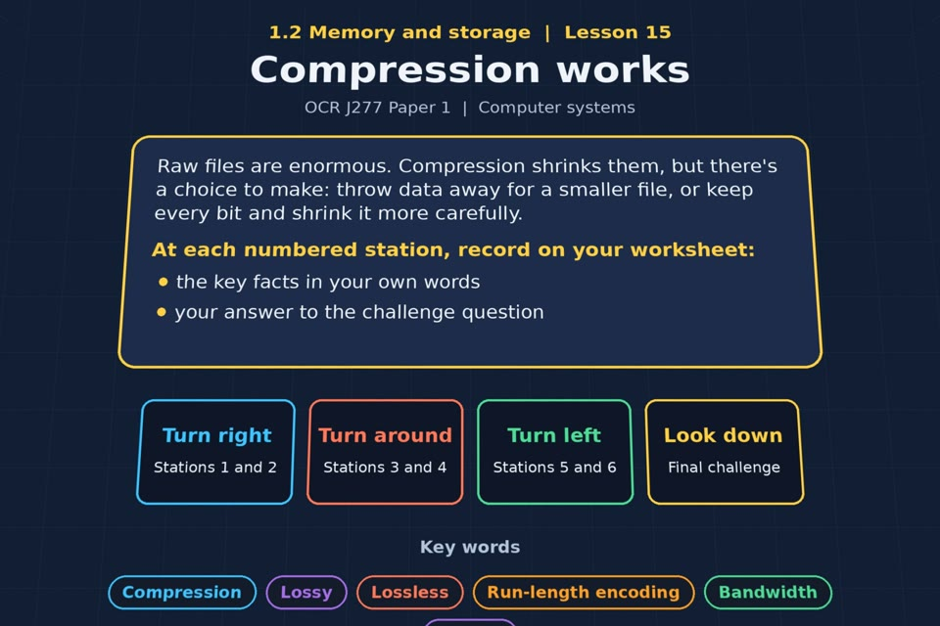

TOPIC 1.2 / LESSON 15
COMPRESSION WORKS
Compression
KEY QUESTION
What are the effects on a file for each type of compression?
1 / 19
Notes:
The image is a straight-on perspective preview of the actual experience. Start with the worksheet starter.
Sources: Revise 360 experiences/ms-l15.json and worksheets/MS_L15_CompressionWorks_Worksheet.docx. Answers are indicative classroom examples, not an official OCR mark scheme. Calculations follow the worksheet’s decimal kB/MB/GB convention unless stated.

Slide 2
TOPIC 1.2 / LESSON 15 / WORKSHEET
By the end of this lesson
1.
know why data is compressed
2.
understand the difference between lossy and lossless compression
3.
know why some data can only be compressed losslessly
2 / 19
Notes:
These outcomes follow the wording of the lesson worksheet.
Sources: Revise 360 experiences/ms-l15.json and worksheets/MS_L15_CompressionWorks_Worksheet.docx. Answers are indicative classroom examples, not an official OCR mark scheme. Calculations follow the worksheet’s decimal kB/MB/GB convention unless stated.

Slide 3
TOPIC 1.2 / LESSON 15 / WORKSHEET STARTER
Starter: before the experience
A three-minute song is about 30 MB uncompressed, but under 3 MB as an MP3. Suggest what could have been removed, and what could not.
3 / 19
Notes:
Allow students to answer the exact worksheet starter before showing the sample answers.
Sources: Revise 360 experiences/ms-l15.json and worksheets/MS_L15_CompressionWorks_Worksheet.docx. Answers are indicative classroom examples, not an official OCR mark scheme. Calculations follow the worksheet’s decimal kB/MB/GB convention unless stated.

Slide 4
TOPIC 1.2 / LESSON 15 / CHECK
Starter: sample answers
1.
MP3 uses lossy compression: it can discard sound detail judged less noticeable to listeners.
2.
The song’s main audible content must remain, but the original samples cannot be recovered exactly.
4 / 19
Notes:
Accept equivalent correct responses. These examples respond to the worksheet starter.
Sources: Revise 360 experiences/ms-l15.json and worksheets/MS_L15_CompressionWorks_Worksheet.docx. Answers are indicative classroom examples, not an official OCR mark scheme. Calculations follow the worksheet’s decimal kB/MB/GB convention unless stated.

Slide 5
TOPIC 1.2 / LESSON 15 / WORKSHEET KEY TERMS
Key terminology quiz
1.
Lossy compression
2.
Lossless compression
5 / 19
Notes:
Students define the two terms printed on the worksheet before marking them.
Sources: Revise 360 experiences/ms-l15.json and worksheets/MS_L15_CompressionWorks_Worksheet.docx. Answers are indicative classroom examples, not an official OCR mark scheme. Calculations follow the worksheet’s decimal kB/MB/GB convention unless stated.

Slide 6
TOPIC 1.2 / LESSON 15 / CHECK
Key terminology: answers
Lossy compression
Lossy compression: makes a smaller file by permanently discarding some data.
Lossless compression
Lossless compression: makes a smaller file while allowing the original data to be restored exactly.
6 / 19
Notes:
Reveal after students attempt the definitions; accept accurate wording in their own words.
Sources: Revise 360 experiences/ms-l15.json and worksheets/MS_L15_CompressionWorks_Worksheet.docx. Answers are indicative classroom examples, not an official OCR mark scheme. Calculations follow the worksheet’s decimal kB/MB/GB convention unless stated.

Slide 7
TOPIC 1.2 / LESSON 15 / EXPERIENCE
Worksheet + experience
01 OPEN EXPERIENCE ↗
Open Compression works in Topic 1.2. Keep the worksheet beside you.
02 SIX STATIONS
Read each panel. Write the key fact IN YOUR OWN WORDS and answer the worksheet challenge before tapping its badge.
03 FINAL CHALLENGE
Complete the ★ task before tapping the star. Copy your score (out of 24), then finish the worksheet task or review.
04 PLENARY
Finish the experience in this lesson. Near the end, close it for the plenary knowledge checks.
7 / 19
Notes:
Leave this board slide visible during the experience. The OPEN EXPERIENCE label is a clickable link. Everyone should complete the experience and reach the plenary near the end of the lesson. First on-screen responses count.
Sources: Revise 360 experiences/ms-l15.json and worksheets/MS_L15_CompressionWorks_Worksheet.docx. Answers are indicative classroom examples, not an official OCR mark scheme. Calculations follow the worksheet’s decimal kB/MB/GB convention unless stated.

Slide 8
TOPIC 1.2 / LESSON 15 / EXTENSION
Apply your learning
Run-length encoding. Write the RLE for the first two rows of your image, then compare the sizes.
Use the task and table on your worksheet.
8 / 19
Notes:
This follows the task after the score on the worksheet. For revision, students use their results and outstanding work list.
Sources: Revise 360 experiences/ms-l15.json and worksheets/MS_L15_CompressionWorks_Worksheet.docx. Answers are indicative classroom examples, not an official OCR mark scheme. Calculations follow the worksheet’s decimal kB/MB/GB convention unless stated.

Slide 9
TOPIC 1.2 / LESSON 15 / EXTENSION
Check and improve
Why might run-length encoding enlarge a noisy photograph but shrink a simple cartoon?
9 / 19
Notes:
Use this question to deepen or correct the worksheet response before the plenary.
Sources: Revise 360 experiences/ms-l15.json and worksheets/MS_L15_CompressionWorks_Worksheet.docx. Answers are indicative classroom examples, not an official OCR mark scheme. Calculations follow the worksheet’s decimal kB/MB/GB convention unless stated.

Slide 10
TOPIC 1.2 / LESSON 15 / CHECK
Application: sample answers
1.
Row 1: 11111111 → (8,1). Row 2: 00001111 → (4,0),(4,1).
2.
The two raw 1-bit rows contain 16 pixels = 16 bits. RLE uses three runs; exact stored size depends on how counts and values are encoded.
3.
A cartoon has long stretches of repeated colours, so runs replace many pixels. A varied photo has short runs, and storing their counts adds overhead.
10 / 19
Notes:
These are sample answers or a sample revision action. Ratings and open choices may vary with a justified device and context.
Sources: Revise 360 experiences/ms-l15.json and worksheets/MS_L15_CompressionWorks_Worksheet.docx. Answers are indicative classroom examples, not an official OCR mark scheme. Calculations follow the worksheet’s decimal kB/MB/GB convention unless stated.

Slide 11
TOPIC 1.2 / LESSON 15 / ANSWERS
After the experience: stations 1–3
Check your key facts and challenge responses.
1 Why compress?
Smaller files take less storage and bandwidth, download faster and can stream with less buffering.
2 Lossy compression
Lossy compression discards detail permanently; MP3 audio and JPEG images are examples.
3 Lossless compression
Lossless keeps all information recoverable. Program or text files must be restored exactly to work correctly.
11 / 19
Notes:
Show only after students have completed the experience. These concise points answer the station challenges and help students improve their own wording.
Sources: Revise 360 experiences/ms-l15.json and worksheets/MS_L15_CompressionWorks_Worksheet.docx. Answers are indicative classroom examples, not an official OCR mark scheme. Calculations follow the worksheet’s decimal kB/MB/GB convention unless stated.

Slide 12
TOPIC 1.2 / LESSON 15 / ANSWERS
After the experience: stations 4–6
Check your key facts and challenge responses.
4 Which one, when?
A photo or stream may use lossy compression if some quality loss is acceptable; code and text need lossless.
5 Run-length encoding
Run-length encoding records each run of repeated values as a value and count. Row 1 is eight 1s; row 2 is four 0s then four 1s.
6 Does it always help?
RLE works best for long repeated runs; a varied photo may have many short runs and gain little or even grow.
12 / 19
Notes:
Show only after students have completed the experience. These concise points answer the station challenges and help students improve their own wording.
Sources: Revise 360 experiences/ms-l15.json and worksheets/MS_L15_CompressionWorks_Worksheet.docx. Answers are indicative classroom examples, not an official OCR mark scheme. Calculations follow the worksheet’s decimal kB/MB/GB convention unless stated.

Slide 13
TOPIC 1.2 / LESSON 15 / CHECK
Final challenge: answers 1–5
1.
Data is permanently removed → Lossy
2.
The original file can be restored exactly → Lossless
3.
Used for MP3 and JPEG files → Lossy
4.
Used for text and program files → Lossless
5.
Usually gives the smallest file → Lossy
13 / 19
Notes:
Answers are in the same order as the worksheet final challenge and the experience star task. Pixel and sound sketches should be checked against the interactive pattern or wave.
Sources: Revise 360 experiences/ms-l15.json and worksheets/MS_L15_CompressionWorks_Worksheet.docx. Answers are indicative classroom examples, not an official OCR mark scheme. Calculations follow the worksheet’s decimal kB/MB/GB convention unless stated.

Slide 14
TOPIC 1.2 / LESSON 15 / CHECK
Final challenge: answers 6–8
6.
Run-length encoding is an example → Lossless
7.
2. Five 1s then three 0s: two runs.
8.
It reduces the bandwidth needed, so video plays without buffering. Less data per second is the whole point.
14 / 19
Notes:
Answers are in the same order as the worksheet final challenge and the experience star task. Pixel and sound sketches should be checked against the interactive pattern or wave.
Sources: Revise 360 experiences/ms-l15.json and worksheets/MS_L15_CompressionWorks_Worksheet.docx. Answers are indicative classroom examples, not an official OCR mark scheme. Calculations follow the worksheet’s decimal kB/MB/GB convention unless stated.

Slide 15
TOPIC 1.2 / LESSON 15 / PLENARY
Plenary: questions 1–2
Close the experience. Answer from memory on the worksheet.
a) Give two reasons why files are compressed before being sent over a network. [2]
b) Compare lossy and lossless compression, using an example of a file that suits each. [6]
15 / 19
Notes:
These are the exact exam-practice questions from the worksheet. Allow independent writing before displaying the answer slides.
Sources: Revise 360 experiences/ms-l15.json and worksheets/MS_L15_CompressionWorks_Worksheet.docx. Answers are indicative classroom examples, not an official OCR mark scheme. Calculations follow the worksheet’s decimal kB/MB/GB convention unless stated.

Slide 16
TOPIC 1.2 / LESSON 15 / PLENARY
Plenary: question 3
Close the experience. Answer from memory on the worksheet.
c) Explain why run-length encoding shrinks a cartoon image more than a photograph. [3]
16 / 19
Notes:
These are the exact exam-practice questions from the worksheet. Allow independent writing before displaying the answer slides.
Sources: Revise 360 experiences/ms-l15.json and worksheets/MS_L15_CompressionWorks_Worksheet.docx. Answers are indicative classroom examples, not an official OCR mark scheme. Calculations follow the worksheet’s decimal kB/MB/GB convention unless stated.

Slide 17
TOPIC 1.2 / LESSON 15 / CHECK
Plenary: answers 1–2
Indicative points. Credit accurate answers in students’ own words.
a) Smaller files need less bandwidth and transfer faster over the network (also less storage).
b) Lossy removes data permanently and cannot reproduce the original exactly, for example JPEG or MP3. Lossless restores every bit, for example ZIP or a text/program file. Lossy can be smaller when some quality loss is acceptable; lossless is essential where exact data matters.
17 / 19
Notes:
Classroom answer points, not an official OCR mark scheme. Ask students to correct or improve one answer.
Sources: Revise 360 experiences/ms-l15.json and worksheets/MS_L15_CompressionWorks_Worksheet.docx. Answers are indicative classroom examples, not an official OCR mark scheme. Calculations follow the worksheet’s decimal kB/MB/GB convention unless stated.

Slide 18
TOPIC 1.2 / LESSON 15 / CHECK
Plenary: answer 3
Indicative points. Credit accurate answers in students’ own words.
c) Cartoons have large areas of the same colour, which form long runs encoded compactly. Photographs vary pixel by pixel, so short runs add count overhead and reduce the saving.
18 / 19
Notes:
Classroom answer points, not an official OCR mark scheme. Ask students to correct or improve one answer.
Sources: Revise 360 experiences/ms-l15.json and worksheets/MS_L15_CompressionWorks_Worksheet.docx. Answers are indicative classroom examples, not an official OCR mark scheme. Calculations follow the worksheet’s decimal kB/MB/GB convention unless stated.

Slide 19
TOPIC 1.2 / LESSON 15 / SELF-CHECK
How confident am I?
Select Not yet, Getting there or Confident for each objective on the worksheet.
1.
Why data is compressed
2.
Lossy and lossless
3.
Run-length encoding
19 / 19
Notes:
Use the exact confidence objectives from the worksheet. Students identify one area to revisit.
Sources: Revise 360 experiences/ms-l15.json and worksheets/MS_L15_CompressionWorks_Worksheet.docx. Answers are indicative classroom examples, not an official OCR mark scheme. Calculations follow the worksheet’s decimal kB/MB/GB convention unless stated.

