Slide 1
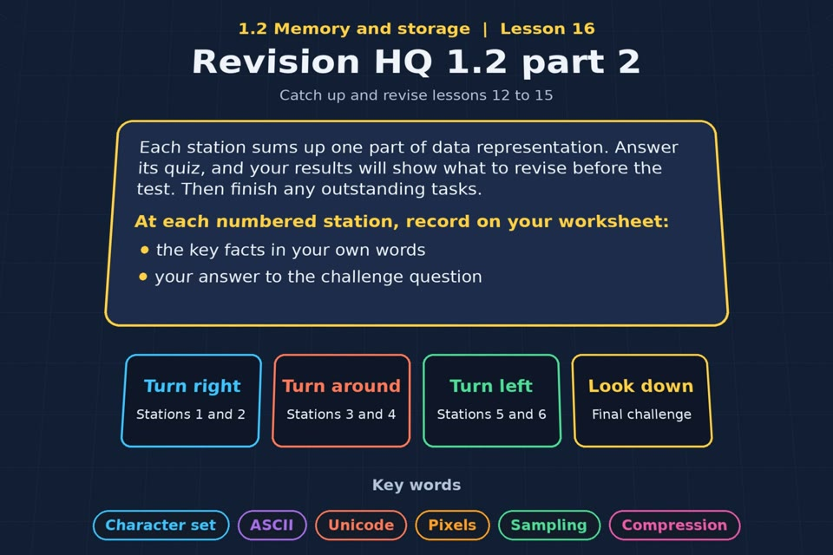

TOPIC 1.2 / LESSON 16
REVISION HQ 1.2 PART 2
Catch-up and revision: lessons 12 to 16
REVISION FOCUS
Which areas need more practice?
1 / 16
Notes:
The image is a straight-on perspective preview of the actual experience. Start with the worksheet starter.
Sources: Revise 360 experiences/ms-l16.json and worksheets/MS_L16_RevisionHQ12Part2_Worksheet.docx. Answers are indicative classroom examples, not an official OCR mark scheme. Calculations follow the worksheet’s decimal kB/MB/GB convention unless stated.

Slide 2
TOPIC 1.2 / LESSON 16 / WORKSHEET
By the end of this lesson
1.
know which parts of data representation I am secure on
2.
finish outstanding tasks from lessons 12 to 15
2 / 16
Notes:
These outcomes follow the wording of the lesson worksheet.
Sources: Revise 360 experiences/ms-l16.json and worksheets/MS_L16_RevisionHQ12Part2_Worksheet.docx. Answers are indicative classroom examples, not an official OCR mark scheme. Calculations follow the worksheet’s decimal kB/MB/GB convention unless stated.

Slide 3
TOPIC 1.2 / LESSON 16 / WORKSHEET STARTER
Starter: before the experience
Without notes, write the three file size formulas: images, sound and text.
3 / 16
Notes:
Allow students to answer the exact worksheet starter before showing the sample answers.
Sources: Revise 360 experiences/ms-l16.json and worksheets/MS_L16_RevisionHQ12Part2_Worksheet.docx. Answers are indicative classroom examples, not an official OCR mark scheme. Calculations follow the worksheet’s decimal kB/MB/GB convention unless stated.

Slide 4
TOPIC 1.2 / LESSON 16 / CHECK
Starter: sample answers
1.
Image bits = width × height × colour depth. Sound bits = sample rate × bit depth × duration × channels.
2.
Text bits = number of characters × bits per character. Divide bits by 8 to get bytes.
4 / 16
Notes:
Accept equivalent correct responses. These examples respond to the worksheet starter.
Sources: Revise 360 experiences/ms-l16.json and worksheets/MS_L16_RevisionHQ12Part2_Worksheet.docx. Answers are indicative classroom examples, not an official OCR mark scheme. Calculations follow the worksheet’s decimal kB/MB/GB convention unless stated.

Slide 5
TOPIC 1.2 / LESSON 16 / EXPERIENCE
Worksheet + experience
01 OPEN EXPERIENCE ↗
Open Revision HQ 1.2 part 2 in Topic 1.2. Keep the worksheet beside you.
02 SIX STATIONS
Read each panel. Write THREE key facts IN YOUR OWN WORDS and answer the worksheet challenge before tapping its badge.
03 FINAL CHALLENGE
Complete the ★ task before tapping the star. Copy your score (out of 27), then finish the worksheet task or review.
04 PLENARY
Finish the experience in this lesson. Near the end, close it for the plenary knowledge checks.
5 / 16
Notes:
Leave this board slide visible during the experience. The OPEN EXPERIENCE label is a clickable link. Everyone should complete the experience and reach the plenary near the end of the lesson. First on-screen responses count.
Sources: Revise 360 experiences/ms-l16.json and worksheets/MS_L16_RevisionHQ12Part2_Worksheet.docx. Answers are indicative classroom examples, not an official OCR mark scheme. Calculations follow the worksheet’s decimal kB/MB/GB convention unless stated.

Slide 6
TOPIC 1.2 / LESSON 16 / EXTENSION
Apply your learning
Use the My results table and outstanding programs checklist. Choose one weak area and a specific task to complete.
Use the task and table on your worksheet.
6 / 16
Notes:
This follows the task after the score on the worksheet. For revision, students use their results and outstanding work list.
Sources: Revise 360 experiences/ms-l16.json and worksheets/MS_L16_RevisionHQ12Part2_Worksheet.docx. Answers are indicative classroom examples, not an official OCR mark scheme. Calculations follow the worksheet’s decimal kB/MB/GB convention unless stated.

Slide 7
TOPIC 1.2 / LESSON 16 / EXTENSION
Check and improve
An image is 500 × 500 pixels at 8-bit colour depth. Explain each unit conversion in its raw file size.
7 / 16
Notes:
Use this question to deepen or correct the worksheet response before the plenary.
Sources: Revise 360 experiences/ms-l16.json and worksheets/MS_L16_RevisionHQ12Part2_Worksheet.docx. Answers are indicative classroom examples, not an official OCR mark scheme. Calculations follow the worksheet’s decimal kB/MB/GB convention unless stated.

Slide 8
TOPIC 1.2 / LESSON 16 / CHECK
Application: sample answers
1.
Choose an area using your score and on-screen feedback rather than guessing.
2.
Write an action such as “redo the Pixel studio file size table, showing bits → bytes → kB.”
3.
500 × 500 × 8 = 2,000,000 bits; ÷ 8 = 250,000 bytes; ÷ 1,000 = 250 kB. This excludes metadata and compression.
8 / 16
Notes:
These are sample answers or a sample revision action. Ratings and open choices may vary with a justified device and context.
Sources: Revise 360 experiences/ms-l16.json and worksheets/MS_L16_RevisionHQ12Part2_Worksheet.docx. Answers are indicative classroom examples, not an official OCR mark scheme. Calculations follow the worksheet’s decimal kB/MB/GB convention unless stated.

Slide 9
TOPIC 1.2 / LESSON 16 / ANSWERS
After the experience: stations 1–3
Check your key facts and challenge responses.
1 Character sets
ASCII has a small basic set; Unicode supports many more scripts and symbols. Some encodings use more bytes for some characters.
2 Images
500 × 500 × 8 = 2,000,000 bits = 250,000 bytes = 250 kB.
3 Sound
20 × 16,000 × 8 = 2,560,000 bits = 320,000 bytes = 320 kB for mono sound.
9 / 16
Notes:
Show only after students have completed the experience. These concise points answer the station challenges and help students improve their own wording.
Sources: Revise 360 experiences/ms-l16.json and worksheets/MS_L16_RevisionHQ12Part2_Worksheet.docx. Answers are indicative classroom examples, not an official OCR mark scheme. Calculations follow the worksheet’s decimal kB/MB/GB convention unless stated.

Slide 10
TOPIC 1.2 / LESSON 16 / ANSWERS
After the experience: stations 4–6
Check your key facts and challenge responses.
4 Compression
Compression reduces storage and transmission time; lossless recovers exact data, while lossy removes detail.
5 Calculations practice
For each image, sound or text problem, choose the correct formula, calculate bits, then convert to bytes and a sensible unit.
6 Exam technique
State gives a brief fact; describe gives detail; explain links cause and effect; calculate shows the method and units.
10 / 16
Notes:
Show only after students have completed the experience. These concise points answer the station challenges and help students improve their own wording.
Sources: Revise 360 experiences/ms-l16.json and worksheets/MS_L16_RevisionHQ12Part2_Worksheet.docx. Answers are indicative classroom examples, not an official OCR mark scheme. Calculations follow the worksheet’s decimal kB/MB/GB convention unless stated.

Slide 11
TOPIC 1.2 / LESSON 16 / CHECK
Final challenge: answers 1–5
1.
Convert the character code 90 (the letter Z) into 8-bit binary → 01011010. 90 is 01011010.
2.
ASCII uses 7 bits per character → Text
3.
Colour depth is bits per pixel → Images
4.
Sample rate is measured in hertz → Sound
5.
Lossy removes data permanently → Compression
11 / 16
Notes:
Answers are in the same order as the worksheet final challenge and the experience star task. Pixel and sound sketches should be checked against the interactive pattern or wave.
Sources: Revise 360 experiences/ms-l16.json and worksheets/MS_L16_RevisionHQ12Part2_Worksheet.docx. Answers are indicative classroom examples, not an official OCR mark scheme. Calculations follow the worksheet’s decimal kB/MB/GB convention unless stated.

Slide 12
TOPIC 1.2 / LESSON 16 / CHECK
Final challenge: answers 6–9
6.
Metadata stores the dimensions → Images
7.
Unicode covers every writing system → Text
8.
Bit depth sets the number of levels → Sound
9.
Run-length encoding is lossless → Compression
12 / 16
Notes:
Answers are in the same order as the worksheet final challenge and the experience star task. Pixel and sound sketches should be checked against the interactive pattern or wave.
Sources: Revise 360 experiences/ms-l16.json and worksheets/MS_L16_RevisionHQ12Part2_Worksheet.docx. Answers are indicative classroom examples, not an official OCR mark scheme. Calculations follow the worksheet’s decimal kB/MB/GB convention unless stated.

Slide 13
TOPIC 1.2 / LESSON 16 / PLENARY
Plenary: questions
Close the experience. Answer from memory on the worksheet.
a) Describe the difference between lossy and lossless compression. [4]
b) An image is 640 × 480 with 8-bit colour depth. Calculate its size in kilobytes. [3]
13 / 16
Notes:
These are the exact exam-practice questions from the worksheet. Allow independent writing before displaying the answer slides.
Sources: Revise 360 experiences/ms-l16.json and worksheets/MS_L16_RevisionHQ12Part2_Worksheet.docx. Answers are indicative classroom examples, not an official OCR mark scheme. Calculations follow the worksheet’s decimal kB/MB/GB convention unless stated.

Slide 14
TOPIC 1.2 / LESSON 16 / CHECK
Plenary: answers
Indicative points. Credit accurate answers in students’ own words.
a) Lossy permanently removes some data, so the exact original cannot be restored. Lossless reduces size while allowing all original data to be reconstructed.
b) 640 × 480 × 8 = 2,457,600 bits; ÷ 8 = 307,200 bytes; ÷ 1,000 = 307.2 kB.
14 / 16
Notes:
Classroom answer points, not an official OCR mark scheme. Ask students to correct or improve one answer.
Sources: Revise 360 experiences/ms-l16.json and worksheets/MS_L16_RevisionHQ12Part2_Worksheet.docx. Answers are indicative classroom examples, not an official OCR mark scheme. Calculations follow the worksheet’s decimal kB/MB/GB convention unless stated.

Slide 15
TOPIC 1.2 / LESSON 16 / WORKSHEET
Revision checklist
RAG the Topic 1.2 areas on your worksheet.
1.
Character sets: ASCII and Unicode
2.
Images: pixels, colour depth, resolution, metadata
3.
Image file size calculations
4.
Sound: sampling, sample rate, bit depth
5.
Sound file size calculations
6.
Compression: lossy and lossless
7.
Run-length encoding
15 / 16
Notes:
This checklist follows the revision worksheet. Students mark red, amber or green and select a next task from their results.
Sources: Revise 360 experiences/ms-l16.json and worksheets/MS_L16_RevisionHQ12Part2_Worksheet.docx. Answers are indicative classroom examples, not an official OCR mark scheme. Calculations follow the worksheet’s decimal kB/MB/GB convention unless stated.

Slide 16
TOPIC 1.2 / LESSON 16 / SELF-CHECK
How confident am I?
Select Not yet, Getting there or Confident for each objective on the worksheet.
1.
Character sets
2.
Images and sound
3.
Compression
16 / 16
Notes:
Use the exact confidence objectives from the worksheet. Students identify one area to revisit.
Sources: Revise 360 experiences/ms-l16.json and worksheets/MS_L16_RevisionHQ12Part2_Worksheet.docx. Answers are indicative classroom examples, not an official OCR mark scheme. Calculations follow the worksheet’s decimal kB/MB/GB convention unless stated.

