Slide 1
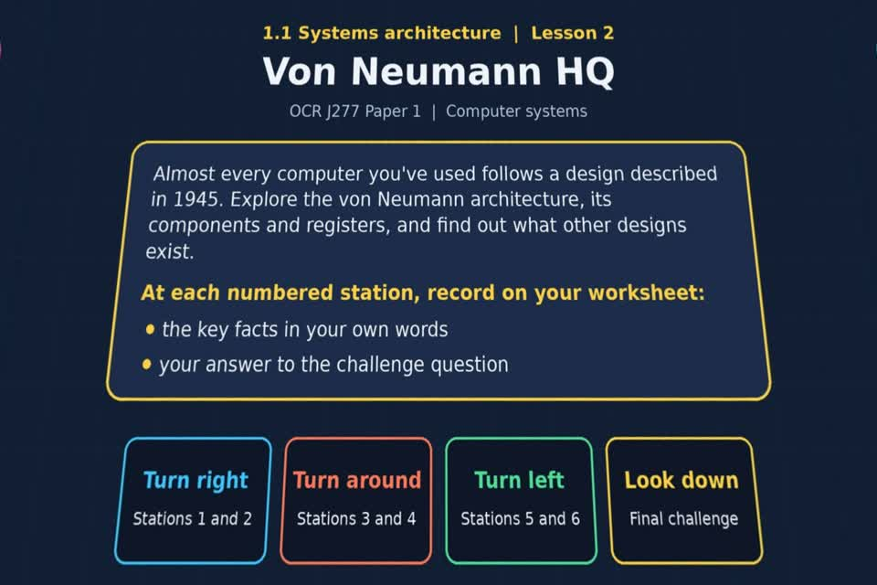
TOPIC 1.1 / LESSON 02
VON NEUMANN HQ
Architecture of the CPU
Start with your worksheet.
Open the experience after the starter and key terms have been marked.
Revise 360 OCR J277 1.1 Systems architecture
1 / 20
Notes:
The picture shows a straight-on perspective view of the actual 360 experience opening scene. Students should keep the experience closed until slide 7.
Sources: Revise360 experiences/sa-l02.json and worksheets/SA_L02_VonNeumannHQ_Worksheet.docx. Indicative answers are for discussion and self-check, not an official exam-board mark scheme.

Slide 2
TOPIC 1.1 / LESSON 02 / WORKSHEET
By the end of this lesson
Your worksheet lists these learning outcomes:
1.
Describe the von Neumann architecture
2.
Know the components of the von Neumann architecture
3.
Understand what a keyword is
Complete the experience in this lesson; finish with the plenary knowledge check.
Revise 360 OCR J277 1.1 Systems architecture
2 / 20
Notes:
Read the outcomes with the class. They follow the wording of the lesson worksheet.
Sources: Revise360 experiences/sa-l02.json and worksheets/SA_L02_VonNeumannHQ_Worksheet.docx. Indicative answers are for discussion and self-check, not an official exam-board mark scheme.

Slide 3
TOPIC 1.1 / LESSON 02 / WORKSHEET STARTER
Starter: before the experience
Answer the starter question in the box on your worksheet.
The same laptop can run a game, then a word processor, then a browser, with no hardware changed. What makes that possible?
Keep the experience closed until the starter and key terms are checked.
Revise 360 OCR J277 1.1 Systems architecture
3 / 20
Notes:
Allow pupils to attempt the exact starter question printed on the worksheet. Take a few suggestions before showing the model answer.
Sources: Revise360 experiences/sa-l02.json and worksheets/SA_L02_VonNeumannHQ_Worksheet.docx. Indicative answers are for discussion and self-check, not an official exam-board mark scheme.

Slide 4
TOPIC 1.1 / LESSON 02 / CHECK
Starter: sample answers
Compare your worksheet answer with these examples. Other accurate examples count.
1.
The CPU can run different stored programs loaded into main memory.
2.
New instructions change the task without rewiring the hardware.
Revise 360 OCR J277 1.1 Systems architecture
4 / 20
Notes:
These are sample answers to the exact worksheet starter question. Accept other correct examples and explanations.
Sources: Revise360 experiences/sa-l02.json and worksheets/SA_L02_VonNeumannHQ_Worksheet.docx. Indicative answers are for discussion and self-check, not an official exam-board mark scheme.

Slide 5
TOPIC 1.1 / LESSON 02 / WORKSHEET KEY TERMS
Key terminology quiz
Define the two terms listed in the key terminology section of your worksheet.
1.
ALU
2.
CU (control unit)
Revise 360 OCR J277 1.1 Systems architecture
5 / 20
Notes:
Students write definitions from memory. These two terms are the worksheet’s exact key terminology entries, including the recap terms in Lesson 4.
Sources: Revise360 experiences/sa-l02.json and worksheets/SA_L02_VonNeumannHQ_Worksheet.docx. Indicative answers are for discussion and self-check, not an official exam-board mark scheme.

Slide 6
TOPIC 1.1 / LESSON 02 / CHECK
Key terminology: answers
Correct or improve your two definitions before opening the experience.
ALU
The arithmetic logic unit performs calculations and logical operations.
CU (control unit)
The control unit decodes instructions and sends control signals.
Revise 360 OCR J277 1.1 Systems architecture
6 / 20
Notes:
Both term definitions are visible for pupils to correct their quiz. Reveal this slide after attempts.
Sources: Revise360 experiences/sa-l02.json and worksheets/SA_L02_VonNeumannHQ_Worksheet.docx. Indicative answers are for discussion and self-check, not an official exam-board mark scheme.

Slide 7
TOPIC 1.1 / LESSON 02 / EXPERIENCE
Open the experience now
START
Select Von Neumann HQ from Topic 1.1 and keep your worksheet beside you.
AT EVERY STATION
Write the key fact IN YOUR OWN WORDS and answer the worksheet challenge before tapping the badge.
FINISH
Answer on screen, then copy your score into the yellow worksheet box (out of 19).
Open the experience online ↗
Revise 360 OCR J277 1.1 Systems architecture
7 / 20
Notes:
This is the first slide where students open the experience file. Leave it visible while they get set up. The link opens the matching experience.
Sources: Revise360 experiences/sa-l02.json and worksheets/SA_L02_VonNeumannHQ_Worksheet.docx. Indicative answers are for discussion and self-check, not an official exam-board mark scheme.

Slide 8
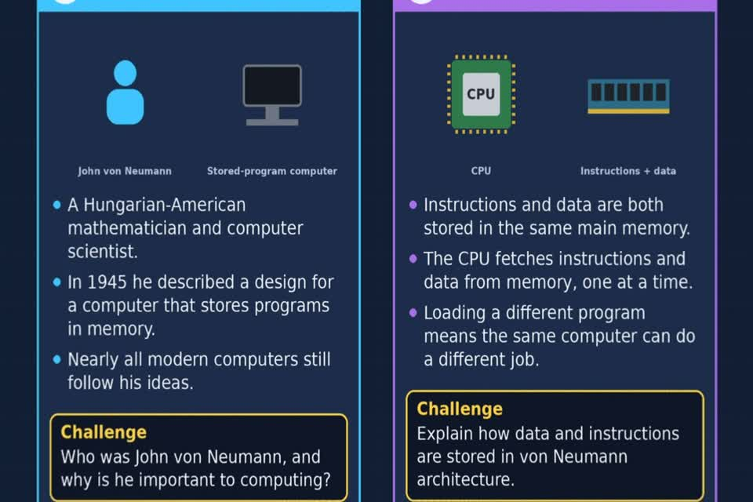
TOPIC 1.1 / LESSON 02 / EXPERIENCE
The stations in your worksheet
Follow your worksheet route. Write key facts in your own words before tapping each badge.
RIGHT
1 John von Neumann
2 The stored-program concept
AROUND
3 Program counter and accumulator
4 MAR and MDR
LEFT
5 Other architectures
6 Keywords
DOWN
★ Final challenge
Revise 360 OCR J277 1.1 Systems architecture
8 / 20
Notes:
The image is a straight-on perspective view of stations 1 and 2 in the actual experience. Students should record the key fact and their own answer before selecting each badge.
Sources: Revise360 experiences/sa-l02.json and worksheets/SA_L02_VonNeumannHQ_Worksheet.docx. Indicative answers are for discussion and self-check, not an official exam-board mark scheme.

Slide 9
TOPIC 1.1 / LESSON 02 / WORKSHEET
Final challenge, score and key question
Look down. Complete the ★ final challenge table on your worksheet before tapping the star.
Copy the result from the score screen: ______ / 19
KEY QUESTION
What other architectures exist and where are they used?
Revise 360 OCR J277 1.1 Systems architecture
9 / 20
Notes:
Once students have reached the score screen, they copy the mark straight away. The key question is printed on the worksheet after the score box.
Sources: Revise360 experiences/sa-l02.json and worksheets/SA_L02_VonNeumannHQ_Worksheet.docx. Indicative answers are for discussion and self-check, not an official exam-board mark scheme.

Slide 10
TOPIC 1.1 / LESSON 02 / EXTENSION
Apply your learning
Once you have completed the experience, use your worksheet to reason further.
A laptop runs a game, then a spreadsheet. Explain how a stored program makes this possible without rewiring the computer.
Compare shared memory with the separate instruction and data memories in Harvard architecture.
Revise 360 OCR J277 1.1 Systems architecture
10 / 20
Notes:
This extension is optional and comes after the experience. Give students time to reason in full sentences.
Sources: Revise360 experiences/sa-l02.json and worksheets/SA_L02_VonNeumannHQ_Worksheet.docx. Indicative answers are for discussion and self-check, not an official exam-board mark scheme.

Slide 11
TOPIC 1.1 / LESSON 02 / EXTENSION
Check and improve
Use your worksheet notes and the experience feedback.
Explain MAR and MDR in one sentence each. Then describe what the control unit does during decode.
Near the end of the lesson, close the experience for the plenary knowledge check.
Revise 360 OCR J277 1.1 Systems architecture
11 / 20
Notes:
Use this work after the experience has been completed. Move the whole class to the plenary knowledge check near the end of the lesson. Do not reveal station answers until pupils have completed the experience.
Sources: Revise360 experiences/sa-l02.json and worksheets/SA_L02_VonNeumannHQ_Worksheet.docx. Indicative answers are for discussion and self-check, not an official exam-board mark scheme.

Slide 12
TOPIC 1.1 / LESSON 02 / CHECK
Application: sample answers
Compare your reasoning, then improve one sentence on your worksheet.
Application
Loading a new stored program into main memory lets the same CPU run a new task. Harvard architecture separates instruction and data memories.
Check and stretch
MAR holds the memory address. MDR holds data or an instruction moving to or from memory. The control unit interprets the instruction during decode.
Revise 360 OCR J277 1.1 Systems architecture
12 / 20
Notes:
Show the sample answers after students have attempted the two application prompts. These are examples rather than a single required wording.
Sources: Revise360 experiences/sa-l02.json and worksheets/SA_L02_VonNeumannHQ_Worksheet.docx. Indicative answers are for discussion and self-check, not an official exam-board mark scheme.

Slide 13
TOPIC 1.1 / LESSON 02 / ANSWERS
After the experience: stations 1–3
Close the experience. Check your key facts and challenge responses.
1 John von Neumann
John von Neumann described a stored-program computer design in 1945.
2 The stored-program concept
Instructions and data share main memory. Loading a different program changes what the computer does.
3 Program counter and accumulator
PC holds the next instruction address and increments; accumulator holds calculation results.
Revise 360 OCR J277 1.1 Systems architecture
13 / 20
Notes:
These are concise answers to the worksheet station prompts, shared only after pupils complete the experience. Correct wording can vary.
Sources: Revise360 experiences/sa-l02.json and worksheets/SA_L02_VonNeumannHQ_Worksheet.docx. Indicative answers are for discussion and self-check, not an official exam-board mark scheme.

Slide 14
TOPIC 1.1 / LESSON 02 / ANSWERS
After the experience: stations 4–6
Continue checking the station notes on your worksheet.
4 MAR and MDR
MAR holds the memory address. MDR holds data or an instruction moving between CPU and main memory.
5 Other architectures
Harvard architecture keeps instructions and data in separate memories; microcontrollers often use it.
6 Keywords
For example, while repeats a loop, if tests a condition, and for iterates. Keywords are reserved.
Revise 360 OCR J277 1.1 Systems architecture
14 / 20
Notes:
These are concise answers to the worksheet station prompts, shared only after pupils complete the experience. Correct wording can vary.
Sources: Revise360 experiences/sa-l02.json and worksheets/SA_L02_VonNeumannHQ_Worksheet.docx. Indicative answers are for discussion and self-check, not an official exam-board mark scheme.

Slide 15
TOPIC 1.1 / LESSON 02 / CHECK
Final challenge: answers
Compare your star challenge table with the answers below.
1.
Program counter: next instruction address
2.
Control unit: decodes and controls
3.
MAR: memory address
4.
ALU: arithmetic and logic
5.
MDR: data to or from memory
6.
Accumulator: calculation results
7.
Cache: frequently used data and instructions
Revise 360 OCR J277 1.1 Systems architecture
15 / 20
Notes:
These answers follow the final challenge in the interactive experience and the worksheet. Students should correct their table before the exam questions.
Sources: Revise360 experiences/sa-l02.json and worksheets/SA_L02_VonNeumannHQ_Worksheet.docx. Indicative answers are for discussion and self-check, not an official exam-board mark scheme.

Slide 16
TOPIC 1.1 / LESSON 02 / PLENARY
Plenary: questions (a–b)
Take the headset off or close the page. Answer from memory on the worksheet.
a)
Name the register that holds the address of the next instruction to be fetched. [1]
b)
Describe what the memory data register holds and when it is used. [2]
Revise 360 OCR J277 1.1 Systems architecture
16 / 20
Notes:
These are the exact exam-practice questions a and b from the worksheet. Give independent writing time before revealing the answers.
Sources: Revise360 experiences/sa-l02.json and worksheets/SA_L02_VonNeumannHQ_Worksheet.docx. Indicative answers are for discussion and self-check, not an official exam-board mark scheme.

Slide 17
TOPIC 1.1 / LESSON 02 / PLENARY
Plenary: question (c)
Keep the experience closed. Explain your reasoning in full sentences.
c)
Explain what happens during each of the three stages of the fetch-decode-execute cycle. [6]
Use the marks in brackets to judge how much detail to include.
Revise 360 OCR J277 1.1 Systems architecture
17 / 20
Notes:
This is the exact worksheet exam-practice question c. Let students answer independently.
Sources: Revise360 experiences/sa-l02.json and worksheets/SA_L02_VonNeumannHQ_Worksheet.docx. Indicative answers are for discussion and self-check, not an official exam-board mark scheme.

Slide 18
TOPIC 1.1 / LESSON 02 / CHECK
Plenary: answers (a–b)
Indicative points. Credit accurate answers in students’ own words.
a Program counter (PC).
b The MDR holds data or an instruction fetched from memory, or data waiting to be written. It is used during transfer between main memory and the CPU.
Revise 360 OCR J277 1.1 Systems architecture
18 / 20
Notes:
These are classroom answer points, not an official OCR mark scheme. Ask students to improve one response in a different colour.
Sources: Revise360 experiences/sa-l02.json and worksheets/SA_L02_VonNeumannHQ_Worksheet.docx. Indicative answers are for discussion and self-check, not an official exam-board mark scheme.

Slide 19
TOPIC 1.1 / LESSON 02 / CHECK
Plenary: answer (c)
Indicative points for the final question.
1.
Fetch: the PC address goes to the MAR; the instruction arrives from RAM in the MDR; the PC increments.
2.
Decode: the control unit interprets the instruction and decides the required operation.
3.
Execute: the CPU carries it out, for example an ALU calculation whose result is held in the accumulator.
Revise 360 OCR J277 1.1 Systems architecture
19 / 20
Notes:
Accept equivalent descriptions. The experience also covers Harvard architecture and Python keywords; the exam questions on the worksheet focus on registers and the cycle. Ask students to revise one sentence after self-check.
Sources: Revise360 experiences/sa-l02.json and worksheets/SA_L02_VonNeumannHQ_Worksheet.docx. Indicative answers are for discussion and self-check, not an official exam-board mark scheme.

Slide 20
TOPIC 1.1 / LESSON 02 / SELF-CHECK
How confident am I?
On the worksheet, select Not yet, Getting there or Confident for each objective.
1.
The von Neumann architecture
2.
The PC, MAR, MDR and accumulator
3.
What a keyword is
Revise 360 OCR J277 1.1 Systems architecture
20 / 20
Notes:
End with the exact confidence objectives listed in the worksheet. Ask students to identify one item to revisit next time.
Sources: Revise360 experiences/sa-l02.json and worksheets/SA_L02_VonNeumannHQ_Worksheet.docx. Indicative answers are for discussion and self-check, not an official exam-board mark scheme.

