Slide 1
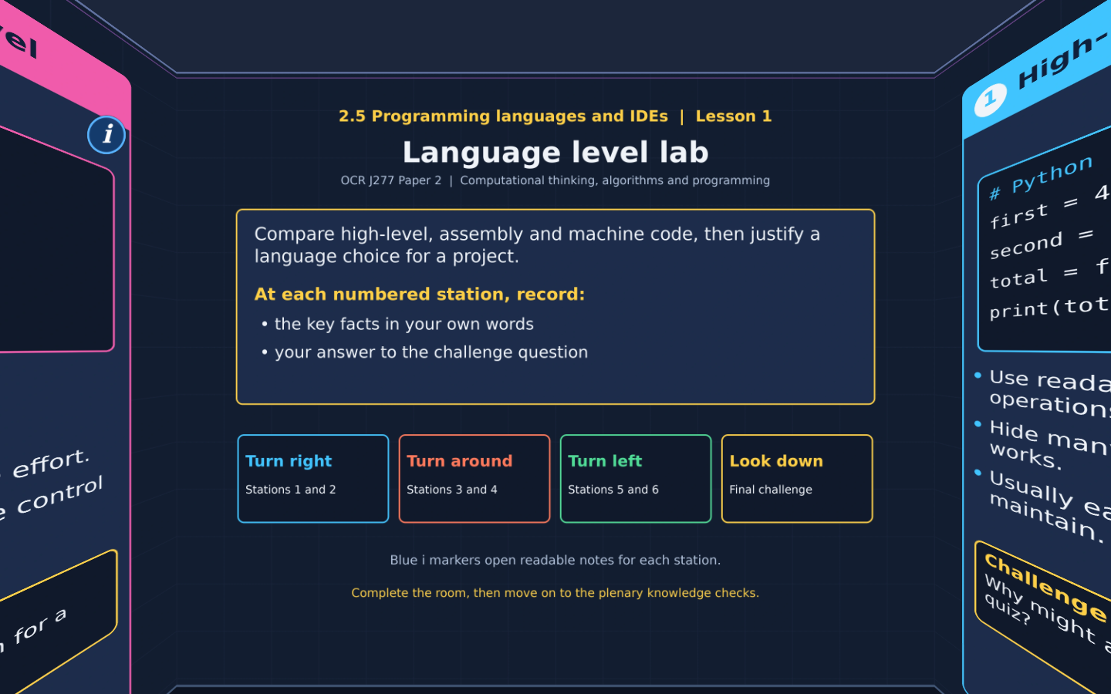

TOPIC 2.5 / LESSON 01
LANGUAGE LEVEL LAB
Language characteristics
DO NOW: RESEARCH AND DISCUSS
Why might two programmers choose different languages to solve the same problem?
1 / 18
Notes:
Revise360 original lesson content. Teaching examples support OCR J277 Topic 2.5. The low-level instruction model is explanatory enrichment, not an additional required instruction set.

Slide 2
TOPIC 2.5 / LESSON 01 / WORKSHEET
By the end of this lesson
1.
Compare high-level and low-level languages.
2.
Distinguish source code, assembly and machine code.
3.
Justify language choices using project requirements.
2 / 18
Notes:
Revise360 original lesson content. Teaching examples support OCR J277 Topic 2.5. The low-level instruction model is explanatory enrichment, not an additional required instruction set.

Slide 3
TOPIC 2.5 / LESSON 01 / WORKSHEET STARTER
Starter: before the experience
A school needs a quiz app that staff can update. A device needs precise control of processor registers. Would the same language level suit both equally well? Explain.
3 / 18
Notes:
Revise360 original lesson content. Teaching examples support OCR J277 Topic 2.5. The low-level instruction model is explanatory enrichment, not an additional required instruction set.

Slide 4
TOPIC 2.5 / LESSON 01 / CHECK
Starter: sample answers
1.
The quiz may suit a high-level language because readable code is easier to maintain. The hardware routine may suit a low-level language because it exposes processor operations.
4 / 18
Notes:
Revise360 original lesson content. Teaching examples support OCR J277 Topic 2.5. The low-level instruction model is explanatory enrichment, not an additional required instruction set.

Slide 5
TOPIC 2.5 / LESSON 01 / WORKSHEET KEY TERMS
Key terminology quiz
1.
High-level language
2.
Low-level language
5 / 18
Notes:
Revise360 original lesson content. Teaching examples support OCR J277 Topic 2.5. The low-level instruction model is explanatory enrichment, not an additional required instruction set.

Slide 6
TOPIC 2.5 / LESSON 01 / CHECK
Key terminology: answers
High-level language
A language that abstracts many hardware details using human-readable constructs.
Low-level language
A language closely related to a processor instruction set and hardware operations.
6 / 18
Notes:
Revise360 original lesson content. Teaching examples support OCR J277 Topic 2.5. The low-level instruction model is explanatory enrichment, not an additional required instruction set.

Slide 7
TOPIC 2.5 / LESSON 01 / EXPERIENCE
Worksheet + experience
01 OPEN THE EXPERIENCE NOW
Open Language level lab in Topic 2.5. Keep the worksheet beside you.
02 SIX STATIONS
At each station, write key facts IN YOUR OWN WORDS. Answer its worksheet challenge before tapping the badge.
03 FINAL CHALLENGE
Attempt the worksheet final challenge before tapping the star. Record your score, then use review mode to correct mistakes.
04 PLENARY
Finish the experience in this lesson. Near the end, close it for the plenary knowledge checks.
7 / 18
Notes:
Revise360 original lesson content. Teaching examples support OCR J277 Topic 2.5. The low-level instruction model is explanatory enrichment, not an additional required instruction set.

Slide 8
TOPIC 2.5 / LESSON 01 / CONSOLIDATION
After the experience
Return to the Do Now question. Use two things you learned in the room to improve your original answer.
Check that each reason links a specific characteristic or tool to the task.
8 / 18
Notes:
Revise360 original lesson content. Teaching examples support OCR J277 Topic 2.5. The low-level instruction model is explanatory enrichment, not an additional required instruction set.

Slide 9
TOPIC 2.5 / LESSON 01 / CONSOLIDATION
Check and improve
Use review mode to correct any mistakes. Write one correction and explain why the right answer fits. Then move on to the plenary knowledge checks.
9 / 18
Notes:
Revise360 original lesson content. Teaching examples support OCR J277 Topic 2.5. The low-level instruction model is explanatory enrichment, not an additional required instruction set.

Slide 10
TOPIC 2.5 / LESSON 01 / CHECK
A stronger explanation
Compare your reasoning, then improve one sentence on your worksheet.
Choosing the right level
A high-level language supports readable, maintainable code, making updates easier.
Review and explain
Your correction should name the correct idea and explain why it fits the question. Use the experience feedback to check it.
10 / 18
Notes:
Revise360 original lesson content. Teaching examples support OCR J277 Topic 2.5. The low-level instruction model is explanatory enrichment, not an additional required instruction set.

Slide 11
TOPIC 2.5 / LESSON 01 / ANSWERS
After the experience: stations 1–3
Check your key facts and challenge responses.
1 High-level languages
Python hides hardware details and is readable, so staff can build and maintain the quiz more easily.
2 Low-level languages
A device may need exact control over processor operations or memory use. Low-level code exposes these details.
3 Machine code
No. A CPU must support the instruction set used by that machine code.
11 / 18
Notes:
Revise360 original lesson content. Teaching examples support OCR J277 Topic 2.5. The low-level instruction model is explanatory enrichment, not an additional required instruction set.

Slide 12
TOPIC 2.5 / LESSON 01 / ANSWERS
After the experience: stations 4–6
Check your key facts and challenge responses.
4 Assembly language
Assembly instructions remain closely tied to a processor instruction set, even though mnemonics are readable.
5 Moving between devices
A compatible Python runtime and any required libraries must be available.
6 Choosing the right level
A high-level language supports readable, maintainable code, making updates easier.
12 / 18
Notes:
Revise360 original lesson content. Teaching examples support OCR J277 Topic 2.5. The low-level instruction model is explanatory enrichment, not an additional required instruction set.

Slide 13
TOPIC 2.5 / LESSON 01 / CHECK
Final challenge: answers
Check your choices and the reasons you gave.
A revision app: readable code and frequent updates: High-level. A tiny hardware routine: direct register control: Low-level. A data report: rapid development using libraries: High-level. A processor-specific routine: fine control over instructions: Low-level
High-level for a changing school quiz: Easier to read and maintain. Low-level for a hardware-specific routine: Direct control of processor operations. Check before moving high-level source to another system: A compatible runtime and dependencies are available
13 / 18
Notes:
Revise360 original lesson content. Teaching examples support OCR J277 Topic 2.5. The low-level instruction model is explanatory enrichment, not an additional required instruction set.

Slide 14
TOPIC 2.5 / LESSON 01 / PLENARY
Plenary: questions (a–b)
Take the headset off or close the page. Answer from memory on the worksheet.
a)
Explain two benefits of a high-level language for staff maintaining a school quiz app. [4]
b)
State one difference between assembly and machine code. [2]
14 / 18
Notes:
Revise360 original lesson content. Teaching examples support OCR J277 Topic 2.5. The low-level instruction model is explanatory enrichment, not an additional required instruction set.

Slide 15
TOPIC 2.5 / LESSON 01 / PLENARY
Plenary: question (c)
Keep the experience closed. Explain your reasoning in full sentences.
c)
A Python program is moved to another computer. Explain one software requirement before it can run. [2]
Use the marks in brackets to judge how much detail to include.
15 / 18
Notes:
Revise360 original lesson content. Teaching examples support OCR J277 Topic 2.5. The low-level instruction model is explanatory enrichment, not an additional required instruction set.

Slide 16
TOPIC 2.5 / LESSON 01 / CHECK
Plenary: answers (a–b)
Indicative points. Credit accurate answers in students’ own words.
a Readable source is easier for staff to understand. That makes updates easier to maintain. Useful libraries can provide existing functions. This reduces the amount of code staff need to develop.
b Assembly uses readable mnemonics for instructions. Machine code represents processor instructions in binary.
16 / 18
Notes:
Revise360 original lesson content. Teaching examples support OCR J277 Topic 2.5. The low-level instruction model is explanatory enrichment, not an additional required instruction set.

Slide 17
TOPIC 2.5 / LESSON 01 / CHECK
Plenary: answer (c)
Indicative points for the final question.
1.
The computer needs a compatible Python interpreter or runtime.
2.
It executes the Python source, which the CPU cannot execute directly.
17 / 18
Notes:
Revise360 original lesson content. Teaching examples support OCR J277 Topic 2.5. The low-level instruction model is explanatory enrichment, not an additional required instruction set.

Slide 18
TOPIC 2.5 / LESSON 01 / SELF-CHECK
How confident am I?
On the worksheet, select Not yet, Getting there or Confident for each objective.
1.
Compare high-level and low-level languages.
2.
Distinguish source code, assembly and machine code.
3.
Justify language choices using project requirements.
18 / 18
Notes:
Revise360 original lesson content. Teaching examples support OCR J277 Topic 2.5. The low-level instruction model is explanatory enrichment, not an additional required instruction set.

