Slide 1
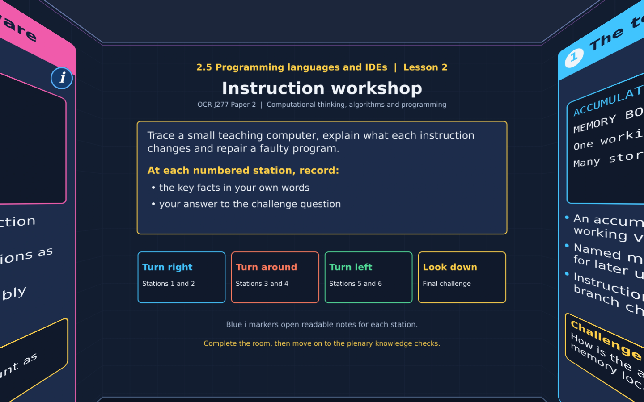

TOPIC 2.5 / LESSON 02
INSTRUCTION WORKSHOP
Low-level instructions
DO NOW: RESEARCH AND DISCUSS
How can a short instruction make a processor change a stored value?
1 / 18
Notes:
Revise360 original lesson content. Teaching examples support OCR J277 Topic 2.5. The low-level instruction model is explanatory enrichment, not an additional required instruction set.

Slide 2
TOPIC 2.5 / LESSON 02 / WORKSHEET
By the end of this lesson
1.
Compare assembly with machine code.
2.
Trace simple input, storage and calculation instructions.
3.
Explain why instruction order matters.
2 / 18
Notes:
Revise360 original lesson content. Teaching examples support OCR J277 Topic 2.5. The low-level instruction model is explanatory enrichment, not an additional required instruction set.

Slide 3
TOPIC 2.5 / LESSON 02 / WORKSHEET STARTER
Starter: before the experience
A box contains 6. Add 5, store the result, then subtract 2. What is in the box before and after the subtraction?
3 / 18
Notes:
Revise360 original lesson content. Teaching examples support OCR J277 Topic 2.5. The low-level instruction model is explanatory enrichment, not an additional required instruction set.

Slide 4
TOPIC 2.5 / LESSON 02 / CHECK
Starter: sample answers
1.
Before subtraction: 11. After subtraction: 9. Each instruction uses the result left by the previous one.
4 / 18
Notes:
Revise360 original lesson content. Teaching examples support OCR J277 Topic 2.5. The low-level instruction model is explanatory enrichment, not an additional required instruction set.

Slide 5
TOPIC 2.5 / LESSON 02 / WORKSHEET KEY TERMS
Key terminology quiz
1.
Mnemonic
2.
Accumulator
5 / 18
Notes:
Revise360 original lesson content. Teaching examples support OCR J277 Topic 2.5. The low-level instruction model is explanatory enrichment, not an additional required instruction set.

Slide 6
TOPIC 2.5 / LESSON 02 / CHECK
Key terminology: answers
Mnemonic
A short name that represents an instruction, such as ADD.
Accumulator
A register that holds a value being processed in this teaching computer.
6 / 18
Notes:
Revise360 original lesson content. Teaching examples support OCR J277 Topic 2.5. The low-level instruction model is explanatory enrichment, not an additional required instruction set.

Slide 7
TOPIC 2.5 / LESSON 02 / EXPERIENCE
Worksheet + experience
01 OPEN THE EXPERIENCE NOW
Open Instruction workshop in Topic 2.5. Keep the worksheet beside you.
02 SIX STATIONS
At each station, write key facts IN YOUR OWN WORDS. Answer its worksheet challenge before tapping the badge.
03 FINAL CHALLENGE
Attempt the worksheet final challenge before tapping the star. Record your score, then use review mode to correct mistakes.
04 PLENARY
Finish the experience in this lesson. Near the end, close it for the plenary knowledge checks.
7 / 18
Notes:
Revise360 original lesson content. Teaching examples support OCR J277 Topic 2.5. The low-level instruction model is explanatory enrichment, not an additional required instruction set.

Slide 8
TOPIC 2.5 / LESSON 02 / CONSOLIDATION
After the experience
Return to the Do Now question. Use two things you learned in the room to improve your original answer.
Check that each reason links a specific characteristic or tool to the task.
8 / 18
Notes:
Revise360 original lesson content. Teaching examples support OCR J277 Topic 2.5. The low-level instruction model is explanatory enrichment, not an additional required instruction set.

Slide 9
TOPIC 2.5 / LESSON 02 / CONSOLIDATION
Check and improve
Use review mode to correct any mistakes. Write one correction and explain why the right answer fits. Then move on to the plenary knowledge checks.
9 / 18
Notes:
Revise360 original lesson content. Teaching examples support OCR J277 Topic 2.5. The low-level instruction model is explanatory enrichment, not an additional required instruction set.

Slide 10
TOPIC 2.5 / LESSON 02 / CHECK
A stronger explanation
Compare your reasoning, then improve one sentence on your worksheet.
Linking code to hardware
Its operations closely match a processor instruction set and expose hardware details.
Review and explain
Your correction should name the correct idea and explain why it fits the question. Use the experience feedback to check it.
10 / 18
Notes:
Revise360 original lesson content. Teaching examples support OCR J277 Topic 2.5. The low-level instruction model is explanatory enrichment, not an additional required instruction set.

Slide 11
TOPIC 2.5 / LESSON 02 / ANSWERS
After the experience: stations 1–3
Check your key facts and challenge responses.
1 The teaching computer
The accumulator holds the current working value. Memory keeps values that the program can load later.
2 Input and output
The output is 9. INP reads it, OUT displays it, then HLT stops the program.
3 Keeping a value
ACC contains 8 and BOX contains 8. The later LDA restores the first input from BOX.
11 / 18
Notes:
Revise360 original lesson content. Teaching examples support OCR J277 Topic 2.5. The low-level instruction model is explanatory enrichment, not an additional required instruction set.

Slide 12
TOPIC 2.5 / LESSON 02 / ANSWERS
After the experience: stations 4–6
Check your key facts and challenge responses.
4 Calculating step by step
LDA gives 8. ADD gives 13. SUB gives 11. OUT displays 11.
5 Repairing a program
Insert STA FIRST after the first INP. FIRST then holds 6, so ADD FIRST adds it to the second input 4.
6 Linking code to hardware
Its operations closely match a processor instruction set and expose hardware details.
12 / 18
Notes:
Revise360 original lesson content. Teaching examples support OCR J277 Topic 2.5. The low-level instruction model is explanatory enrichment, not an additional required instruction set.

Slide 13
TOPIC 2.5 / LESSON 02 / CHECK
Final challenge: answers
Check your choices and the reasons you gave.
After first INP: 7. After STA FIRST: 7. After second INP: 2. After ADD FIRST: 9
Use 7 and 2, and expect 9
13 / 18
Notes:
Revise360 original lesson content. Teaching examples support OCR J277 Topic 2.5. The low-level instruction model is explanatory enrichment, not an additional required instruction set.

Slide 14
TOPIC 2.5 / LESSON 02 / PLENARY
Plenary: questions (a–b)
Take the headset off or close the page. Answer from memory on the worksheet.
a)
Explain the difference between assembly and machine code. [2]
b)
A program reads two inputs into one accumulator. Explain why it must store the first before reading the second if it needs both. [2]
14 / 18
Notes:
Revise360 original lesson content. Teaching examples support OCR J277 Topic 2.5. The low-level instruction model is explanatory enrichment, not an additional required instruction set.

Slide 15
TOPIC 2.5 / LESSON 02 / PLENARY
Plenary: question (c)
Keep the experience closed. Explain your reasoning in full sentences.
c)
Trace LDA X, ADD Y, SUB Z, OUT for X = 9, Y = 4 and Z = 3. Give the intermediate values and output. [4]
Use the marks in brackets to judge how much detail to include.
15 / 18
Notes:
Revise360 original lesson content. Teaching examples support OCR J277 Topic 2.5. The low-level instruction model is explanatory enrichment, not an additional required instruction set.

Slide 16
TOPIC 2.5 / LESSON 02 / CHECK
Plenary: answers (a–b)
Indicative points. Credit accurate answers in students’ own words.
a Assembly uses mnemonic instruction names. Machine code uses binary instructions a compatible CPU executes.
b The second input replaces the accumulator value. Storing the first preserves it for later use.
16 / 18
Notes:
Revise360 original lesson content. Teaching examples support OCR J277 Topic 2.5. The low-level instruction model is explanatory enrichment, not an additional required instruction set.

Slide 17
TOPIC 2.5 / LESSON 02 / CHECK
Plenary: answer (c)
Indicative points for the final question.
1.
After LDA X: 9.
2.
After ADD Y: 13.
3.
After SUB Z: 10. OUT displays 10.
17 / 18
Notes:
Revise360 original lesson content. Teaching examples support OCR J277 Topic 2.5. The low-level instruction model is explanatory enrichment, not an additional required instruction set.

Slide 18
TOPIC 2.5 / LESSON 02 / SELF-CHECK
How confident am I?
On the worksheet, select Not yet, Getting there or Confident for each objective.
1.
Compare assembly with machine code.
2.
Trace simple input, storage and calculation instructions.
3.
Explain why instruction order matters.
18 / 18
Notes:
Revise360 original lesson content. Teaching examples support OCR J277 Topic 2.5. The low-level instruction model is explanatory enrichment, not an additional required instruction set.

