Slide 1
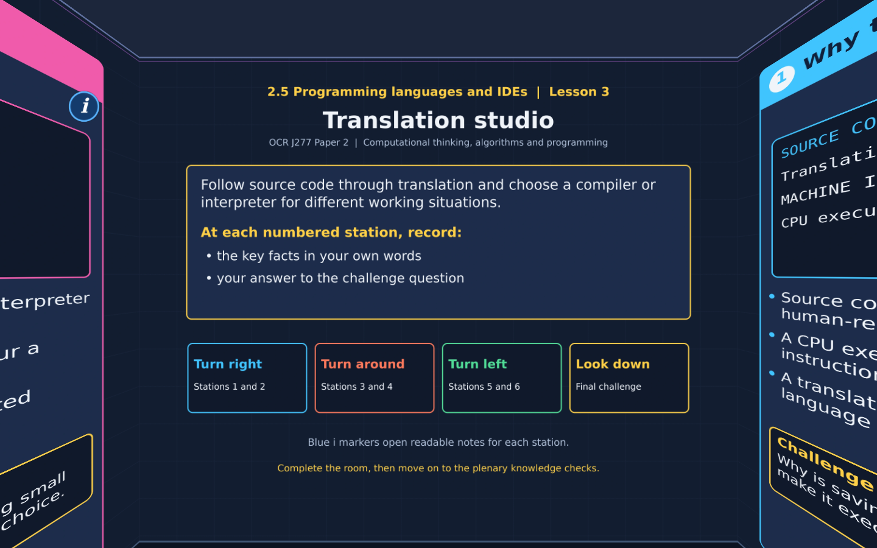

TOPIC 2.5 / LESSON 03
TRANSLATION STUDIO
Compilers and interpreters
DO NOW: RESEARCH AND DISCUSS
Why can a CPU not simply follow a Python source file as written?
1 / 18
Notes:
Revise360 original lesson content. Teaching examples support OCR J277 Topic 2.5. The low-level instruction model is explanatory enrichment, not an additional required instruction set.

Slide 2
TOPIC 2.5 / LESSON 03 / WORKSHEET
By the end of this lesson
1.
Explain why programs need translation.
2.
Compare how compilers and interpreters work.
3.
Justify a translator choice using the task requirements.
2 / 18
Notes:
Revise360 original lesson content. Teaching examples support OCR J277 Topic 2.5. The low-level instruction model is explanatory enrichment, not an additional required instruction set.

Slide 3
TOPIC 2.5 / LESSON 03 / WORKSHEET STARTER
Starter: before the experience
A programmer writes total = price * quantity. Identify the source code and explain why the CPU needs another representation.
3 / 18
Notes:
Revise360 original lesson content. Teaching examples support OCR J277 Topic 2.5. The low-level instruction model is explanatory enrichment, not an additional required instruction set.

Slide 4
TOPIC 2.5 / LESSON 03 / CHECK
Starter: sample answers
1.
The written statement is source code. The CPU executes instructions in its own machine-code instruction set.
4 / 18
Notes:
Revise360 original lesson content. Teaching examples support OCR J277 Topic 2.5. The low-level instruction model is explanatory enrichment, not an additional required instruction set.

Slide 5
TOPIC 2.5 / LESSON 03 / WORKSHEET KEY TERMS
Key terminology quiz
1.
Compiler
2.
Interpreter
5 / 18
Notes:
Revise360 original lesson content. Teaching examples support OCR J277 Topic 2.5. The low-level instruction model is explanatory enrichment, not an additional required instruction set.

Slide 6
TOPIC 2.5 / LESSON 03 / CHECK
Key terminology: answers
Compiler
A translator that processes a program into target code before that translated program runs.
Interpreter
Software that translates and executes source instructions as the program runs.
6 / 18
Notes:
Revise360 original lesson content. Teaching examples support OCR J277 Topic 2.5. The low-level instruction model is explanatory enrichment, not an additional required instruction set.

Slide 7
TOPIC 2.5 / LESSON 03 / EXPERIENCE
Worksheet + experience
01 OPEN THE EXPERIENCE NOW
Open Translation studio in Topic 2.5. Keep the worksheet beside you.
02 SIX STATIONS
At each station, write key facts IN YOUR OWN WORDS. Answer its worksheet challenge before tapping the badge.
03 FINAL CHALLENGE
Attempt the worksheet final challenge before tapping the star. Record your score, then use review mode to correct mistakes.
04 PLENARY
Finish the experience in this lesson. Near the end, close it for the plenary knowledge checks.
7 / 18
Notes:
Revise360 original lesson content. Teaching examples support OCR J277 Topic 2.5. The low-level instruction model is explanatory enrichment, not an additional required instruction set.

Slide 8
TOPIC 2.5 / LESSON 03 / CONSOLIDATION
After the experience
Return to the Do Now question. Use two things you learned in the room to improve your original answer.
Check that each reason links a specific characteristic or tool to the task.
8 / 18
Notes:
Revise360 original lesson content. Teaching examples support OCR J277 Topic 2.5. The low-level instruction model is explanatory enrichment, not an additional required instruction set.

Slide 9
TOPIC 2.5 / LESSON 03 / CONSOLIDATION
Check and improve
Use review mode to correct any mistakes. Write one correction and explain why the right answer fits. Then move on to the plenary knowledge checks.
9 / 18
Notes:
Revise360 original lesson content. Teaching examples support OCR J277 Topic 2.5. The low-level instruction model is explanatory enrichment, not an additional required instruction set.

Slide 10
TOPIC 2.5 / LESSON 03 / CHECK
A stronger explanation
Compare your reasoning, then improve one sentence on your worksheet.
Choosing a route
An interpreter supports quick edit-and-run cycles without a separate full compilation step.
Review and explain
Your correction should name the correct idea and explain why it fits the question. Use the experience feedback to check it.
10 / 18
Notes:
Revise360 original lesson content. Teaching examples support OCR J277 Topic 2.5. The low-level instruction model is explanatory enrichment, not an additional required instruction set.

Slide 11
TOPIC 2.5 / LESSON 03 / ANSWERS
After the experience: stations 1–3
Check your key facts and challenge responses.
1 Why translate?
Saving keeps the source text. It does not itself translate the program into instructions the CPU can execute.
2 The compiler route
Users can run the translated program repeatedly without translating the whole source again each time.
3 The interpreter route
The programmer can edit source and test it without a separate whole-program compilation step.
11 / 18
Notes:
Revise360 original lesson content. Teaching examples support OCR J277 Topic 2.5. The low-level instruction model is explanatory enrichment, not an additional required instruction set.

Slide 12
TOPIC 2.5 / LESSON 03 / ANSWERS
After the experience: stations 4–6
Check your key facts and challenge responses.
4 Errors at different stages
No. The code can obey syntax rules while implementing the wrong calculation. Test its outputs against expected results.
5 Time and distribution
Usually no. They need a compatible system and any required runtime libraries, but not the original compiler.
6 Choosing a route
An interpreter supports quick edit-and-run cycles without a separate full compilation step.
12 / 18
Notes:
Revise360 original lesson content. Teaching examples support OCR J277 Topic 2.5. The low-level instruction model is explanatory enrichment, not an additional required instruction set.

Slide 13
TOPIC 2.5 / LESSON 03 / CHECK
Final challenge: answers
Check your choices and the reasons you gave.
Quickly retest a changed source statement: Interpretation supports short edit-and-run cycles. Run a finished program many times: A compiled build avoids repeating source translation. A translated program gives the wrong answer: Logic still needs testing
Translation does not replace testing. A compiled program may need a compatible runtime library
13 / 18
Notes:
Revise360 original lesson content. Teaching examples support OCR J277 Topic 2.5. The low-level instruction model is explanatory enrichment, not an additional required instruction set.

Slide 14
TOPIC 2.5 / LESSON 03 / PLENARY
Plenary: questions (a–b)
Take the headset off or close the page. Answer from memory on the worksheet.
a)
State why a high-level program needs a translator. [2]
b)
Describe two differences between a compiler and an interpreter in the GCSE model. [4]
14 / 18
Notes:
Revise360 original lesson content. Teaching examples support OCR J277 Topic 2.5. The low-level instruction model is explanatory enrichment, not an additional required instruction set.

Slide 15
TOPIC 2.5 / LESSON 03 / PLENARY
Plenary: question (c)
Keep the experience closed. Explain your reasoning in full sentences.
c)
A program compiles but calculates tax incorrectly. Explain why testing is still needed. [2]
Use the marks in brackets to judge how much detail to include.
15 / 18
Notes:
Revise360 original lesson content. Teaching examples support OCR J277 Topic 2.5. The low-level instruction model is explanatory enrichment, not an additional required instruction set.

Slide 16
TOPIC 2.5 / LESSON 03 / CHECK
Plenary: answers (a–b)
Indicative points. Credit accurate answers in students’ own words.
a The CPU executes machine code. The translator processes high-level source into a form that can be executed.
b A compiler translates the source program before execution. An interpreter translates and executes instructions during execution. A compiled build can run again without retranslating the source each time. Interpretation requires the interpreter or suitable runtime when running the source.
16 / 18
Notes:
Revise360 original lesson content. Teaching examples support OCR J277 Topic 2.5. The low-level instruction model is explanatory enrichment, not an additional required instruction set.

Slide 17
TOPIC 2.5 / LESSON 03 / CHECK
Plenary: answer (c)
Indicative points for the final question.
1.
The program may contain a logic error despite valid syntax.
2.
Testing compares actual results with expected results to identify the fault.
17 / 18
Notes:
Revise360 original lesson content. Teaching examples support OCR J277 Topic 2.5. The low-level instruction model is explanatory enrichment, not an additional required instruction set.

Slide 18
TOPIC 2.5 / LESSON 03 / SELF-CHECK
How confident am I?
On the worksheet, select Not yet, Getting there or Confident for each objective.
1.
Explain why programs need translation.
2.
Compare how compilers and interpreters work.
3.
Justify a translator choice using the task requirements.
18 / 18
Notes:
Revise360 original lesson content. Teaching examples support OCR J277 Topic 2.5. The low-level instruction model is explanatory enrichment, not an additional required instruction set.

