Slide 1
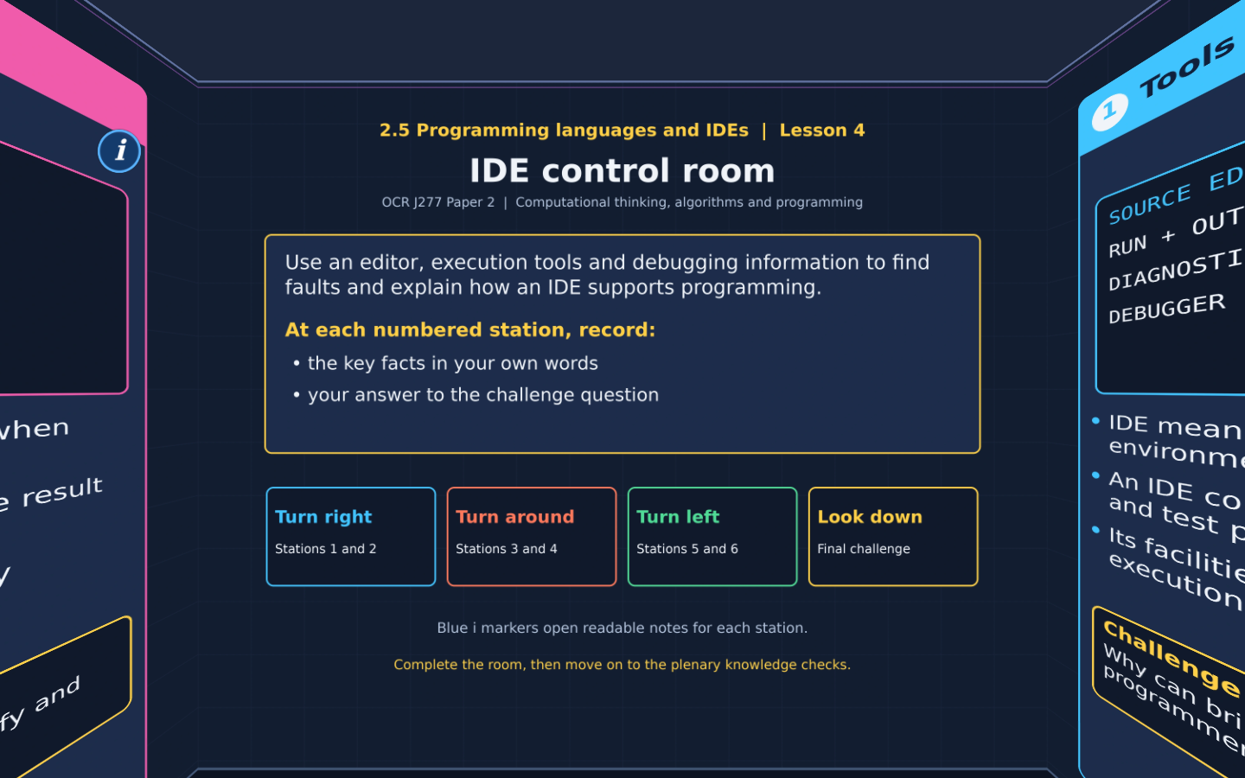

TOPIC 2.5 / LESSON 04
IDE CONTROL ROOM
IDE tools and debugging
DO NOW: RESEARCH AND DISCUSS
What help would you want from the software you use to write programs?
1 / 18
Notes:
Revise360 original lesson content. Teaching examples support OCR J277 Topic 2.5. The low-level instruction model is explanatory enrichment, not an additional required instruction set.

Slide 2
TOPIC 2.5 / LESSON 04 / WORKSHEET
By the end of this lesson
1.
Identify common IDE facilities.
2.
Explain how editing and diagnostics support programmers.
3.
Use a breakpoint, stepping and variable values to investigate a fault.
2 / 18
Notes:
Revise360 original lesson content. Teaching examples support OCR J277 Topic 2.5. The low-level instruction model is explanatory enrichment, not an additional required instruction set.

Slide 3
TOPIC 2.5 / LESSON 04 / WORKSHEET STARTER
Starter: before the experience
A program runs but calculates 3 + 4 as 34. Suggest a cause and one useful piece of evidence to inspect.
3 / 18
Notes:
Revise360 original lesson content. Teaching examples support OCR J277 Topic 2.5. The low-level instruction model is explanatory enrichment, not an additional required instruction set.

Slide 4
TOPIC 2.5 / LESSON 04 / CHECK
Starter: sample answers
1.
The inputs may be strings, so + joins them. Inspect the types and values of the inputs before the calculation.
4 / 18
Notes:
Revise360 original lesson content. Teaching examples support OCR J277 Topic 2.5. The low-level instruction model is explanatory enrichment, not an additional required instruction set.

Slide 5
TOPIC 2.5 / LESSON 04 / WORKSHEET KEY TERMS
Key terminology quiz
1.
IDE
2.
Breakpoint
5 / 18
Notes:
Revise360 original lesson content. Teaching examples support OCR J277 Topic 2.5. The low-level instruction model is explanatory enrichment, not an additional required instruction set.

Slide 6
TOPIC 2.5 / LESSON 04 / CHECK
Key terminology: answers
IDE
An integrated development environment brings programming tools together in one application.
Breakpoint
A chosen point where a debugger pauses execution for inspection.
6 / 18
Notes:
Revise360 original lesson content. Teaching examples support OCR J277 Topic 2.5. The low-level instruction model is explanatory enrichment, not an additional required instruction set.

Slide 7
TOPIC 2.5 / LESSON 04 / EXPERIENCE
Worksheet + experience
01 OPEN THE EXPERIENCE NOW
Open IDE control room in Topic 2.5. Keep the worksheet beside you.
02 SIX STATIONS
At each station, write key facts IN YOUR OWN WORDS. Answer its worksheet challenge before tapping the badge.
03 FINAL CHALLENGE
Attempt the worksheet final challenge before tapping the star. Record your score, then use review mode to correct mistakes.
04 PLENARY
Finish the experience in this lesson. Near the end, close it for the plenary knowledge checks.
7 / 18
Notes:
Revise360 original lesson content. Teaching examples support OCR J277 Topic 2.5. The low-level instruction model is explanatory enrichment, not an additional required instruction set.

Slide 8
TOPIC 2.5 / LESSON 04 / CONSOLIDATION
After the experience
Return to the Do Now question. Use two things you learned in the room to improve your original answer.
Check that each reason links a specific characteristic or tool to the task.
8 / 18
Notes:
Revise360 original lesson content. Teaching examples support OCR J277 Topic 2.5. The low-level instruction model is explanatory enrichment, not an additional required instruction set.

Slide 9
TOPIC 2.5 / LESSON 04 / CONSOLIDATION
Check and improve
Use review mode to correct any mistakes. Write one correction and explain why the right answer fits. Then move on to the plenary knowledge checks.
9 / 18
Notes:
Revise360 original lesson content. Teaching examples support OCR J277 Topic 2.5. The low-level instruction model is explanatory enrichment, not an additional required instruction set.

Slide 10
TOPIC 2.5 / LESSON 04 / CHECK
A stronger explanation
Compare your reasoning, then improve one sentence on your worksheet.
Finding a logic error
Replace price + quantity with price * quantity. Test that 6 and 4 produce 24, then try another case.
Review and explain
Your correction should name the correct idea and explain why it fits the question. Use the experience feedback to check it.
10 / 18
Notes:
Revise360 original lesson content. Teaching examples support OCR J277 Topic 2.5. The low-level instruction model is explanatory enrichment, not an additional required instruction set.

Slide 11
TOPIC 2.5 / LESSON 04 / ANSWERS
After the experience: stations 1–3
Check your key facts and challenge responses.
1 Tools in one place
The programmer can edit, run and investigate code in one place, reducing switching between separate tools.
2 Writing source code
It can reduce typing errors in suggested names, but the programmer can still select the wrong name or write the wrong logic.
3 Translation and execution
The editor contains the source being written. The output area shows what happens when the program runs.
11 / 18
Notes:
Revise360 original lesson content. Teaching examples support OCR J277 Topic 2.5. The low-level instruction model is explanatory enrichment, not an additional required instruction set.

Slide 12
TOPIC 2.5 / LESSON 04 / ANSWERS
After the experience: stations 4–6
Check your key facts and challenge responses.
4 Diagnostic messages
An earlier missing bracket or other error may only become apparent when the tool reaches the next line.
5 Pausing and stepping
Inspect the current values of price and quantity. Step over the calculation, then inspect total.
6 Finding a logic error
Replace price + quantity with price * quantity. Test that 6 and 4 produce 24, then try another case.
12 / 18
Notes:
Revise360 original lesson content. Teaching examples support OCR J277 Topic 2.5. The low-level instruction model is explanatory enrichment, not an additional required instruction set.

Slide 13
TOPIC 2.5 / LESSON 04 / CHECK
Final challenge: answers
Check your choices and the reasons you gave.
Reduce typing of a long variable name: Auto-completion. Stop just before an incorrect calculation: Breakpoint. Inspect the current total: Variable watch. See a message about a missing bracket: Diagnostics
Inspect that calculation, repair it and retest
13 / 18
Notes:
Revise360 original lesson content. Teaching examples support OCR J277 Topic 2.5. The low-level instruction model is explanatory enrichment, not an additional required instruction set.

Slide 14
TOPIC 2.5 / LESSON 04 / PLENARY
Plenary: questions (a–b)
Take the headset off or close the page. Answer from memory on the worksheet.
a)
Name two IDE editing facilities and explain how each helps a programmer. [4]
b)
Explain how a breakpoint and a variable watch can help investigate a wrong total. [2]
14 / 18
Notes:
Revise360 original lesson content. Teaching examples support OCR J277 Topic 2.5. The low-level instruction model is explanatory enrichment, not an additional required instruction set.

Slide 15
TOPIC 2.5 / LESSON 04 / PLENARY
Plenary: question (c)
Keep the experience closed. Explain your reasoning in full sentences.
c)
Why must a programmer still test code after all syntax errors have been corrected? [2]
Use the marks in brackets to judge how much detail to include.
15 / 18
Notes:
Revise360 original lesson content. Teaching examples support OCR J277 Topic 2.5. The low-level instruction model is explanatory enrichment, not an additional required instruction set.

Slide 16
TOPIC 2.5 / LESSON 04 / CHECK
Plenary: answers (a–b)
Indicative points. Credit accurate answers in students’ own words.
a Syntax highlighting makes code elements easier to distinguish. Auto-completion suggests names and can reduce typing errors. Award one mark for each facility and one for its explained benefit. Automatic indentation with a clear benefit is also acceptable.
b A breakpoint pauses near the calculation. The variable watch shows values to compare with the expected inputs or result.
16 / 18
Notes:
Revise360 original lesson content. Teaching examples support OCR J277 Topic 2.5. The low-level instruction model is explanatory enrichment, not an additional required instruction set.

Slide 17
TOPIC 2.5 / LESSON 04 / CHECK
Plenary: answer (c)
Indicative points for the final question.
1.
Valid syntax can still express incorrect logic.
2.
Testing checks actual results against expected results.
17 / 18
Notes:
Revise360 original lesson content. Teaching examples support OCR J277 Topic 2.5. The low-level instruction model is explanatory enrichment, not an additional required instruction set.

Slide 18
TOPIC 2.5 / LESSON 04 / SELF-CHECK
How confident am I?
On the worksheet, select Not yet, Getting there or Confident for each objective.
1.
Identify common IDE facilities.
2.
Explain how editing and diagnostics support programmers.
3.
Use a breakpoint, stepping and variable values to investigate a fault.
18 / 18
Notes:
Revise360 original lesson content. Teaching examples support OCR J277 Topic 2.5. The low-level instruction model is explanatory enrichment, not an additional required instruction set.

