Slide 1
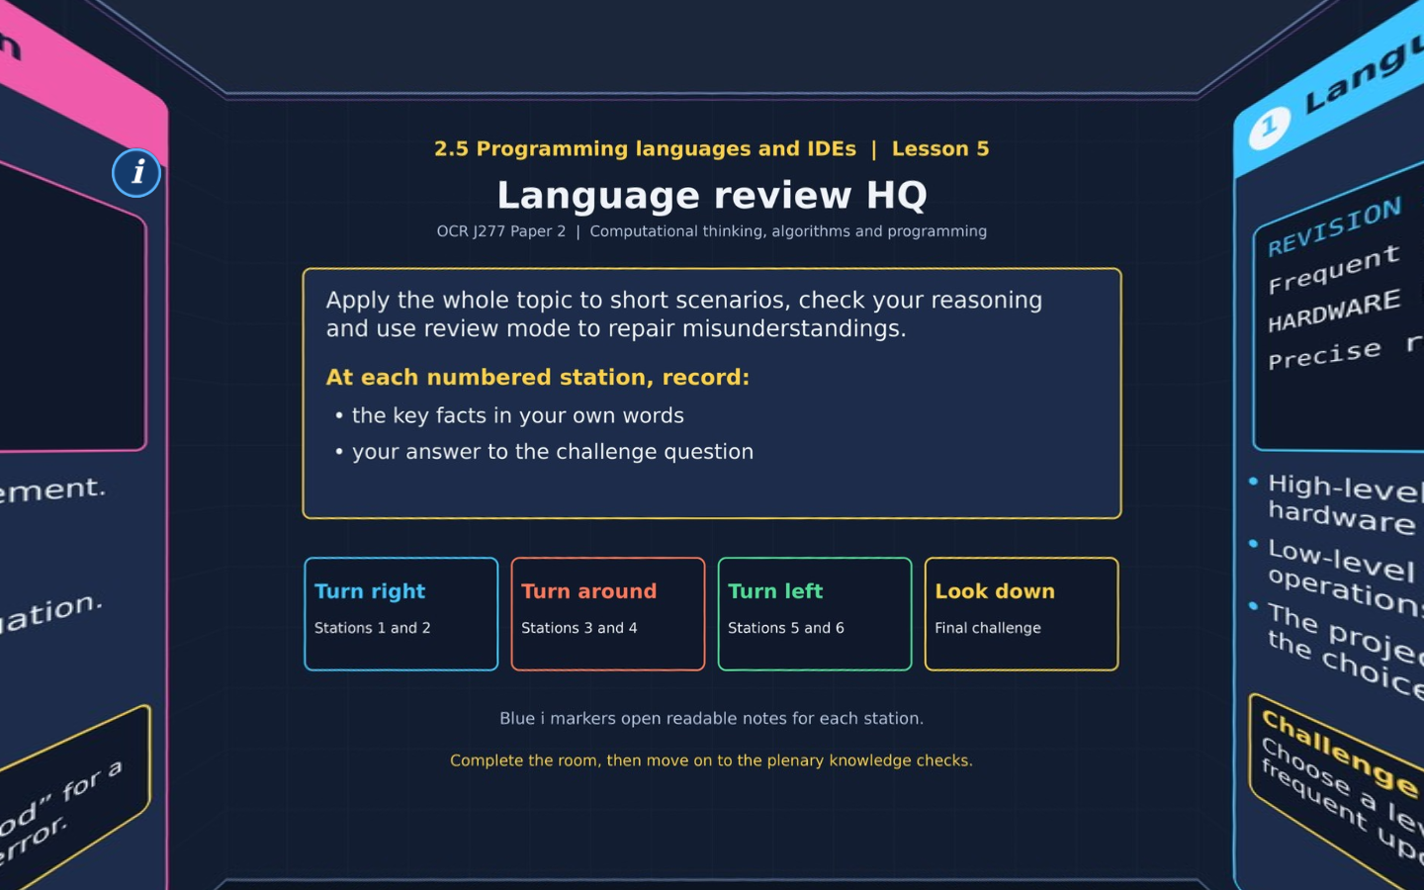

TOPIC 2.5 / LESSON 05
LANGUAGE REVIEW HQ
Topic 2.5 knowledge review
DO NOW: RESEARCH AND DISCUSS
Which tool or language choice would most help you build a reliable revision app?
1 / 18
Notes:
Revise360 original lesson content. Teaching examples support OCR J277 Topic 2.5. Scope: OCR J277 specification v3.1, May 2026, printed page 21, sections 2.5.1 and 2.5.2. https://www.ocr.org.uk/images/558027-specification-gcse-computer-science-j277.pdf

Slide 2
TOPIC 2.5 / LESSON 05 / WORKSHEET
By the end of this lesson
1.
Recall language levels and translator behaviour.
2.
Select IDE tools for specific problems.
3.
Write explanations linked to the needs of a scenario.
2 / 18
Notes:
Revise360 original lesson content. Teaching examples support OCR J277 Topic 2.5. Scope: OCR J277 specification v3.1, May 2026, printed page 21, sections 2.5.1 and 2.5.2. https://www.ocr.org.uk/images/558027-specification-gcse-computer-science-j277.pdf

Slide 3
TOPIC 2.5 / LESSON 05 / WORKSHEET STARTER
Starter: before the experience
A programmer wants readable source that is easy to update. Which language level usually suits this requirement, and why?
3 / 18
Notes:
Revise360 original lesson content. Teaching examples support OCR J277 Topic 2.5. Scope: OCR J277 specification v3.1, May 2026, printed page 21, sections 2.5.1 and 2.5.2. https://www.ocr.org.uk/images/558027-specification-gcse-computer-science-j277.pdf

Slide 4
TOPIC 2.5 / LESSON 05 / CHECK
Starter: sample answers
1.
A high-level language usually suits it because readable words and structures make the code easier to understand and maintain.
4 / 18
Notes:
Revise360 original lesson content. Teaching examples support OCR J277 Topic 2.5. Scope: OCR J277 specification v3.1, May 2026, printed page 21, sections 2.5.1 and 2.5.2. https://www.ocr.org.uk/images/558027-specification-gcse-computer-science-j277.pdf

Slide 5
TOPIC 2.5 / LESSON 05 / WORKSHEET KEY TERMS
Key terminology quiz
1.
Source code
2.
Run-time environment
5 / 18
Notes:
Revise360 original lesson content. Teaching examples support OCR J277 Topic 2.5. Scope: OCR J277 specification v3.1, May 2026, printed page 21, sections 2.5.1 and 2.5.2. https://www.ocr.org.uk/images/558027-specification-gcse-computer-science-j277.pdf

Slide 6
TOPIC 2.5 / LESSON 05 / CHECK
Key terminology: answers
Source code
The program text written by a programmer before translation.
Run-time environment
The facilities used to run a program and interact with it during execution.
6 / 18
Notes:
Revise360 original lesson content. Teaching examples support OCR J277 Topic 2.5. Scope: OCR J277 specification v3.1, May 2026, printed page 21, sections 2.5.1 and 2.5.2. https://www.ocr.org.uk/images/558027-specification-gcse-computer-science-j277.pdf

Slide 7
TOPIC 2.5 / LESSON 05 / EXPERIENCE
Worksheet + experience
01 OPEN THE EXPERIENCE NOW
Open Language review HQ in Topic 2.5. Keep the worksheet beside you.
02 SIX STATIONS
At each station, write key facts IN YOUR OWN WORDS. Answer its worksheet challenge before tapping the badge.
03 FINAL CHALLENGE
Attempt the worksheet final challenge before tapping the star. Record your score, then use review mode to correct mistakes.
04 PLENARY
Finish the experience in this lesson. Near the end, close it for the plenary knowledge checks.
7 / 18
Notes:
Revise360 original lesson content. Teaching examples support OCR J277 Topic 2.5. Scope: OCR J277 specification v3.1, May 2026, printed page 21, sections 2.5.1 and 2.5.2. https://www.ocr.org.uk/images/558027-specification-gcse-computer-science-j277.pdf

Slide 8
TOPIC 2.5 / LESSON 05 / CONSOLIDATION
After the experience
Return to the Do Now question. Use two things you learned in the room to improve your original answer.
Check that each reason links a specific characteristic or tool to the task.
8 / 18
Notes:
Revise360 original lesson content. Teaching examples support OCR J277 Topic 2.5. Scope: OCR J277 specification v3.1, May 2026, printed page 21, sections 2.5.1 and 2.5.2. https://www.ocr.org.uk/images/558027-specification-gcse-computer-science-j277.pdf

Slide 9
TOPIC 2.5 / LESSON 05 / CONSOLIDATION
Check and improve
Use review mode to correct any mistakes. Write one correction and explain why the right answer fits. Then move on to the plenary knowledge checks.
9 / 18
Notes:
Revise360 original lesson content. Teaching examples support OCR J277 Topic 2.5. Scope: OCR J277 specification v3.1, May 2026, printed page 21, sections 2.5.1 and 2.5.2. https://www.ocr.org.uk/images/558027-specification-gcse-computer-science-j277.pdf

Slide 10
TOPIC 2.5 / LESSON 05 / CHECK
A stronger explanation
Compare your reasoning, then improve one sentence on your worksheet.
Writing an explanation
Error diagnostics can identify the problem and its location, helping the programmer find the source to correct.
Review and explain
Your correction should name the correct idea and explain why it fits the question. Use the experience feedback to check it.
10 / 18
Notes:
Revise360 original lesson content. Teaching examples support OCR J277 Topic 2.5. Scope: OCR J277 specification v3.1, May 2026, printed page 21, sections 2.5.1 and 2.5.2. https://www.ocr.org.uk/images/558027-specification-gcse-computer-science-j277.pdf

Slide 11
TOPIC 2.5 / LESSON 05 / ANSWERS
After the experience: stations 1–3
Check your key facts and challenge responses.
1 Language decisions
High-level code is usually easier to read and maintain, helping staff update the app.
2 Source and execution
Its instruction set uses machine code. The high-level source must be translated for its instructions to execute.
3 Translator choices
An interpreter supports quick edit-and-run cycles without a separate whole-program compilation step.
11 / 18
Notes:
Revise360 original lesson content. Teaching examples support OCR J277 Topic 2.5. Scope: OCR J277 specification v3.1, May 2026, printed page 21, sections 2.5.1 and 2.5.2. https://www.ocr.org.uk/images/558027-specification-gcse-computer-science-j277.pdf

Slide 12
TOPIC 2.5 / LESSON 05 / ANSWERS
After the experience: stations 4–6
Check your key facts and challenge responses.
4 Editing and diagnostics
The diagnostic helps locate and explain the problem. The programmer uses the editor to change the source.
5 Translation and running
The translator processes the source. The run-time environment executes it and lets you observe output.
6 Writing an explanation
Error diagnostics can identify the problem and its location, helping the programmer find the source to correct.
12 / 18
Notes:
Revise360 original lesson content. Teaching examples support OCR J277 Topic 2.5. Scope: OCR J277 specification v3.1, May 2026, printed page 21, sections 2.5.1 and 2.5.2. https://www.ocr.org.uk/images/558027-specification-gcse-computer-science-j277.pdf

Slide 13
TOPIC 2.5 / LESSON 05 / CHECK
Final challenge: answers
Check your choices and the reasons you gave.
Quickly try frequent source edits: Interpreter. Maintain a frequently updated app: High-level language. Describe a detected source problem: Error diagnostics. Run the program and see output: Run-time environment
Low-level code gives detailed hardware control. Compiled code can run again without source translation
13 / 18
Notes:
Revise360 original lesson content. Teaching examples support OCR J277 Topic 2.5. Scope: OCR J277 specification v3.1, May 2026, printed page 21, sections 2.5.1 and 2.5.2. https://www.ocr.org.uk/images/558027-specification-gcse-computer-science-j277.pdf

Slide 14
TOPIC 2.5 / LESSON 05 / PLENARY
Plenary: questions (a–b)
Take the headset off or close the page. Answer from memory on the worksheet.
a)
A school will update its quiz app each week. Explain two reasons for choosing a high-level language. [4]
b)
Compare a compiler and an interpreter. [4]
14 / 18
Notes:
Revise360 original lesson content. Teaching examples support OCR J277 Topic 2.5. Scope: OCR J277 specification v3.1, May 2026, printed page 21, sections 2.5.1 and 2.5.2. https://www.ocr.org.uk/images/558027-specification-gcse-computer-science-j277.pdf

Slide 15
TOPIC 2.5 / LESSON 05 / PLENARY
Plenary: question (c)
Keep the experience closed. Explain your reasoning in full sentences.
c)
Explain how an editor and error diagnostics help a programmer correct source code. [4]
Use the marks in brackets to judge how much detail to include.
15 / 18
Notes:
Revise360 original lesson content. Teaching examples support OCR J277 Topic 2.5. Scope: OCR J277 specification v3.1, May 2026, printed page 21, sections 2.5.1 and 2.5.2. https://www.ocr.org.uk/images/558027-specification-gcse-computer-science-j277.pdf

Slide 16
TOPIC 2.5 / LESSON 05 / CHECK
Plenary: answers (a–b)
Indicative points. Credit accurate answers in students’ own words.
a Readable source helps staff understand the program. This makes frequent changes easier to maintain. Useful libraries can reduce how much code staff must write. This can reduce development time for new features.
b A compiler translates before the resulting program runs. An interpreter processes source during execution. Compiled target code can be run again without repeating source translation. Interpreted source requires its interpreter or execution runtime.
16 / 18
Notes:
Revise360 original lesson content. Teaching examples support OCR J277 Topic 2.5. Scope: OCR J277 specification v3.1, May 2026, printed page 21, sections 2.5.1 and 2.5.2. https://www.ocr.org.uk/images/558027-specification-gcse-computer-science-j277.pdf

Slide 17
TOPIC 2.5 / LESSON 05 / CHECK
Plenary: answer (c)
Indicative points for the final question.
1.
Diagnostics describe a detected problem.
2.
A reported location helps the programmer find it.
3.
The editor lets the programmer change source text. The programmer uses it to correct the identified instruction.
17 / 18
Notes:
Revise360 original lesson content. Teaching examples support OCR J277 Topic 2.5. Scope: OCR J277 specification v3.1, May 2026, printed page 21, sections 2.5.1 and 2.5.2. https://www.ocr.org.uk/images/558027-specification-gcse-computer-science-j277.pdf

Slide 18
TOPIC 2.5 / LESSON 05 / SELF-CHECK
How confident am I?
On the worksheet, select Not yet, Getting there or Confident for each objective.
1.
Recall language levels and translator behaviour.
2.
Select IDE tools for specific problems.
3.
Write explanations linked to the needs of a scenario.
18 / 18
Notes:
Revise360 original lesson content. Teaching examples support OCR J277 Topic 2.5. Scope: OCR J277 specification v3.1, May 2026, printed page 21, sections 2.5.1 and 2.5.2. https://www.ocr.org.uk/images/558027-specification-gcse-computer-science-j277.pdf

