Slide 1
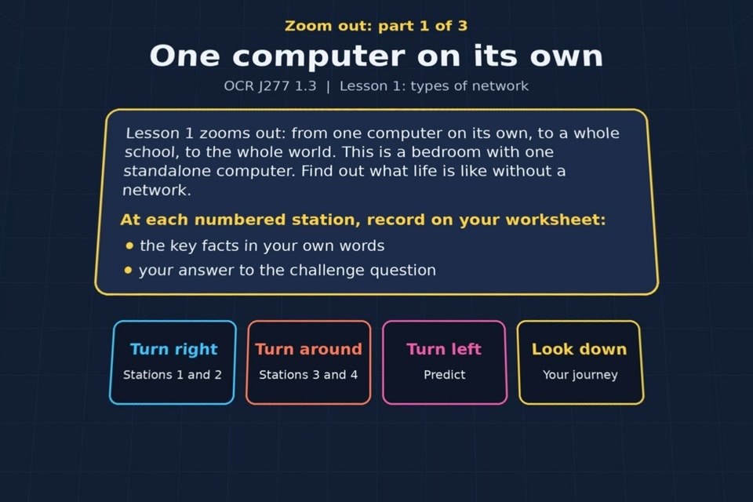

TOPIC 1.3 / LESSON 01
TYPES OF NETWORK: ZOOM OUT
Standalone computers, LANs and WANs
KEY QUESTION
What makes a LAN different from a WAN?
1 / 24
Notes:
The image shows the actual opening scene of the experience. Begin with the worksheet starter, or the brief opening question for lessons without one.
Sources: Revise 360 experiences/nw-l01.json and worksheets/NW_L01_TypesOfNetworkZoomOut_Worksheet.docx. Answers are indicative classroom examples, not an official OCR mark scheme.

Slide 2
TOPIC 1.3 / LESSON 01 / WORKSHEET
By the end of this lesson
1.
know what is meant by a standalone computer
2.
know the different types of network: LAN and WAN
3.
understand the advantages of networking
4.
understand the implications (disadvantages) of networking
2 / 24
Notes:
These learning outcomes follow the lesson worksheet.
Sources: Revise 360 experiences/nw-l01.json and worksheets/NW_L01_TypesOfNetworkZoomOut_Worksheet.docx. Answers are indicative classroom examples, not an official OCR mark scheme.

Slide 3
TOPIC 1.3 / LESSON 01 / WORKSHEET STARTER
Opening question
How could two standalone computers share a file without a network?
3 / 24
Notes:
A brief spoken warm-up drawn from the worksheet content; the worksheet has no written starter.
Sources: Revise 360 experiences/nw-l01.json and worksheets/NW_L01_TypesOfNetworkZoomOut_Worksheet.docx. Answers are indicative classroom examples, not an official OCR mark scheme.

Slide 4
TOPIC 1.3 / LESSON 01 / CHECK
Opening question: answers
1.
Copy it using a USB stick or other removable storage.
2.
Separate copies can get out of date when both people edit them.
4 / 24
Notes:
Accept equivalent correct explanations. Reveal after the question so it can be marked as students go.
Sources: Revise 360 experiences/nw-l01.json and worksheets/NW_L01_TypesOfNetworkZoomOut_Worksheet.docx. Answers are indicative classroom examples, not an official OCR mark scheme.

Slide 5
TOPIC 1.3 / LESSON 01 / EXPERIENCE
Worksheet + experience
01 OPEN EXPERIENCE ↗
Open Types of network: zoom out in Topic 1.3. Keep the worksheet beside you.
02 WORK THROUGH EACH PART
Read each panel. Write the key fact IN YOUR OWN WORDS and answer the worksheet challenge before tapping its badge.
03 SCORES BY PART
Complete 3 parts in order and copy each score (12 / 10 / 13) into its worksheet box. Finish the comparison or prediction tasks.
04 PLENARY
Finish the experience in this lesson. Near the end, close it for the plenary knowledge checks.
5 / 24
Notes:
Leave this combined worksheet and experience instruction slide on the board. The OPEN EXPERIENCE label is a clickable link. Students should complete the experience and reach the plenary near the end of the lesson. First on-screen answers count.
Sources: Revise 360 experiences/nw-l01.json and worksheets/NW_L01_TypesOfNetworkZoomOut_Worksheet.docx. Answers are indicative classroom examples, not an official OCR mark scheme.

Slide 6
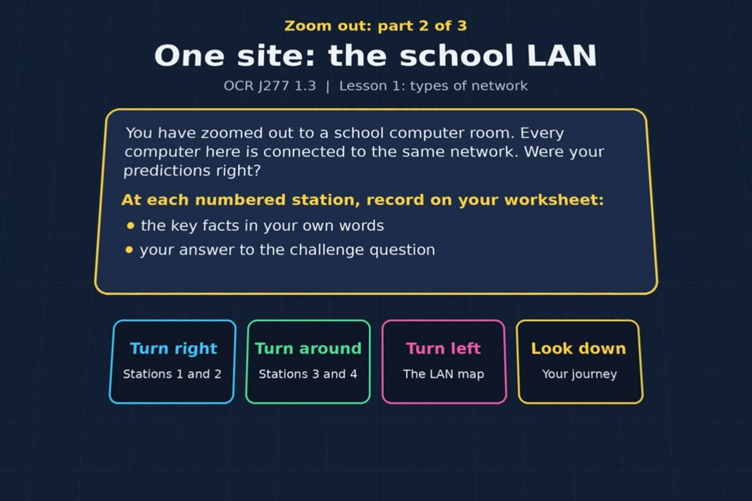
TOPIC 1.3 / LESSON 01 / EXPERIENCE
Part 2: LAN
PART 2 OF 3
Continue to Part 2: LAN. Fill in the next worksheet section and record this part's score (out of 10).
6 / 24
Notes:
Show this scene transition after the previous part. The image is the actual opening view of this part, not a flat crop of the 360 photo.
Sources: Revise 360 experiences/nw-l01.json and worksheets/NW_L01_TypesOfNetworkZoomOut_Worksheet.docx. Answers are indicative classroom examples, not an official OCR mark scheme.

Slide 7
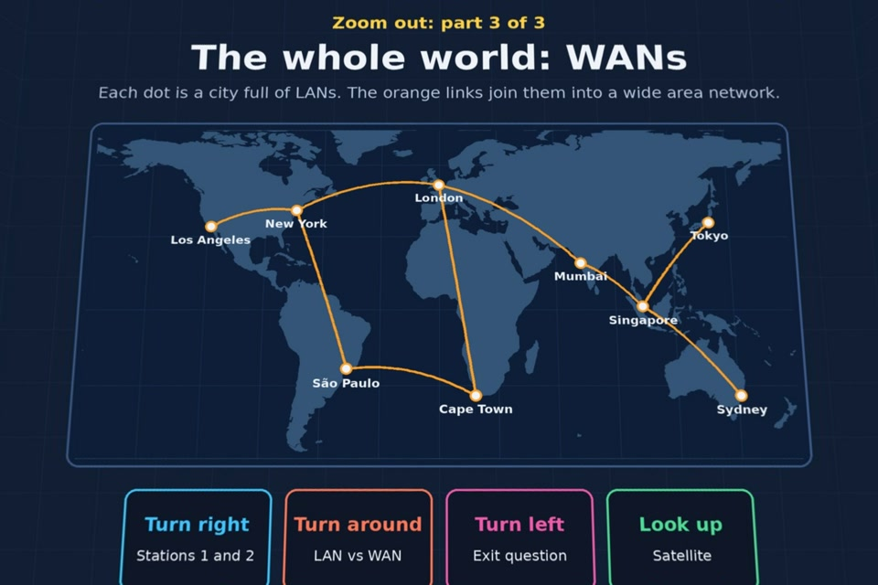
TOPIC 1.3 / LESSON 01 / EXPERIENCE
Part 3: WAN
PART 3 OF 3
Continue to Part 3: WAN. Fill in the next worksheet section and record this part's score (out of 13).
7 / 24
Notes:
Show this scene transition after the previous part. The image is the actual opening view of this part, not a flat crop of the 360 photo.
Sources: Revise 360 experiences/nw-l01.json and worksheets/NW_L01_TypesOfNetworkZoomOut_Worksheet.docx. Answers are indicative classroom examples, not an official OCR mark scheme.

Slide 8
TOPIC 1.3 / LESSON 01 / EXTENSION
Apply your learning
Complete the LAN versus WAN comparison in Part 3. Include coverage, ownership and how sites connect.
Use the task and table on your worksheet.
8 / 24
Notes:
This follows the post-experience task, key question or revision results on the worksheet.
Sources: Revise 360 experiences/nw-l01.json and worksheets/NW_L01_TypesOfNetworkZoomOut_Worksheet.docx. Answers are indicative classroom examples, not an official OCR mark scheme.

Slide 9
TOPIC 1.3 / LESSON 01 / EXTENSION
Check and improve
A school trust joins the networks at three schools in different towns. Is the new connection a LAN or a WAN? Explain.
9 / 24
Notes:
Use this question to extend or improve an explanation before the plenary.
Sources: Revise 360 experiences/nw-l01.json and worksheets/NW_L01_TypesOfNetworkZoomOut_Worksheet.docx. Answers are indicative classroom examples, not an official OCR mark scheme.

Slide 10
TOPIC 1.3 / LESSON 01 / CHECK
Application: sample answers
1.
A LAN usually covers one building or site. A WAN covers towns, countries or more.
2.
LAN hardware belongs to the school or organisation. WAN links are often provided by telecoms companies.
3.
A WAN joins LANs across distance. The school network is a LAN; the internet is a WAN.
4.
It is a WAN because it joins separate school LANs over a large geographical area.
10 / 24
Notes:
These are indicative answers. Credit other accurate examples or justified choices.
Sources: Revise 360 experiences/nw-l01.json and worksheets/NW_L01_TypesOfNetworkZoomOut_Worksheet.docx. Answers are indicative classroom examples, not an official OCR mark scheme.

Slide 11
TOPIC 1.3 / LESSON 01 / ANSWERS
Part 1: Standalone: stations 1–3
Check your key facts and challenge responses.
1 Standalone computer
A standalone device is not connected to other computers. A home PC used offline is an example; a phone on home Wi-Fi is networked.
2 Sharing a file
Passing a USB stick creates several copies. Two people could overwrite or lose each other's changes.
3 Printing
Without shared printing, each computer may need its own printer and supplies, increasing costs.
11 / 24
Notes:
Show after completion. These concise points address the worksheet station challenges and help students improve their own wording.
Sources: Revise 360 experiences/nw-l01.json and worksheets/NW_L01_TypesOfNetworkZoomOut_Worksheet.docx. Answers are indicative classroom examples, not an official OCR mark scheme.

Slide 12
TOPIC 1.3 / LESSON 01 / ANSWERS
Part 1: Standalone: stations 4–5
Check your key facts and challenge responses.
4 Updates and backups
Updates and backups must be done on each machine. If an unbacked-up drive fails, its files and work can be lost.
? Predict
A network can share files from a server, share one printer, install updates centrally and back up work together.
12 / 24
Notes:
Show after completion. These concise points address the worksheet station challenges and help students improve their own wording.
Sources: Revise 360 experiences/nw-l01.json and worksheets/NW_L01_TypesOfNetworkZoomOut_Worksheet.docx. Answers are indicative classroom examples, not an official OCR mark scheme.

Slide 13
TOPIC 1.3 / LESSON 01 / ANSWERS
Part 2: LAN: stations 1–3
Check your key facts and challenge responses.
1 Local area network (LAN)
LAN means local area network. It covers a small site, such as a home or school. One organisation owns the hardware. Home Wi-Fi is a LAN.
2 Sharing resources
A school LAN can share files, a printer and user logins across connected computers.
3 Advantages
Shared printers and central software management can save money. Other advantages include easier communication and central backup.
13 / 24
Notes:
Show after completion. These concise points address the worksheet station challenges and help students improve their own wording.
Sources: Revise 360 experiences/nw-l01.json and worksheets/NW_L01_TypesOfNetworkZoomOut_Worksheet.docx. Answers are indicative classroom examples, not an official OCR mark scheme.

Slide 14
TOPIC 1.3 / LESSON 01 / ANSWERS
Part 2: LAN: stations 4–5
Check your key facts and challenge responses.
4 Disadvantages
Disadvantages include setup cost, specialist management, a shared failure point and malware spreading. Use security software and updates.
5 The LAN in this room
The computers and shared printer connect to the switch. The file server also connects to the switch so clients can reach it.
14 / 24
Notes:
Show after completion. These concise points address the worksheet station challenges and help students improve their own wording.
Sources: Revise 360 experiences/nw-l01.json and worksheets/NW_L01_TypesOfNetworkZoomOut_Worksheet.docx. Answers are indicative classroom examples, not an official OCR mark scheme.

Slide 15
TOPIC 1.3 / LESSON 01 / ANSWERS
Part 3: WAN: stations 1–3
Check your key facts and challenge responses.
1 Wide area network (WAN)
WAN means wide area network. It covers a large area and connects LANs. Schools in different towns form a WAN. The internet is the largest WAN.
2 Who owns the connections?
WAN links commonly use rented telecoms infrastructure such as fibre, telephone lines or satellites. Laying a private 30-mile cable is costly.
3 LAN vs WAN
LAN: one site, organisation-owned hardware, local links. WAN: large area, joins LANs, links often rented from telecoms firms.
15 / 24
Notes:
Show after completion. These concise points address the worksheet station challenges and help students improve their own wording.
Sources: Revise 360 experiences/nw-l01.json and worksheets/NW_L01_TypesOfNetworkZoomOut_Worksheet.docx. Answers are indicative classroom examples, not an official OCR mark scheme.

Slide 16
TOPIC 1.3 / LESSON 01 / ANSWERS
Part 3: WAN: stations 4–5
Check your key facts and challenge responses.
4 Quick check
Use the exit questions on the plenary slides after closing the experience.
5 Satellite
Satellites can connect remote places where cables are impractical, though the long signal path may add latency.
16 / 24
Notes:
Show after completion. These concise points address the worksheet station challenges and help students improve their own wording.
Sources: Revise 360 experiences/nw-l01.json and worksheets/NW_L01_TypesOfNetworkZoomOut_Worksheet.docx. Answers are indicative classroom examples, not an official OCR mark scheme.

Slide 17
TOPIC 1.3 / LESSON 01 / CHECK
Part 1: prediction check · answers
1.
Sharing files → Save files on a file server that every computer can open
2.
Printing → Share one printer between many computers
3.
Installing updates → Install updates on every computer from one place
4.
Backing up → Back up everyone's data centrally, all at once
17 / 24
Notes:
These are the exact matches, sort categories or ordered steps from the interactive experience task. Use them to check the corresponding worksheet work.
Sources: Revise 360 experiences/nw-l01.json and worksheets/NW_L01_TypesOfNetworkZoomOut_Worksheet.docx. Answers are indicative classroom examples, not an official OCR mark scheme.

Slide 18
TOPIC 1.3 / LESSON 01 / CHECK
Part 3: LAN versus WAN · answers 1–4
1.
Covers one building or site → LAN
2.
Covers towns, countries or the world → WAN
3.
Hardware is owned by the organisation → LAN
4.
Connections are usually rented from telecoms companies → WAN
18 / 24
Notes:
These are the exact matches, sort categories or ordered steps from the interactive experience task. Use them to check the corresponding worksheet work.
Sources: Revise 360 experiences/nw-l01.json and worksheets/NW_L01_TypesOfNetworkZoomOut_Worksheet.docx. Answers are indicative classroom examples, not an official OCR mark scheme.

Slide 19
TOPIC 1.3 / LESSON 01 / CHECK
Part 3: LAN versus WAN · answers 5–6
5.
Your school network → LAN
6.
The internet → WAN
19 / 24
Notes:
These are the exact matches, sort categories or ordered steps from the interactive experience task. Use them to check the corresponding worksheet work.
Sources: Revise 360 experiences/nw-l01.json and worksheets/NW_L01_TypesOfNetworkZoomOut_Worksheet.docx. Answers are indicative classroom examples, not an official OCR mark scheme.

Slide 20
TOPIC 1.3 / LESSON 01 / PLENARY
Plenary: questions 1–2
Close the experience. Answer from memory on the worksheet.
a) What is meant by a standalone computer?
b) Name one advantage of a network.
20 / 24
Notes:
These are the exact exit, exam-practice or test-ready questions from the worksheet. Allow independent writing before the answers.
Sources: Revise 360 experiences/nw-l01.json and worksheets/NW_L01_TypesOfNetworkZoomOut_Worksheet.docx. Answers are indicative classroom examples, not an official OCR mark scheme.

Slide 21
TOPIC 1.3 / LESSON 01 / PLENARY
Plenary: questions 3–4
Close the experience. Answer from memory on the worksheet.
c) Name one disadvantage of a network.
d) Give two differences between a LAN and a WAN.
21 / 24
Notes:
These are the exact exit, exam-practice or test-ready questions from the worksheet. Allow independent writing before the answers.
Sources: Revise 360 experiences/nw-l01.json and worksheets/NW_L01_TypesOfNetworkZoomOut_Worksheet.docx. Answers are indicative classroom examples, not an official OCR mark scheme.

Slide 22
TOPIC 1.3 / LESSON 01 / CHECK
Plenary: answers 1–2
Indicative points. Credit accurate answers in students’ own words.
a) A standalone computer works independently and is not connected to a network.
b) One advantage is that several users can share one printer or centrally stored files.
22 / 24
Notes:
Classroom answer points, not an official OCR mark scheme. Ask students to improve one answer.
Sources: Revise 360 experiences/nw-l01.json and worksheets/NW_L01_TypesOfNetworkZoomOut_Worksheet.docx. Answers are indicative classroom examples, not an official OCR mark scheme.

Slide 23
TOPIC 1.3 / LESSON 01 / CHECK
Plenary: answers 3–4
Indicative points. Credit accurate answers in students’ own words.
c) One disadvantage is that a network failure can prevent many users accessing shared resources.
d) A LAN covers a small area; a WAN spans a larger area and links LANs. LAN hardware is usually owned by one organisation, while WAN links are often rented.
23 / 24
Notes:
Classroom answer points, not an official OCR mark scheme. Ask students to improve one answer.
Sources: Revise 360 experiences/nw-l01.json and worksheets/NW_L01_TypesOfNetworkZoomOut_Worksheet.docx. Answers are indicative classroom examples, not an official OCR mark scheme.

Slide 24
TOPIC 1.3 / LESSON 01 / SELF-CHECK
How confident am I?
Select Not yet, Getting there or Confident for each objective on the worksheet.
1.
What a standalone computer is
2.
The difference between a LAN and a WAN
3.
The advantages of networking
4.
The disadvantages of networking
24 / 24
Notes:
These are the exact confidence objectives from the worksheet. Students identify one area to revisit.
Sources: Revise 360 experiences/nw-l01.json and worksheets/NW_L01_TypesOfNetworkZoomOut_Worksheet.docx. Answers are indicative classroom examples, not an official OCR mark scheme.

