Slide 1
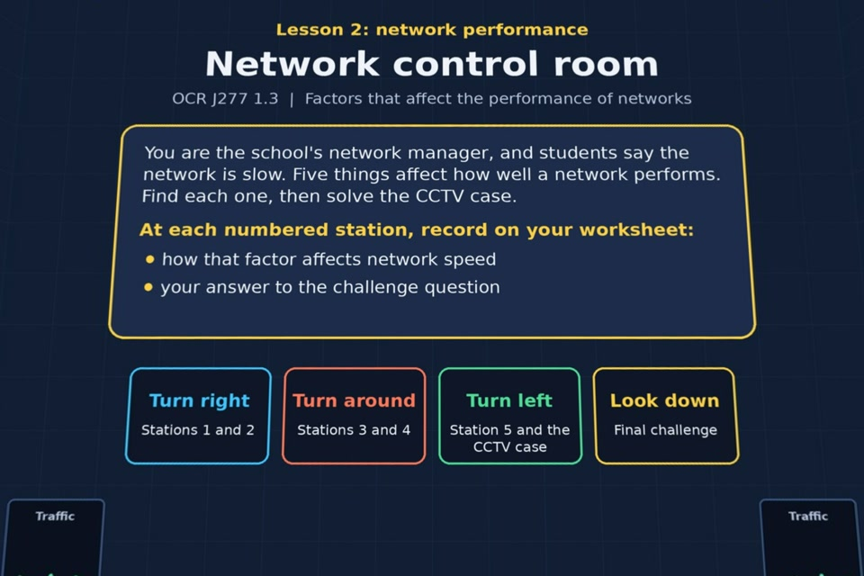

TOPIC 1.3 / LESSON 02
NETWORK CONTROL ROOM
Network performance
KEY QUESTION
What affects network performance?
1 / 17
Notes:
The image shows the actual opening scene of the experience. Begin with the worksheet starter, or the brief opening question for lessons without one.
Sources: Revise 360 experiences/nw-l02.json and worksheets/NW_L02_NetworkControlRoom_Worksheet.docx. Answers are indicative classroom examples, not an official OCR mark scheme.

Slide 2
TOPIC 1.3 / LESSON 02 / WORKSHEET
By the end of this lesson
1.
understand what factors can affect the performance of a network
2.
be able to explain how each factor affects network speed
2 / 17
Notes:
These learning outcomes follow the lesson worksheet.
Sources: Revise 360 experiences/nw-l02.json and worksheets/NW_L02_NetworkControlRoom_Worksheet.docx. Answers are indicative classroom examples, not an official OCR mark scheme.

Slide 3
TOPIC 1.3 / LESSON 02 / WORKSHEET STARTER
Starter: before the experience
What can affect the performance of a network? Write down as many ideas as you can.
3 / 17
Notes:
Students answer the worksheet starter before showing the sample answers.
Sources: Revise 360 experiences/nw-l02.json and worksheets/NW_L02_NetworkControlRoom_Worksheet.docx. Answers are indicative classroom examples, not an official OCR mark scheme.

Slide 4
TOPIC 1.3 / LESSON 02 / CHECK
Starter: sample answers
1.
Bandwidth, the number of users, transmission media, error rate and latency all affect performance.
2.
A busy connection or damaged packets can make transfers slower even when the computers themselves are fast.
4 / 17
Notes:
Accept equivalent correct explanations. Reveal after the question so it can be marked as students go.
Sources: Revise 360 experiences/nw-l02.json and worksheets/NW_L02_NetworkControlRoom_Worksheet.docx. Answers are indicative classroom examples, not an official OCR mark scheme.

Slide 5
TOPIC 1.3 / LESSON 02 / EXPERIENCE
Worksheet + experience
01 OPEN EXPERIENCE ↗
Open Network control room in Topic 1.3. Keep the worksheet beside you.
02 SIX STATIONS
Read each panel. Write the key fact IN YOUR OWN WORDS and answer the worksheet challenge before tapping its badge.
03 FINAL CHALLENGE
Complete the ★ task before tapping the star. Copy your score (out of 17), then complete the worksheet task or review.
04 PLENARY
Finish the experience in this lesson. Near the end, close it for the plenary knowledge checks.
5 / 17
Notes:
Leave this combined worksheet and experience instruction slide on the board. The OPEN EXPERIENCE label is a clickable link. Students should complete the experience and reach the plenary near the end of the lesson. First on-screen answers count.
Sources: Revise 360 experiences/nw-l02.json and worksheets/NW_L02_NetworkControlRoom_Worksheet.docx. Answers are indicative classroom examples, not an official OCR mark scheme.

Slide 6
TOPIC 1.3 / LESSON 02 / EXTENSION
Apply your learning
Explain how each of the five factors affects network performance. Give a real example for each.
Use the task and table on your worksheet.
6 / 17
Notes:
This follows the post-experience task, key question or revision results on the worksheet.
Sources: Revise 360 experiences/nw-l02.json and worksheets/NW_L02_NetworkControlRoom_Worksheet.docx. Answers are indicative classroom examples, not an official OCR mark scheme.

Slide 7
TOPIC 1.3 / LESSON 02 / EXTENSION
Check and improve
A video call freezes only when many people join the school Wi-Fi. Which factors should the network manager check first?
7 / 17
Notes:
Use this question to extend or improve an explanation before the plenary.
Sources: Revise 360 experiences/nw-l02.json and worksheets/NW_L02_NetworkControlRoom_Worksheet.docx. Answers are indicative classroom examples, not an official OCR mark scheme.

Slide 8
TOPIC 1.3 / LESSON 02 / CHECK
Application: sample answers
1.
Bandwidth: less capacity means a 4K stream buffers. Users: more simultaneous traffic shares the same link.
2.
Media: a weak Wi-Fi link may be slower than a cable. Error rate: damaged packets need retransmission.
3.
Latency: long delay makes a game or video call feel unresponsive.
4.
Check the number of users and available bandwidth, then Wi-Fi signal quality and packet errors. Each can increase delay or reduce throughput.
8 / 17
Notes:
These are indicative answers. Credit other accurate examples or justified choices.
Sources: Revise 360 experiences/nw-l02.json and worksheets/NW_L02_NetworkControlRoom_Worksheet.docx. Answers are indicative classroom examples, not an official OCR mark scheme.

Slide 9
TOPIC 1.3 / LESSON 02 / ANSWERS
After the experience: stations 1–3
Check your key facts and challenge responses.
1 Bandwidth
Bandwidth is the amount of data a link can carry per second. 4K video transfers far more data each second than music.
2 Number of users
Many simultaneous users share available bandwidth. Lots of logins at once can congest the network.
3 Transmission media
Try a wired Ethernet connection for the games console. A stable cable avoids Wi-Fi interference and can reduce delay.
9 / 17
Notes:
Show after completion. These concise points address the worksheet station challenges and help students improve their own wording.
Sources: Revise 360 experiences/nw-l02.json and worksheets/NW_L02_NetworkControlRoom_Worksheet.docx. Answers are indicative classroom examples, not an official OCR mark scheme.

Slide 10
TOPIC 1.3 / LESSON 02 / ANSWERS
After the experience: stations 4–6
Check your key facts and challenge responses.
4 Error rate
Interference may corrupt wireless packets. Resending them increases the error rate and slows useful data transfer.
5 Latency
Latency is the delay before data arrives, measured in milliseconds. A longer route to Australia usually adds delay.
6 Case study: CCTV
More CCTV streams increase bandwidth demand and user traffic. Check the links, server capacity and possible wireless errors or latency.
10 / 17
Notes:
Show after completion. These concise points address the worksheet station challenges and help students improve their own wording.
Sources: Revise 360 experiences/nw-l02.json and worksheets/NW_L02_NetworkControlRoom_Worksheet.docx. Answers are indicative classroom examples, not an official OCR mark scheme.

Slide 11
TOPIC 1.3 / LESSON 02 / CHECK
Final challenge · answers 1–4
1.
Downloads slow right down every lunchtime, when 300 students go online → Number of users
2.
A 10 Mbps connection can't stream several HD videos at once → Bandwidth
3.
A laptop at the far end of the building keeps losing its Wi-Fi → Transmission media
4.
Packets are corrupted near heavy machinery and keep being resent → Error rate
11 / 17
Notes:
These are the exact matches, sort categories or ordered steps from the interactive experience task. Use them to check the corresponding worksheet work.
Sources: Revise 360 experiences/nw-l02.json and worksheets/NW_L02_NetworkControlRoom_Worksheet.docx. Answers are indicative classroom examples, not an official OCR mark scheme.

Slide 12
TOPIC 1.3 / LESSON 02 / CHECK
Final challenge · answer 5
5.
Online gamers notice a delay between pressing a button and the action happening → Latency
12 / 17
Notes:
These are the exact matches, sort categories or ordered steps from the interactive experience task. Use them to check the corresponding worksheet work.
Sources: Revise 360 experiences/nw-l02.json and worksheets/NW_L02_NetworkControlRoom_Worksheet.docx. Answers are indicative classroom examples, not an official OCR mark scheme.

Slide 13
TOPIC 1.3 / LESSON 02 / PLENARY
Plenary: questions 1–2
Close the experience. Answer from memory on the worksheet.
a) State two factors that can affect the performance of a network. [2]
b) Explain how the number of users can affect the performance of a network. [2]
13 / 17
Notes:
These are the exact exit, exam-practice or test-ready questions from the worksheet. Allow independent writing before the answers.
Sources: Revise 360 experiences/nw-l02.json and worksheets/NW_L02_NetworkControlRoom_Worksheet.docx. Answers are indicative classroom examples, not an official OCR mark scheme.

Slide 14
TOPIC 1.3 / LESSON 02 / PLENARY
Plenary: question 3
Close the experience. Answer from memory on the worksheet.
c) A student's online game keeps lagging. Explain two possible causes and suggest a fix for each. [4]
14 / 17
Notes:
These are the exact exit, exam-practice or test-ready questions from the worksheet. Allow independent writing before the answers.
Sources: Revise 360 experiences/nw-l02.json and worksheets/NW_L02_NetworkControlRoom_Worksheet.docx. Answers are indicative classroom examples, not an official OCR mark scheme.

Slide 15
TOPIC 1.3 / LESSON 02 / CHECK
Plenary: answers 1–2
Indicative points. Credit accurate answers in students’ own words.
a) Any two: bandwidth, number of users, transmission media, error rate or latency.
b) More users transfer data at once and share finite bandwidth. Congestion makes each transfer slower.
15 / 17
Notes:
Classroom answer points, not an official OCR mark scheme. Ask students to improve one answer.
Sources: Revise 360 experiences/nw-l02.json and worksheets/NW_L02_NetworkControlRoom_Worksheet.docx. Answers are indicative classroom examples, not an official OCR mark scheme.

Slide 16
TOPIC 1.3 / LESSON 02 / CHECK
Plenary: answer 3
Indicative points. Credit accurate answers in students’ own words.
c) Weak or interfered-with Wi-Fi can cause retransmissions: use Ethernet or move nearer the access point. Too many users can congest the link: increase capacity or reduce competing traffic.
16 / 17
Notes:
Classroom answer points, not an official OCR mark scheme. Ask students to improve one answer.
Sources: Revise 360 experiences/nw-l02.json and worksheets/NW_L02_NetworkControlRoom_Worksheet.docx. Answers are indicative classroom examples, not an official OCR mark scheme.

Slide 17
TOPIC 1.3 / LESSON 02 / SELF-CHECK
How confident am I?
Select Not yet, Getting there or Confident for each objective on the worksheet.
1.
Naming the five factors that affect performance
2.
Explaining how each factor affects network speed
3.
Applying the factors to a scenario, like the CCTV case
17 / 17
Notes:
These are the exact confidence objectives from the worksheet. Students identify one area to revisit.
Sources: Revise 360 experiences/nw-l02.json and worksheets/NW_L02_NetworkControlRoom_Worksheet.docx. Answers are indicative classroom examples, not an official OCR mark scheme.

