Slide 1
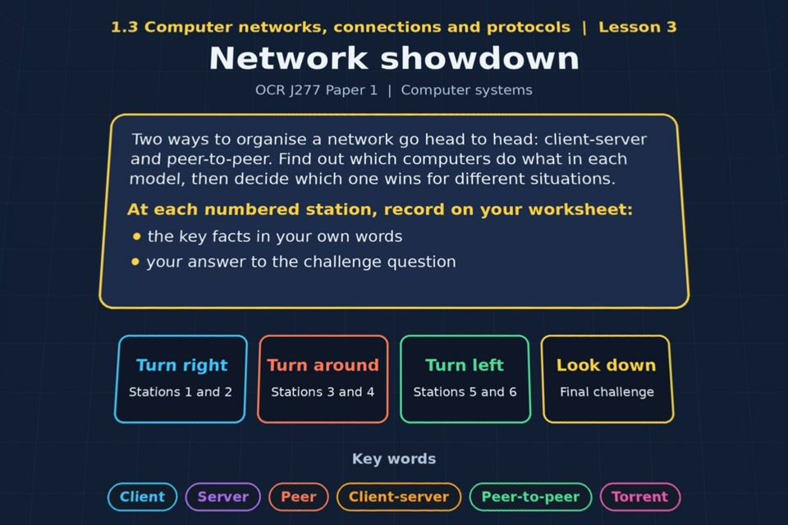

TOPIC 1.3 / LESSON 03
NETWORK SHOWDOWN
Client-server and peer-to-peer
KEY QUESTION
What are the differences between peer-to-peer and client-server networks?
1 / 20
Notes:
The image shows the actual opening scene of the experience. Begin with the worksheet starter, or the brief opening question for lessons without one.
Sources: Revise 360 experiences/nw-l03.json and worksheets/NW_L03_NetworkShowdown_Worksheet.docx. Answers are indicative classroom examples, not an official OCR mark scheme.

Slide 2
TOPIC 1.3 / LESSON 03 / WORKSHEET
By the end of this lesson
1.
know what a client-server model is
2.
know what a peer-to-peer model is
3.
understand the different roles computers have in each model
2 / 20
Notes:
These learning outcomes follow the lesson worksheet.
Sources: Revise 360 experiences/nw-l03.json and worksheets/NW_L03_NetworkShowdown_Worksheet.docx. Answers are indicative classroom examples, not an official OCR mark scheme.

Slide 3
TOPIC 1.3 / LESSON 03 / WORKSHEET STARTER
Starter: before the experience
A class of 30 needs to share one big video file. Describe two ways it could be done, and say which would be quicker.
3 / 20
Notes:
Students answer the worksheet starter before showing the sample answers.
Sources: Revise 360 experiences/nw-l03.json and worksheets/NW_L03_NetworkShowdown_Worksheet.docx. Answers are indicative classroom examples, not an official OCR mark scheme.

Slide 4
TOPIC 1.3 / LESSON 03 / CHECK
Starter: sample answers
1.
One method is to place the video on a central server and let everyone download it.
2.
Another is to copy it between classmates' computers. A server is simpler to manage; speed depends on the network and simultaneous downloads.
4 / 20
Notes:
Accept equivalent correct explanations. Reveal after the question so it can be marked as students go.
Sources: Revise 360 experiences/nw-l03.json and worksheets/NW_L03_NetworkShowdown_Worksheet.docx. Answers are indicative classroom examples, not an official OCR mark scheme.

Slide 5
TOPIC 1.3 / LESSON 03 / WORKSHEET KEY TERMS
Key terminology quiz
1.
Client-server
2.
Peer-to-peer
5 / 20
Notes:
Students define the exact terms listed on their worksheet.
Sources: Revise 360 experiences/nw-l03.json and worksheets/NW_L03_NetworkShowdown_Worksheet.docx. Answers are indicative classroom examples, not an official OCR mark scheme.

Slide 6
TOPIC 1.3 / LESSON 03 / CHECK
Key terminology: answers
Client-server
Client-server: clients request services or resources from a central server that manages them.
Peer-to-peer
Peer-to-peer: computers share resources directly and each peer can both request and provide them.
6 / 20
Notes:
Reveal after the key terminology quiz. Accept accurate definitions in students’ own words.
Sources: Revise 360 experiences/nw-l03.json and worksheets/NW_L03_NetworkShowdown_Worksheet.docx. Answers are indicative classroom examples, not an official OCR mark scheme.

Slide 7
TOPIC 1.3 / LESSON 03 / EXPERIENCE
Worksheet + experience
01 OPEN EXPERIENCE ↗
Open Network showdown in Topic 1.3. Keep the worksheet beside you.
02 SIX STATIONS
Read each panel. Write the key fact IN YOUR OWN WORDS and answer the worksheet challenge before tapping its badge.
03 FINAL CHALLENGE
Complete the ★ task before tapping the star. Copy your score (out of 26), then complete the worksheet task or review.
04 PLENARY
Finish the experience in this lesson. Near the end, close it for the plenary knowledge checks.
7 / 20
Notes:
Leave this combined worksheet and experience instruction slide on the board. The OPEN EXPERIENCE label is a clickable link. Students should complete the experience and reach the plenary near the end of the lesson. First on-screen answers count.
Sources: Revise 360 experiences/nw-l03.json and worksheets/NW_L03_NetworkShowdown_Worksheet.docx. Answers are indicative classroom examples, not an official OCR mark scheme.

Slide 8
TOPIC 1.3 / LESSON 03 / EXTENSION
Apply your learning
Answer the key question: how do client-server and peer-to-peer networks differ?
Use the task and table on your worksheet.
8 / 20
Notes:
This follows the post-experience task, key question or revision results on the worksheet.
Sources: Revise 360 experiences/nw-l03.json and worksheets/NW_L03_NetworkShowdown_Worksheet.docx. Answers are indicative classroom examples, not an official OCR mark scheme.

Slide 9
TOPIC 1.3 / LESSON 03 / EXTENSION
Check and improve
A three-person office grows to 60 staff. What changes in the case for a central server?
9 / 20
Notes:
Use this question to extend or improve an explanation before the plenary.
Sources: Revise 360 experiences/nw-l03.json and worksheets/NW_L03_NetworkShowdown_Worksheet.docx. Answers are indicative classroom examples, not an official OCR mark scheme.

Slide 10
TOPIC 1.3 / LESSON 03 / CHECK
Application: sample answers
1.
Client-server uses a central machine to provide services and manage users, files and backups.
2.
Peer-to-peer devices share directly. Setup can cost less, but administration and backup are less consistent.
3.
A school usually benefits from central control; a very small office may accept the trade-offs of peer-to-peer.
4.
Central accounts, permissions, backups and updates become more valuable as the number of users grows, despite extra cost and management.
10 / 20
Notes:
These are indicative answers. Credit other accurate examples or justified choices.
Sources: Revise 360 experiences/nw-l03.json and worksheets/NW_L03_NetworkShowdown_Worksheet.docx. Answers are indicative classroom examples, not an official OCR mark scheme.

Slide 11
TOPIC 1.3 / LESSON 03 / ANSWERS
After the experience: stations 1–3
Check your key facts and challenge responses.
1 Client-server model
School servers may provide shared files, logins and printers. Clients request those services.
2 Peer-to-peer model
Two home computers sharing a folder directly are peers. Each owner manages their own files and backups.
3 Client-server: pros and cons
A school needs central user accounts, permissions and backups. A server provides these consistently.
11 / 20
Notes:
Show after completion. These concise points address the worksheet station challenges and help students improve their own wording.
Sources: Revise 360 experiences/nw-l03.json and worksheets/NW_L03_NetworkShowdown_Worksheet.docx. Answers are indicative classroom examples, not an official OCR mark scheme.

Slide 12
TOPIC 1.3 / LESSON 03 / ANSWERS
After the experience: stations 4–6
Check your key facts and challenge responses.
4 Peer-to-peer: pros and cons
For three computers, peer-to-peer may be cheap and simple, but each person must manage their own backup and security.
5 Who's who?
A server supplies a shared service; a client asks for it. A peer both supplies and requests resources from other peers.
6 How torrents work
Torrenting is peer-to-peer. Different peers can send different pieces of one large file at once, which may speed the download.
12 / 20
Notes:
Show after completion. These concise points address the worksheet station challenges and help students improve their own wording.
Sources: Revise 360 experiences/nw-l03.json and worksheets/NW_L03_NetworkShowdown_Worksheet.docx. Answers are indicative classroom examples, not an official OCR mark scheme.

Slide 13
TOPIC 1.3 / LESSON 03 / CHECK
Final challenge · answers 1–4
1.
Each user has to back up their own machine → Peer-to-peer
2.
Files end up scattered and hard to find → Peer-to-peer
3.
No expensive central machine to buy → Peer-to-peer
4.
One nightly backup covers everyone's shared work → Client-server
13 / 20
Notes:
These are the exact matches, sort categories or ordered steps from the interactive experience task. Use them to check the corresponding worksheet work.
Sources: Revise 360 experiences/nw-l03.json and worksheets/NW_L03_NetworkShowdown_Worksheet.docx. Answers are indicative classroom examples, not an official OCR mark scheme.

Slide 14
TOPIC 1.3 / LESSON 03 / CHECK
Final challenge · answers 5–8
5.
Carries on working if one computer is switched off → Peer-to-peer
6.
Security settings are hard to apply consistently → Peer-to-peer
7.
Permissions are set once, centrally → Client-server
8.
Needs trained staff to look after it → Client-server
14 / 20
Notes:
These are the exact matches, sort categories or ordered steps from the interactive experience task. Use them to check the corresponding worksheet work.
Sources: Revise 360 experiences/nw-l03.json and worksheets/NW_L03_NetworkShowdown_Worksheet.docx. Answers are indicative classroom examples, not an official OCR mark scheme.

Slide 15
TOPIC 1.3 / LESSON 03 / CHECK
Final challenge · answers 9–12
9.
New software can be pushed to every machine at once → Client-server
10.
Costs more to buy and to run → Client-server
11.
Anyone can set it up without training → Peer-to-peer
12.
Everything stops if the central machine fails → Client-server
15 / 20
Notes:
These are the exact matches, sort categories or ordered steps from the interactive experience task. Use them to check the corresponding worksheet work.
Sources: Revise 360 experiences/nw-l03.json and worksheets/NW_L03_NetworkShowdown_Worksheet.docx. Answers are indicative classroom examples, not an official OCR mark scheme.

Slide 16
TOPIC 1.3 / LESSON 03 / PLENARY
Plenary: questions 1–2
Close the experience. Answer from memory on the worksheet.
a) Describe what a server does in a client-server network. [2]
b) Give two reasons a small office might choose peer-to-peer. [2]
16 / 20
Notes:
These are the exact exit, exam-practice or test-ready questions from the worksheet. Allow independent writing before the answers.
Sources: Revise 360 experiences/nw-l03.json and worksheets/NW_L03_NetworkShowdown_Worksheet.docx. Answers are indicative classroom examples, not an official OCR mark scheme.

Slide 17
TOPIC 1.3 / LESSON 03 / PLENARY
Plenary: question 3
Close the experience. Answer from memory on the worksheet.
c) A school is choosing between client-server and peer-to-peer. Recommend one and justify your choice using two characteristics. [6]
17 / 20
Notes:
These are the exact exit, exam-practice or test-ready questions from the worksheet. Allow independent writing before the answers.
Sources: Revise 360 experiences/nw-l03.json and worksheets/NW_L03_NetworkShowdown_Worksheet.docx. Answers are indicative classroom examples, not an official OCR mark scheme.

Slide 18
TOPIC 1.3 / LESSON 03 / CHECK
Plenary: answers 1–2
Indicative points. Credit accurate answers in students’ own words.
a) A server stores or manages resources and responds when client devices request a service.
b) Peer-to-peer can be cheaper because no dedicated server is needed, and it is simple to set up for a few users.
18 / 20
Notes:
Classroom answer points, not an official OCR mark scheme. Ask students to improve one answer.
Sources: Revise 360 experiences/nw-l03.json and worksheets/NW_L03_NetworkShowdown_Worksheet.docx. Answers are indicative classroom examples, not an official OCR mark scheme.

Slide 19
TOPIC 1.3 / LESSON 03 / CHECK
Plenary: answer 3
Indicative points. Credit accurate answers in students’ own words.
c) Recommend client-server for the school. Central accounts and permissions make access easier to manage; central backups protect shared work. It costs more and needs support, but those controls matter at school scale.
19 / 20
Notes:
Classroom answer points, not an official OCR mark scheme. Ask students to improve one answer.
Sources: Revise 360 experiences/nw-l03.json and worksheets/NW_L03_NetworkShowdown_Worksheet.docx. Answers are indicative classroom examples, not an official OCR mark scheme.

Slide 20
TOPIC 1.3 / LESSON 03 / SELF-CHECK
How confident am I?
Select Not yet, Getting there or Confident for each objective on the worksheet.
1.
What a client-server model is
2.
What a peer-to-peer model is
3.
The roles of servers, clients and peers
20 / 20
Notes:
These are the exact confidence objectives from the worksheet. Students identify one area to revisit.
Sources: Revise 360 experiences/nw-l03.json and worksheets/NW_L03_NetworkShowdown_Worksheet.docx. Answers are indicative classroom examples, not an official OCR mark scheme.

