Slide 1
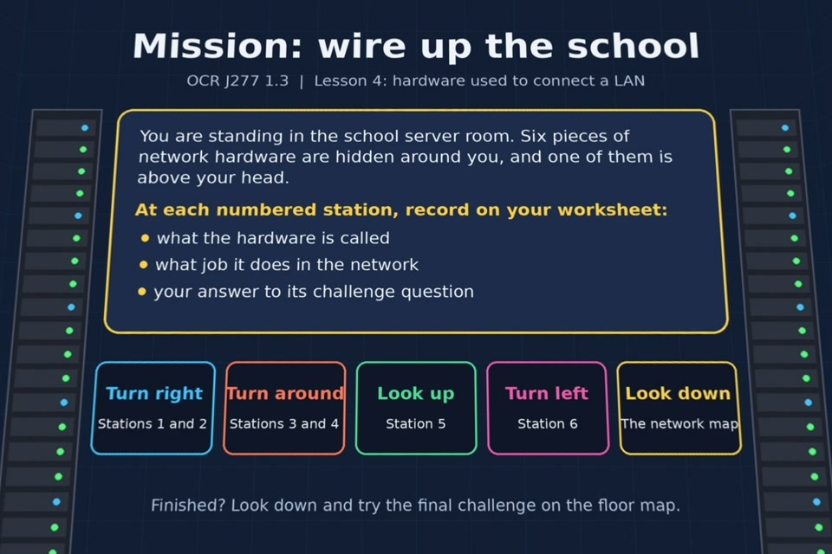

TOPIC 1.3 / LESSON 04
MISSION: WIRE UP THE SCHOOL
LAN hardware
KEY QUESTION
How is a school LAN connected?
1 / 16
Notes:
The image shows the actual opening scene of the experience. Begin with the worksheet starter, or the brief opening question for lessons without one.
Sources: Revise 360 experiences/nw-l04.json and worksheets/NW_L04_MissionWireUpTheSchool_Worksheet.docx. Answers are indicative classroom examples, not an official OCR mark scheme.

Slide 2
TOPIC 1.3 / LESSON 04 / WORKSHEET
By the end of this lesson
1.
know the hardware needed to connect a LAN
2.
understand the purpose of each piece of hardware and the jobs it does
2 / 16
Notes:
These learning outcomes follow the lesson worksheet.
Sources: Revise 360 experiences/nw-l04.json and worksheets/NW_L04_MissionWireUpTheSchool_Worksheet.docx. Answers are indicative classroom examples, not an official OCR mark scheme.

Slide 3
TOPIC 1.3 / LESSON 04 / WORKSHEET STARTER
Starter: before the experience
A school has one building for Years 7 to 9 and another 200 metres away for Years 10 and 11. Suggest how you would connect the two, and why.
3 / 16
Notes:
Students answer the worksheet starter before showing the sample answers.
Sources: Revise 360 experiences/nw-l04.json and worksheets/NW_L04_MissionWireUpTheSchool_Worksheet.docx. Answers are indicative classroom examples, not an official OCR mark scheme.

Slide 4
TOPIC 1.3 / LESSON 04 / CHECK
Starter: sample answers
1.
Use a fibre optic link between the buildings. It can carry data over 200 metres with high bandwidth.
2.
Ordinary copper Ethernet runs are much shorter and can suffer more interference.
4 / 16
Notes:
Accept equivalent correct explanations. Reveal after the question so it can be marked as students go.
Sources: Revise 360 experiences/nw-l04.json and worksheets/NW_L04_MissionWireUpTheSchool_Worksheet.docx. Answers are indicative classroom examples, not an official OCR mark scheme.

Slide 5
TOPIC 1.3 / LESSON 04 / EXPERIENCE
Worksheet + experience
01 OPEN EXPERIENCE ↗
Open Mission: wire up the school in Topic 1.3. Keep the worksheet beside you.
02 SIX STATIONS
Read each panel. Write the key fact IN YOUR OWN WORDS and answer the worksheet challenge before tapping its badge.
03 FINAL CHALLENGE
Complete the ★ task before tapping the star. Copy your score (out of 16), then complete the worksheet task or review.
04 PLENARY
Finish the experience in this lesson. Near the end, close it for the plenary knowledge checks.
5 / 16
Notes:
Leave this combined worksheet and experience instruction slide on the board. The OPEN EXPERIENCE label is a clickable link. Students should complete the experience and reach the plenary near the end of the lesson. First on-screen answers count.
Sources: Revise 360 experiences/nw-l04.json and worksheets/NW_L04_MissionWireUpTheSchool_Worksheet.docx. Answers are indicative classroom examples, not an official OCR mark scheme.

Slide 6
TOPIC 1.3 / LESSON 04 / EXTENSION
Apply your learning
Complete the hardware summary and compare UTP cable with fibre optic cable on your worksheet.
Use the task and table on your worksheet.
6 / 16
Notes:
This follows the post-experience task, key question or revision results on the worksheet.
Sources: Revise 360 experiences/nw-l04.json and worksheets/NW_L04_MissionWireUpTheSchool_Worksheet.docx. Answers are indicative classroom examples, not an official OCR mark scheme.

Slide 7
TOPIC 1.3 / LESSON 04 / EXTENSION
Check and improve
The router fails but the switch and file server still work. Which tasks can continue?
7 / 16
Notes:
Use this question to extend or improve an explanation before the plenary.
Sources: Revise 360 experiences/nw-l04.json and worksheets/NW_L04_MissionWireUpTheSchool_Worksheet.docx. Answers are indicative classroom examples, not an official OCR mark scheme.

Slide 8
TOPIC 1.3 / LESSON 04 / CHECK
Application: sample answers
1.
Switch: local frames and MAC addresses. Router: packets between networks and IP addresses. WAP: Wi-Fi into the LAN.
2.
NIC: a device's wired or wireless interface. UTP: twisted copper pairs for shorter links.
3.
Fibre: light over longer distances, high bandwidth and resistance to electrical interference.
4.
Devices can still use local LAN resources, such as the file server or printer, but cannot reach another network or the internet through the failed router.
8 / 16
Notes:
These are indicative answers. Credit other accurate examples or justified choices.
Sources: Revise 360 experiences/nw-l04.json and worksheets/NW_L04_MissionWireUpTheSchool_Worksheet.docx. Answers are indicative classroom examples, not an official OCR mark scheme.

Slide 9
TOPIC 1.3 / LESSON 04 / ANSWERS
After the experience: stations 1–3
Check your key facts and challenge responses.
1 Switch
A switch connects devices on one LAN and forwards frames to the right port. PCs on a failed switch lose that connection.
2 UTP cable
UTP uses pairs of twisted copper wires. A 2 km run is beyond a normal Ethernet cable's practical length; fibre suits the distance.
3 Router
A router connects different networks. Local printing may still work through switches, but a website outside the LAN cannot load.
9 / 16
Notes:
Show after completion. These concise points address the worksheet station challenges and help students improve their own wording.
Sources: Revise 360 experiences/nw-l04.json and worksheets/NW_L04_MissionWireUpTheSchool_Worksheet.docx. Answers are indicative classroom examples, not an official OCR mark scheme.

Slide 10
TOPIC 1.3 / LESSON 04 / ANSWERS
After the experience: stations 4–6
Check your key facts and challenge responses.
4 Fibre optic cable
Fibre carries light pulses, works over long distances and resists electrical interference. It is suitable between buildings.
5 Wireless access point
A WAP connects wireless devices to the wired LAN. Several WAPs cover separate rooms and handle users more effectively.
6 Network interface card
A NIC gives a device a network interface and MAC address. A PC with only a wired NIC must use an Ethernet cable.
10 / 16
Notes:
Show after completion. These concise points address the worksheet station challenges and help students improve their own wording.
Sources: Revise 360 experiences/nw-l04.json and worksheets/NW_L04_MissionWireUpTheSchool_Worksheet.docx. Answers are indicative classroom examples, not an official OCR mark scheme.

Slide 11
TOPIC 1.3 / LESSON 04 / CHECK
Final challenge · answers
1.
The laptop sends the request by Wi-Fi to the wireless access point
2.
The WAP passes it along a UTP cable to the switch
3.
The switch forwards it to the router
4.
The router sends it along fibre optic cable to the internet
11 / 16
Notes:
These are the exact matches, sort categories or ordered steps from the interactive experience task. Use them to check the corresponding worksheet work.
Sources: Revise 360 experiences/nw-l04.json and worksheets/NW_L04_MissionWireUpTheSchool_Worksheet.docx. Answers are indicative classroom examples, not an official OCR mark scheme.

Slide 12
TOPIC 1.3 / LESSON 04 / PLENARY
Plenary: questions 1–2
Close the experience. Answer from memory on the worksheet.
a) State the purpose of a router. [1]
b) Explain the difference between a switch and a router. [2]
12 / 16
Notes:
These are the exact exit, exam-practice or test-ready questions from the worksheet. Allow independent writing before the answers.
Sources: Revise 360 experiences/nw-l04.json and worksheets/NW_L04_MissionWireUpTheSchool_Worksheet.docx. Answers are indicative classroom examples, not an official OCR mark scheme.

Slide 13
TOPIC 1.3 / LESSON 04 / PLENARY
Plenary: question 3
Close the experience. Answer from memory on the worksheet.
c) How do you set up a LAN? Describe the hardware a small office would need and what each piece does. [6]
13 / 16
Notes:
These are the exact exit, exam-practice or test-ready questions from the worksheet. Allow independent writing before the answers.
Sources: Revise 360 experiences/nw-l04.json and worksheets/NW_L04_MissionWireUpTheSchool_Worksheet.docx. Answers are indicative classroom examples, not an official OCR mark scheme.

Slide 14
TOPIC 1.3 / LESSON 04 / CHECK
Plenary: answers 1–2
Indicative points. Credit accurate answers in students’ own words.
a) A router forwards data between different networks.
b) A switch connects devices within a LAN and uses MAC addresses. A router connects networks and uses IP addresses to forward packets.
14 / 16
Notes:
Classroom answer points, not an official OCR mark scheme. Ask students to improve one answer.
Sources: Revise 360 experiences/nw-l04.json and worksheets/NW_L04_MissionWireUpTheSchool_Worksheet.docx. Answers are indicative classroom examples, not an official OCR mark scheme.

Slide 15
TOPIC 1.3 / LESSON 04 / CHECK
Plenary: answer 3
Indicative points. Credit accurate answers in students’ own words.
c) Give each PC a NIC and connect wired PCs by UTP to a switch. Add a WAP for wireless devices and a router for internet access. A server or shared printer can connect to the switch if needed.
15 / 16
Notes:
Classroom answer points, not an official OCR mark scheme. Ask students to improve one answer.
Sources: Revise 360 experiences/nw-l04.json and worksheets/NW_L04_MissionWireUpTheSchool_Worksheet.docx. Answers are indicative classroom examples, not an official OCR mark scheme.

Slide 16
TOPIC 1.3 / LESSON 04 / SELF-CHECK
How confident am I?
Select Not yet, Getting there or Confident for each objective on the worksheet.
1.
The hardware needed to connect a LAN
2.
What a switch, router, WAP and NIC each do
3.
The differences between UTP and fibre optic
16 / 16
Notes:
These are the exact confidence objectives from the worksheet. Students identify one area to revisit.
Sources: Revise 360 experiences/nw-l04.json and worksheets/NW_L04_MissionWireUpTheSchool_Worksheet.docx. Answers are indicative classroom examples, not an official OCR mark scheme.

