Slide 1
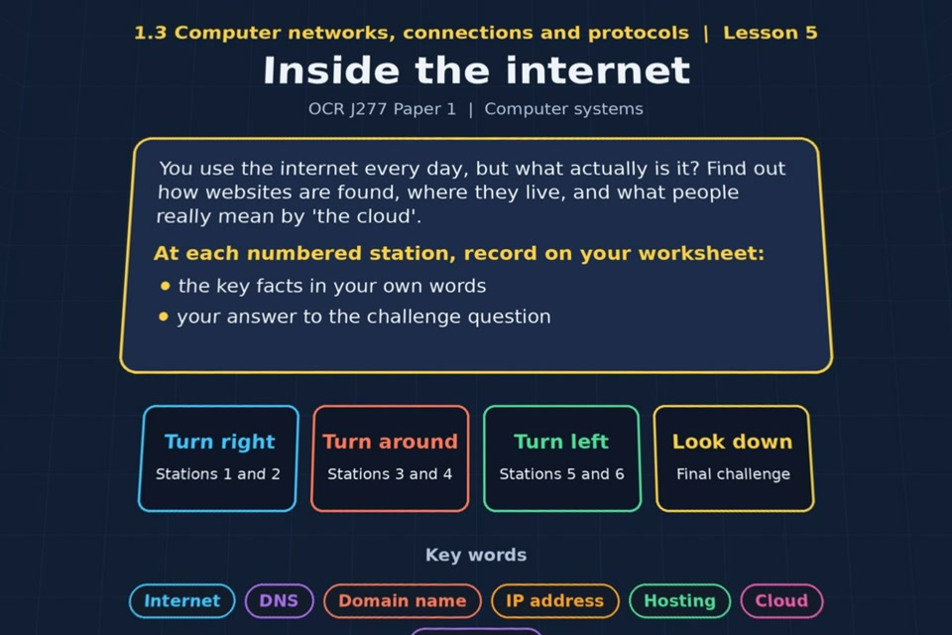

TOPIC 1.3 / LESSON 05
INSIDE THE INTERNET
The internet, DNS and cloud
KEY QUESTION
How does the internet work?
1 / 19
Notes:
The image shows the actual opening scene of the experience. Begin with the worksheet starter, or the brief opening question for lessons without one.
Sources: Revise 360 experiences/nw-l05.json and worksheets/NW_L05_InsideTheInternet_Worksheet.docx. Answers are indicative classroom examples, not an official OCR mark scheme.

Slide 2
TOPIC 1.3 / LESSON 05 / WORKSHEET
By the end of this lesson
1.
understand what the internet actually is
2.
understand the terms Domain Name Service and domain name server
3.
understand what is meant by hosting and the cloud
4.
understand what is meant by the terms web server and client
2 / 19
Notes:
These learning outcomes follow the lesson worksheet.
Sources: Revise 360 experiences/nw-l05.json and worksheets/NW_L05_InsideTheInternet_Worksheet.docx. Answers are indicative classroom examples, not an official OCR mark scheme.

Slide 3
TOPIC 1.3 / LESSON 05 / WORKSHEET STARTER
Starter: before the experience
You save a file on a school computer and open it later at home. Describe what has to happen for that to work.
3 / 19
Notes:
Students answer the worksheet starter before showing the sample answers.
Sources: Revise 360 experiences/nw-l05.json and worksheets/NW_L05_InsideTheInternet_Worksheet.docx. Answers are indicative classroom examples, not an official OCR mark scheme.

Slide 4
TOPIC 1.3 / LESSON 05 / CHECK
Starter: sample answers
1.
The file must be stored on a school server or cloud service that can be reached from home over the internet.
2.
Your home device connects, authenticates and downloads or opens the file. The school must allow secure remote access.
4 / 19
Notes:
Accept equivalent correct explanations. Reveal after the question so it can be marked as students go.
Sources: Revise 360 experiences/nw-l05.json and worksheets/NW_L05_InsideTheInternet_Worksheet.docx. Answers are indicative classroom examples, not an official OCR mark scheme.

Slide 5
TOPIC 1.3 / LESSON 05 / WORKSHEET KEY TERMS
Key terminology quiz
1.
DNS (Domain Name Service)
2.
Hosting
3.
The cloud
5 / 19
Notes:
Students define the exact terms listed on their worksheet.
Sources: Revise 360 experiences/nw-l05.json and worksheets/NW_L05_InsideTheInternet_Worksheet.docx. Answers are indicative classroom examples, not an official OCR mark scheme.

Slide 6
TOPIC 1.3 / LESSON 05 / CHECK
Key terminology: answers
DNS (Domain Name Service)
DNS (Domain Name Service): finds the IP address associated with a domain name so the browser can contact the right server.
Hosting
Hosting: a provider stores a website or service on servers that other users can reach.
The cloud
The cloud: remote servers reached through the internet to store data or run software.
6 / 19
Notes:
Reveal after the key terminology quiz. Accept accurate definitions in students’ own words.
Sources: Revise 360 experiences/nw-l05.json and worksheets/NW_L05_InsideTheInternet_Worksheet.docx. Answers are indicative classroom examples, not an official OCR mark scheme.

Slide 7
TOPIC 1.3 / LESSON 05 / EXPERIENCE
Worksheet + experience
01 OPEN EXPERIENCE ↗
Open Inside the internet in Topic 1.3. Keep the worksheet beside you.
02 SIX STATIONS
Read each panel. Write the key fact IN YOUR OWN WORDS and answer the worksheet challenge before tapping its badge.
03 FINAL CHALLENGE
Complete the ★ task before tapping the star. Copy your score (out of 27), then complete the worksheet task or review.
04 PLENARY
Finish the experience in this lesson. Near the end, close it for the plenary knowledge checks.
7 / 19
Notes:
Leave this combined worksheet and experience instruction slide on the board. The OPEN EXPERIENCE label is a clickable link. Students should complete the experience and reach the plenary near the end of the lesson. First on-screen answers count.
Sources: Revise 360 experiences/nw-l05.json and worksheets/NW_L05_InsideTheInternet_Worksheet.docx. Answers are indicative classroom examples, not an official OCR mark scheme.

Slide 8
TOPIC 1.3 / LESSON 05 / EXTENSION
Apply your learning
Answer the key question: how does the internet help a browser find and load a web page?
Use the task and table on your worksheet.
8 / 19
Notes:
This follows the post-experience task, key question or revision results on the worksheet.
Sources: Revise 360 experiences/nw-l05.json and worksheets/NW_L05_InsideTheInternet_Worksheet.docx. Answers are indicative classroom examples, not an official OCR mark scheme.

Slide 9
TOPIC 1.3 / LESSON 05 / EXTENSION
Check and improve
A school moves files to the cloud. Which benefit and which risk would matter most during an internet outage?
9 / 19
Notes:
Use this question to extend or improve an explanation before the plenary.
Sources: Revise 360 experiences/nw-l05.json and worksheets/NW_L05_InsideTheInternet_Worksheet.docx. Answers are indicative classroom examples, not an official OCR mark scheme.

Slide 10
TOPIC 1.3 / LESSON 05 / CHECK
Application: sample answers
1.
The internet links networks across the world through routers.
2.
DNS turns the domain name into an IP address. The browser uses it to reach the web server.
3.
The web server sends the page back to the browser. A hosting company may run that server.
4.
Cloud files can be opened from home and centrally backed up, but an outage may stop staff and students accessing them.
10 / 19
Notes:
These are indicative answers. Credit other accurate examples or justified choices.
Sources: Revise 360 experiences/nw-l05.json and worksheets/NW_L05_InsideTheInternet_Worksheet.docx. Answers are indicative classroom examples, not an official OCR mark scheme.

Slide 11
TOPIC 1.3 / LESSON 05 / ANSWERS
After the experience: stations 1–3
Check your key facts and challenge responses.
1 What is the internet?
The internet is a worldwide network of interconnected networks, using common protocols to exchange data.
2 Domain Name Service (DNS)
DNS saves us memorising numeric IP addresses. It looks up the address for a readable domain name.
3 Hosting
A hosting company supplies and maintains the web server, connectivity and availability for the business.
11 / 19
Notes:
Show after completion. These concise points address the worksheet station challenges and help students improve their own wording.
Sources: Revise 360 experiences/nw-l05.json and worksheets/NW_L05_InsideTheInternet_Worksheet.docx. Answers are indicative classroom examples, not an official OCR mark scheme.

Slide 12
TOPIC 1.3 / LESSON 05 / ANSWERS
After the experience: stations 4–6
Check your key facts and challenge responses.
4 The cloud
Cloud files and apps can be reached from different devices, though they depend on an internet connection and provider.
5 Web servers and clients
A phone is the client: it requests a page. The web server stores or generates it and sends the response.
6 File servers
A desktop client requests a file from the file server. Central storage can make sharing and backup easier.
12 / 19
Notes:
Show after completion. These concise points address the worksheet station challenges and help students improve their own wording.
Sources: Revise 360 experiences/nw-l05.json and worksheets/NW_L05_InsideTheInternet_Worksheet.docx. Answers are indicative classroom examples, not an official OCR mark scheme.

Slide 13
TOPIC 1.3 / LESSON 05 / CHECK
Final challenge · answers 1–4
1.
Copies are kept automatically, so files survive a failed laptop → Advantage
2.
Your files sit on someone else's servers → Disadvantage
3.
A slow connection makes large files painful → Disadvantage
4.
More space can be added the day you need it → Advantage
13 / 19
Notes:
These are the exact matches, sort categories or ordered steps from the interactive experience task. Use them to check the corresponding worksheet work.
Sources: Revise 360 experiences/nw-l05.json and worksheets/NW_L05_InsideTheInternet_Worksheet.docx. Answers are indicative classroom examples, not an official OCR mark scheme.

Slide 14
TOPIC 1.3 / LESSON 05 / CHECK
Final challenge · answers 5–8
5.
There's a bill every month for as long as you use it → Disadvantage
6.
No servers to buy, power or replace → Advantage
7.
Nothing works if the internet goes down → Disadvantage
8.
The same files open on any device, anywhere → Advantage
14 / 19
Notes:
These are the exact matches, sort categories or ordered steps from the interactive experience task. Use them to check the corresponding worksheet work.
Sources: Revise 360 experiences/nw-l05.json and worksheets/NW_L05_InsideTheInternet_Worksheet.docx. Answers are indicative classroom examples, not an official OCR mark scheme.

Slide 15
TOPIC 1.3 / LESSON 05 / PLENARY
Plenary: questions 1–2
Close the experience. Answer from memory on the worksheet.
a) Describe what the internet is. [2]
b) Explain the steps DNS goes through when a browser looks up a web address. [4]
15 / 19
Notes:
These are the exact exit, exam-practice or test-ready questions from the worksheet. Allow independent writing before the answers.
Sources: Revise 360 experiences/nw-l05.json and worksheets/NW_L05_InsideTheInternet_Worksheet.docx. Answers are indicative classroom examples, not an official OCR mark scheme.

Slide 16
TOPIC 1.3 / LESSON 05 / PLENARY
Plenary: question 3
Close the experience. Answer from memory on the worksheet.
c) A school is considering moving its files to the cloud. Discuss the benefits and the risks. [8]
16 / 19
Notes:
These are the exact exit, exam-practice or test-ready questions from the worksheet. Allow independent writing before the answers.
Sources: Revise 360 experiences/nw-l05.json and worksheets/NW_L05_InsideTheInternet_Worksheet.docx. Answers are indicative classroom examples, not an official OCR mark scheme.

Slide 17
TOPIC 1.3 / LESSON 05 / CHECK
Plenary: answers 1–2
Indicative points. Credit accurate answers in students’ own words.
a) The internet is a worldwide WAN made of connected networks. Routers move data between them using common protocols.
b) The browser asks DNS for the domain's IP address. A DNS server looks it up, sometimes by asking other DNS servers, and returns the IP address. The browser then contacts the web server at that address.
17 / 19
Notes:
Classroom answer points, not an official OCR mark scheme. Ask students to improve one answer.
Sources: Revise 360 experiences/nw-l05.json and worksheets/NW_L05_InsideTheInternet_Worksheet.docx. Answers are indicative classroom examples, not an official OCR mark scheme.

Slide 18
TOPIC 1.3 / LESSON 05 / CHECK
Plenary: answer 3
Indicative points. Credit accurate answers in students’ own words.
c) Cloud storage offers access from different locations, easier sharing, scalable capacity and provider-managed backups. Risks include dependence on a working connection, recurring cost, and privacy or security concerns because another organisation holds the data. The school should weigh these against its reliability and safeguarding needs.
18 / 19
Notes:
Classroom answer points, not an official OCR mark scheme. Ask students to improve one answer.
Sources: Revise 360 experiences/nw-l05.json and worksheets/NW_L05_InsideTheInternet_Worksheet.docx. Answers are indicative classroom examples, not an official OCR mark scheme.

Slide 19
TOPIC 1.3 / LESSON 05 / SELF-CHECK
How confident am I?
Select Not yet, Getting there or Confident for each objective on the worksheet.
1.
What the internet is
2.
How DNS works
3.
Hosting, the cloud, web servers and clients
19 / 19
Notes:
These are the exact confidence objectives from the worksheet. Students identify one area to revisit.
Sources: Revise 360 experiences/nw-l05.json and worksheets/NW_L05_InsideTheInternet_Worksheet.docx. Answers are indicative classroom examples, not an official OCR mark scheme.

