Slide 1
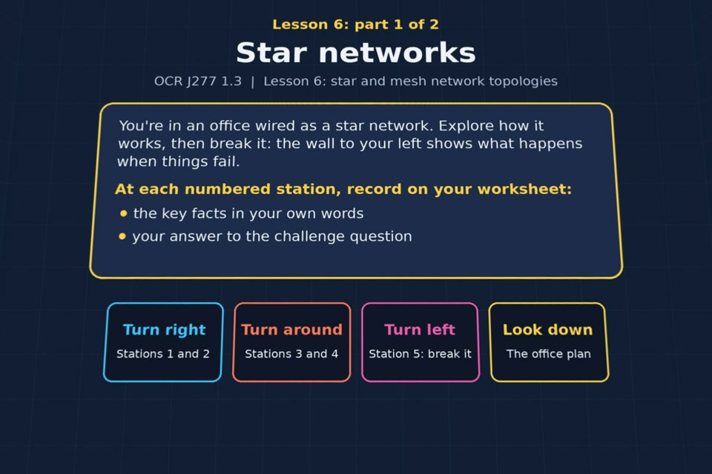

TOPIC 1.3 / LESSON 06
STAR AND MESH NETWORKS
Star and mesh topologies
KEY QUESTION
How do star and mesh networks compare?
1 / 20
Notes:
The image shows the actual opening scene of the experience. Begin with the worksheet starter, or the brief opening question for lessons without one.
Sources: Revise 360 experiences/nw-l06.json and worksheets/NW_L06_StarAndMeshNetworks_Worksheet.docx. Answers are indicative classroom examples, not an official OCR mark scheme.

Slide 2
TOPIC 1.3 / LESSON 06 / WORKSHEET
By the end of this lesson
1.
know what a star network is
2.
know what a mesh network is
3.
understand that the internet is an example of a partial mesh network
4.
know the advantages and disadvantages of star and mesh networks
2 / 20
Notes:
These learning outcomes follow the lesson worksheet.
Sources: Revise 360 experiences/nw-l06.json and worksheets/NW_L06_StarAndMeshNetworks_Worksheet.docx. Answers are indicative classroom examples, not an official OCR mark scheme.

Slide 3
TOPIC 1.3 / LESSON 06 / WORKSHEET STARTER
Opening question
What happens if the one switch at the centre of a star network fails?
3 / 20
Notes:
A brief spoken warm-up drawn from the worksheet content; the worksheet has no written starter.
Sources: Revise 360 experiences/nw-l06.json and worksheets/NW_L06_StarAndMeshNetworks_Worksheet.docx. Answers are indicative classroom examples, not an official OCR mark scheme.

Slide 4
TOPIC 1.3 / LESSON 06 / CHECK
Opening question: answers
1.
Devices connected through that switch lose their path to one another.
2.
A broken cable to one computer would usually disconnect only that computer.
4 / 20
Notes:
Accept equivalent correct explanations. Reveal after the question so it can be marked as students go.
Sources: Revise 360 experiences/nw-l06.json and worksheets/NW_L06_StarAndMeshNetworks_Worksheet.docx. Answers are indicative classroom examples, not an official OCR mark scheme.

Slide 5
TOPIC 1.3 / LESSON 06 / EXPERIENCE
Worksheet + experience
01 OPEN EXPERIENCE ↗
Open Star and mesh networks in Topic 1.3. Keep the worksheet beside you.
02 WORK THROUGH EACH PART
Read each panel. Write the key fact IN YOUR OWN WORDS and answer the worksheet challenge before tapping its badge.
03 SCORES BY PART
Complete 2 parts in order and copy each score (12 / 14) into its worksheet box. Finish the comparison or prediction tasks.
04 PLENARY
Finish the experience in this lesson. Near the end, close it for the plenary knowledge checks.
5 / 20
Notes:
Leave this combined worksheet and experience instruction slide on the board. The OPEN EXPERIENCE label is a clickable link. Students should complete the experience and reach the plenary near the end of the lesson. First on-screen answers count.
Sources: Revise 360 experiences/nw-l06.json and worksheets/NW_L06_StarAndMeshNetworks_Worksheet.docx. Answers are indicative classroom examples, not an official OCR mark scheme.

Slide 6
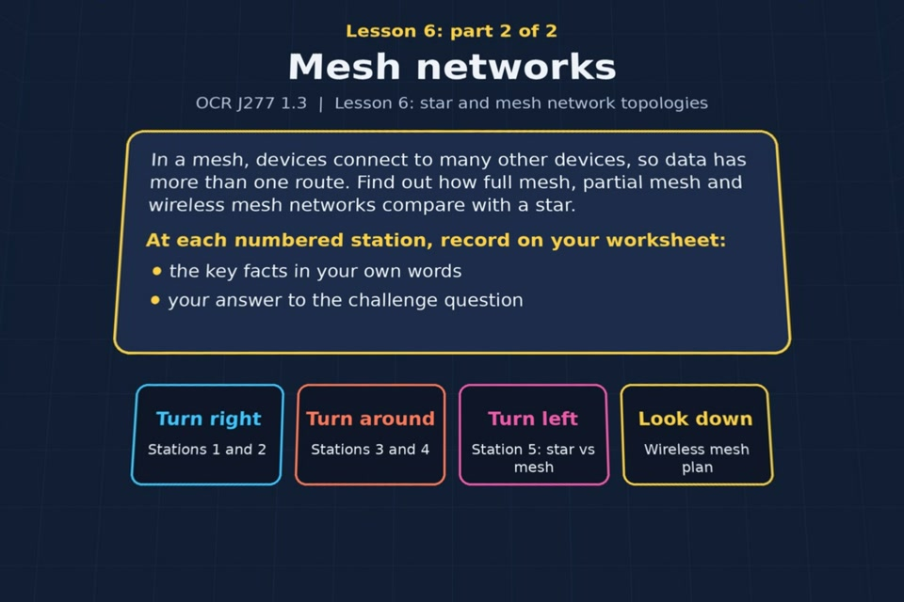
TOPIC 1.3 / LESSON 06 / EXPERIENCE
Part 2: Mesh
PART 2 OF 2
Continue to Part 2: Mesh. Fill in the next worksheet section and record this part's score (out of 14).
6 / 20
Notes:
Show this scene transition after the previous part. The image is the actual opening view of this part, not a flat crop of the 360 photo.
Sources: Revise 360 experiences/nw-l06.json and worksheets/NW_L06_StarAndMeshNetworks_Worksheet.docx. Answers are indicative classroom examples, not an official OCR mark scheme.

Slide 7
TOPIC 1.3 / LESSON 06 / EXTENSION
Apply your learning
Complete the star versus mesh table in Part 2. Compare links, reliability, cost and a suitable use.
Use the task and table on your worksheet.
7 / 20
Notes:
This follows the post-experience task, key question or revision results on the worksheet.
Sources: Revise 360 experiences/nw-l06.json and worksheets/NW_L06_StarAndMeshNetworks_Worksheet.docx. Answers are indicative classroom examples, not an official OCR mark scheme.

Slide 8
TOPIC 1.3 / LESSON 06 / EXTENSION
Check and improve
Why might a small business choose a star even though a mesh survives some link failures?
8 / 20
Notes:
Use this question to extend or improve an explanation before the plenary.
Sources: Revise 360 experiences/nw-l06.json and worksheets/NW_L06_StarAndMeshNetworks_Worksheet.docx. Answers are indicative classroom examples, not an official OCR mark scheme.

Slide 9
TOPIC 1.3 / LESSON 06 / CHECK
Application: sample answers
1.
Star connects each device to one switch. It uses fewer links, costs less and suits a small office.
2.
Mesh gives devices several connections, so traffic can reroute if a link fails.
3.
A full mesh needs many links, which raises cost and complexity. The internet uses a partial mesh.
4.
A star is cheaper and simpler to install and maintain. The business may accept the risk of central switch failure.
9 / 20
Notes:
These are indicative answers. Credit other accurate examples or justified choices.
Sources: Revise 360 experiences/nw-l06.json and worksheets/NW_L06_StarAndMeshNetworks_Worksheet.docx. Answers are indicative classroom examples, not an official OCR mark scheme.

Slide 10
TOPIC 1.3 / LESSON 06 / ANSWERS
Part 1: Star: stations 1–3
Check your key facts and challenge responses.
1 Star topology
Each device has its own connection to a central switch, forming spokes around a hub. Sketch five PCs with five separate lines to the switch.
2 Advantages of star
If one device's cable is cut, only that device loses the network. Star networks are also easy to add to and troubleshoot.
3 Disadvantages of star
The central switch is a single point of failure. If it breaks, all attached devices lose connectivity.
10 / 20
Notes:
Show after completion. These concise points address the worksheet station challenges and help students improve their own wording.
Sources: Revise 360 experiences/nw-l06.json and worksheets/NW_L06_StarAndMeshNetworks_Worksheet.docx. Answers are indicative classroom examples, not an official OCR mark scheme.

Slide 11
TOPIC 1.3 / LESSON 06 / ANSWERS
Part 1: Star: stations 4–5
Check your key facts and challenge responses.
4 Joining star networks
Two switches can be linked. If that link fails, devices on each switch still talk locally but not across the link.
5 Break it!
A Sales PC sends a file through Switch A, the inter-switch link, then Switch B to the server. A cut Sales 2 cable affects only Sales 2.
11 / 20
Notes:
Show after completion. These concise points address the worksheet station challenges and help students improve their own wording.
Sources: Revise 360 experiences/nw-l06.json and worksheets/NW_L06_StarAndMeshNetworks_Worksheet.docx. Answers are indicative classroom examples, not an official OCR mark scheme.

Slide 12
TOPIC 1.3 / LESSON 06 / ANSWERS
Part 2: Mesh: stations 1–3
Check your key facts and challenge responses.
1 Full mesh
A full mesh directly connects every pair of devices. Four devices need 4 × 3 ÷ 2 = 6 links; six need 6 × 5 ÷ 2 = 15.
2 Mesh: pros and cons
Several routes can keep traffic moving if one link fails, valuable for a bank. Extra links cost more to install and manage.
3 Partial mesh: the internet
The internet uses a partial mesh because connecting every router directly to every other router would be impractical.
12 / 20
Notes:
Show after completion. These concise points address the worksheet station challenges and help students improve their own wording.
Sources: Revise 360 experiences/nw-l06.json and worksheets/NW_L06_StarAndMeshNetworks_Worksheet.docx. Answers are indicative classroom examples, not an official OCR mark scheme.

Slide 13
TOPIC 1.3 / LESSON 06 / ANSWERS
Part 2: Mesh: stations 4–5
Check your key facts and challenge responses.
4 Wireless mesh
Wireless mesh access points relay traffic along several routes and can cover awkward buildings. Removing one works only if another path remains.
5 Star vs mesh
Star: one central switch, less cable and easy expansion, but one central failure. Mesh: several links and route redundancy, but greater cost and complexity.
13 / 20
Notes:
Show after completion. These concise points address the worksheet station challenges and help students improve their own wording.
Sources: Revise 360 experiences/nw-l06.json and worksheets/NW_L06_StarAndMeshNetworks_Worksheet.docx. Answers are indicative classroom examples, not an official OCR mark scheme.

Slide 14
TOPIC 1.3 / LESSON 06 / CHECK
Part 2: star versus mesh · answers 1–4
1.
The central switch is a single point of failure → Star
2.
Data can be rerouted if a link fails → Mesh
3.
Uses the least cable of the two → Star
4.
Each device connects to several others → Mesh
14 / 20
Notes:
These are the exact matches, sort categories or ordered steps from the interactive experience task. Use them to check the corresponding worksheet work.
Sources: Revise 360 experiences/nw-l06.json and worksheets/NW_L06_StarAndMeshNetworks_Worksheet.docx. Answers are indicative classroom examples, not an official OCR mark scheme.

Slide 15
TOPIC 1.3 / LESSON 06 / CHECK
Part 2: star versus mesh · answers 5–6
5.
A new device needs just one cable to the switch → Star
6.
The internet is an example → Mesh
15 / 20
Notes:
These are the exact matches, sort categories or ordered steps from the interactive experience task. Use them to check the corresponding worksheet work.
Sources: Revise 360 experiences/nw-l06.json and worksheets/NW_L06_StarAndMeshNetworks_Worksheet.docx. Answers are indicative classroom examples, not an official OCR mark scheme.

Slide 16
TOPIC 1.3 / LESSON 06 / PLENARY
Plenary: questions 1–2
Close the experience. Answer from memory on the worksheet.
a) Explain the biggest weakness of a star network. [2]
b) Explain how a mesh network overcomes this weakness. [2]
16 / 20
Notes:
These are the exact exit, exam-practice or test-ready questions from the worksheet. Allow independent writing before the answers.
Sources: Revise 360 experiences/nw-l06.json and worksheets/NW_L06_StarAndMeshNetworks_Worksheet.docx. Answers are indicative classroom examples, not an official OCR mark scheme.

Slide 17
TOPIC 1.3 / LESSON 06 / PLENARY
Plenary: questions 3–4
Close the experience. Answer from memory on the worksheet.
c) State one disadvantage of a full mesh network. [1]
d) A small business with 15 staff in one building is setting up a wired network. Should it use a star or a full mesh topology? Justify your answer. [4]
17 / 20
Notes:
These are the exact exit, exam-practice or test-ready questions from the worksheet. Allow independent writing before the answers.
Sources: Revise 360 experiences/nw-l06.json and worksheets/NW_L06_StarAndMeshNetworks_Worksheet.docx. Answers are indicative classroom examples, not an official OCR mark scheme.

Slide 18
TOPIC 1.3 / LESSON 06 / CHECK
Plenary: answers 1–2
Indicative points. Credit accurate answers in students’ own words.
a) The central switch is a single point of failure. If it breaks, the devices connected through it cannot communicate.
b) Mesh provides more than one route between devices, so data can take another path when one link fails.
18 / 20
Notes:
Classroom answer points, not an official OCR mark scheme. Ask students to improve one answer.
Sources: Revise 360 experiences/nw-l06.json and worksheets/NW_L06_StarAndMeshNetworks_Worksheet.docx. Answers are indicative classroom examples, not an official OCR mark scheme.

Slide 19
TOPIC 1.3 / LESSON 06 / CHECK
Plenary: answers 3–4
Indicative points. Credit accurate answers in students’ own words.
c) Full mesh requires many cables or connections, increasing cost and complexity.
d) Choose star for a 15-person office: one cable per device to a switch is simpler and cheaper than all the full-mesh links. The switch is a risk, so the business should plan for failure or replacement.
19 / 20
Notes:
Classroom answer points, not an official OCR mark scheme. Ask students to improve one answer.
Sources: Revise 360 experiences/nw-l06.json and worksheets/NW_L06_StarAndMeshNetworks_Worksheet.docx. Answers are indicative classroom examples, not an official OCR mark scheme.

Slide 20
TOPIC 1.3 / LESSON 06 / SELF-CHECK
How confident am I?
Select Not yet, Getting there or Confident for each objective on the worksheet.
1.
What a star network is
2.
What a mesh network is
3.
Why the internet is a partial mesh
4.
Advantages and disadvantages of star and mesh
20 / 20
Notes:
These are the exact confidence objectives from the worksheet. Students identify one area to revisit.
Sources: Revise 360 experiences/nw-l06.json and worksheets/NW_L06_StarAndMeshNetworks_Worksheet.docx. Answers are indicative classroom examples, not an official OCR mark scheme.

