Slide 1
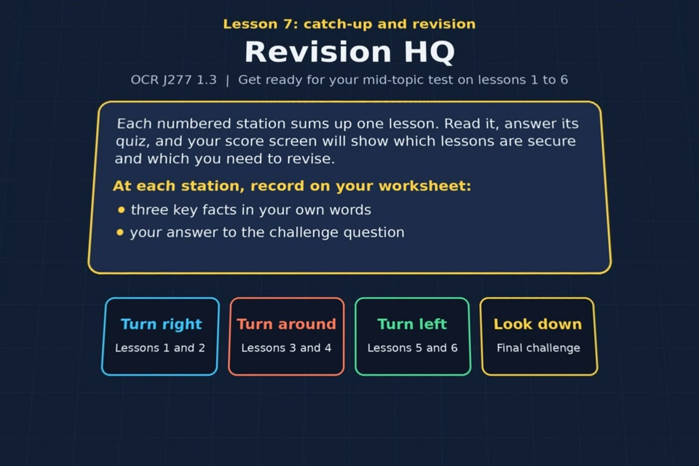

TOPIC 1.3 / LESSON 07
REVISION HQ
Catch-up and revision: lessons 1–6
REVISION FOCUS
Which lessons need another look?
1 / 16
Notes:
The image shows the actual opening scene of the experience. Begin with the worksheet starter, or the brief opening question for lessons without one.
Sources: Revise 360 experiences/nw-l07.json and worksheets/NW_L07_RevisionHQ_Worksheet.docx. Answers are indicative classroom examples, not an official OCR mark scheme.

Slide 2
TOPIC 1.3 / LESSON 07 / WORKSHEET
By the end of this lesson
1.
know which lessons I am secure on and which I need to revise
2.
have completed any outstanding work from lessons 1 to 6
3.
be ready for my mid-topic test next lesson
2 / 16
Notes:
These learning outcomes follow the lesson worksheet.
Sources: Revise 360 experiences/nw-l07.json and worksheets/NW_L07_RevisionHQ_Worksheet.docx. Answers are indicative classroom examples, not an official OCR mark scheme.

Slide 3
TOPIC 1.3 / LESSON 07 / WORKSHEET STARTER
Opening question
Recall one key idea from each of Lessons 1 to 6 before opening Revision HQ.
3 / 16
Notes:
A brief spoken warm-up drawn from the worksheet content; the worksheet has no written starter.
Sources: Revise 360 experiences/nw-l07.json and worksheets/NW_L07_RevisionHQ_Worksheet.docx. Answers are indicative classroom examples, not an official OCR mark scheme.

Slide 4
TOPIC 1.3 / LESSON 07 / CHECK
Opening question: answers
1.
LAN versus WAN; bandwidth and users; client-server versus peer-to-peer.
2.
Switch versus router; DNS and cloud; star versus mesh.
4 / 16
Notes:
Accept equivalent correct explanations. Reveal after the question so it can be marked as students go.
Sources: Revise 360 experiences/nw-l07.json and worksheets/NW_L07_RevisionHQ_Worksheet.docx. Answers are indicative classroom examples, not an official OCR mark scheme.

Slide 5
TOPIC 1.3 / LESSON 07 / EXPERIENCE
Worksheet + experience
01 OPEN EXPERIENCE ↗
Open Revision HQ in Topic 1.3. Keep the worksheet beside you.
02 SIX STATIONS
Read each panel. Write THREE key facts IN YOUR OWN WORDS and answer its worksheet challenge before tapping the badge.
03 FINAL CHALLENGE
Put the ★ DNS steps in order. Copy your station results and total (out of 23) into Section B, then choose a catch-up task.
04 PLENARY
Finish the experience in this lesson. Near the end, close it for the plenary knowledge checks.
5 / 16
Notes:
Leave this combined worksheet and experience instruction slide on the board. The OPEN EXPERIENCE label is a clickable link. Students should complete the experience and reach the plenary near the end of the lesson. First on-screen answers count.
Sources: Revise 360 experiences/nw-l07.json and worksheets/NW_L07_RevisionHQ_Worksheet.docx. Answers are indicative classroom examples, not an official OCR mark scheme.

Slide 6
TOPIC 1.3 / LESSON 07 / EXTENSION
Apply your learning
Copy your station scores into Section B. Choose one Focus here lesson and a specific catch-up task from Section C.
Use the task and table on your worksheet.
6 / 16
Notes:
This follows the post-experience task, key question or revision results on the worksheet.
Sources: Revise 360 experiences/nw-l07.json and worksheets/NW_L07_RevisionHQ_Worksheet.docx. Answers are indicative classroom examples, not an official OCR mark scheme.

Slide 7
TOPIC 1.3 / LESSON 07 / EXTENSION
Check and improve
How will you turn a Focus here result into a task you can complete before the test?
7 / 16
Notes:
Use this question to extend or improve an explanation before the plenary.
Sources: Revise 360 experiences/nw-l07.json and worksheets/NW_L07_RevisionHQ_Worksheet.docx. Answers are indicative classroom examples, not an official OCR mark scheme.

Slide 8
TOPIC 1.3 / LESSON 07 / CHECK
Application: sample answers
1.
Use the lowest station score to select a lesson rather than guessing.
2.
Finish its worksheet task, then reopen the experience in review mode to retry missed questions.
3.
Record the experience revisited and the number of questions retried.
4.
For example: revise the Lesson 5 DNS sequence, complete that worksheet section, then retry the DNS station in review mode.
8 / 16
Notes:
These are indicative answers. Credit other accurate examples or justified choices.
Sources: Revise 360 experiences/nw-l07.json and worksheets/NW_L07_RevisionHQ_Worksheet.docx. Answers are indicative classroom examples, not an official OCR mark scheme.

Slide 9
TOPIC 1.3 / LESSON 07 / ANSWERS
After the experience: stations 1–3
Check your key facts and challenge responses.
1 Lesson 1: Types of network
LANs cover a local site and usually have organisation-owned hardware. WANs span larger areas and join LANs.
2 Lesson 2: Network performance
Extra CCTV streams need bandwidth and may increase congestion. Check users, media, errors and latency too.
3 Lesson 3: Client-server and P2P
Torrenting is peer-to-peer: each peer can send pieces of the file to other peers.
9 / 16
Notes:
Show after completion. These concise points address the worksheet station challenges and help students improve their own wording.
Sources: Revise 360 experiences/nw-l07.json and worksheets/NW_L07_RevisionHQ_Worksheet.docx. Answers are indicative classroom examples, not an official OCR mark scheme.

Slide 10
TOPIC 1.3 / LESSON 07 / ANSWERS
After the experience: stations 4–6
Check your key facts and challenge responses.
4 Lesson 4: LAN hardware
A switch forwards frames within one LAN using MAC addresses. A router links networks using IP addresses.
5 Lesson 5: The internet
Cloud apps and files can be reached from several devices without local installation, provided the internet and service work.
6 Lesson 6: Star and mesh
Mesh offers alternative routes when a link fails. A star depends on its central switch.
10 / 16
Notes:
Show after completion. These concise points address the worksheet station challenges and help students improve their own wording.
Sources: Revise 360 experiences/nw-l07.json and worksheets/NW_L07_RevisionHQ_Worksheet.docx. Answers are indicative classroom examples, not an official OCR mark scheme.

Slide 11
TOPIC 1.3 / LESSON 07 / CHECK
Final challenge · answers 1–4
1.
You type www.google.com into the browser
2.
The browser asks a DNS server for the IP address of www.google.com
3.
DNS servers look up the domain name, asking other DNS servers if they need to
4.
The IP address is sent back to the browser
11 / 16
Notes:
These are the exact matches, sort categories or ordered steps from the interactive experience task. Use them to check the corresponding worksheet work.
Sources: Revise 360 experiences/nw-l07.json and worksheets/NW_L07_RevisionHQ_Worksheet.docx. Answers are indicative classroom examples, not an official OCR mark scheme.

Slide 12
TOPIC 1.3 / LESSON 07 / CHECK
Final challenge · answer 5
5.
The browser uses the IP address to request the page from the web server, which sends it back
12 / 16
Notes:
These are the exact matches, sort categories or ordered steps from the interactive experience task. Use them to check the corresponding worksheet work.
Sources: Revise 360 experiences/nw-l07.json and worksheets/NW_L07_RevisionHQ_Worksheet.docx. Answers are indicative classroom examples, not an official OCR mark scheme.

Slide 13
TOPIC 1.3 / LESSON 07 / PLENARY
Plenary: questions
Close the experience. Answer from memory on the worksheet.
How does the internet work? Use the terms WAN, router, DNS and web server. [4]
13 / 16
Notes:
These are the exact exit, exam-practice or test-ready questions from the worksheet. Allow independent writing before the answers.
Sources: Revise 360 experiences/nw-l07.json and worksheets/NW_L07_RevisionHQ_Worksheet.docx. Answers are indicative classroom examples, not an official OCR mark scheme.

Slide 14
TOPIC 1.3 / LESSON 07 / CHECK
Plenary: answers
Indicative points. Credit accurate answers in students’ own words.
A browser uses DNS to find a web server's IP address. Its request travels through routers across the internet, a worldwide WAN. The web server sends the page back to the browser.
14 / 16
Notes:
Classroom answer points, not an official OCR mark scheme. Ask students to improve one answer.
Sources: Revise 360 experiences/nw-l07.json and worksheets/NW_L07_RevisionHQ_Worksheet.docx. Answers are indicative classroom examples, not an official OCR mark scheme.

Slide 15
TOPIC 1.3 / LESSON 07 / WORKSHEET
Revision checklist
RAG these areas on your worksheet and select the next task.
1.
Lesson 1: LAN/WAN comparison and network advantages
2.
Lesson 2: five performance factors and examples
3.
Lesson 3: client-server and peer-to-peer diagrams
4.
Lesson 4: switch, router, WAP, NIC, UTP and fibre
5.
Lesson 5: internet, DNS, hosting and cloud
6.
Lesson 6: star and mesh diagrams and comparisons
15 / 16
Notes:
This checklist follows the worksheet. Students mark red, amber or green and choose a concrete next action.
Sources: Revise 360 experiences/nw-l07.json and worksheets/NW_L07_RevisionHQ_Worksheet.docx. Answers are indicative classroom examples, not an official OCR mark scheme.

Slide 16
TOPIC 1.3 / LESSON 07 / SELF-CHECK
My next revision task
1. Use your Section B results to mark one lesson Focus here.
2. Complete its catch-up task in Section C.
3. Reopen that experience in review mode and retry the questions you missed.
16 / 16
Notes:
This final action follows the Revision HQ worksheet rather than inventing a confidence table.
Sources: Revise 360 experiences/nw-l07.json and worksheets/NW_L07_RevisionHQ_Worksheet.docx. Answers are indicative classroom examples, not an official OCR mark scheme.

