Slide 1
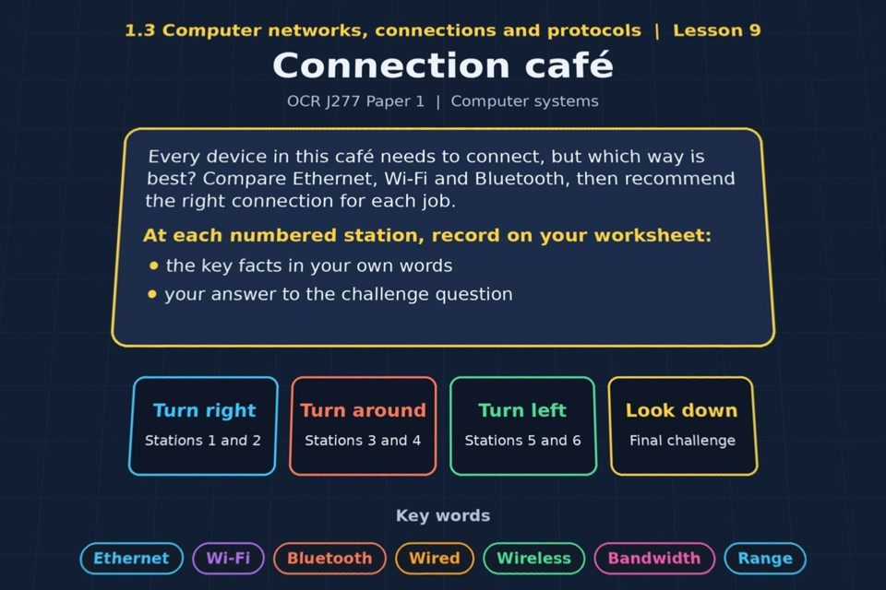

TOPIC 1.3 / LESSON 09
CONNECTION CAFÉ
Wired and wireless connections
KEY QUESTION
Which is better: a wired or wireless network?
1 / 20
Notes:
The image shows the actual opening scene of the experience. Begin with the worksheet starter, or the brief opening question for lessons without one.
Sources: Revise 360 experiences/nw-l09.json and worksheets/NW_L09_ConnectionCafe_Worksheet.docx. Answers are indicative classroom examples, not an official OCR mark scheme.

Slide 2
TOPIC 1.3 / LESSON 09 / WORKSHEET
By the end of this lesson
1.
understand that Ethernet is a wired method of connection
2.
understand that Wi-Fi and Bluetooth are wireless methods of connection
3.
understand the benefits and drawbacks of wired versus wireless connections
4.
be able to recommend a connection type for a specified scenario
2 / 20
Notes:
These learning outcomes follow the lesson worksheet.
Sources: Revise 360 experiences/nw-l09.json and worksheets/NW_L09_ConnectionCafe_Worksheet.docx. Answers are indicative classroom examples, not an official OCR mark scheme.

Slide 3
TOPIC 1.3 / LESSON 09 / WORKSHEET STARTER
Starter: before the experience
Count the devices around you that connect without a cable. For each one, say why a cable would be worse.
3 / 20
Notes:
Students answer the worksheet starter before showing the sample answers.
Sources: Revise 360 experiences/nw-l09.json and worksheets/NW_L09_ConnectionCafe_Worksheet.docx. Answers are indicative classroom examples, not an official OCR mark scheme.

Slide 4
TOPIC 1.3 / LESSON 09 / CHECK
Starter: sample answers
1.
A phone or laptop can use Wi-Fi while moving around. Earbuds or a mouse often use Bluetooth to avoid a cable.
2.
A cable might restrict movement or be impractical for a small wearable device.
4 / 20
Notes:
Accept equivalent correct explanations. Reveal after the question so it can be marked as students go.
Sources: Revise 360 experiences/nw-l09.json and worksheets/NW_L09_ConnectionCafe_Worksheet.docx. Answers are indicative classroom examples, not an official OCR mark scheme.

Slide 5
TOPIC 1.3 / LESSON 09 / WORKSHEET KEY TERMS
Key terminology quiz
1.
Ethernet
2.
Wi-Fi
3.
Bluetooth
5 / 20
Notes:
Students define the exact terms listed on their worksheet.
Sources: Revise 360 experiences/nw-l09.json and worksheets/NW_L09_ConnectionCafe_Worksheet.docx. Answers are indicative classroom examples, not an official OCR mark scheme.

Slide 6
TOPIC 1.3 / LESSON 09 / CHECK
Key terminology: answers
Ethernet
Ethernet: a wired networking standard commonly used to connect devices on a LAN.
Wi-Fi
Wi-Fi: a wireless LAN connection using radio signals through an access point.
Bluetooth
Bluetooth: a short-range, low-power wireless connection between nearby devices.
6 / 20
Notes:
Reveal after the key terminology quiz. Accept accurate definitions in students’ own words.
Sources: Revise 360 experiences/nw-l09.json and worksheets/NW_L09_ConnectionCafe_Worksheet.docx. Answers are indicative classroom examples, not an official OCR mark scheme.

Slide 7
TOPIC 1.3 / LESSON 09 / EXPERIENCE
Worksheet + experience
01 OPEN EXPERIENCE ↗
Open Connection café in Topic 1.3. Keep the worksheet beside you.
02 SIX STATIONS
Read each panel. Write the key fact IN YOUR OWN WORDS and answer the worksheet challenge before tapping its badge.
03 FINAL CHALLENGE
Complete the ★ task before tapping the star. Copy your score (out of 28), then complete the worksheet task or review.
04 PLENARY
Finish the experience in this lesson. Near the end, close it for the plenary knowledge checks.
7 / 20
Notes:
Leave this combined worksheet and experience instruction slide on the board. The OPEN EXPERIENCE label is a clickable link. Students should complete the experience and reach the plenary near the end of the lesson. First on-screen answers count.
Sources: Revise 360 experiences/nw-l09.json and worksheets/NW_L09_ConnectionCafe_Worksheet.docx. Answers are indicative classroom examples, not an official OCR mark scheme.

Slide 8
TOPIC 1.3 / LESSON 09 / EXTENSION
Apply your learning
Answer the key question: when would a wired or wireless connection be the better choice?
Use the task and table on your worksheet.
8 / 20
Notes:
This follows the post-experience task, key question or revision results on the worksheet.
Sources: Revise 360 experiences/nw-l09.json and worksheets/NW_L09_ConnectionCafe_Worksheet.docx. Answers are indicative classroom examples, not an official OCR mark scheme.

Slide 9
TOPIC 1.3 / LESSON 09 / EXTENSION
Check and improve
Would you use Wi-Fi or Bluetooth to connect 30 laptops to the school internet for one day? Explain.
9 / 20
Notes:
Use this question to extend or improve an explanation before the plenary.
Sources: Revise 360 experiences/nw-l09.json and worksheets/NW_L09_ConnectionCafe_Worksheet.docx. Answers are indicative classroom examples, not an official OCR mark scheme.

Slide 10
TOPIC 1.3 / LESSON 09 / CHECK
Application: sample answers
1.
Ethernet suits servers or fixed gaming devices where reliability and low latency matter.
2.
Wi-Fi suits mobile devices and many customers sharing internet access.
3.
Bluetooth suits low-power devices a short distance apart, such as earbuds and a phone.
4.
Wi-Fi connects the laptops to access points and the wider network. Bluetooth is designed for short-range device links, not this classroom internet access.
10 / 20
Notes:
These are indicative answers. Credit other accurate examples or justified choices.
Sources: Revise 360 experiences/nw-l09.json and worksheets/NW_L09_ConnectionCafe_Worksheet.docx. Answers are indicative classroom examples, not an official OCR mark scheme.

Slide 11
TOPIC 1.3 / LESSON 09 / ANSWERS
After the experience: stations 1–3
Check your key facts and challenge responses.
1 Ethernet
Gamers often choose Ethernet for a stable, fast link with less interference and lower latency.
2 Wi-Fi
A laptop needs a wireless network interface, an access point within range and the network credentials.
3 Bluetooth
Bluetooth uses little power and suits short-range links between earbuds and a phone.
11 / 20
Notes:
Show after completion. These concise points address the worksheet station challenges and help students improve their own wording.
Sources: Revise 360 experiences/nw-l09.json and worksheets/NW_L09_ConnectionCafe_Worksheet.docx. Answers are indicative classroom examples, not an official OCR mark scheme.

Slide 12
TOPIC 1.3 / LESSON 09 / ANSWERS
After the experience: stations 4–6
Check your key facts and challenge responses.
4 Wi-Fi vs Bluetooth
Use Wi-Fi, or preferably a wired link, to move a 2 GB file to a server. Bluetooth's lower speed makes it less suitable.
5 Wired vs wireless
Wired usually offers stable speed and security. Wireless gives mobility and simpler access, but can suffer interference.
6 Recommend a connection
Offer customers Wi-Fi via access points: they can connect their own phones and laptops without cables. Secure the network appropriately.
12 / 20
Notes:
Show after completion. These concise points address the worksheet station challenges and help students improve their own wording.
Sources: Revise 360 experiences/nw-l09.json and worksheets/NW_L09_ConnectionCafe_Worksheet.docx. Answers are indicative classroom examples, not an official OCR mark scheme.

Slide 13
TOPIC 1.3 / LESSON 09 / CHECK
Final challenge · answers 1–4
1.
Thick walls and other signals can interrupt it → Wireless
2.
Needs cable runs, sockets and switches everywhere → Wired
3.
Speeds drop the further you are from the access point → Wireless
4.
A cable gives the same speed every time → Wired
13 / 20
Notes:
These are the exact matches, sort categories or ordered steps from the interactive experience task. Use them to check the corresponding worksheet work.
Sources: Revise 360 experiences/nw-l09.json and worksheets/NW_L09_ConnectionCafe_Worksheet.docx. Answers are indicative classroom examples, not an official OCR mark scheme.

Slide 14
TOPIC 1.3 / LESSON 09 / CHECK
Final challenge · answers 5–8
5.
An attacker has to get inside the building to tap it → Wired
6.
Signals spread outside the building where anyone can capture them → Wireless
7.
Best choice for machines that never move → Wired
8.
Lets a class of laptops move room to room → Wireless
14 / 20
Notes:
These are the exact matches, sort categories or ordered steps from the interactive experience task. Use them to check the corresponding worksheet work.
Sources: Revise 360 experiences/nw-l09.json and worksheets/NW_L09_ConnectionCafe_Worksheet.docx. Answers are indicative classroom examples, not an official OCR mark scheme.

Slide 15
TOPIC 1.3 / LESSON 09 / CHECK
Final challenge · answers 9–11
9.
Can be set up in an old building without drilling holes → Wireless
10.
Handles very large file transfers most quickly → Wired
11.
Performance drops as more devices join the same access point → Wireless
15 / 20
Notes:
These are the exact matches, sort categories or ordered steps from the interactive experience task. Use them to check the corresponding worksheet work.
Sources: Revise 360 experiences/nw-l09.json and worksheets/NW_L09_ConnectionCafe_Worksheet.docx. Answers are indicative classroom examples, not an official OCR mark scheme.

Slide 16
TOPIC 1.3 / LESSON 09 / PLENARY
Plenary: questions 1–2
Close the experience. Answer from memory on the worksheet.
a) Describe two differences between Wi-Fi and Bluetooth. [4]
b) Explain one benefit and one drawback of using cables rather than Wi-Fi. [4]
16 / 20
Notes:
These are the exact exit, exam-practice or test-ready questions from the worksheet. Allow independent writing before the answers.
Sources: Revise 360 experiences/nw-l09.json and worksheets/NW_L09_ConnectionCafe_Worksheet.docx. Answers are indicative classroom examples, not an official OCR mark scheme.

Slide 17
TOPIC 1.3 / LESSON 09 / PLENARY
Plenary: question 3
Close the experience. Answer from memory on the worksheet.
c) A café wants to offer internet access to customers. Recommend a connection type and justify your choice. [4]
17 / 20
Notes:
These are the exact exit, exam-practice or test-ready questions from the worksheet. Allow independent writing before the answers.
Sources: Revise 360 experiences/nw-l09.json and worksheets/NW_L09_ConnectionCafe_Worksheet.docx. Answers are indicative classroom examples, not an official OCR mark scheme.

Slide 18
TOPIC 1.3 / LESSON 09 / CHECK
Plenary: answers 1–2
Indicative points. Credit accurate answers in students’ own words.
a) Wi-Fi normally covers a larger area and connects devices to a LAN or internet. Bluetooth is shorter range, uses less power and usually links nearby devices directly.
b) A cable can be faster and more stable, with less radio interference. It restricts movement and requires a physical port and cable.
18 / 20
Notes:
Classroom answer points, not an official OCR mark scheme. Ask students to improve one answer.
Sources: Revise 360 experiences/nw-l09.json and worksheets/NW_L09_ConnectionCafe_Worksheet.docx. Answers are indicative classroom examples, not an official OCR mark scheme.

Slide 19
TOPIC 1.3 / LESSON 09 / CHECK
Plenary: answer 3
Indicative points. Credit accurate answers in students’ own words.
c) Offer Wi-Fi because customers bring mobile devices and need internet without plugging in. Access points can cover the seating area; configure security and adequate capacity for many users.
19 / 20
Notes:
Classroom answer points, not an official OCR mark scheme. Ask students to improve one answer.
Sources: Revise 360 experiences/nw-l09.json and worksheets/NW_L09_ConnectionCafe_Worksheet.docx. Answers are indicative classroom examples, not an official OCR mark scheme.

Slide 20
TOPIC 1.3 / LESSON 09 / SELF-CHECK
How confident am I?
Select Not yet, Getting there or Confident for each objective on the worksheet.
1.
Ethernet as a wired connection
2.
Wi-Fi and Bluetooth
3.
Recommending a connection for a scenario
20 / 20
Notes:
These are the exact confidence objectives from the worksheet. Students identify one area to revisit.
Sources: Revise 360 experiences/nw-l09.json and worksheets/NW_L09_ConnectionCafe_Worksheet.docx. Answers are indicative classroom examples, not an official OCR mark scheme.

